Slide 1

CORAZON SHIRT

Slide 2

Theme: Healthcare and Medication
Members
Aditya Mitra
Sania Sinha
Vijayasharada Palakonda

Slide 3
Corazon shirt is a shirt that reads and monitors your health data such as ECG, SpO2 saturation, and heart rate and notifies your family or emergency contact in the event of an emergency.
Arduino nano is used to read the data and compare it against a system defined threshold limit for healthy parameters. The system, then works on them to determine, if a person requires urgent medical attention. An alert is sent via SMS in case of emergency like low heart rate or low oxygen saturation.
This project comes with a companion android app and allows for seamless integration with smart wearables like smart watches.
INTRODUCTION

Slide 4
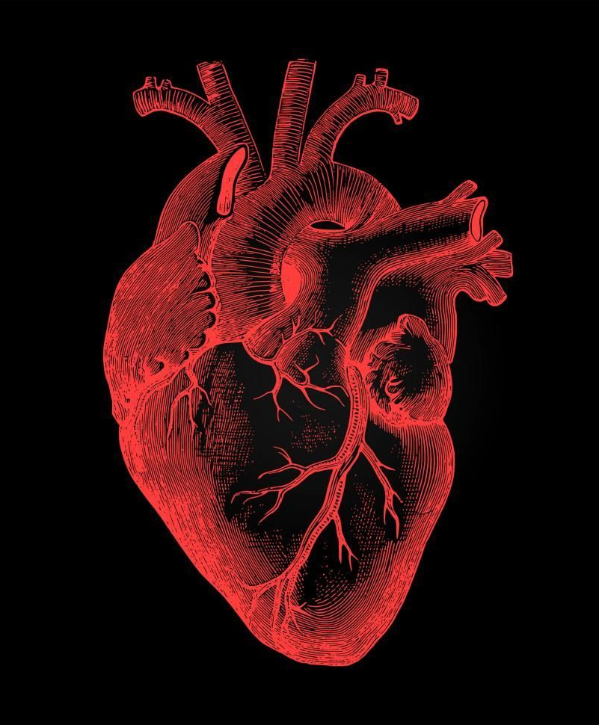
WORKING
AD8232 sensor is used to read the ECG and MAX30102 sensor is used to sense SpO2 and Heart rate
Arduino nano (ATmega328P) is used for reading data from the sensors and analyzing it
An HC-05 Bluetooth Serial Port Protocol Module is used to send the corresponding data to the wearer’s android device in case of an emergency.
A companion android app running on the phone (developed with MIT AI2) sends an SMS to a family member as soon the signal from the shirt is received.
A notification is pushed to any wearable device the wearer uses, for example, a fitness band or a smart watch.
Works on a 3.7v Li-ion rechargeable battery

Slide 5
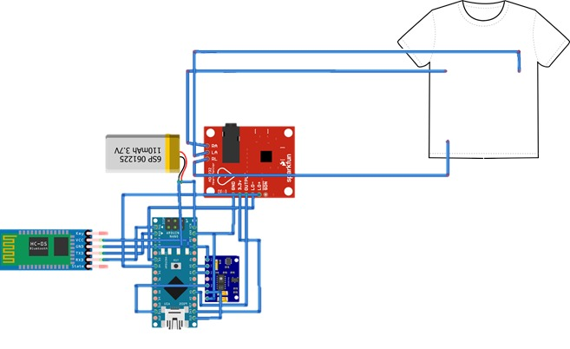
Diagram

Slide 6
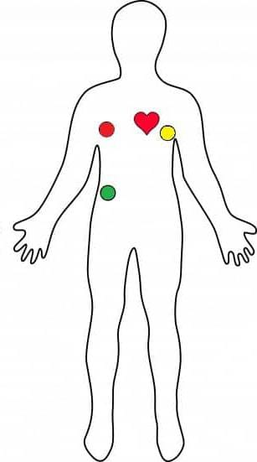
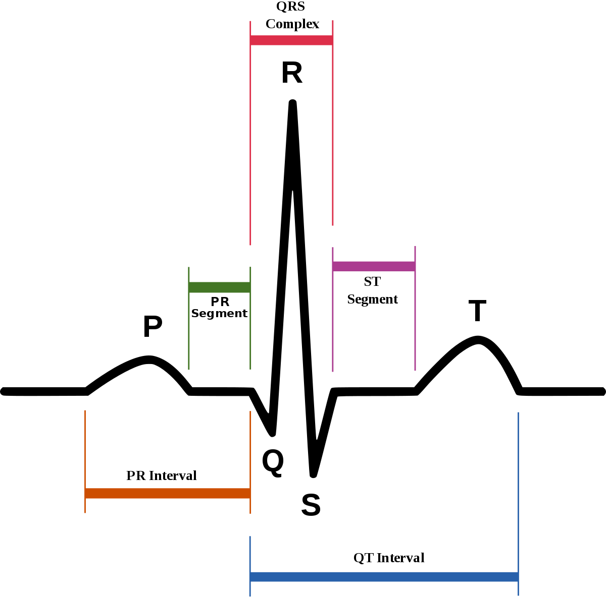
We check for normal body conditions from the data read by the AD8232 sensor, based on a standard ECG graph (shown above)
After checking a block of buffer from ECG monitor we move onto the oxygen saturation monitor via MAX30102 sensors, keeping 85% saturation as a threshold limit
REFERENCES

Slide 7
FEATURES
Auto measure with high refresh rate
Battery to last more than 20 hours on full charge
Charge time less than an hour from 5v 4A USB Charger
Bluetooth Low Energy Connection to android device
Easy pairing using companion app
Seamless integration with all wearable fitness band and smart watches (tested on low end device like DZ-09 and on high end device like Samsung Galaxy Fit 2)
Instant SMS to family member in case of emergency

Slide 8
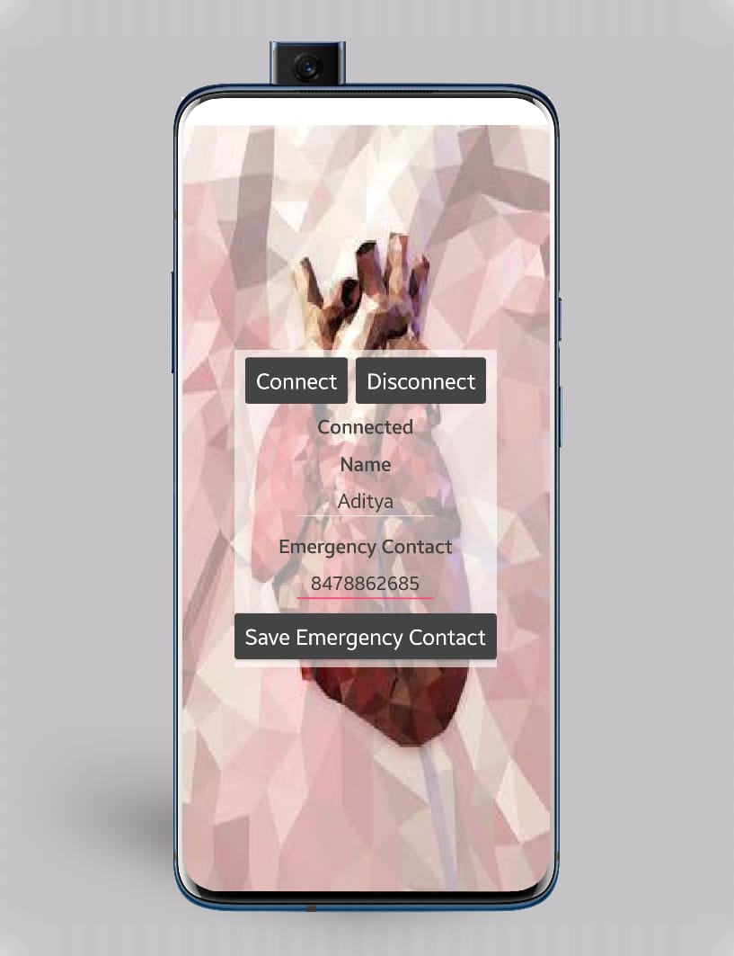
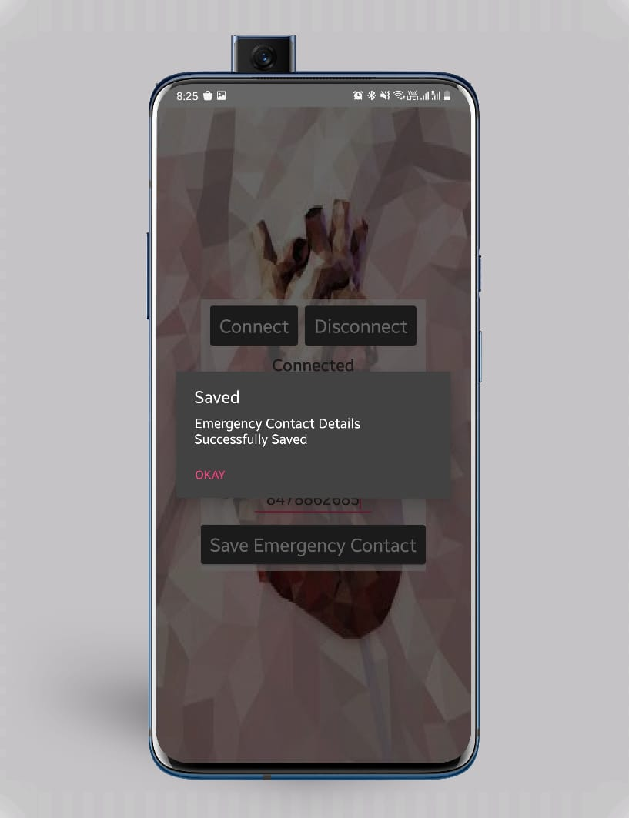
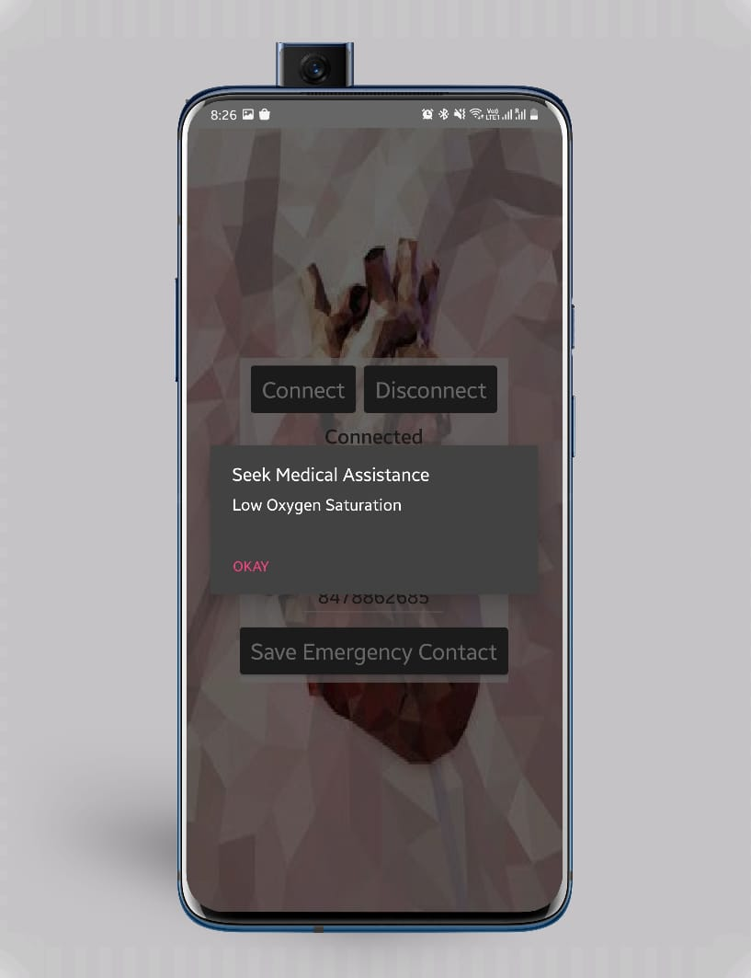
APP INTERFACE

Slide 9
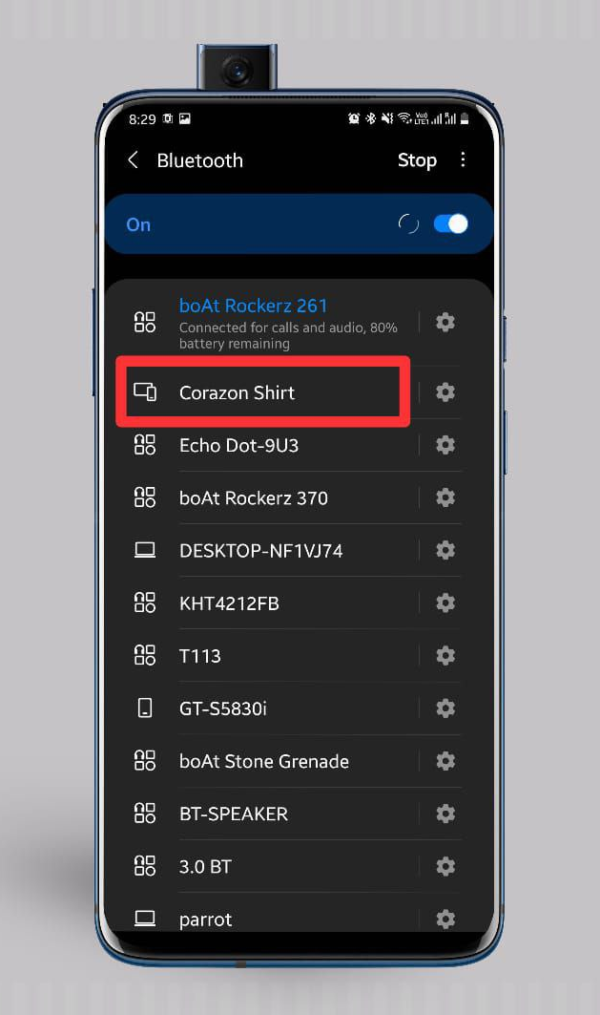
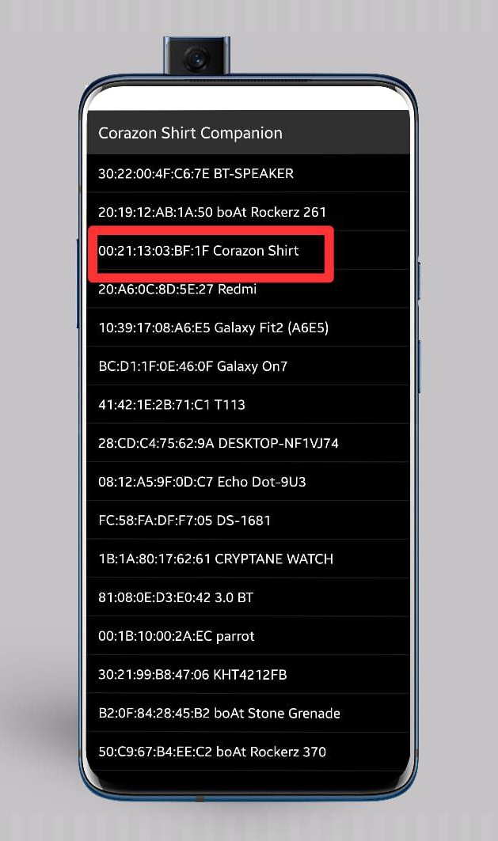
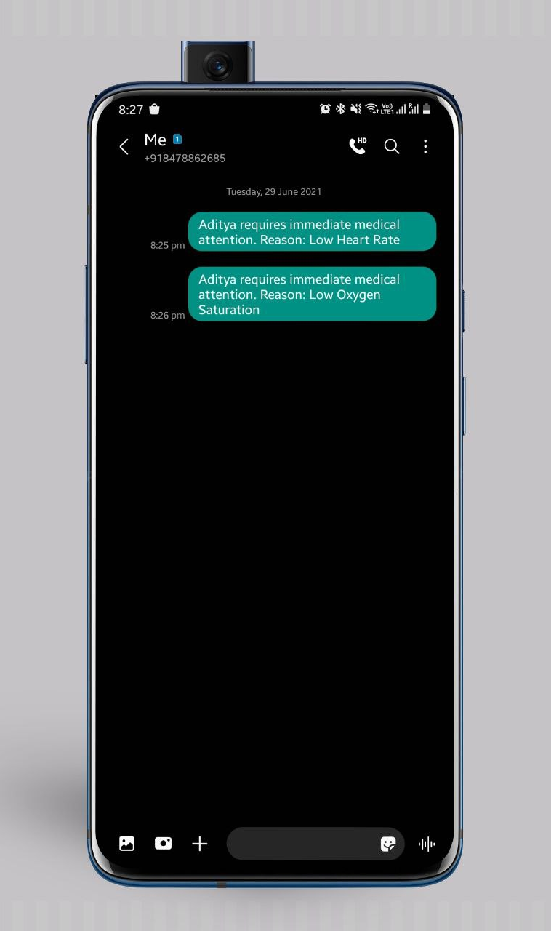

Slide 10
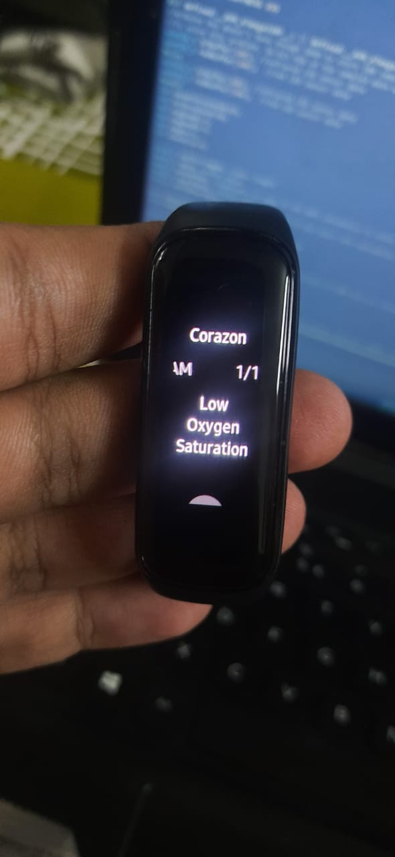
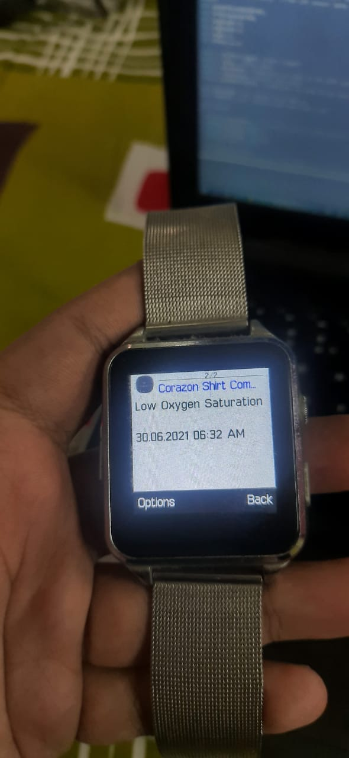
SMART WATCH INTEGRATION

Slide 11

FUTURE SCOPE
Android app will be able to directly view the ECG graph and SpO2 readings
In fatal conditions of heart rate and SpO2, the nearest hospital will also be informed
Increased sensitivity for better analysis

Slide 12

LINKS
Source Code: https://github.com/AdityaMitra5102/Corazon_Shirt

Slide 13

THANK YOU

