Slide 1


SMART INDIA HACKATHON 2026
DRISHTI
The AI-eye on every MPLADS rupee
AI checks on every MPLADS work — flags what needs checking, with the evidence
Problem Statement ID –
SIH26102
Problem Statement Title-
Development of an AI-powered system to detect
anomalies, fraud, and inefficiencies in MPLAD Scheme
implementation regd.
Organisation-
Ministry of Statistics & Programme Implementation
(MoSPI)
Theme-
Smart Automation
PS Category-
Software
Team ID-
121911
Team Name-
NeuralNexus
Notes:
Good morning. We are team NeuralNexus, and our problem statement is SIH26102 from the Ministry of Statistics and Programme Implementation: finding anomalies, fraud and inefficiencies in how MPLADS works are carried out. Our answer is DRISHTI, which means sight. It looks at every MPLADS work and tells an officer which ones need checking first, and why.

Slide 2
NeuralNexus
DRISHTI · the AI-eye on every MPLADS rupee
Proposed Solution (Describe your Idea/Solution/Prototype)
A read-only AI layer on eSAKSHI. Every work is checked; only the risky ones reach an officer, with the evidence.
DETAILED EXPLANATION OF THE PROPOSED SOLUTION
Before sanction
During construction
Money & time
After completion
Risk score
0–100, parts add up
Eligibility
Site Progress
Delay
Citizen check
Duplicate & Split
Photo Forensics
Fund Flow
Ranked review list
Cost
Geo-Location
Contractor
risk × money
eSAKSHI
Document
works, papers,
12 AI AGENTS
Officer decides
site photos
Satellite
each answers one question
about the work
visits, then gives a verdict
live
tested on real eSAKSHI works
planned
verdicts become training labels (next)
How it addresses the problem
Innovation and uniqueness of the solution
4,918
Photo + plaque check
Reads the GPS stamp
Proven before launch
works had no plaque (CAG)
printed inside site photos
on real eSAKSHI works
12,006
Stuck-work alerts
works left incomplete (CAG)
10%
Evidence, not accusation
Reads papers for free
of works a district must inspect
Risk-ranked visit list
every flag cites its clause
certificates & bills, on our server
Notes:
DRISHTI sits on top of eSAKSHI and only reads from it, so no officer has to enter anything new. Twelve agents follow a work from recommendation to completion, and each one answers a single question, such as whether this photo was already used on another work. Their findings are combined into one score out of 100, and the parts add up exactly, so an officer can see which agent raised a work and disagree with any single part. That ranked list becomes the ten percent of works the District Authority must inspect every year under para 6.4 of the guidelines. The problems we target come from the CAG audit and the guidelines themselves, for example 4,918 works that never got the mandatory plaque.

Slide 3
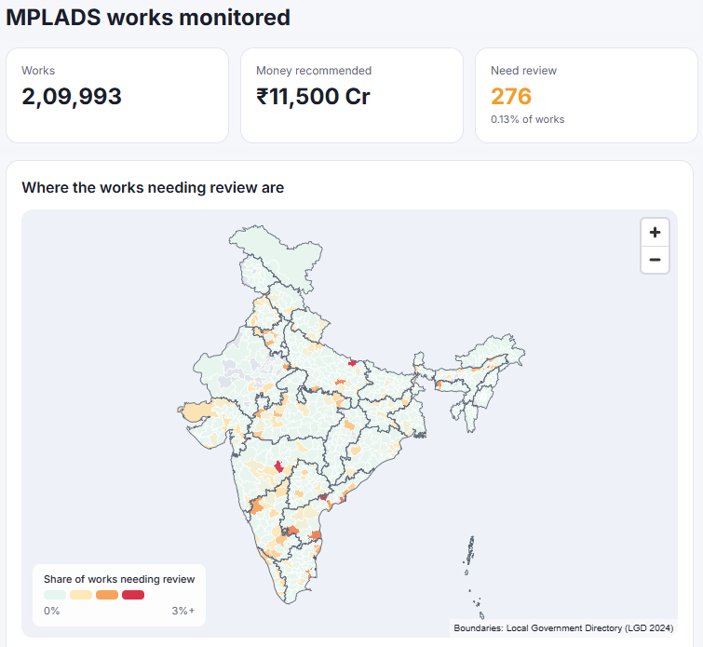
TECHNICAL APPROACH
NeuralNexus
Technologies to be used (e.g. programming languages,
frameworks, hardware)
Methodology and process for implementation (Flow Charts/Images/ working prototype)
Screens
web dashboards
Next.js
React
Tailwind
MapLibre
eSAKSHI
Validate
12 agents
Risk Fusion
Review queue
2,09,993 works + files
clean dates, mask IDs
4 stages of a work
one score, 0–100
ranked, with evidence
Engine
API + agents
Python
FastAPI
Officer decides
verdicts retrain the agents (next)
Data
Mumbai region
PostgreSQL
Supabase
WORKING PROTOTYPE · LIVE
drishti-lyart.vercel.app
AI & vision
2,09,993
276
837
+ LightGBM, OCR
scikit-learn
OpenCV
pandas
Gemini*
real works assessed
in the review queue (0.13%)
real works tested with their
files
Hosting
EVERY AGENT ANSWERS IN ONE FORM
tests on every push
Vercel
Actions
GitHub
status
risk
confidence
evidence
what it could not check
SIGN-IN BY ROLE
No hardware to buy
Ministry
District
Field
officers use a browser or a phone · *Gemini planned
all India
own district
site visits
Notes:
On the left is the stack we actually run: Next.js for the screens, a Python FastAPI engine, and PostgreSQL on Supabase in the Mumbai region, hosted on Vercel. The flow on the right is how one work moves through the system: eSAKSHI data is checked and cleaned, the agents run, Risk Fusion ranks the result, and an officer makes the final call. The screenshot is the live prototype, which has assessed all 2,09,993 real works and puts 276 of them in the review queue. Every agent answers in the same form, including what it could not check, so a missing check is never shown as a clean result.

Slide 4
FEASIBILITY AND VIABILITY
NeuralNexus
Analysis of the feasibility of the idea
Potential challenges and risks
Strategies for overcoming
these challenges
EACH AGENT, MEASURED ON REAL eSAKSHI WORKS
Cost
LIVE
Photo Forensics
TESTED
Geo-Location
TESTED
No confirmed fraud labels
Planted test cases; officer
verdicts as labels
63%
of 5× mark-ups caught · 1.5%
false alarms
99.9%
of edited photo copies
recognised
12 / 12
GPS points correct
when checked
False alarms
Price alone never makes a work
high-risk
Document
TESTED
Eligibility
TESTED
Split works
TESTED
Hindi & handwritten papers
Unclear reads = “can't tell”; AI
reader capped
≥99%
of amounts & payment dates
read
56%
of its flags plainly prohibited
12×
more works just under ₹5 lakh
Personal data in records
Phone & bank numbers masked;
role access
Delay
WEAK
Satellite
OFF
Citizen
DEMO ONLY
0.71
vs 0.68 for the office's record
OFF
pilot works too small to see
4
of 21,793 eSAKSHI ratings are above zero
Portal habits look odd
Compare each office with the
same period
COST AGENT: INFLATED WORKS CAUGHT
FEASIBILITY
PROOF BEFORE LAUNCH
84%
Technical
Data
63%
live on Vercel + Supabase
2 in 3 finished works have files
Test on real
Meets its
yes → goes live
39%
Operational
Economic
eSAKSHI works
target?
18%
read-only, no new data entry
open source, AI cost capped
no → stays off
2×
3×
5×
10×
Notes:
Every tile here is a result measured on real eSAKSHI works, and we list the weak and switched-off agents alongside the ones that work. The cost agent, which is live, catches 63 percent of estimates inflated five times over while flagging 1.5 percent of normal works. Photo forensics recognised 99.9 percent of edited copies of real site photos, and the certificate reader picked out amounts and payment dates on at least 99 percent of 431 Uttar Pradesh certificates. Delay prediction was only slightly better than an office's past record, so we show it as a track record, and satellite stays off because the works we could place were too small to see. On the right are the main risks, such as false alarms and handwritten Hindi papers, with how we handle each one. The box at the bottom is the rule we follow: an agent is tested on real works and goes live only if it meets its target, otherwise it stays off.

Slide 5
IMPACT AND BENEFITS
NeuralNexus
Potential impact on the target audience
FROM EVERY WORK TO THE FEW THAT MATTER
2,09,993 works in eSAKSHI
12 agents check every one
Ministry
State nodal
District
MPs & citizens
national risk map
sanction backlog
district track records
what to escalate
276 works to review
10% inspection plan
live work status
stuck-work warnings
276 to review first · 0.13%
→ the district's 10% inspection plan
ALREADY FOUND IN REAL eSAKSHI DATA · each one needs checking, none is a verdict
21,323
40,489
136
282 / 285
3
works waiting for sanction past 75 days
works still incomplete after two years
bulk orders kept just under ₹5 lakh
“done” works whose papers say “in
progress”
works photographed finished before
recommended
Benefits of the solution (social, economic, environmental, etc.)
Next steps
Social
Economic
Environmental
✓
M1
M2
M3
M4–6
assets exist where claimed
trust through open records
risk caught before money moves
visits go where risk is
remote checks from photos
fewer wasted site trips
Prototype live
Document +
Eligibility,
Photo +
AI reader,
+ 837-work trial
Contractor
splits, repeats
Geo checks
field app
Notes:
Each level of government gets a different view: the Ministry sees the national map and the sanction backlog, and a District Authority sees a short list of works to visit. The funnel shows how 2,09,993 works come down to 276 worth checking first. The orange tiles are things DRISHTI has already found in public eSAKSHI data. For example, 21,323 works worth 1,361 crore rupees are still waiting for sanction past the 75 day limit, and three works have photos showing them finished before the MP recommended them. We present each of these as something to check, never as a verdict. Next we move the Document and Contractor agents into the live engine, followed by eligibility, split works, photo checks and the field app.

Slide 6
RESEARCH AND REFERENCES
NeuralNexus
Details / Links of the reference and research work
How DRISHTI compares with existing monitoring
GOVERNMENT & SCHEME SOURCES
Capability
Existing systems*
DRISHTI
1
MoSPI — Guidelines on MPLADS (June 2016), paras 2.1, 3.12, 3.13, 3.22, 4.4, 6.4
cdnbbsr.s3waas.gov.in/s3c3614206a443012045cfd75d2600af2d/uploads/2023/02/2023020891.pdf
Coverage
audits check a sample
every work, 2,09,993
2
PIB — Revised MPLADS Guidelines 2023 (release 2155040, 11 Aug 2025)
pib.gov.in/PressReleasePage.aspx?PRID=2155040
3
CAG — Report No. 31 of 2010-11, Performance Audit of MPLADS (Annex 4.7, 7.2)
Cost vs similar works
manual, in audits
live, every work
cag.gov.in/uploads/download_audit_report/2010/
Union_Performance_Local_area_Development_Scheme_31_2010_annexures.pdf
4
MoSPI — eSAKSHI public dashboard and uploaded files (data to 26 May 2026)
Reused / edited photos
viewed by eye
99.9% recognised
mplads.mospi.gov.in
METHODS WE USE
Photo place & time
geotag on a map
stamp read + checked
5
Rublee et al. — ORB: an efficient alternative to SIFT or SURF. ICCV 2011
6
Fischler & Bolles — Random Sample Consensus (RANSAC). Comm. ACM 24(6), 1981
7
Zauner — Implementation and Benchmarking of Perceptual Image Hash Functions. MSc thesis, 2010
Reads certificates & bills
stored as files
dates, payments, vendor
8
Ke et al. — LightGBM: a highly efficient gradient boosting decision tree. NeurIPS 2017
9
Wilson — Probable inference, the law of succession, and statistical inference. JASA 22(158), 1927
Split works & repeats
not automated
splits yes; rewording next
DATA & TOOLS
•
LGD district outlines (github.com/yashveeeeeeer/india-geodata) · India Post PIN–district mapping
OpenCV · scikit-learn · RapidOCR · PyMuPDF
Risk-ranked review list
picked by hand
276, by risk × money
Reason for each flag
—
evidence + clause
Progress from photos
checked by eye
planned, AI vision
Code
Live demo
yes
partly
no
*eSAKSHI, PMAY-G AwaasApp, GeoMGNREGA / NMMS, CAG & social audits,
github.com/AdityaMore776/drishti
drishti-lyart.vercel.app
as their own public documents describe them
Every number on these slides: docs/trial/FINDINGS.md in the repo
Notes:
All our government sources are public, and each one has a link here: the MPLADS guidelines, the PIB release on the 2023 revision, the CAG performance audit and the eSAKSHI dashboard. The methods papers are the ones behind the code we run, such as ORB feature matching for photos and LightGBM for the delay model. The table on the right is the only comparison in this deck, and it compares DRISHTI with how existing systems check works, based on their own public documents. The code, the live demo and the write-up behind every number are open at the links at the bottom left.

