Slide 1
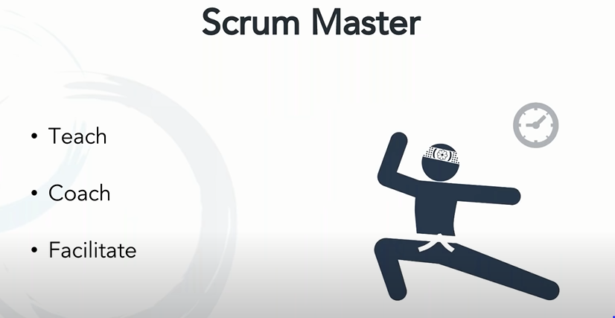
He teaches the members how to follow the scrum rules.
He is a coach for all members including their behaving with the team and he facilitate for the work to productive and make it delivery ready.
Team to focus towards and work protecting the team as shield form other people in org making the team members do which is not part of their work.
Scrum master can lead more than one team . multiskilled and great leader and make the team work independently focussed on delivering in time.

Slide 2
Skill Levels
While there are no officially defined levels of skill for scrum masters, in practice there are different levels of experience:
Rotating scrum master –
members of a team rotate scrum master responsibilities (primarily the administrative ones)
amongst each other on a sprint by sprint basis
Part time scrum master –
one individual on the team takes on scrum master responsibilities in addition to other responsibilities on the same team.
Full time dedicated scrum master –
one individual’s sole responsibility is as a scrum master for one time. This model is best suited for a team learning agile
Full time scrum master with more than one team –
This model is quite frequently applied where an individual’s sole responsibility is to be a scrum master,
but they work with more than one team

Slide 3
Common Pitfalls
While having a scrum master can provide several benefits, there are also several problems that arise from improper application of the role. Those problems include:
Assuming that you can just slide project managers who are used to command and control type leadership into a scrum master role and expect them to be effective.
Asking someone to fill the scrum master role without any experience working in an agile setting
Expecting the work load for a scrum master to be the same on every team irrespective of how long the team has worked together, their understanding of agile values and principles, and their experience in the domain. A well functioning team will most likely need much less coaching from a scrum master than a team new to working with each other and in agile values and principles

Slide 4
Responsibilities
Leading daily stand-up meetings, reviews, demos, and other project-related meetings
Supporting team members in their tasks
Coaching the team on scrum principles and best practices
Facilitating open discussion and conflict resolution

Slide 5
Challenges faced during Implementation
Trust issues -
Planning for only 85% of the team time, rest 15% is usually enough to handle unplanned contingencies.
Team member not attending the meeting
Scrum master need to coach him, understand his point of view and help him imbibe the scrum values and principles. Your meeting with him should highlight the areas of your sprint planning where he can bring a value focus on how the team needs and appreciates his contribution.

Slide 6
Implementation - (continued)
The scrum master has to create a balance between the pressure which may be applied by a product owner looking for rapid results and the capabilities of the team
Team is unable to complete the project in stipulated time
Scalability issues during festival time or year end or high discount

