Slide 1

Proximity Analyzer using Ultrasonic Sensor
Under the Mentorship of Ms. Priyanka
By: AAKASH SINGH (00196202817) F-14
Aditya Nahata(00496202817) F-14
ROHAN SINGH (01796202817) F-14

Slide 2
Content
Introduction
Objective
Tools Used
Methodology
Advantage
Conclusion
References

Slide 3
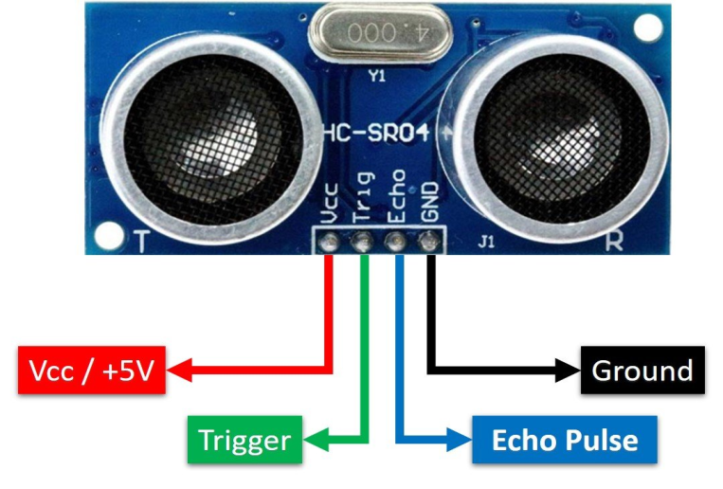
Introduction
Ultrasonic sensors
Work on a principle similar to radar or sonar which evaluate attributes of a target by interpreting the echoes from radio or sound waves respectively.
Ultrasonic sensors generate high frequency sound waves and evaluate the echo which is received back by the sensor.

Slide 4
Objective
To create a System using the Ultrasonic sensor for Distance Measurement for:
1. Automobile Parking Senor
2. Obstacle Detector Glove
3. Covid-19 Protocol Enforcer

Slide 5
Tools Used / Components Used :
❖ Power Supply : 12V/1A DC
❖ µcontroller : Arduino UNO
❖ Buzzer : Frequency range between 1Hz to 18 KHz [5V-12V]
❖ Relay : 12V
❖ LCD : 16 characters * 2 lines
❖ Sensor : ultrasonic transducer (transmitter and receiver).

Slide 6
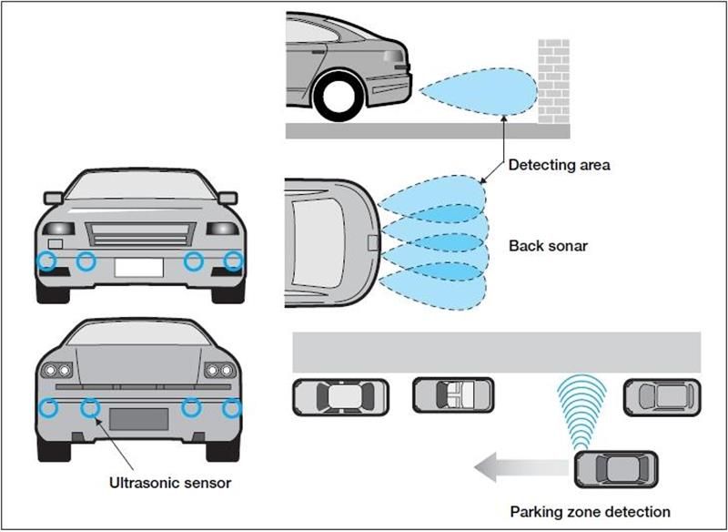
Application 1

Slide 7
Methodology
This system controls steering, acceleration and braking automatically, based on the parking zone and location information gained from the ultrasonic sensor, to achieve parallel parking and garage parking.
In the case of the rear sonar, two to four ultrasonic sensors are mounted on the rear bumper to detect an obstacle up to 2 to 2.5m away. The distance is communicated to the driver in real time using varying buzzer sounds. Even a wire fence can be detected if it is close enough.

Slide 8
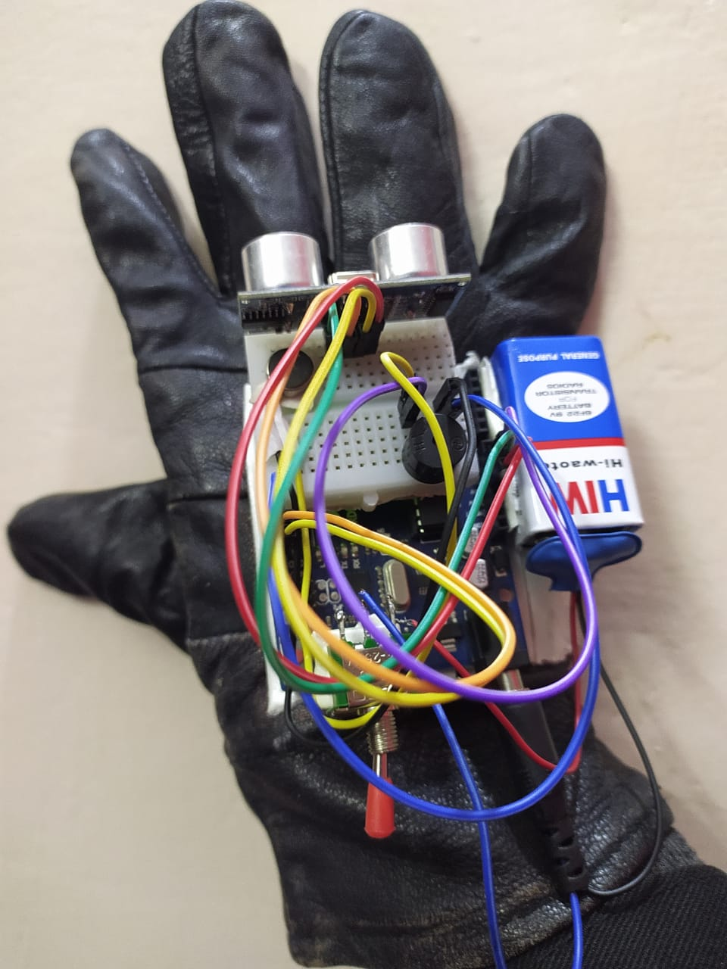
Application 2

Slide 9
Methodology
The objective of this project is to design a product which is very much useful to those people who are visually impaired and those who often have to rely on others.
Develop a cheap, affordable and more efficient way to help the blind people to navigate with greater comfort, speed and confidence.
This device is light, portable but limited to its size and it is not used for dynamic obstacle detection.

Slide 10
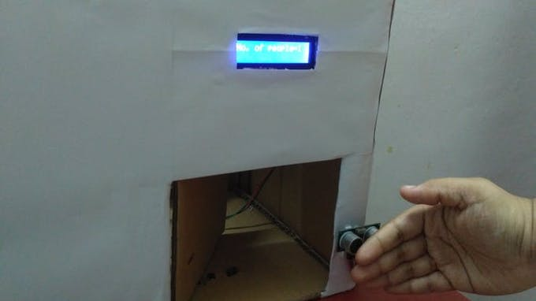
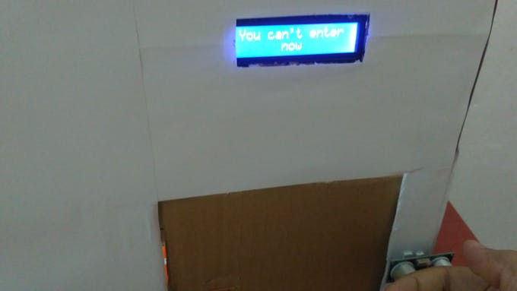
Application 3

Slide 11
Methodology
A cheap and effective method to limit the crowd in public places - such as shopping malls, supermarkets, etc - and public transport vehicles.
If a person is going to enter the building or vehicle, he/ she can wave or hover his/ her hand over the ultrasonic/ IR tracking sensor module.
If an ultrasonic sensor module is used, the door will be opened when the sensor detects an obstacle within 5 cm away from itself. The door will remain open for 5 seconds and the value stored in the count variable will increase by one after the door is closed

Slide 12
Advantage:
Used to avoid and detect obstacles with robots like biped robot, obstacle avoider robot, path finding robot etc.
Used to measure the distance within a wide range of 2cm to 400cm.
Can be used to map the objects surrounding the sensor by rotating it.
Depth of certain places like wells, pits etc can be measured since the waves can penetrate through water

Slide 13
Conclusion:
The microcontroller with LCD makes it user friendly.
The circuit can easily been implemented on breadboard and tested for its functionality by varying the distance between the transducer and the target.
The target surface needs to be perpendicular to the impinging ultrasound waves.
The power level of the signal is too low for long range measurement.
Less hardware are used so smaller in size.• Inexpensive components used so that reduces the cost per unit

Slide 14
References / Link of Research Paper
IEEE SENSORS JOURNAL, VOL. 1, NO. 2, AUGUST 2001 143An Ultrasonic Sensor for Distance Measurement inAutomotive ApplicationsAlessio Carullo and Marco Parvis, Senior Member, IEEE
Honeywell Sensing and Control Catalog. (2000) Series 940-942 Ultra-sonic Sensors. [Online]. Available: www.honeywell.ca/sensing/
. Md. S.Arefi and, T. Mollick, ―Design of an Ultrasonic Distance Meter,‖ International journal of scientific and engineering research Vol. 4, Issue3, March, 2013
Pooja Sharma, Shimi SL, Chatterji S. A Review on Obstacle Detection and Vision, International Journal of Science and Research Technology. 2015; 4(1):1-11.

Slide 15
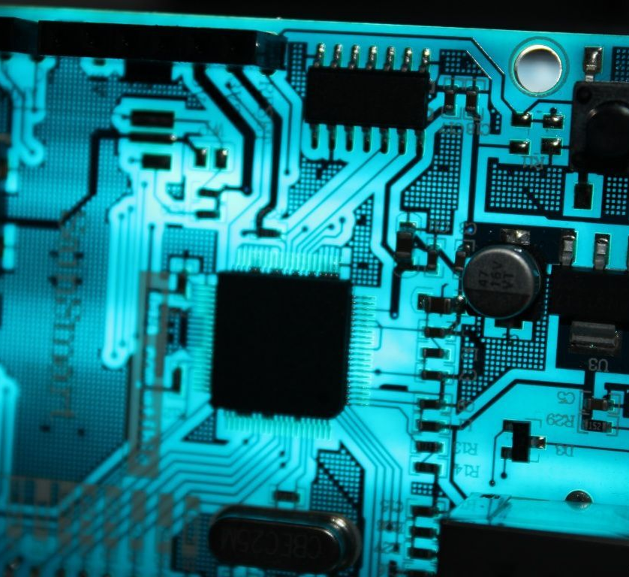
THANK YOU

