Slide 1
SPORTS PERFORMANCE ANALYTICS
Capstone project : IPL Performance Analytics using Power BI
Team Member:
Aditya Nambiar
Batch Code:
DA784S78
Project Guide:
Priya Shanmugam

Slide 2
Problem Statement
IPL generates a large amount of match, batting, bowling, team and toss-related data across seasons.
Analyzing this data manually makes it difficult to identify performance trends and meaningful patterns.
This project uses Power BI to analyze IPL data and transform it into interactive dashboards that help identify:
• Team performance and win percentages
• Performance trends across seasons
• Top batting and bowling performances
• The relationship between toss results and match outcomes

Slide 3
Objectives
• Analyze IPL team performance across seasons.
• Identify teams with the highest win percentages.
• Analyze seasonal performance trends.
• Identify top batsmen based on total runs and strike rate.
• Identify top bowlers based on wickets and economy rate.
• Analyze whether winning the toss influences the match outcome.
• Develop interactive dashboards using Power BI.
• Extract meaningful insights to support data-driven conclusions.

Slide 4
Dataset Overview
Dataset: IPL Performance Dataset
The dataset contains IPL match, batting, bowling, team performance and toss-related information.
Main Tables
IPL Matches — Match details, teams, venues, toss and match results
IPL Batting — Batter-wise runs, balls faced, fours, sixes and strike rate
IPL Bowling — Bowler-wise overs, runs conceded, wickets and economy rate Team Performance — Season-wise team matches, wins, losses and win percentage
Toss Analysis — Toss decisions and relationship between toss result and match outcome
Records:
• 1,054 matches
• 447 batting records
• 306 bowling records
• 170 team-season records
Tool Used: Microsoft Power BI

Slide 5
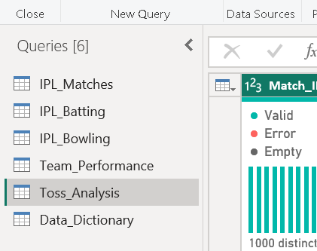
Data Cleaning & Pre-processing
• Imported the IPL dataset into Power BI using Power Query.
• Cleaned and organized the dataset before starting the analysis.
• Checked and corrected the data types of different columns.
• Checked the data for missing or inconsistent values.
• Standardized the required columns and table structure.
• Verified important fields such as Match ID, Season, Teams, Runs and Wickets.
• Prepared the cleaned data for data modeling and dashboard creation.
Tool Used: Power Query

Slide 6
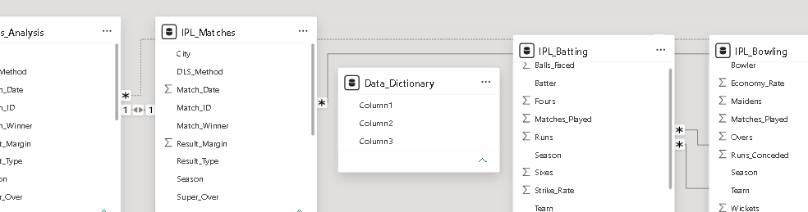
Data Modeling & DAX
Created separate Season and Team dimension tables for better analysis.
Connected the tables using appropriate relationships.
Linked match and toss data using Match ID.
Created DAX measures to calculate important performance metrics.
Main Measures
• Total Matches
• Total Runs
• Total Wickets
• Strike Rate
• Economy Rate
• Win Percentage
• Toss Winner Match Win %

Slide 7
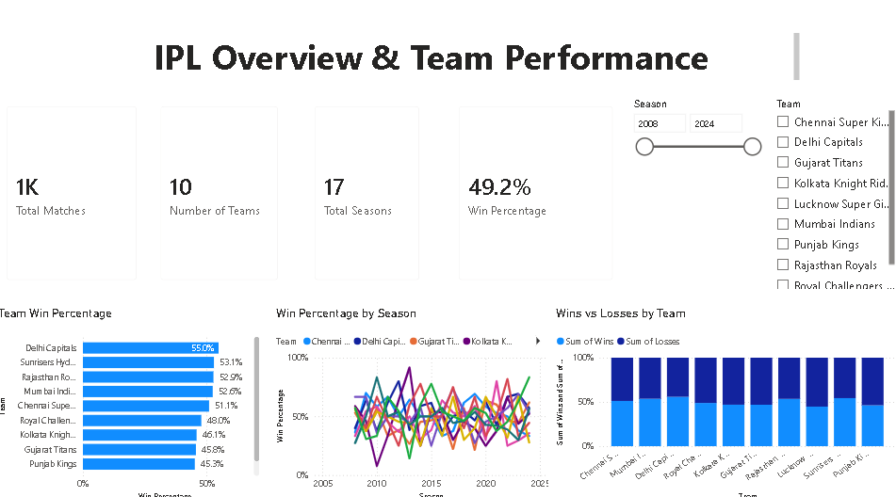
IPL Overview & Team Performance
Questions Covered
Q1. Which IPL teams have the highest win percentage?
Q2. How has IPL performance changed across seasons?
Dashboard Highlights
• Overall IPL match and team performance overview
• Team-wise win percentage comparison
• Season-wise win percentage trends
• Wins vs losses comparison by team
• Interactive Season and Team filters

Slide 8
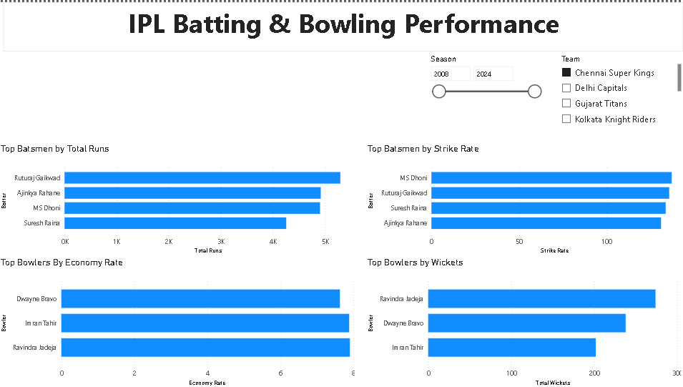
IPL Batting & Bowling Performance
Questions Covered
Q3. Who are the top batsmen based on total runs and strike rate?
Q4. Who are the top bowlers based on wickets and economy rate?
Dashboard Highlights
• Top 10 batsmen by total runs
• Top 10 batsmen by strike rate
• Top 10 bowlers by total wickets
• Top 10 bowlers by economy rate
• Interactive Season and Team filters

Slide 9
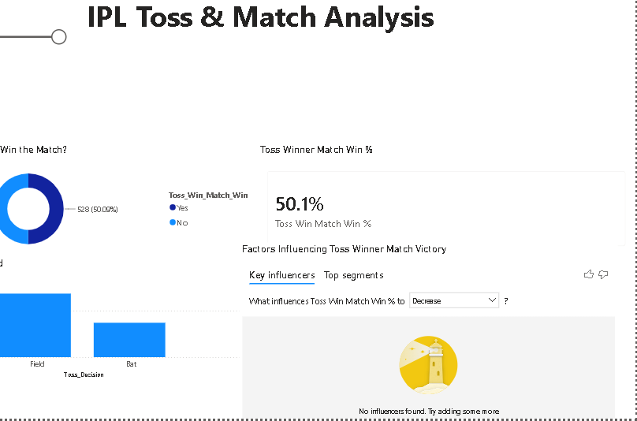
IPL Toss & Match Analysis
Question Covered
Q5. Does winning the toss influence the match outcome?
Dashboard Highlights
• Toss winner vs match winner analysis
• Toss decision comparison — Bat vs Field
• Toss Winner Match Win %
• Key Influencers analysis
• Interactive Season filter

Slide 10
Key Insights & Recommendations
Key Insights
• Team performance differs across IPL seasons.
• Win percentage helps compare overall team performance.
• Total runs and strike rate highlight different aspects of batting performance.
• Wickets and economy rate help evaluate bowling performance.
• Toss results can be compared with match outcomes to understand the impact of winning the toss.
Recommendations
• Teams should study their performance across seasons to identify areas for improvement.
• Batting decisions should consider both run scoring and strike rate.
• Bowling performance should focus on both wickets and economy.
• Toss decisions should be supported by historical match data.

Slide 11
Conclusion
The project analyzed IPL performance using Power BI and converted the available match, team, batting, bowling and toss data into interactive dashboards.
Power Query was used for data preparation, while data modeling and DAX were used to create the required performance measures.
The three dashboards provide a clear view of team performance, player performance and toss-related match outcomes.
Overall, the project demonstrates how Power BI can be used to explore sports data and present useful insights through interactive visualizations.

Slide 12
THANK YOU

