Slide 1
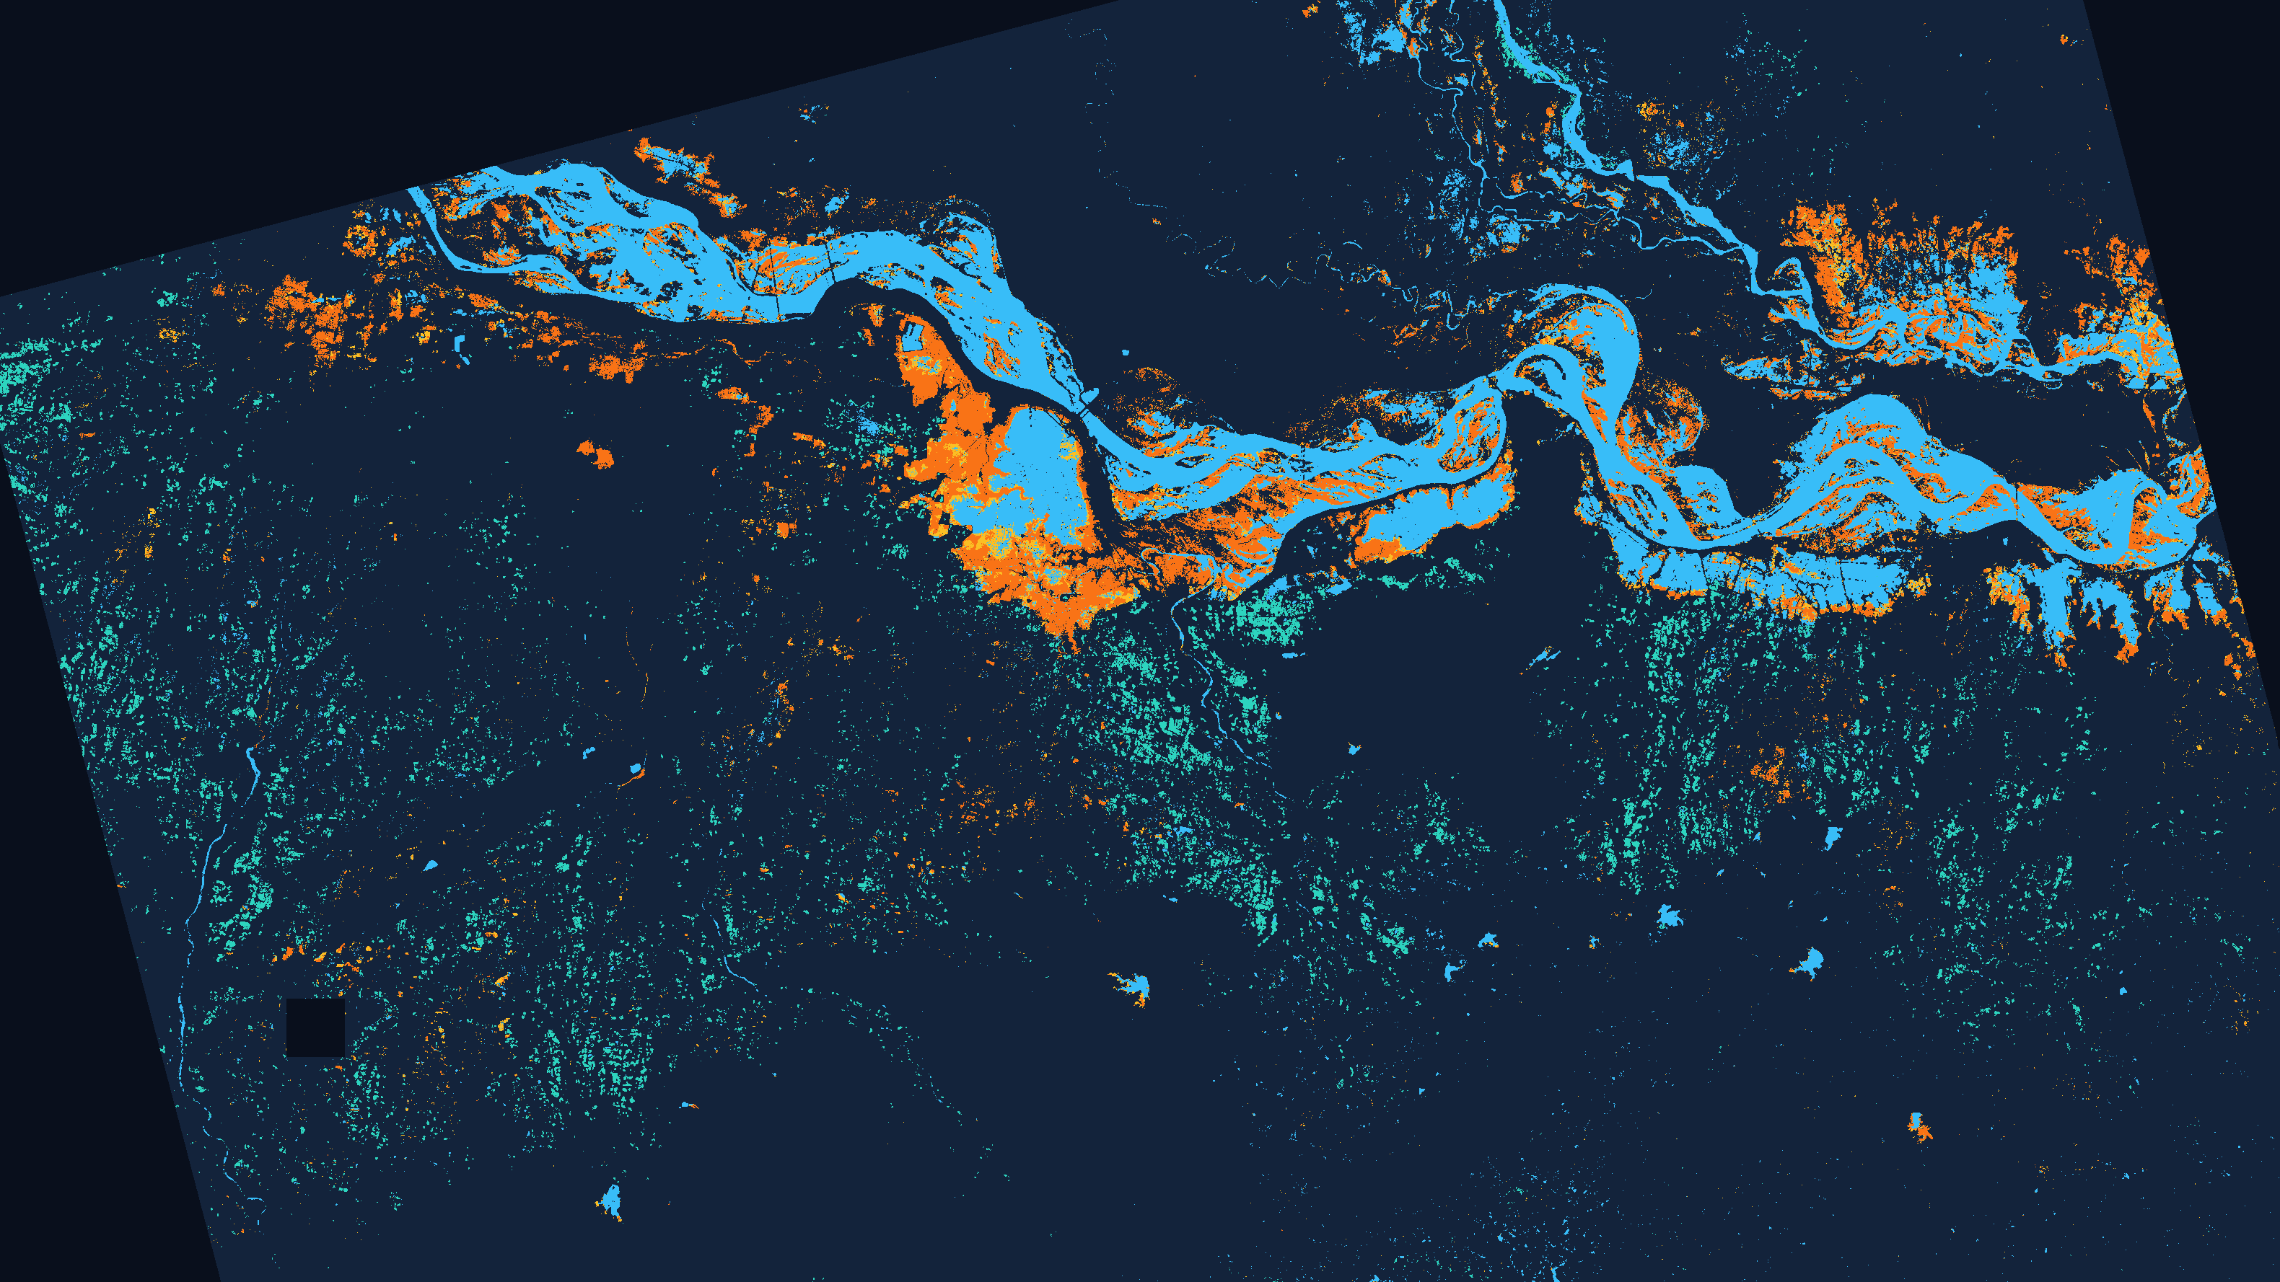
IEEE InGARSS 2026 · YOUNG PROFESSIONALS HACKATHON · PHASE 1
Does combining NISAR L-band and S-band give a better water map?
Surface-water change over the Ganga plain, Bihar, July to October 2026
Aditya Narayan Nayak | Team RunLayer Labs | NISAR Pro
Background: our L+S water map, 31 Aug → 12 Sep 2026. Cyan: stable water. Orange: newly detected water. NISAR L2 GCOV, 80 m, EPSG:32645.

Slide 2
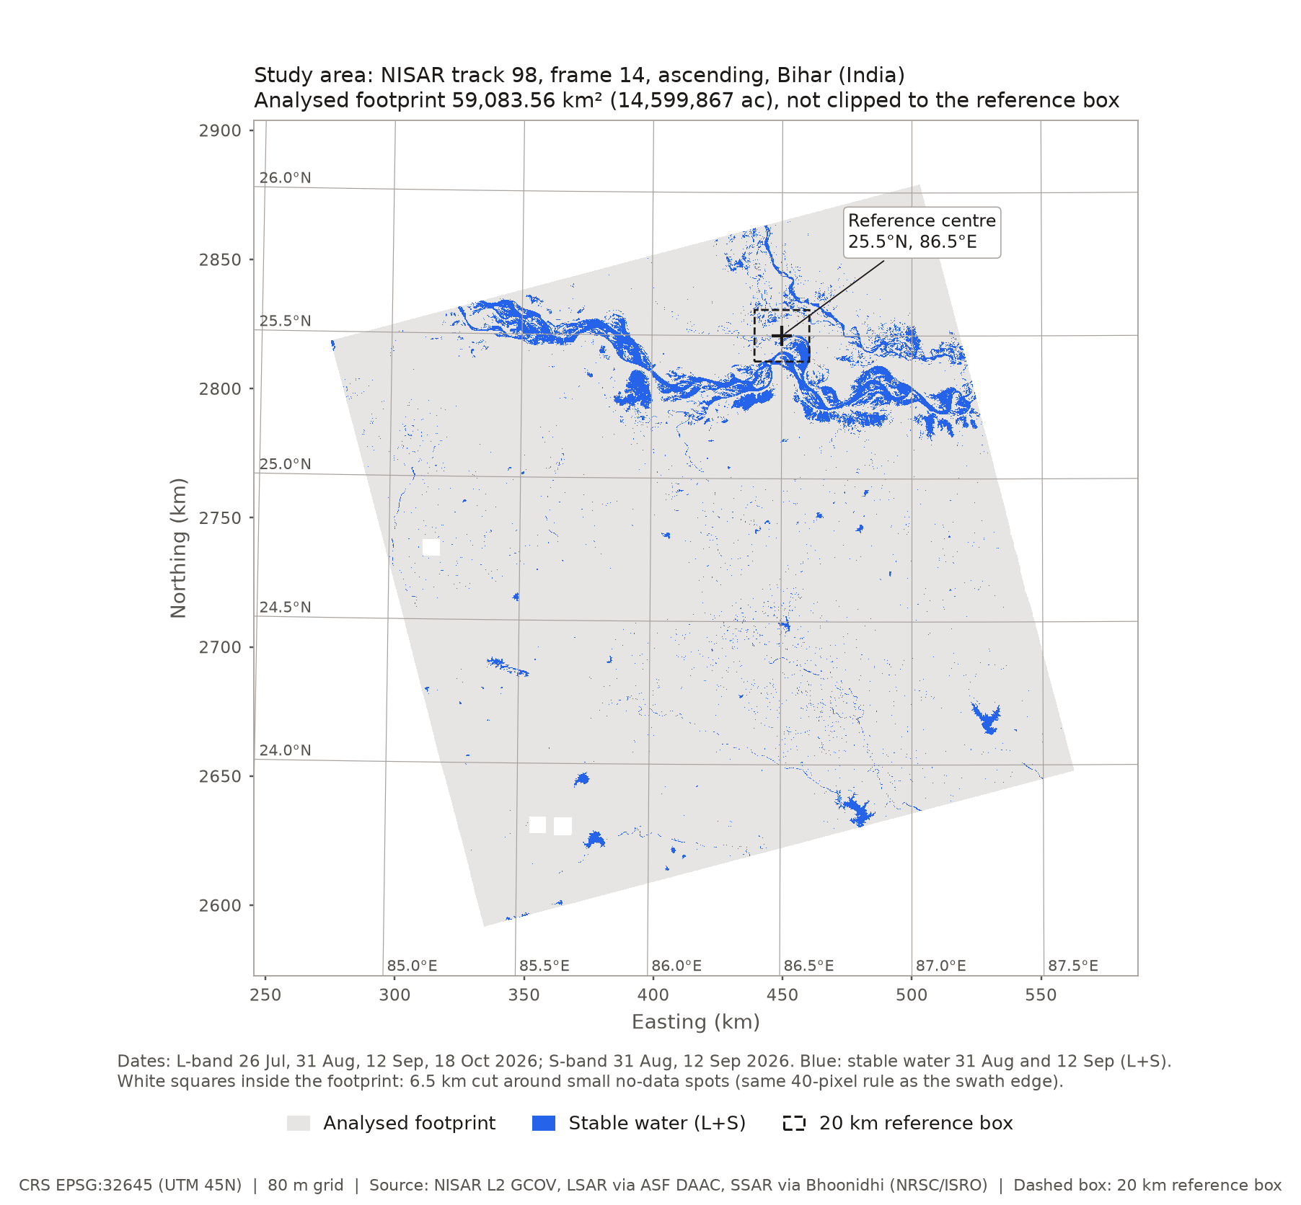
The Challenge and Our Study Area
During the monsoon, Bihar is mostly under cloud, so optical satellites see very little. Radar sees through cloud.
Our question: do NISAR L-band and S-band together map water better than either band alone?
Study area: Ganga plain, Bihar. NISAR track 98, frame 14, ascending. We processed the whole scene, not only the 20 km box.
The three maps are compared on the area both bands cover: 59,083.56 km² (14,599,867 acres).
Band | Mode | Source | Dates (2026)
L-band (1.239 GHz) | DHDH | ASF DAAC | 26 Jul, 31 Aug, 12 Sep, 18 Oct
S-band (3.2 GHz) | DHNA | Bhoonidhi (NRSC/ISRO) | 31 Aug, 12 Sep
L and S were taken seconds apart on 31 Aug and 12 Sep. Sentinel-2 is used only as a check.
NISAR Pro | RunLayer Labs | IEEE InGARSS 2026 YP Hackathon
2

Slide 3
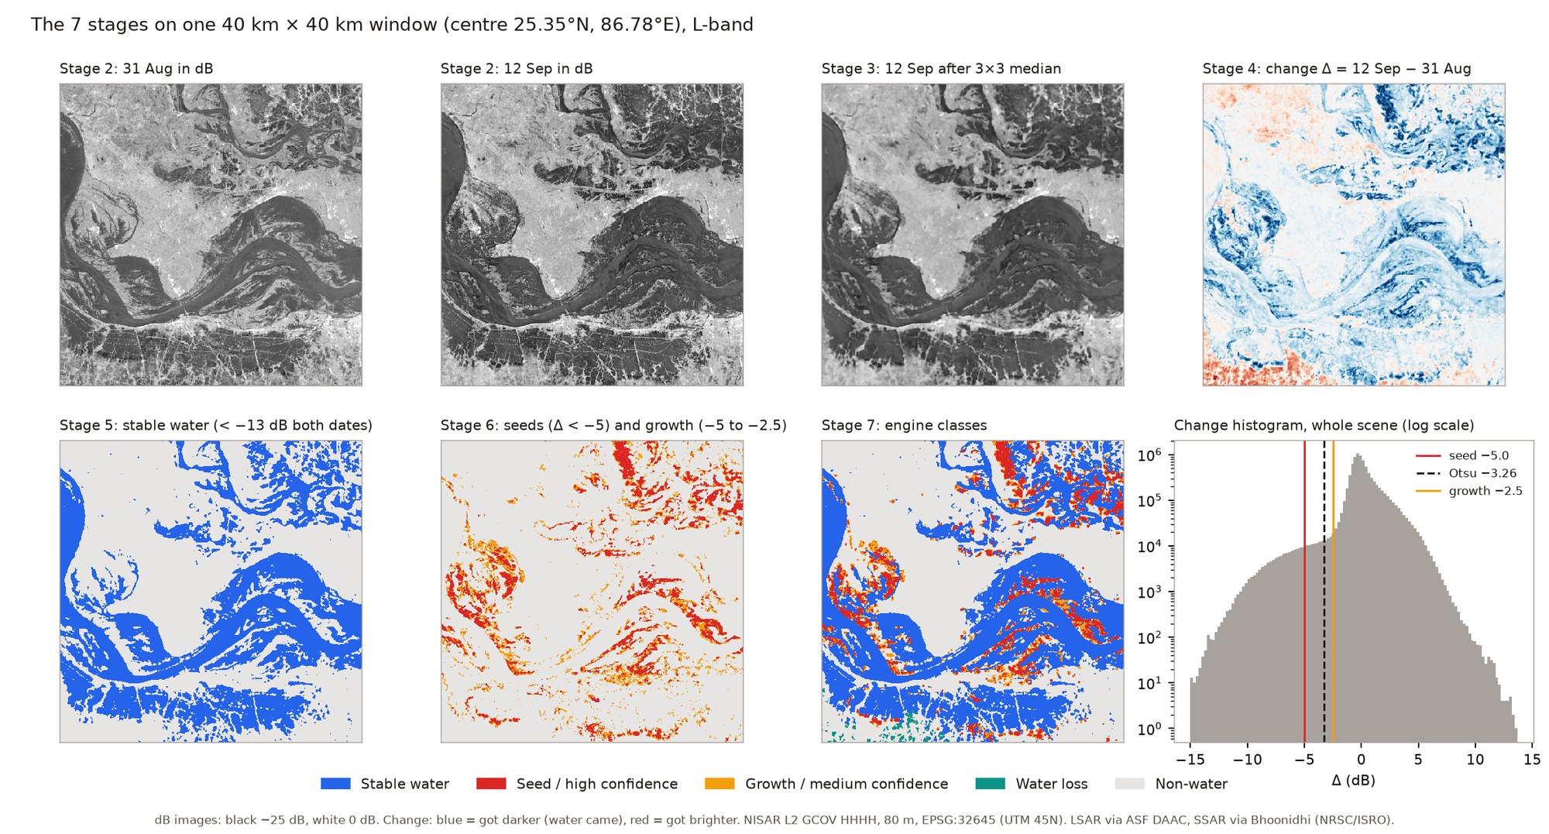
Method: One Pipeline, Two Bands
1. Check both dates use the same term (HHHH)
2. Convert power to dB, cut the scene edge
3. 3×3 median filter for speckle
4. Change Δ = dB(after) − dB(before)
5. Stable water: dark on both dates
6. New water: seed at Δ < −5 dB, grow to Δ < −2.5 dB
7. Classes: land, stable water, new water (high / medium), water loss
Rust engine reads each 1.16-billion-value layer in strips and averages to 80 m.
44–65 s per pair, under 2.4 GB of memory. Same steps for S-band; only the thresholds change.
NISAR Pro | RunLayer Labs | IEEE InGARSS 2026 YP Hackathon
3

Slide 4
How We Combine L and S
Both grids line up exactly at 80 m, so no resampling is needed.
Four simple if/then rules, so every decision can be checked:
  Sandbar: L dark but S bright → not stable water
  Wind: L HH and HV very dark on both dates → stable water
  Canopy: big L-band drop with dark HV → new-water candidate (not proven)
  S-band gate: every new-water candidate must be dark in S on 12 Sep
To see what each rule does, we switched it off and ran again.
Run | Stable water | New water
All rules | 2,652.29 km² (655,395 ac) | 1,337.15 km² (330,417 ac)
No sandbar rule | 2,684.26 km² (663,296 ac) | 1,322.69 km² (326,845 ac)
No wind rule | 2,381.78 km² (588,551 ac) | 1,386.80 km² (342,685 ac)
No canopy rule | 2,652.29 km² (655,395 ac) | 1,113.61 km² (275,180 ac)
No S-band gate | 2,652.29 km² (655,395 ac) | 1,675.85 km² (414,111 ac)
The S-band gate matters most: it removed 338.70 km² (83,695 acres) of candidates. Rule names describe what each rule aims at; the surfaces were not checked on the ground.
NISAR Pro | RunLayer Labs | IEEE InGARSS 2026 YP Hackathon
4

Slide 5
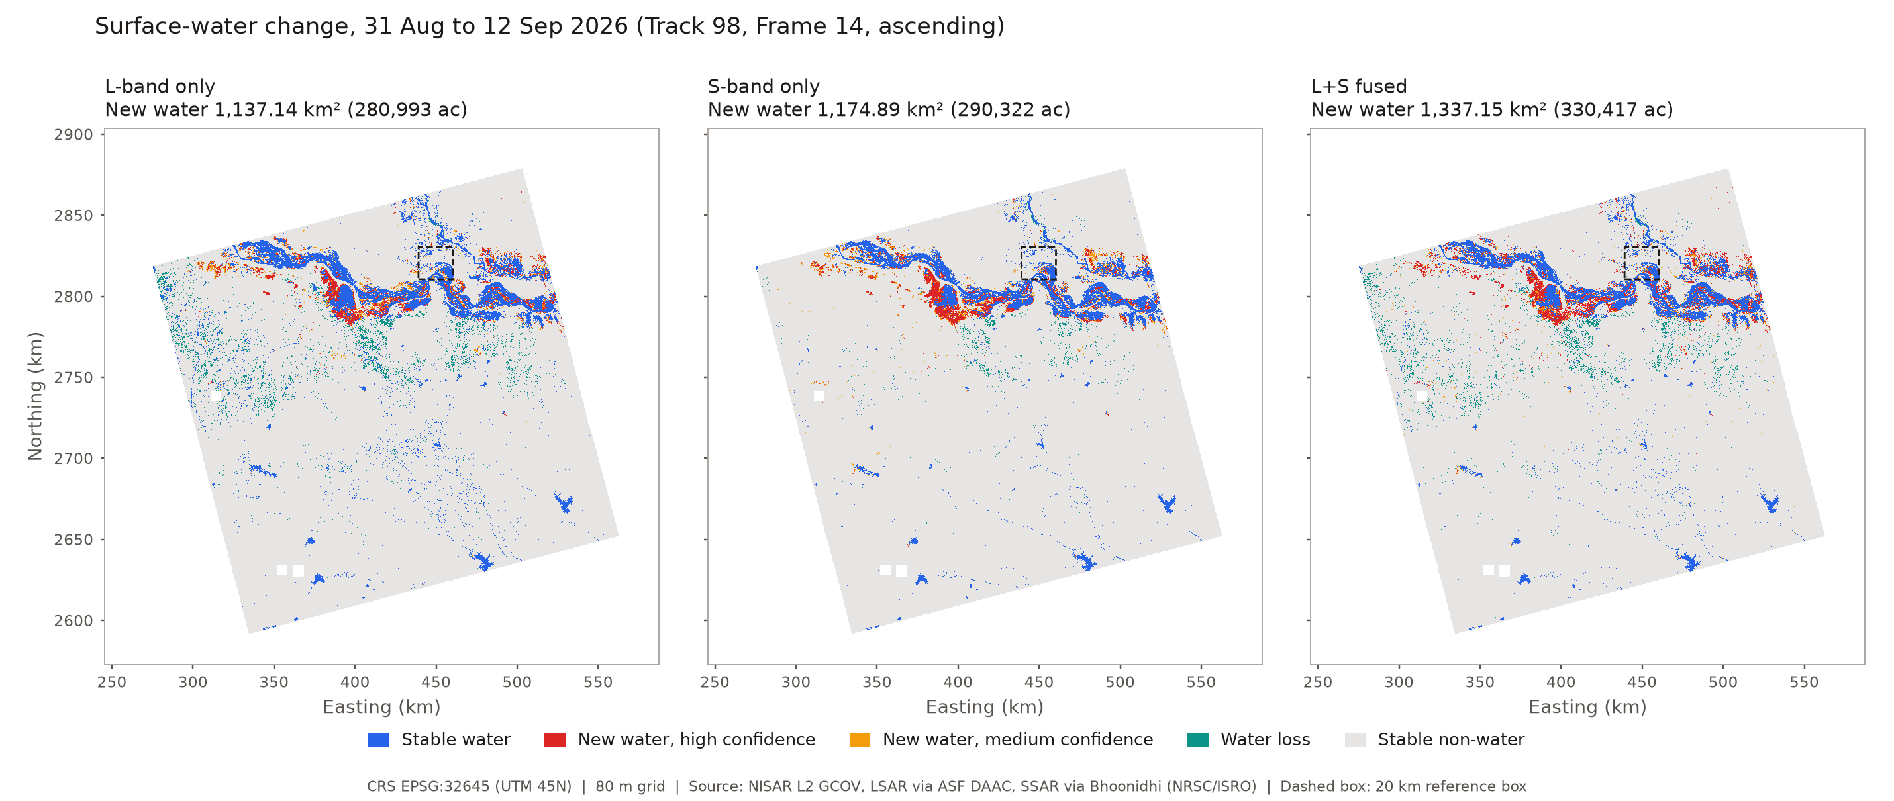
Results: L-only, S-only and L+S (31 Aug → 12 Sep)
Near the river the bands agree.
L-band marks many small dark patches in the west as water; S-band does not.
L-band reports 4 times more water loss than S-band.
L+S keeps the river pattern and drops most of L-band's extra patches.
 | New water | Stable water | Water loss
L-band | 1,137.14 km² (280,993 ac) | 3,314.83 km² (819,112 ac) | 888.84 km² (219,637 ac)
S-band | 1,174.89 km² (290,322 ac) | 2,546.37 km² (629,222 ac) | 214.98 km² (53,123 ac)
L+S | 1,337.15 km² (330,417 ac) | 2,652.29 km² (655,395 ac) | 723.37 km² (178,749 ac)
NISAR Pro | RunLayer Labs | IEEE InGARSS 2026 YP Hackathon
5

Slide 6
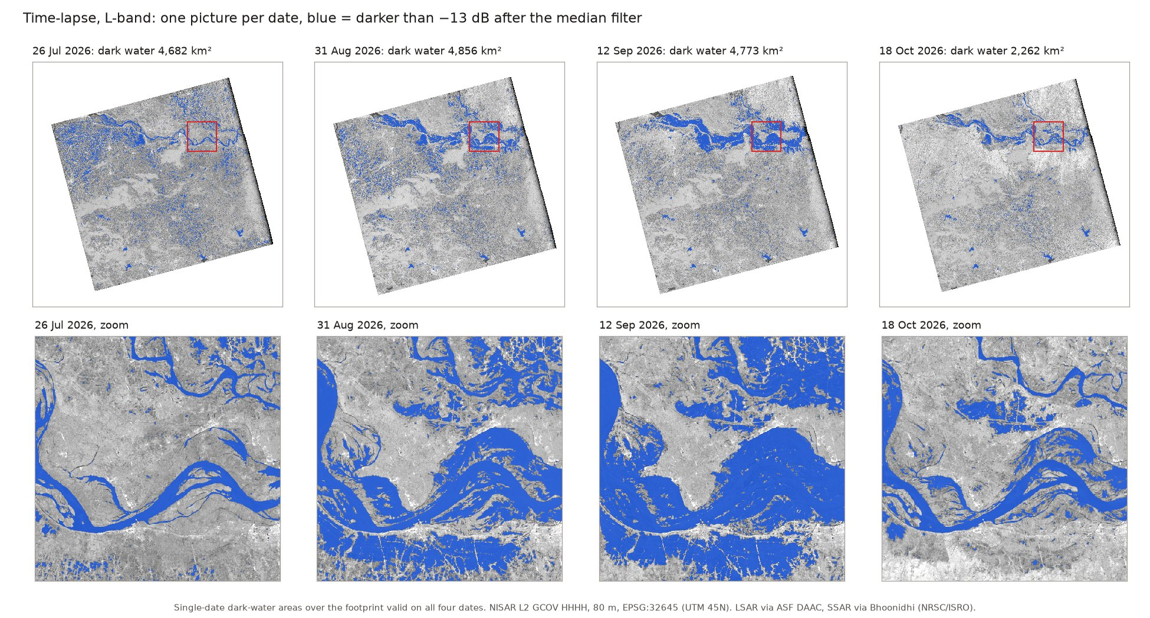
Change Detection: Four Dates, July to October
Dark water in the 40 km river window:
  26 Jul: 213 km² (52,609 ac)
  31 Aug: 617 km² (152,400 ac)
  12 Sep: 812 km² (200,608 ac)
  18 Oct: 299 km² (73,872 ac)
Water spread along the river until 12 Sep; about half the dark water was gone by 18 Oct.
1,282.78 km² (316,982 acres) of L+S new water lies outside any water seen in July or August.
One pair shows one step. Four dates show where the water rose, when it peaked and what is really new. Radar shows where water appeared, not why.
NISAR Pro | RunLayer Labs | IEEE InGARSS 2026 YP Hackathon
6

Slide 7
Validation Against Sentinel-2
We fixed the water test (NDWI ≥ 0) before scoring, and scored every cloud-free pixel.
L+S beat L-band in all 3 tests, mostly by making fewer false alarms.
L+S did not beat S-band: equal on 12 Sep, lower on 31 Aug and for new water.
Pixels dark in L but bright in S were water in only 8.7% of cases on 12 Sep.
HH separated water better than HV in both bands.
12 Sep: 7,946.03 km² (1,963,507 acres) scored, Sentinel-2 about 5 h after NISAR. These are agreement scores with optical labels, not ground truth.
NISAR Pro | RunLayer Labs | IEEE InGARSS 2026 YP Hackathon
7

Slide 8
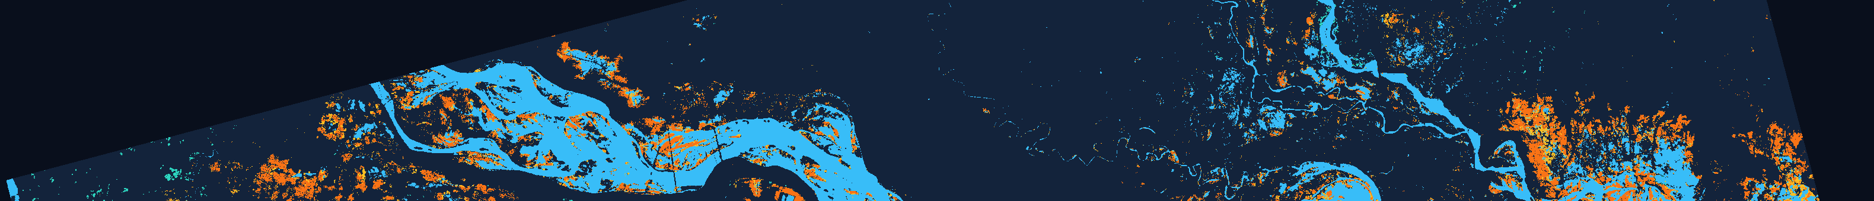
Uncertainty and Conclusions
Uncertainty
  Cloud: only about 14% of the scene could be scored on 12 Sep
  Optical images cannot see water under crops
  Thresholds are set by hand: ±1 dB on the S-band gate moves new water between 1,208.44 and 1,449.29 km² (298,611 to 358,128 acres)
  New water means the echo dropped; features under about 240 m are removed
Conclusions
  L+S improved on L-band in every Sentinel-2 test
  S-band alone was the strongest single band here
  Four L-band dates showed the rise and fall that one pair cannot
  The full scene runs on a normal PC in about 2 GB of memory
  Next: labels under vegetation, more L+S dates, L-band full-pol data
Thank you
Code and data: gitlab.com/Aditya-Narayan-Nayak/nisar_pro
Check every number: python3 run_bihar_analysis.py (in the ingarss_2026 folder)
8

