Slide 1





AI reinvention made real
Accenture Innovation Challenge 2026
Copyright © 2025 Accenture. All rights reserved.
‹#›

Slide 2
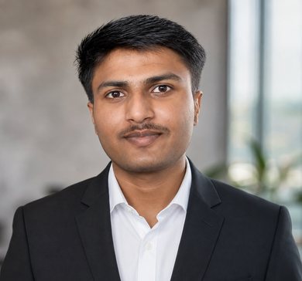

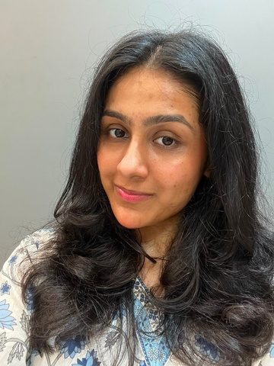
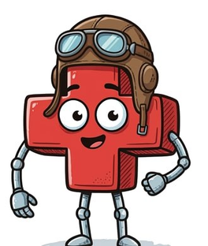
Team details
TEAM NAME: 01BIT
Aditya Onam (Team Leader)
Aditya Gupta
College: Indian Institute of Technology Patna
Stream: Mathematics and Computing
Year of graduation: 2027
College: Indian Institute of Technology Patna
Stream: Mathematics and Computing
Year of graduation: 2027
Varada Patel
MediPilot
Photo
College: Indian Institute of Technology Patna
Stream: Mathematics and Computing
Year of graduation: 2027
AI-Powered Patient Triage Assistant
3

Slide 3












Problem Statement
One person decides — once, in ninety seconds, and then nobody looks again.
FAILURE MODES
WHERE MISTRIAGE ACTUALLY HAPPENS ?
01 — One Person’s Judgment
One person, under pressure, with no second opinion.
Deterioration goes unseen
02 — One-Shot Assessment
Up to 4-Hours: No recheck
Triage happens once. The corridor goes unwatched for hours after.
t = 0:
Patient Seen
03 — Clinical AI Has Failed
Clinical AI already failed here once. Nobody trusts it now.
Everyone's attention is at t = 0. The next four hours get silence — and that's where mistriage becomes irreversible
THE EVIDENCE
32.2%
NO STD
SHORT
0.63
ESI Mistrage
Most Indian EDs
Physician Shortage
Epic Sepsis Model AUC
of ED visits get the wrong acuity level at first triage
have no standard triage protocol — it depends who's on duty
Physician shortages strain every triage decision
Missed 2 in 3 cases; 109 false alerts per real one

Slide 4















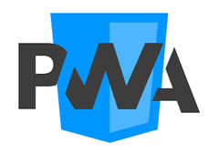














SOLUTION — MEDIPILOT
How It Works:
Core safety principle: It can move a patient up the queue by itself. It can never move one DOWN by itself.
5-LAYER ARCHITECTURE
03
03
03
03
03
03
03
03
03
03
03
05
05
05
05
05
05
05
05
05
05
01
05
01
01
01
01
01
01
01
01
01
01
04
04
04
04
04
04
04
04
04
04
02
04
02
02
02
02
02
02
02
02
02
02
Patient Arrival
First 5 Minutes
Risk / Priority Assessment
Clinician Decision
Continuous Reassessment
New patient information
New observations
TRIAGE LANES
RED
YELLOW
Highest urgency
Urgent
GREEN
? NOT SURE
Lower urgency
Insufficient confidence — human review required
AI ASSISTS. CLINICIANS DECIDE. The NOT SURE lane is not an error state — it is a safety mechanism that escalates uncertainty to human judgment.

Slide 5
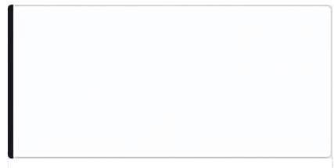

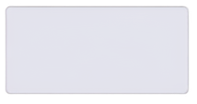
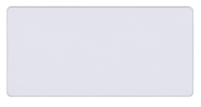
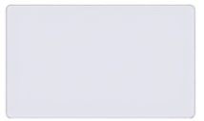
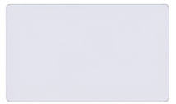
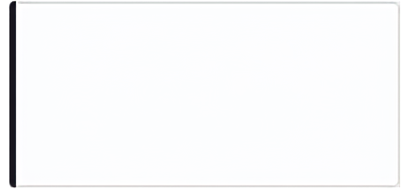

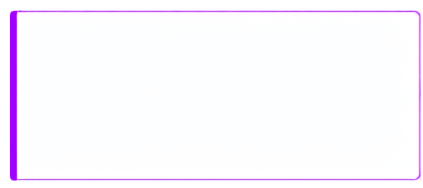
WHY IS THIS DIFFERENT ?
WORST CASE SCENARIOS
01
Re-Triage Every 5 Minutes
NO NETWORK
MODEL DOWN
Traditional triage is a one-time snapshot. MediPilot re-checks every five minutes — so deterioration doesn't go unnoticed.
Box keeps working
Falls back to a printed rule card.
MASS CASUALTY
ESCALATION
Objective switches
Escalate lower, never downgrade alone
02
Trained on Outcomes
Learns from outcomes, not opinions. What happened to the patient — not what was guessed in ninety seconds — is the ground truth it trains on
FEASIBILITY
<₹5
per encounter
03
Knows When It Doesn't Know
6 WEEKS
And says so. Not sure → human review, every time. Uncertainty is a feature, not a failure.
to onboard a hospital
₹15K
mini-PC hardware

Slide 6
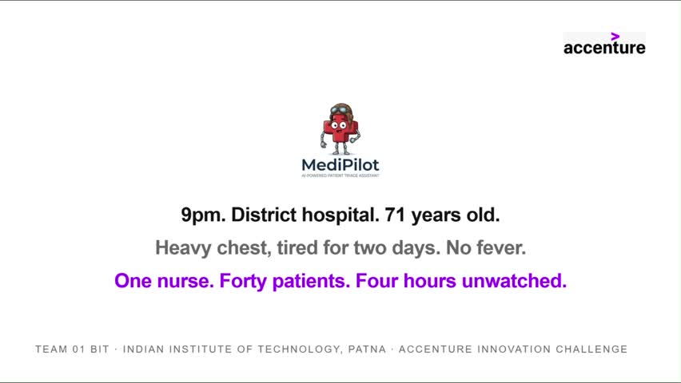
Video

Slide 7

Thank you
Copyright © 2026 Accenture. All rights reserved.
‹#›

