Slide 1
KEEPER
Presented By:
Aditya Pratap Singh (191500060)

Slide 2
OUTLINE
About the Project
Objective
Requirements
Pictures from the website

Slide 3
ABOUT THE PROJECT
Keeper is a note-taking service included as part of the free, web-based Docs Editors suite. Keeper allows users to record plain-text notes and organize, edit, or share them with others using a suite of collaboration tools. You can also use Keeper app to create, set time- and note-based reminders.
Keeper’s objective is to provide such an interface that can help user to store all notes and essential information digitally, usually in a cloud-based storage system. Type, write, and draw notes on the device of choice just as one would using pen and paper.
User just have to visit the site and make a note of whatever he wants to add there, then press a + button, after he/she can delete it also.

Slide 4
OBJECTIVE
Keeper’s objective is to provide such an interface that can help user to store all notes and essential information digitally, usually in a cloud-based storage system. Type, write, and draw notes on the device of choice just as one would using pen and paper.
User friendliness: The project will be very easy to use, anyone can use it with high efficiency and it will also boost the productivity of the user.

Slide 5
REQUIREMENTS
Requirement Specifications:
Technology Implemented: Full-Stack Technologies
Languages/Technologies Used: HTML, CSS, and JavaScript, Motoko
JavaScript Library Used: React
IDE Used: Visual Studio Code
Web Browser: Google Chrome, Edge, Mozilla Firefox

Slide 6
Hardware Requirement :
Processor Used: Intel i5/ Ryzen 5
Operating System: Windows 10
RAM: 4 GB (minimum)
Hardware Devices: Computer System
Hard Disk: 256 GB

Slide 7
THIS IS HOW THE WEBSITE LOOKS
You will like my work, and I know that :)

Slide 8
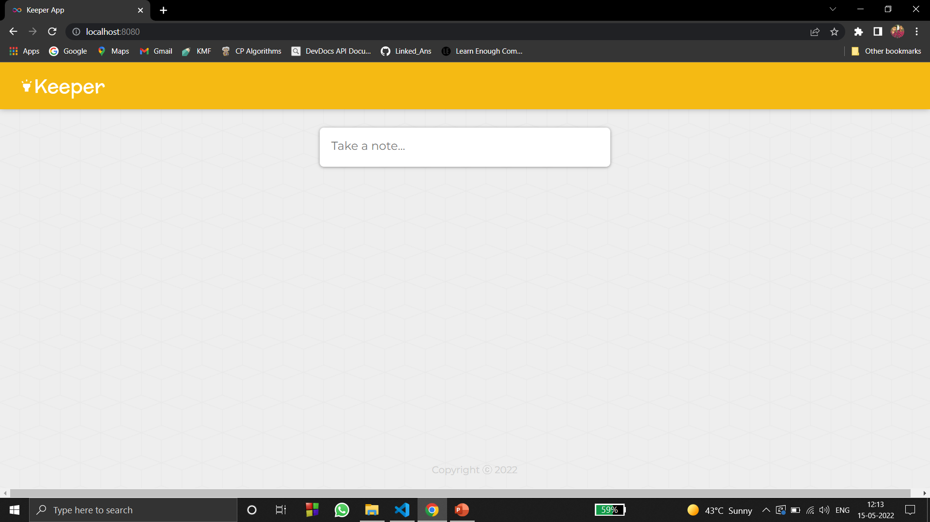
• THE Main Page

Slide 9
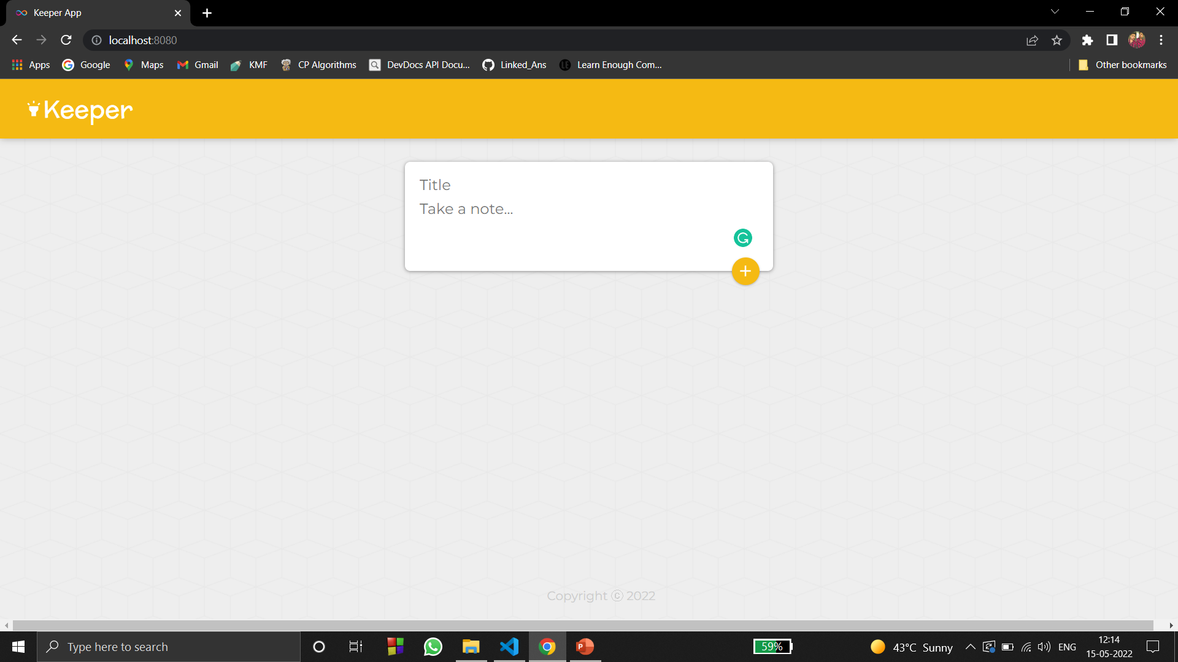
• Title & Note Content Section

Slide 10
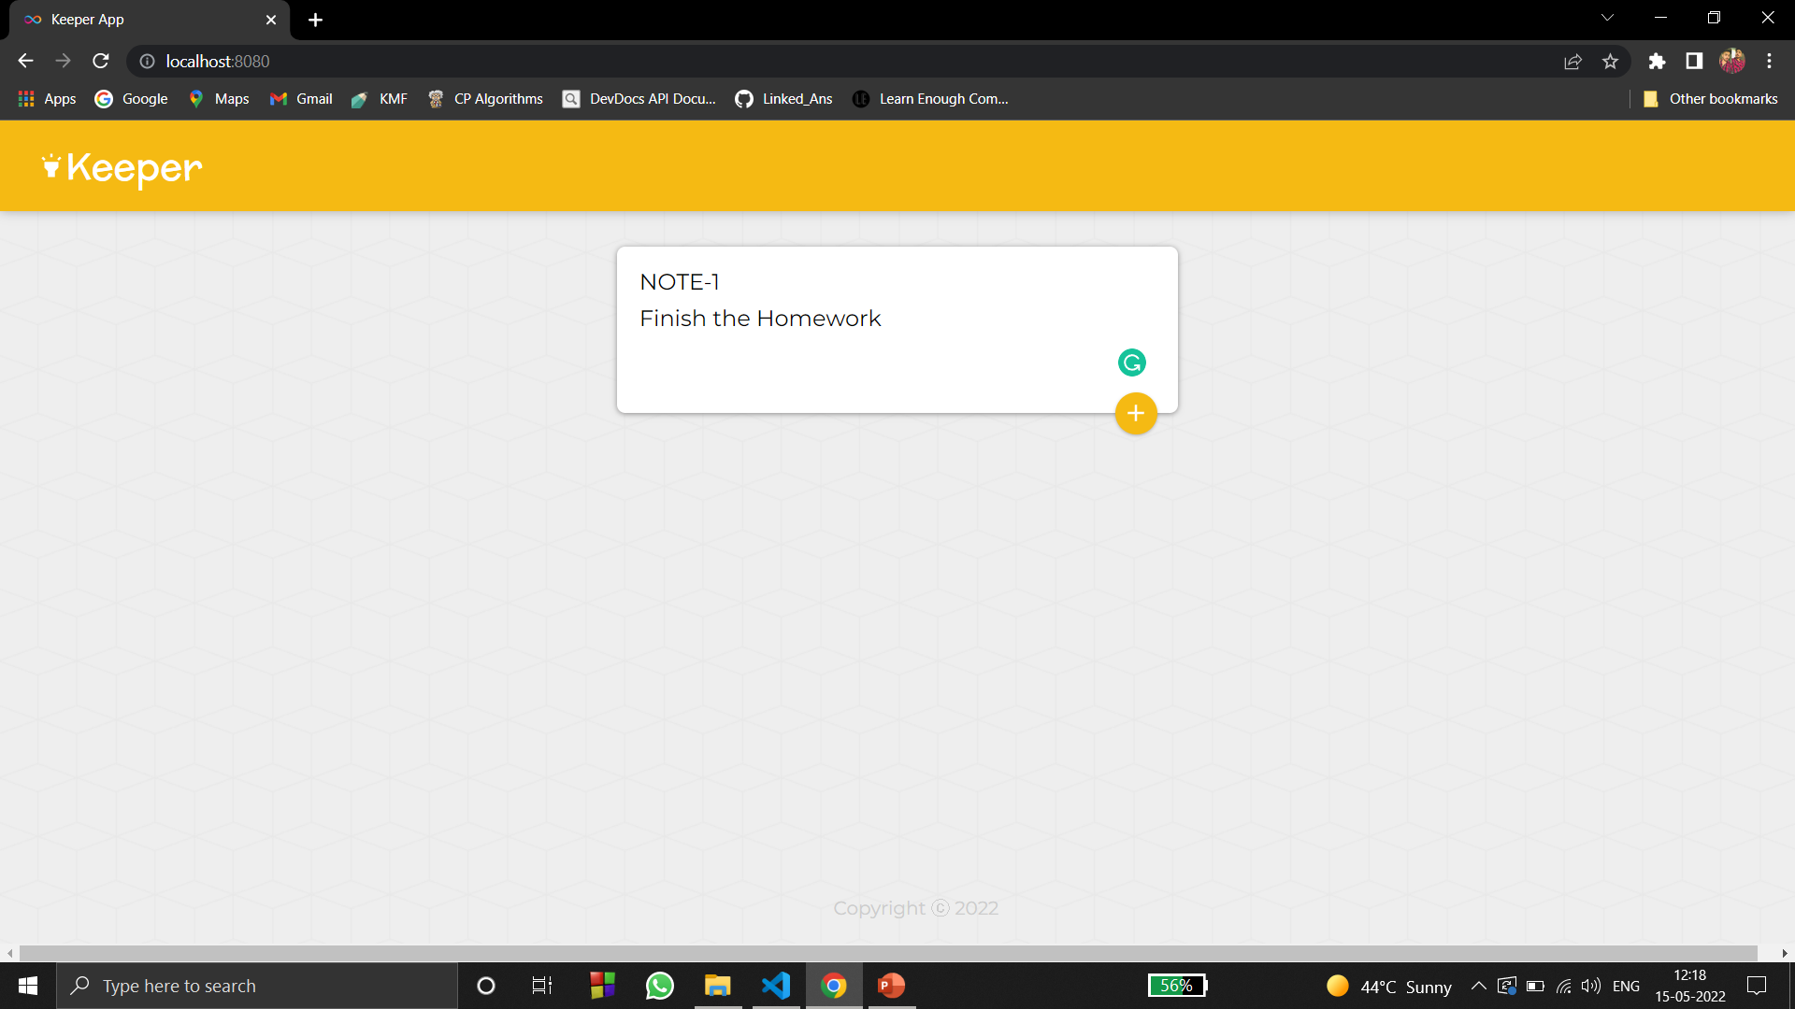
• This is how Title & Content looks like before pressing ADD(+) button

Slide 11
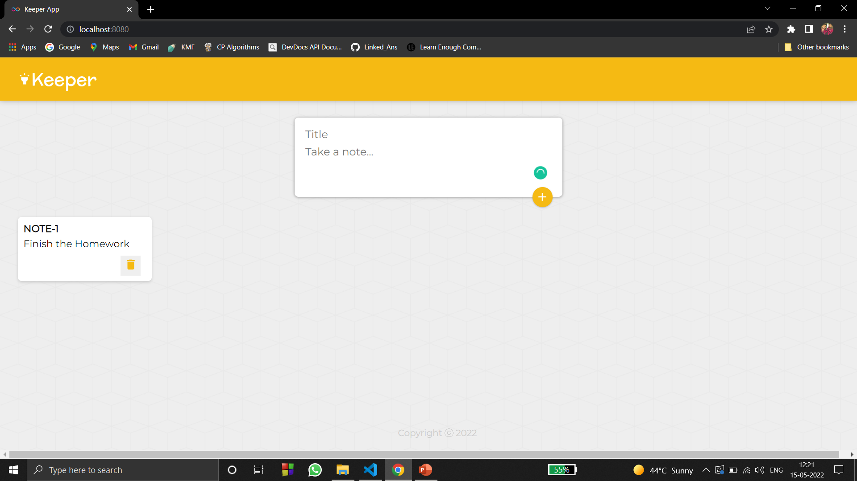
After hitting (+), the note with its title has been added to the queue.

Slide 12
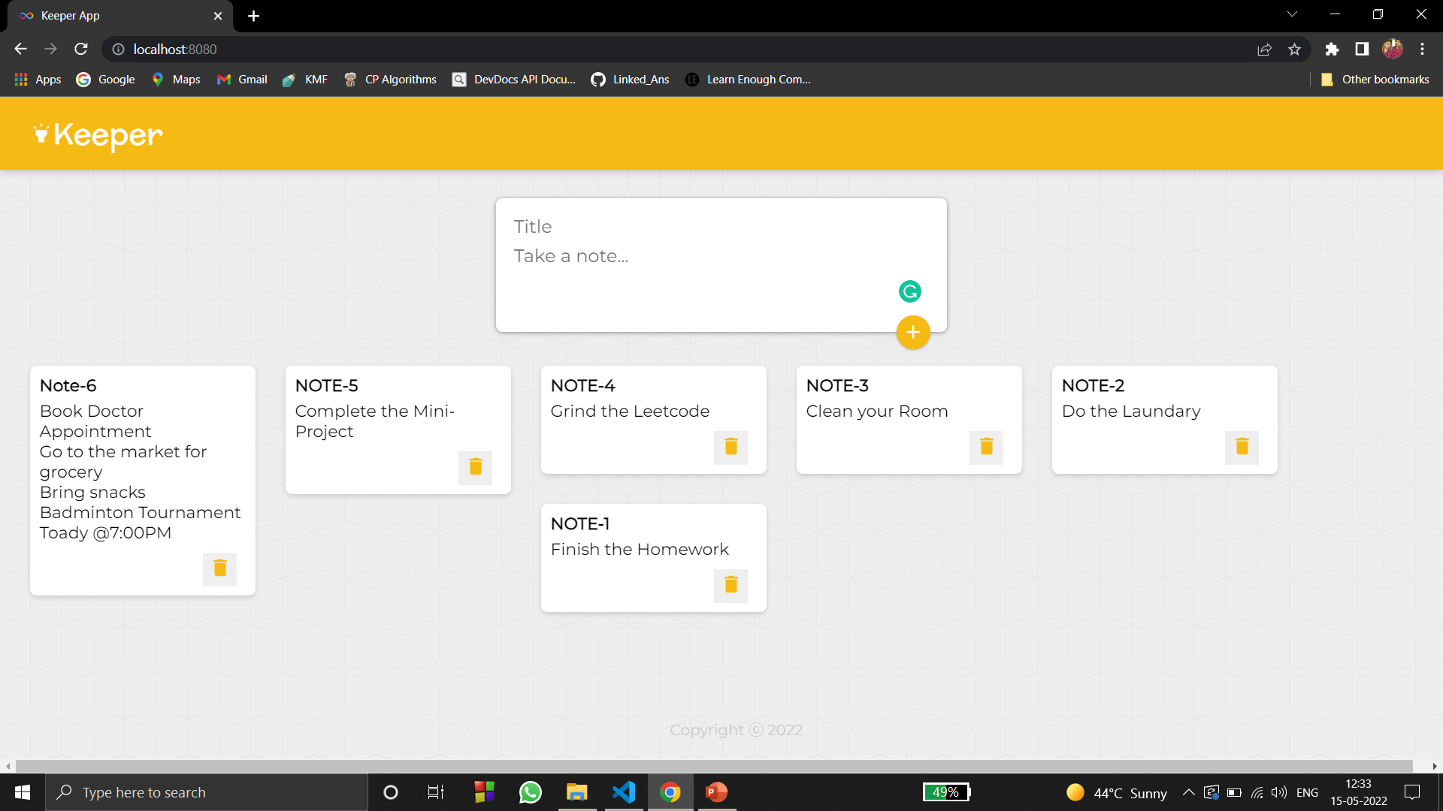
• You can add as my tasks or notes you want :)

Slide 13

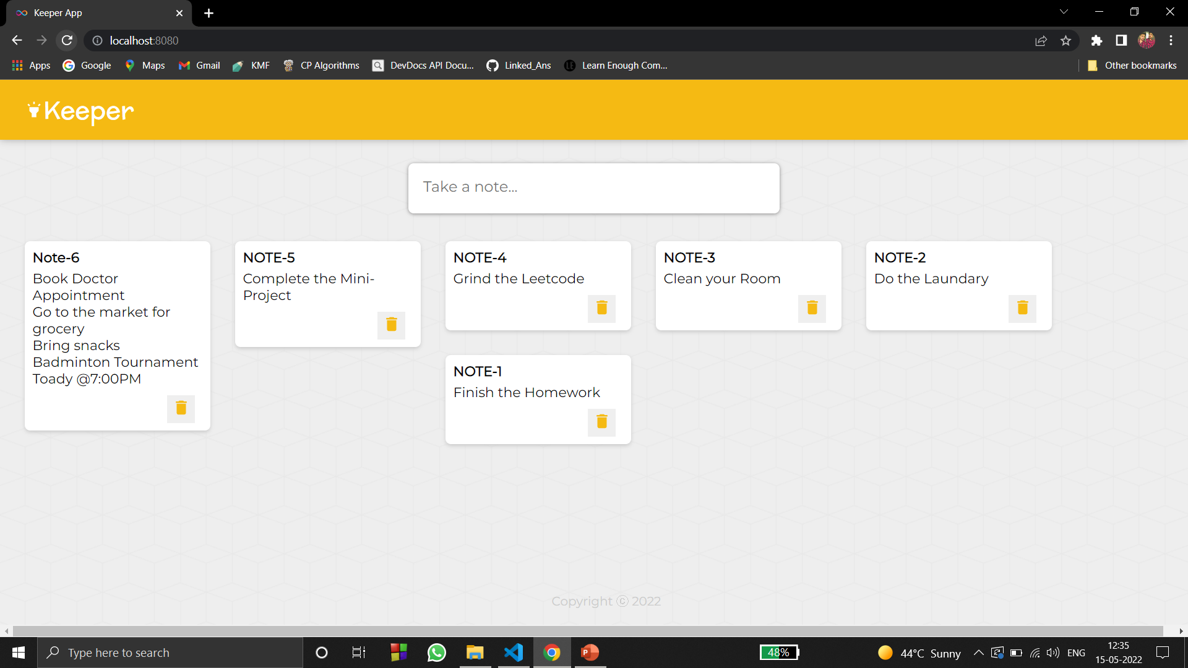
• After refreshing also, the data will persist.

Slide 14
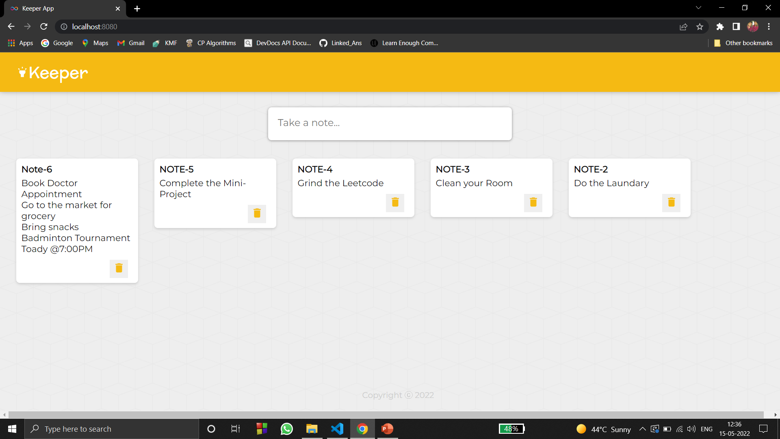

• After finishing, to Delete the task or your notes, just simply hit this (Delete) button.

Slide 15
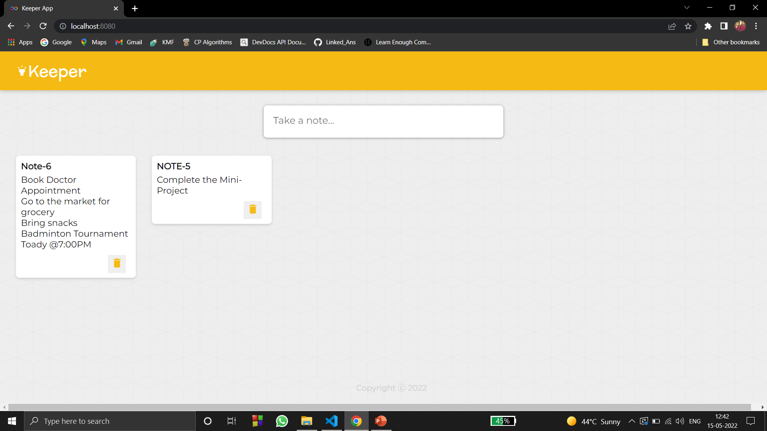
• After Deleting, if you refresh the website, the deleted data will not be shown again.

Slide 16
Thank You !

