Slide 1


EvoTrees.jl
Efficient Boosted Trees on CPUs & GPUs
Jérémie Desgagné-Bouchard, FCAS
Head of Science - Evovest

Slide 2
Motivation
Overview of tree boosting algorithm
And performance tricks used by EvoTrees.jl
Latest features
Tree bagging
Oblivious trees
Alternatives to gradient-based losses
mean-absolute-error
volatility-adjusted losses
Future development paths
Improved acceleration
Multi-target losses

Slide 3
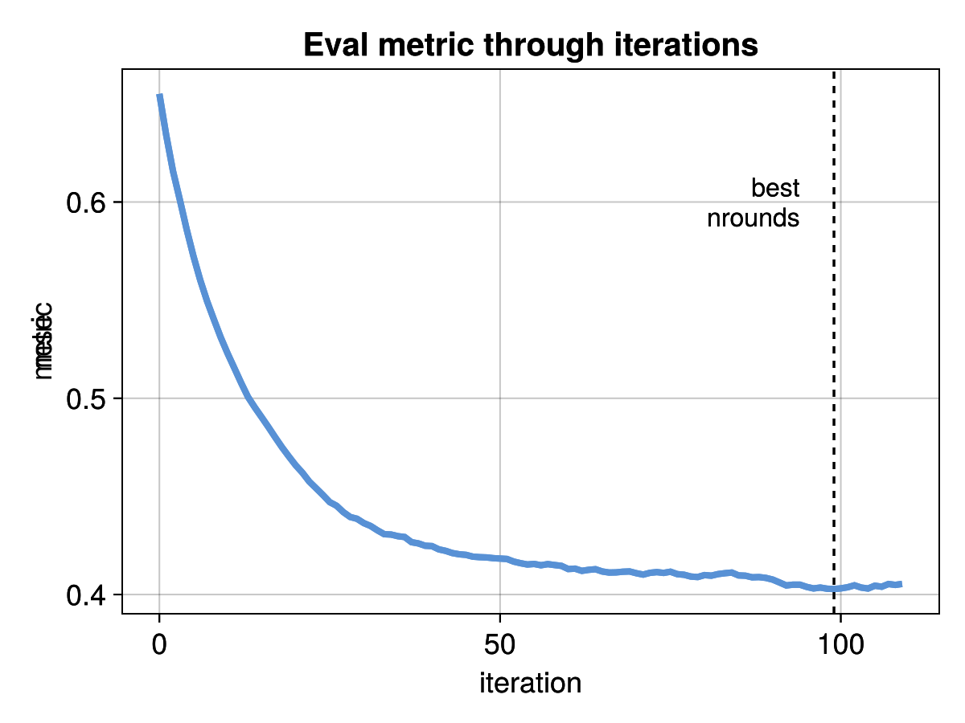
Basics
MLJ compliant API
target_name
feature_names
Row │ Survived Pclass Sex Age SibSp Parch Fare Age_ismissing
│ Int64 Int64 Cat… Float64 Int64 Int64 Float64 Bool
─────┼─────────────────────────────────────────────────────────────────────────
1 │ 0 1 male 29.0 0 0 30.0 false
config = EvoTreeRegressor(
loss=:logloss,
nrounds=200,
early_stopping_rounds=10,
eta=0.05,
max_depth=5
)
model = EvoTrees.fit(
config, dtrain;
deval,
target_name,
feature_names
)
pred = model(deval)

Slide 4
Algo Overview
Boosted algorithm
tree #1 = bias

Slide 5
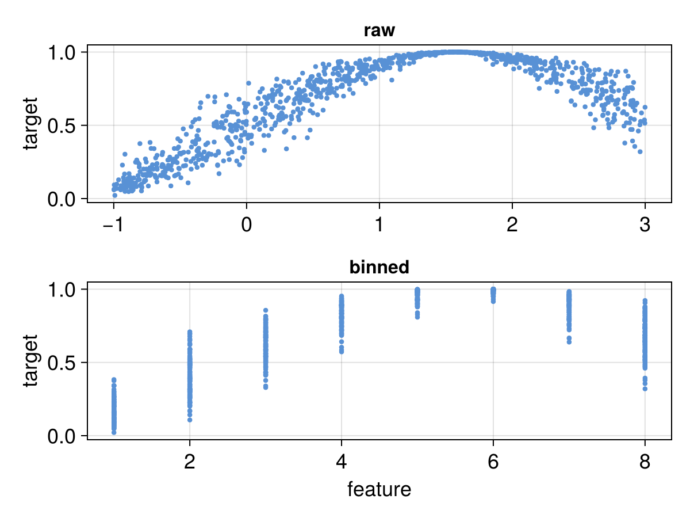
Algo – Histogram method
A core methodology for fast training used by all performant implementations (XGBoost, LightGBM, CatBoost)
Note how the binarization results in features that are scale and distribution invariant

Slide 6
Algo – Histogram method
node ids
data bin id
grads
histogram
1
2
4
…
1
3
2
1
…
2.0
5.0
-3.0
4.0
6.0
5.0
nbins
features
Parallelization
grads: @threads over nobs
histogram: @threads over features (and nobs on GPU)
node id update: @threads over nodes nobs

Slide 7
Training Speed
CPU
# obs | depth | EvoTrees | XGBoost | log-diff
100K | 6 | 0.83 | 1.31 | -20%
100K | 11 | 3.43 | 3.33 | 1%
1M | 6 | 5.50 | 13.57 | -39%
1M | 11 | 15.72 | 18.79 | -8%
10M | 6 | 79.99 | 147.04 | -26%
10M | 11 | 185.47 | 189.04 | -1%
GPU
# obs | depth | EvoTrees | XGBoost | log-diff
100K | 6 | 1.64 | 0.66 | 40%
100K | 11 | 17.98 | 3.77 | 68%
1M | 6 | 3.53 | 3.19 | 4%
1M | 11 | 30.11 | 8.58 | 55%
10M | 6 | 21.56 | 27.49 | -11%
10M | 11 | 65.96 | 49.85 | 12%

Slide 8
Tree Bagging
Tree bagging allows to train models similar to RandomForest
for tree in tree_size
update_gradients!
for bag in bag_size
subsample_row_cols!
grow_tree!
predict!
end
end
EvoTreeRegressor(
nrounds=1,
bagging_size=8,
eta=1.0,
row_sample=0.5,
col_sample=0.5,
loss=:mse,
kwargs…
)

Slide 9

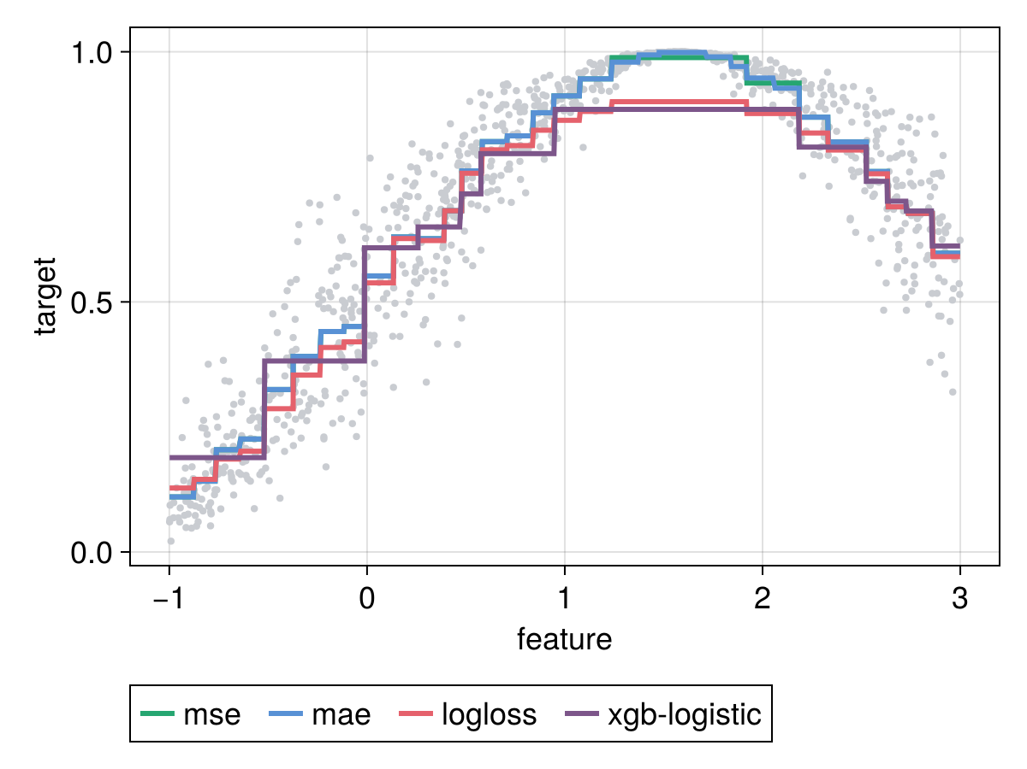
Tree Bagging
Only few loss functions can return a good model with a RandomForest emulation: nrounds = 1; eta = 1.0
Limitation intrinsic to gradient learning method. A single tree quality is limited to the quality of second-order approximation vs. the original loss curve.

Slide 10
Oblivious Tree Structure
Binary
EvoTreeRegressor(
tree_type = :binary,
kwargs…
)
Oblivious
EvoTreeRegressor(
tree_type = :oblivious,
kwargs…
)
feat-3
<= 1.23
feat-3
<= 1.23
feat-1
<= 1.23
feat-3
<= 4.56
feat-2
<= 4.56
feat-2
<= 4.56
leaf-1
leaf-2
leaf-3
leaf-4
leaf-1
leaf-2
leaf-3
leaf-4

Slide 11
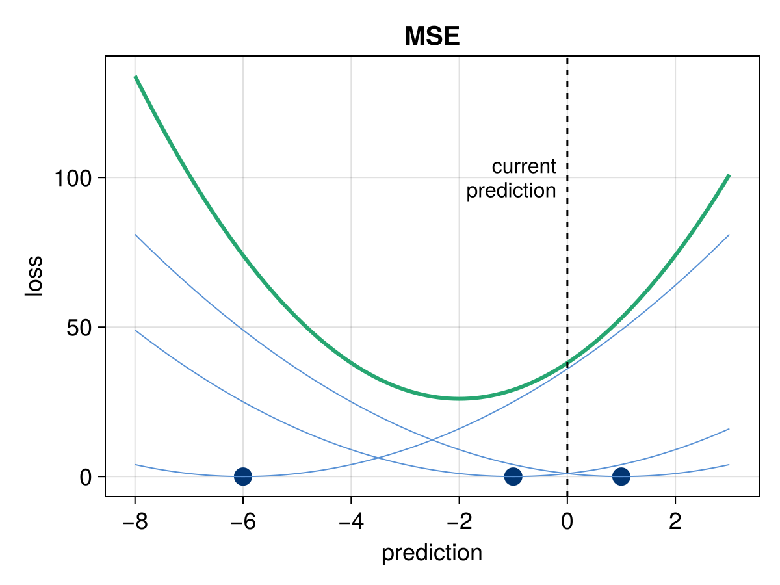
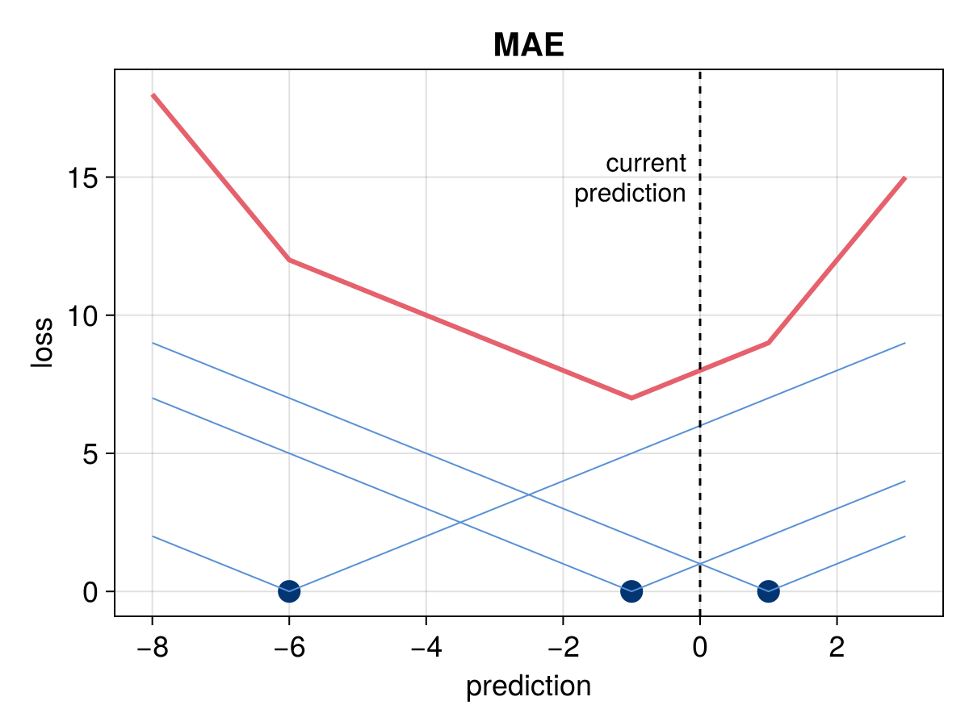
Loss Without Gradients - MAE
Are the 2 first moments needed if all we want is to move prediction towards the mean?
Alternative perspective for tree-split gain: any metric derived from histogram statistics.
For MAE proxy: gain = sum of absolute change in predicted value.
A single metric is needed, the residual: target - pred
Cannot work beyond depth 2 without a trick gain valuation: gains need to be derived from the context of the parent node statistics.

Slide 12
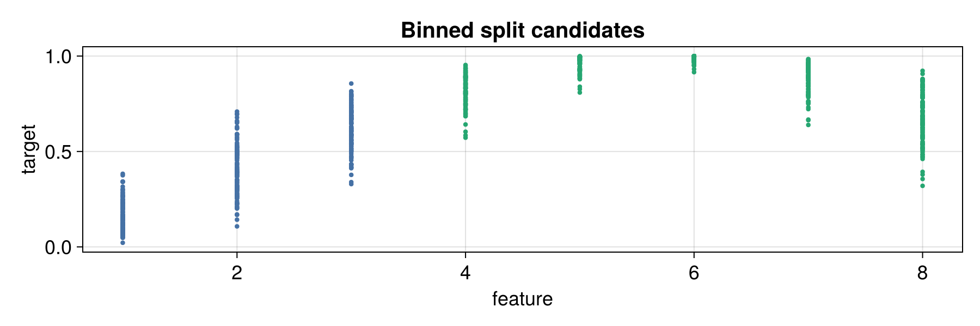
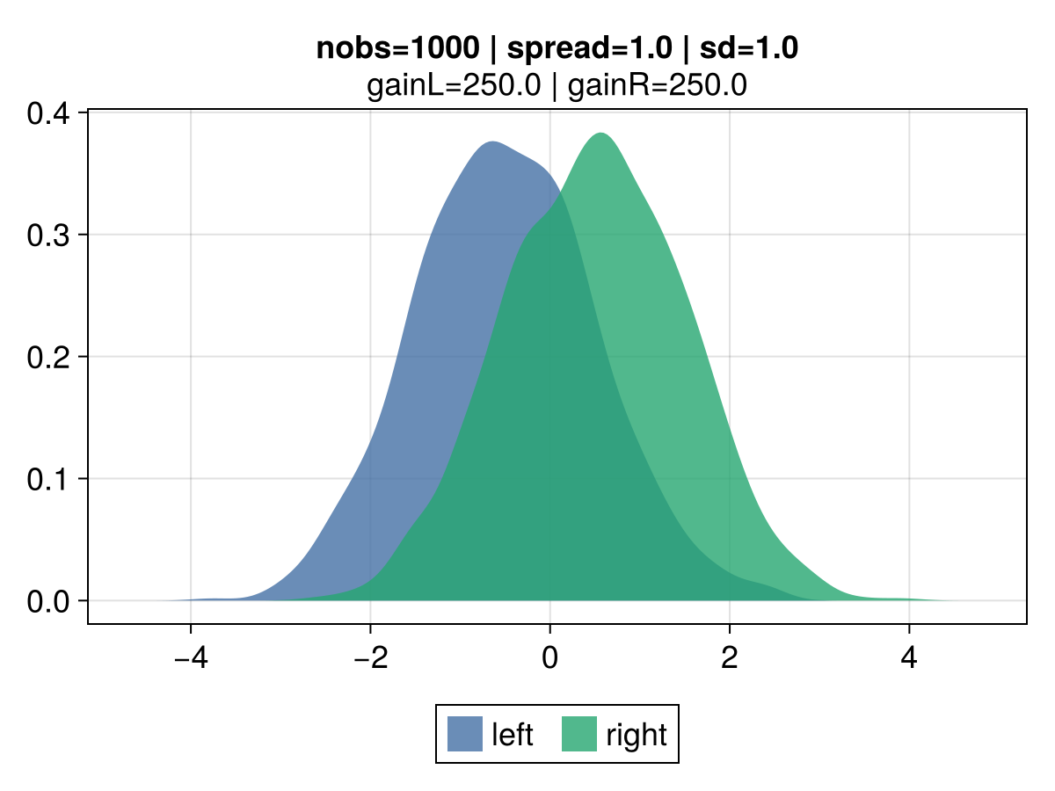
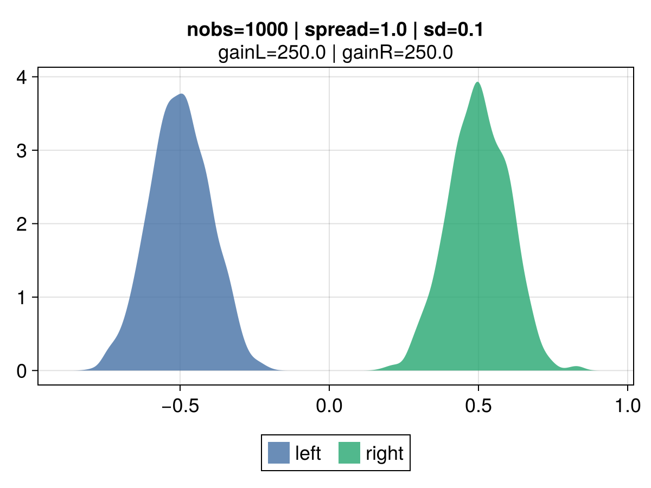
Loss Without Gradients - Credibility
All other things being equal, the gain for two split candidates will be the same regardless of the volatility of observations within each leaf.
In regular regression, the gain is entirely driven by the mean of observations.

Slide 13
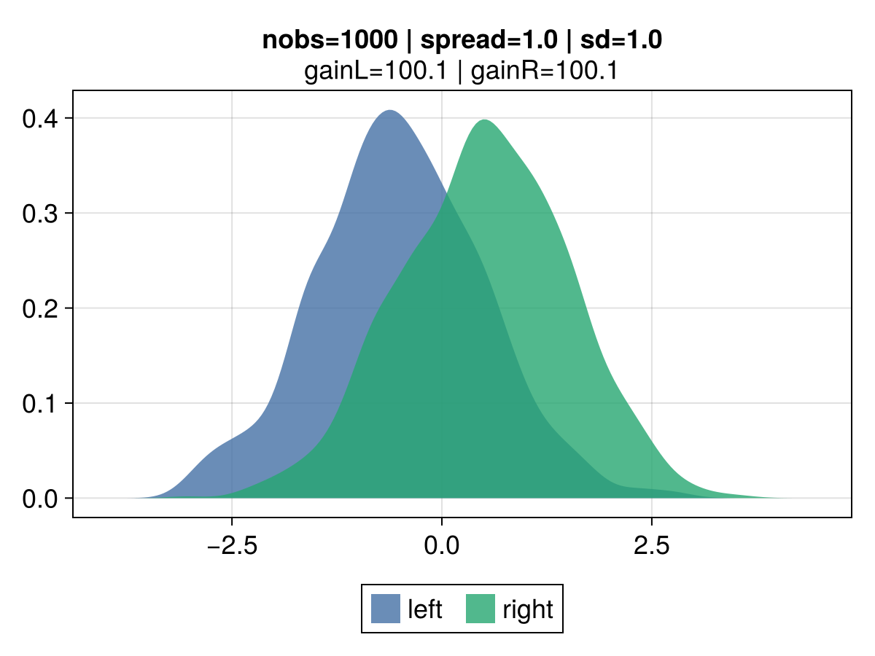
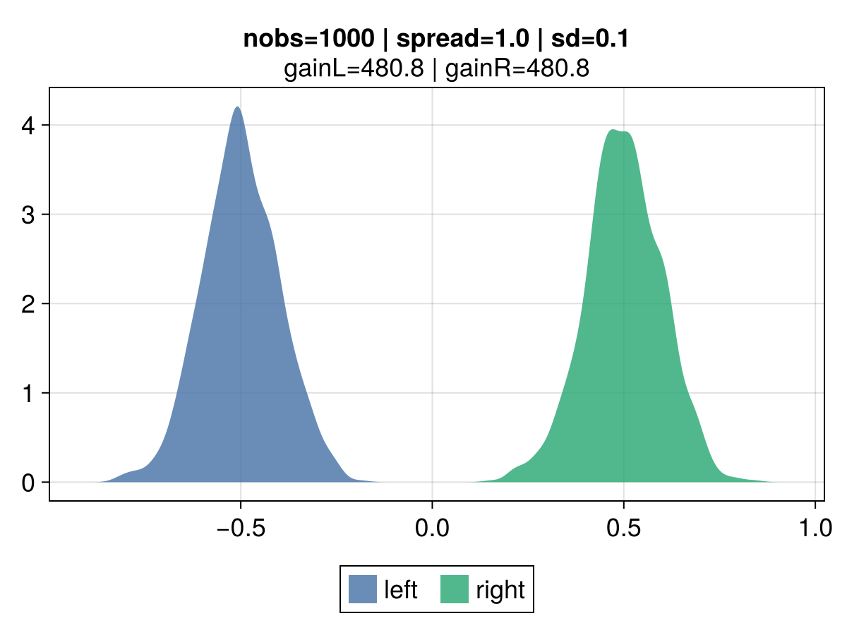
Loss Without Gradients - Credibility
The gain is derived as the credibility-adjusted leaf mean.
Credibility is inversely proportional to the volatility of the leaf’s observations.
Z = VHM / (VHM + EVPV)
Variance of the Hypothetical Means (VHM): if large differences between candidate means are expected, a greater credibility is assigned.
Expected Value of the Process Variance (EVPV): if the data generation process of a given candidate has high volatility, a lower credibility is assigned.

Slide 14
Performance Benchmarks
MSE metrics on regression problems
model | mse | mae | cred_var | cred_std
boston | 6.3 | 5.71 | 5.95 | 5.43
year | 74.9 | 74.3 | 74.6 | 74.2
msrank | 0.55 | 0.549 | 0.551 | 0.549
yahoo | 0.565 | 0.567 | 0.589 | 0.568

Slide 15
Roadmap
GPU improvement
SciML’s small grant to bring GPU at XGBoost level (USD 1,500)
https://github.com/Evovest/EvoTrees.jl/issues/288
Multi-target support
Tree structure where leaves generate a vector of predictions, one for each of the multiple target variables
EvoTrees.fit(
config,
dtrain;
target_name = [y1, y2, y3],
kwargs…
)

Slide 16
Roadmap
Autodiff: Support user defined loss
function my_mse(p, y)
return (x - y)^2
end
function _mse_grad(p, dp, y)
autodiff(Reverse, my_mse, Active, Duplicated(p, dp), Const(y))
return nothing
end
autodiff(Forward, _mse_grad,
Duplicated(p, vp),
Duplicated(dp, hess),
Const(y),
)
Fairly easy for single parameters loss, but trivial to manually implement
Complication arises for complex loss like penalized
Consider 1st-order heirsitics for training (similar to MAE loss)

Slide 17
Questions?

