Slide 1
Project Roadmap
IRIS-HEP Fellowship • Floating point error estimation using Clad

Slide 2
Overview

Slide 3
A Simplified Overview
Jacobians generated from clad are used to generate an approximate upper bound to the errors
Total error may then be represented as
Scope for error correction methods
Error estimation
Precision tuning and SMT solvers etc.
However, linearization itself introduces linearization errors, making the final error term to look like this
Function to be analysed
An error approximation model
clad
In most cases, estimating the linearization error is not possible. The resulting error bounds are not rigorous
For now, let’s assume taylor approximation
Assuming the function can be decomposed into k computational steps of basic binary and unary operations
May warrant use of Interval Arithmetic
or other rigorous estimation methods
Then the error in the function can be represented by
Reference: https://link.springer.com/referenceworkentry/10.1007%2F978-0-387-74759-0_26#Equ9_26

Slide 4


In a gist
Absolute error may be represented as,
Due to linearization, a more rigorous bound will be
This we know already as it is machine dependent
A bit hard to estimate
We can get this via the reverse mode in clad

Slide 5
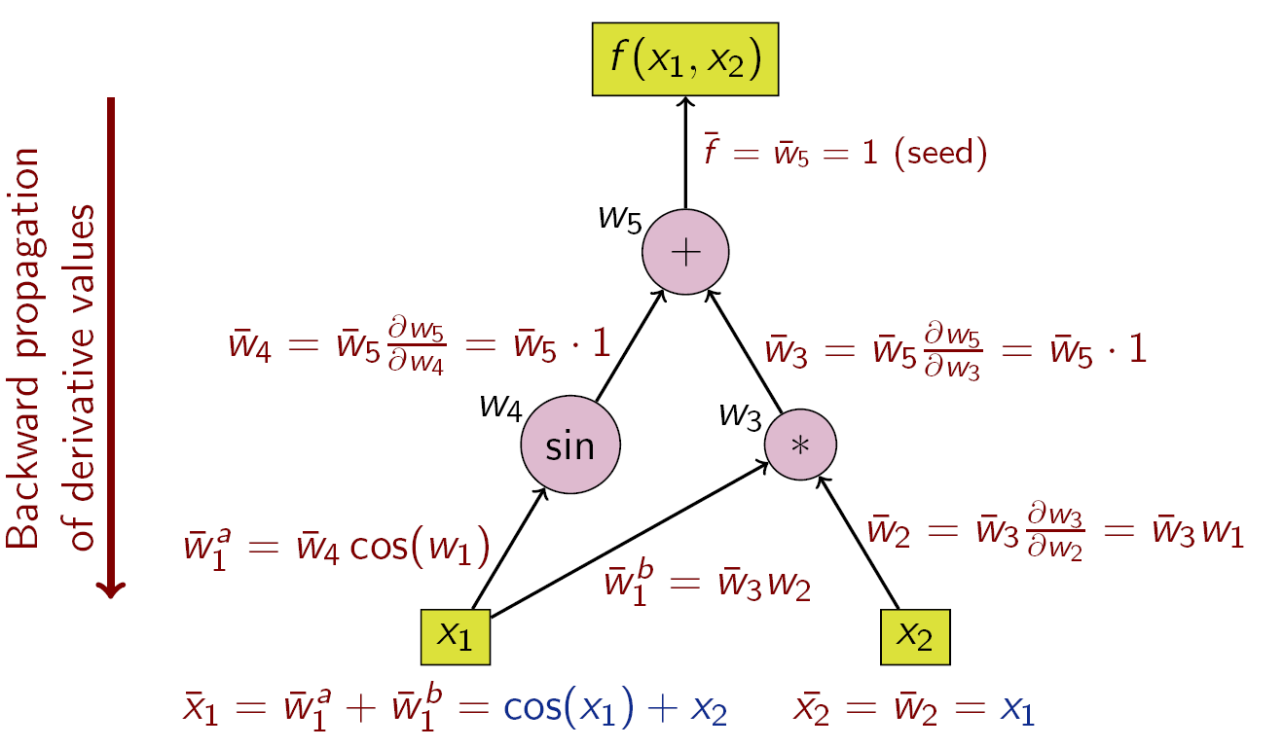
Adjoint AD and Clad
The given computational graph represents the flow of adjoint AD method, which is implemented similarly in Clad.
At each point of derivative calculation, we can calculate the error of the subexpression. For example, at edge W₄ → W₅, we want to calculate the error of the subexpression W₄ (say δ₄) which approximately equals |W₄| . |ε_{M}|
At last, we want to realise the equations given in the slides before to get the final error term
Image credit: https://en.wikipedia.org/wiki/Automatic_differentiation

Slide 6
Adjoint AD and Clad
A way of achieving this might be creating a one on one mapping of the AD Wengert’s list to the value of the expression at runtime.
Or as the list already stores the expression at W_{i} , we might take a running sum and evaluate the list.
Image credit: https://en.wikipedia.org/wiki/Automatic_differentiation

Slide 7
Towards better error computation
A very obvious flaw of the elementary approach might be the effect of linearization errors on the final error term.
This problem is somewhat mitigated in the methods of error estimation discussed hereafter.
Existing Software that use this method (in conjunction with others)
ADAPT: Algorithmic Differentiation for Floating-Point Precision Tuning
Towards automatic significance analysis for approximate computing

Slide 8
Interval estimates
Substitute each basic operation with an operation which takes in an interval [x^{l},x^{u}], and produces the narrowest possible interval that contains the result of the corresponding interval operation with the same arguments.
As an example,
float sine(float x, int n){ float denom, sinx, x1 = x; for(int i = 1; i<=n; i++){ denom = 4 * i * i + 2 * i; x1 = -x1 * n * n / denom; sinx = sinx + x1; } return sinx; }

Slide 9
Interval estimates
template<float RL, float RU> float sine_w_err(inv_float x, int n){ inv_float denom, sinx, x1(x); for(int i = 1; i<=n; i++){ int _i0 = 2 * i + 4 * i * i; // implicit cast to denom, default error value assigned to // denom.rl, denom.ru denom = _i0; int _i1 = n * n; // following the IA operation rule, // S = {x1.rl * _i1.r1, x1.r1 * _i1.ru, x1.ru * _i1.r1, x1.ru * _i1.rl} // _i2.range := {min(S), max(S)} inv_float _i2 = -x1 * _i1 // Similar to above, except here this operation is seen as // _i2.range * 1/denom.range // And implicitly, // denom.range := {1/denom.ru, 1/denom.rl} // then calculation similar to the above are performed inv_float _i3 = _i2 / denom;
// x1.range := _i2.range on reassignment x1 = _i2; // For addition, // _i4.range := {sinx.ru + x1.ru, sinx.rl + x1.rl} inv_float _i4 = sinx + x1 sinx = _i4; } // Assign return variable's error range RU = sinx.ru; RL = sinx.rl; // Return scalar value return sinx.val; }
Here, [RL, RU] becomes the interval ( say
) now contains both a
and

Slide 10

Computing A_{F}
In a similar manner, we can extend IA to calculate A_{F} as follows,
Where,
is summation in IA
is multiplication in IA
where pmin and nmax are the minimum positive floating-point number and the maximum negative floating-point number.

Slide 11
Interval computability and hurdles
A major problem with IA based estimation methods is that the interval becomes larger as the computational steps grow, giving a large output interval and an overestimation of errors.
Difficulty in control flow and evaluation of relation statements also arise. For example, consider the condition a < [x] where [x] refers to the interval of x and a ∈ [x], the result of the comparison becomes ambiguous. Same is the case with comparing two overlapping intervals
For a division operation involving [x]where 0 ∈ [x], there are chances of a division by zero error in which case, the analysis may have to be terminated
To combat the last two issues, one may want to look into interval splitting as described here: https://www.math.kit.edu/ianm2/~kulisch/media/arjpkx.pdf
References: Vassiliadis, V., Riehme, J., Deussen, J., Parasyris, K., Antonopoulos, C. D., Bellas, N., … Naumann, U. (2016). Towards automatic significance analysis for approximate computing; KUBOTA, Koichi & Iri, Masao. (1988). Fast Automatic Differentiation and Interval Estimates of rounding errors. Inf. Process. 14.

Slide 12
Other interesting methods
SMT solvers
Continuing the spirit of IA arithmetic, another interesting topic might be reasoning about an algorithms’ accuracy.
Satisfiability Modulo Theories (SMT) solvers essentially solve a set of constraints using symbolic execution. This constraint solving makes SMT solvers a great tool to judge programs’ accuracy and robustness and essentially prove that they work. A lot of work has been done to model Floating-Point Arithmetic (FPA) as a set of decision procedures that can then be verified by SMT solvers.
SMT theory of Floating Point Arithmetic (FPA) comes in great help to emulate floating-point numbers as real numbers with infinite precision and generate code to reason these float numbers. Most SMT solvers use a bit-blasting technique wherein floating-point theory is reduced to bit-vectors, and the corresponding operations are modeled as circuits. Some famous SMT solvers that support FPA are Z3 and MathSAT.

Slide 13
SMT Solvers and Integration
Integration of an SMT solver with Clad will roughly require the following steps:
Code Annotation
In house code annotation will enable us to use existing SMT solvers. Generating code may also enable us to make use of libraries like symFPU on any other FPA supporting SMT solver directly as backend. These annotations maybe done by hand by the user, automatically or a mix of both.
Setting preconditions and other dynamic parameters
Interfacing an SMT solver with the application we create will require setting of parameters that will define the behavior of the FPA verification. This is the fairly trivial part to implement.

Slide 14
Further reading
Computer-assisted verification of four interval arithmetic operators; Daisuke Ishii, Tomohito Yabu
Verify IA libraries with code annotation + SMT backend
Have a GUI and support manual setting of preconditions/postconditions and splitting verification conditions
Paganelli, G., & Ahrendt, W. (2013). Verifying (In-)Stability in Floating-Point Programs by Increasing Precision, Using SMT Solving.
Checks if a calculation is stable by evaluating it at different precisions and checking if the resulting answers have a reasonable distance between them.
Negates a weak precondition and solves it on two different precisions
W. Kahan, “How futile are mindless assessments of roundoff in floating-point computation?” 2006
Just an interesting read!

Slide 15
Other interesting methods
Monte Carlo Arithmetic (MCA)
MCA’s error analysis is accomplished by repeatedly injecting small errors into an algorithm's data values and determining the relative effect on the results. These small errors are usually injected by random rounding and unrounding (random extension of precision) and serve as a purely unbiased method of fabricating random data.
A quick gist of how MCA works is as follows;
Float computation → injection of randomness → Monte Carlo computation
Round-off analysis → Statistical analysis

Slide 16
MCA Computation
To model errors on a Floating Point (FP) value x at virtual precision (random precision) t, Parker et al. propose the following function:
Where e_{x} is the exponent of x and 𝜉 refers to a uniformly distributed random variable in the range [-0.5, 0.5]. Each floating point operation x*y can then be transformed into an MCA FP operation by employing one of the following models.
Random Rounding: introduces errors in the result of the operation.
x*y → round(inexact(x*y))
Precision Bounding: introduces errors in the respective inputs of the operation.
x*y → round(inexact(x)*inexact(y))
Full MCA: introduces errors in the result and inputs of the operation.
x*y → round(inexact(inexact(x)*inexact(y)))
Reference: Scott Parker. Monte carlo arithmetic: exploiting randomness in floating-point arithmetic. Technical Report CSD-970002, UCLA Computer Science Dept., 1997.

Slide 17
MCA Computation
Parker et al. also show that the significant digits of a MCA result at virtual precision t is given by the magnitude of the relative standard deviation of a distribution which can be estimated by a large number of Monte Carlo trials,
Where 𝜎 represents the standard deviation, 𝜇 represents the means and β represents the base of the numbers.
These Monte Carlo trials can be easily parallelized and hence make this method a feasible way to obtain error estimates for a given function. Clad can also use the existing MCA library backends with modification to aid in the calculations as is done by Verificarlo
Reference: Scott Parker. Monte carlo arithmetic: exploiting randomness in floating-point arithmetic. Technical Report CSD-970002, UCLA Computer Science Dept., 1997.

Slide 18
Further Reading
Verificarlo | Verificarlo: checking floating point accuracy through Monte Carlo Arithmetic
Existing tool based on MCA to analyse and debug FPE
Talks about MCA and Discrete Stochastic Arithmetic
Interesting case studies and comparisons with DSA
Stott Parker, D., Pierce, B., & Eggert, P. R. (2000). Monte Carlo arithmetic: how to gamble with floating point and win
Interesting read on how MCA can help

Slide 19
Misc.

Slide 20
Goals
Cement my ideas and keep looking around for better ideas
As per the schedule, start working on the report on different error estimation methods
Familiarize myself with clad and all the clang functionalities it utilizes.

