Slide 1


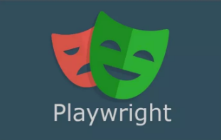
Playwright

Slide 2
Modules
Introduction to PlayWright
Installation of PlayWright
First Test in PlayWright
WebElement Interaction
VerifyText,Login,ViewPort
Record Script in PlayWright
Screenshots and videos in PlayWrigth
Reports in PlayWright

Slide 3
Introduction To Playwright
Playwright is a E2E open source testing and automation framework for modern web apps that allows you to do testing in any browser, device or platform using the language of your choice.
Playwright is an open source test automation library initially developed by Microsoft contributors.
It allows testing Chromium, Firefox and WebKit with a single API.
Playwright supports programming languages such as Java, Python, C# and Node JS with JavaScript.
Playwright It is built to enable cross-browser web automation that is reliable, fast and capable.

Slide 4
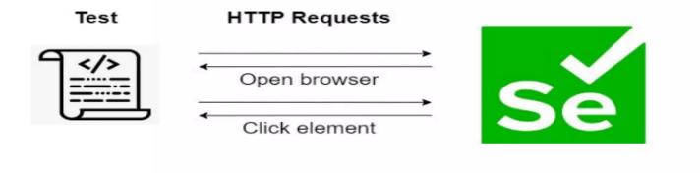
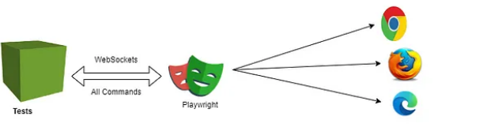
Playwright Architecture

Slide 5
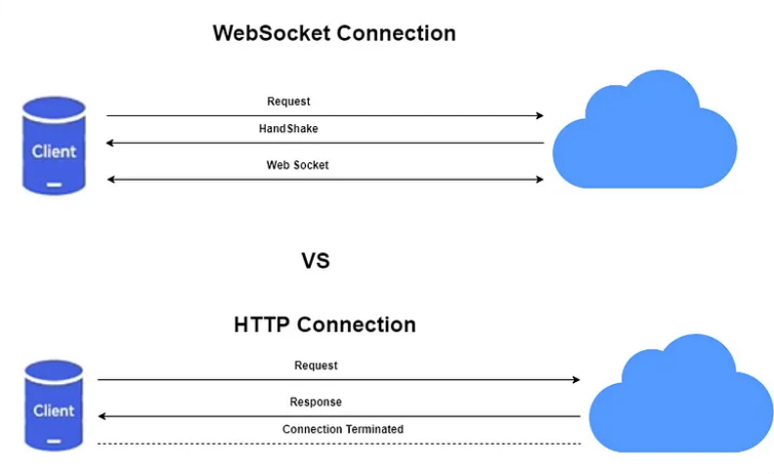
Playwright Architecture
Selenium sends each command as a separate HTTP request and receives JSON responses.
So, every action, such as opening the browser, clicking an element, or sending keys in a text box, is sent as a separate HTTP request.
Additionally, after completion of every request, the connection between server and client will be terminated, which needed to be re-established for the next request.
Connection termination after every request result in slower execution which introduces a layer of flakiness.
Playwright, on the other hand, communicates all requests through a single Web socket connection, which stays in place until test execution is completed.
This reduces the points of failure and allows commands to be sent quickly on a single connection.

Slide 6
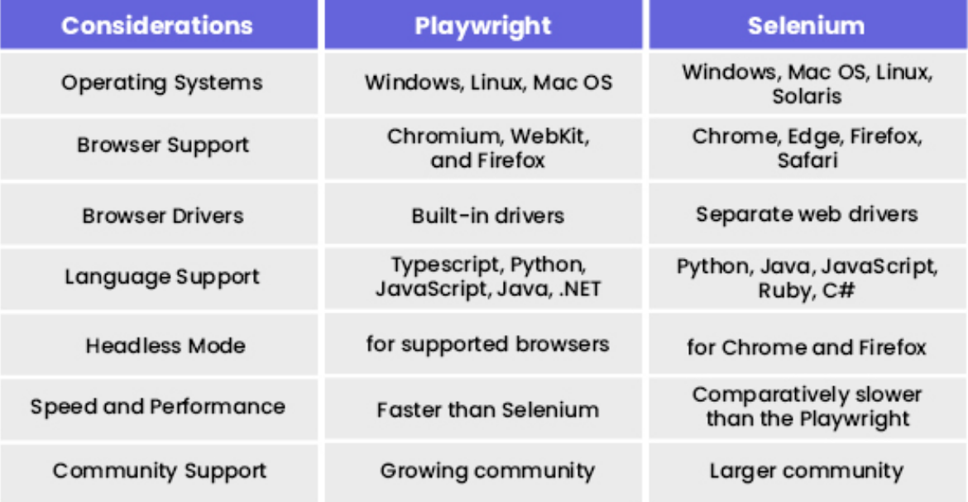
Playwright Vs Selenium

Slide 7
Playwright Vs Selenium Which to Choose
Both Playwright and Selenium have advantages and limitations, which means choosing between them is subjective to the scenario they will be used for.
Playwright offers fast testing in complex web applications with headless architecture and requires NodeJS as a prerequisite, it is relatively new.
It lacks support on various levels, such as community, browsers, real devices, language options, and integrations.
Selenium has all of this to offer
Each supports CI/CD for a software project with due accuracy.
Playwright has the upper hand in complex web applications, but has limited coverage.
On the contrary, Selenium offers comprehensive coverage, scalability, flexibility, and strong community support.
It depends on the project requirements and the priorities to choose one among these two testing frameworks.
When the architecture is very complex with limited coverage, then Playwright is the option to select for testing.
In a scenario that requires wider coverage, Selenium is the best.

Slide 8
Key Features of the playwright Framework
Support for cross-browser platforms built on Chromium, WebKit, and Firefox - which includes Chrome, Edge, Firefox, Opera, and Safari.
Auto-wait built-in, smart assertions that retry until the element is found, and test data tracing - keep track of logs, videos and screenshots easily.
Support for cross-language, including JavaScript, TypeScript, Python, Java, and .NET- write tests in the environment that suits you while still covering all areas and formats.
Support for cross-platform execution on Windows, Linux, and macOS.
Built with modern architecture and no restrictions - interact with multi-page, multi-tab websites like a real user, and tackle frames and browser events with ease.

Slide 9
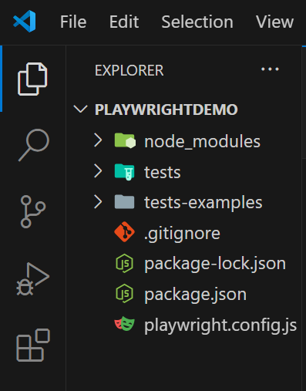
Playwright Installation and Its Project Structure
Here are the prerequisites to install Playwright:
NodeJS
VS Code Editor
Steps to install the Playwright:
After the prerequisites, Create a folder with "Playwright_Demo" as folder name.
Launch VS Code Editor and Open the "Playwright_Demo" Folder.
Open your terminal and Run this command:
npm init playwright@latest.
Playwright will download the browsers needed as well as create the following files i.e. playwright.config.ts, package. json and package-lock.json.

Slide 10
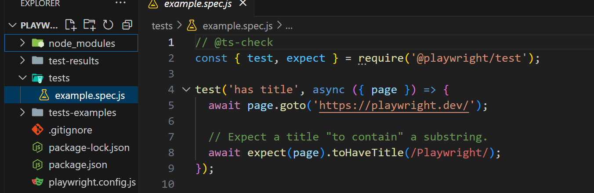
First Test Case In Playwright

Slide 11
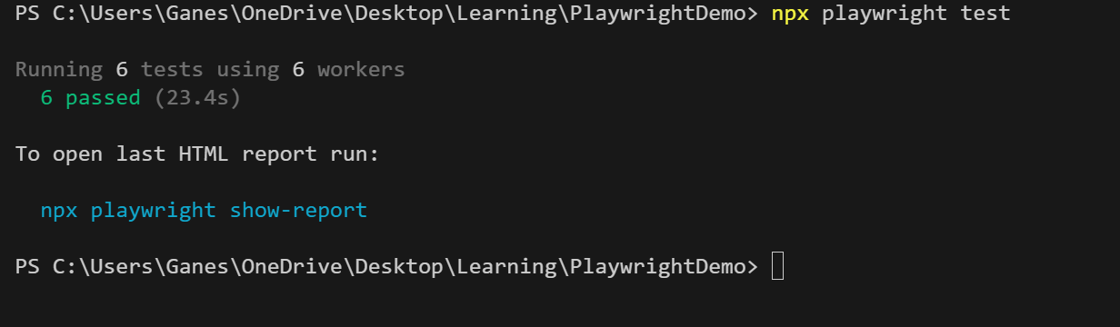
Test Execution In Playwright
Run this command to run your tests:
npx playwright test
This command will run your tests in headless mode for all three browsers i.e. Chromium, Firefox and WebKit.ast read
To see the report, One can run this command that will open report in your browser.
npx playwright show-report

Slide 12
Playwright Locators
Locators are the central piece of Playwright's auto-waiting and retry-ability. In a nutshell, locators represent a way to find element(s) on the page at any moment.
These are the recommended built-in locators.
page.getByRole() :to locate by explicit and implicit accessibility attributes.
page.getByText() :to locate by text content.
page.getByLabel(): to locate a form control by associated label's text.
page.getByPlaceholder() :to locate an input by placeholder.
page.getByAltText(): to locate an element, usually image, by its text alternative.
page.getByTitle() :to locate an element by its title attribute.
page.getByTestId() :to locate an element based on its data-testid attribute (other attributes can be configured).

Slide 13
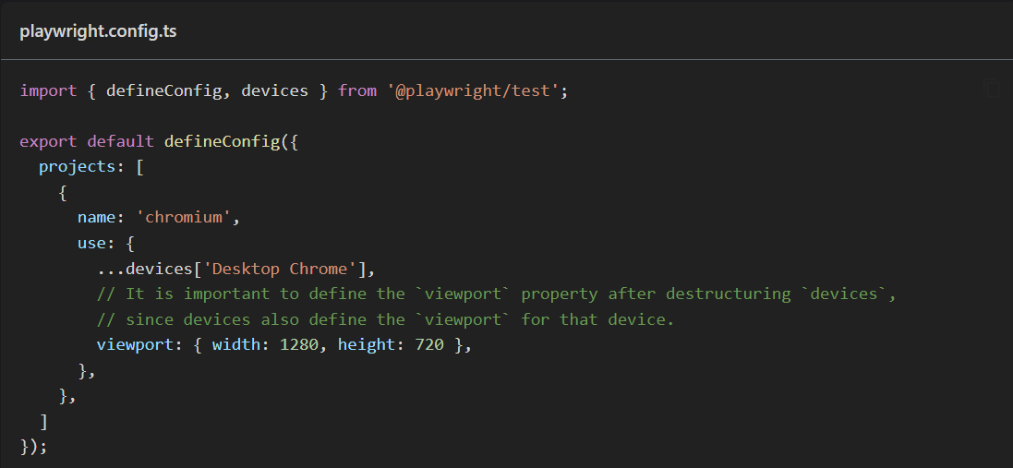
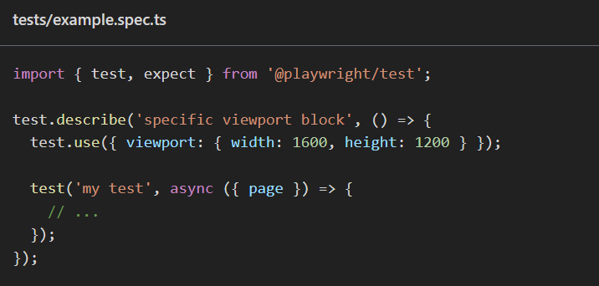
Viewport In Playwright
In Playwright, a "viewport" refers to the visible area of a web page that is rendered in the browser.
It's essentially the size of the browser window when it displays the webpage.
Setting the viewport size allows you to simulate how a webpage will look on different devices and screen resolutions.
You can configure the viewport size when launching a browser instance or when creating a page.

Slide 14
Record Script In Playwright
The Playwright Code Generator is a tool that helps you create automated tests for web applications by recording your interactions in a browser.
As you perform actions (like clicking buttons, filling forms, etc.), the code generator generates corresponding Playwright script code in real-time.
This feature simplifies the process of writing tests by providing a visual way to create scripts.
In Playwright, you can record scripts using the Playwright CLI tool or the Playwright code generator.
Here’s how to do it:
Using the Playwright Code Generator
Run the Code Generator: You can start the Playwright code generator by running:
npx playwright codegen <URL>
Replace <URL> with the website you want to test.
For example:
npx playwright codegen https://example.com

Slide 15
Screenshot In Playwright
Capturing screenshots in Playwright is straightforward and can be done using the screenshot() method.
Here’s how you can take screenshots of a webpage or specific elements.
Full page screenshot is a screenshot of a full scrollable page, as if you had a very tall screen and the page could fit it entirely.
await page.screenshot({ path: 'screenshot.png', fullPage: true });
Element screenshot
Sometimes it is useful to take a screenshot of a single element.
await page.locator('.header').screenshot({ path: 'screenshot.png' });

Slide 16
Videos In Playwright
Record video
Playwright Test can record videos for your tests, controlled by the video option in your Playwright config. By default videos are off.
'off' - Do not record video.
'on' - Record video for each test.
'retain-on-failure' - Record video for each test, but remove all videos from successful test runs.
'on-first-retry' - Record video only when retrying a test for the first time.
Video files will appear in the test output directory, typically test-results.
Videos are saved upon browser context closure at the end of a test.
If you create a browser context manually, make sure to await browserContext.close().

Slide 17
Dropdown In Playwright
Handling dropdowns in Playwright can be done in several ways, depending on whether you're working with <select> elements or custom dropdown implementations.
For standard <select> elements, use the selectOption method.
For custom dropdowns, simulate clicks to open and select options.
Selects one or multiple options in the <select> element with locator.selectOption().
You can specify option value, or label to select. Multiple options can be selected.
// Single selection matching the value or label
await page.getByLabel('Choose a color').selectOption('blue');
// Single selection matching the label
await page.getByLabel('Choose a color').selectOption({ label: 'Blue' });
// Multiple selected items
await page.getByLabel('Choose multiple colors').selectOption(['red', 'green', 'blue']);

Slide 18
Reports In Playwright
Playwright Test comes with a few built-in reporters for different needs and ability to provide custom reporters.
The easiest way to try out built-in reporters is to pass --reporter command line option.
npx playwright test --reporter=line
Built-in reporters
List reporter
Line reporter
Dot reporter
HTML reporter
JSON reporter

