Slide 1
RESUMEIQ
ResumeIQ
An AI-Powered Resume Analyzer built on explainable, rule-based NLP
Capstone Project | Aditya Parthasarathy | SkillOrbit AI Capstone Project

Slide 2
THE PROBLEM
Resumes get filtered before a human ever reads them
No visibility into ATS filtering
1
Job seekers can't tell whether their resume will even reach a recruiter's screen.
Vague feedback
2
Generic reviewers say "make it stronger" without saying which bullet, or why.
Black-box AI tools
3
LLM-based reviewers can't explain their scoring, making the feedback hard to trust or act on.
02

Slide 3
OBJECTIVES
Five required capabilities, one dashboard
1
2
3
4
5
Upload & Parse
Score /100
ATS Keyword Check
Smart Feedback
Dashboard
PDF/DOCX text extraction
Structure, skills, education, projects, contact, completeness
Role-specific gap analysis
Human-readable suggestions
One page, everything visible
03

Slide 4
SYSTEM DESIGN
Request flow: thin routes, testable services
Upload
Form
→
parser.py
extract text
→
scorer.py
ats_matcher.py
impact_score.py
→
feedback.py
synthesize
→
Dashboard
(cached)
Every scoring algorithm lives in a framework-free service module (app/services/) so it can be unit-tested without a running Flask app or browser. Routes only validate input, call services, and render.
04

Slide 5
TECH STACK
Classic NLP, not deep learning
Backend
NLP
Fuzzy Matching
Database
Flask (app factory)
spaCy (en_core_web_sm) + regex
rapidfuzz
SQLite + Flask-SQLAlchemy
Frontend
Testing
Deployment
No LLM calls, no embeddings, no deep learning
Jinja2 + Tailwind + Chart.js
pytest -- 119 tests
Render (gunicorn)
Every score traces to an explicit rule
05

Slide 6
CORE FEATURE
Resume Score Analyzer -- six weighted categories
✓
Sections detected via short, keyword-matching header lines
✓
Avoids false positives from a bullet that just mentions "skills"
✓
Education gets a bonus for a detected degree or graduation year
✓
Structure rewards bullet usage + resume length in a healthy range
06

Slide 7
CORE FEATURE
ATS Keyword Checker -- role-aware gap analysis
Web Developer -- Must-Have
Weighted score formula
✓ JavaScript
70% x must-have match rate + 30% x nice-to-have match rate
✓ Git
✓ REST API (synonym)
Word-boundary regex matching -- "SQL" must not match inside "MySQL".
✗ HTML
✗ CSS
Same resume scores 28/100 as "AI Engineer" but 42/100 as "Cloud Engineer" -- proof it's actually role-sensitive, not just a generic tech-word counter.
✗ Responsive Design
ATS Score: 42 / 100
07

Slide 8
DIFFERENTIATOR A
Impact Score -- bullet-level NLP analysis
Verb Strength
spaCy lemma vs. curated strong/weak lexicon, with a suffix-normalization fallback for mis-tagged fragments
40 pts
Quantification
Regex for %, $, multipliers, or a number next to a metric word ("4 engineers")
40 pts
Passive Voice
spaCy dependency parse -- checks for nsubjpass / auxpass labels
20 pts
"Led a team of 4 engineers to redesign the checkout flow, increasing conversion by 18%"
strong verb ✓ metric
08

Slide 9
DIFFERENTIATOR B
Fuzzy & synonym-aware ATS matching
Exact match → synonym map → rapidfuzz typo match
JS
ML
K8s
dockr
↓
↓
↓
↓
JavaScript
Machine Learning
Kubernetes
Docker
synonym
synonym
synonym
fuzzy (typo)
Calibrated empirically, not guessed
rapidfuzz scores "python" vs. "cython" and "python" vs. "pyhton" (a real typo) identically at 83.3. A looser threshold would credit a resume that only mentions Cython with knowing Python -- so the threshold (90) and a token-length filter were chosen specifically to avoid that false positive, at the cost of some short-word typo recall.
09

Slide 10
RESULTS
One dashboard: score, ATS, impact, feedback
89
42
78
Smart Feedback (sample)
HIGH
Resume Score
ATS Score
Impact Score
Add missing must-have keywords: HTML, CSS, Responsive Design
HIGH
2 bullets use weak phrasing -- replace with strong verbs
MEDIUM
2 of 7 bullets have no quantified metric
10

Slide 11
QUALITY ASSURANCE
119 tests -- plus bugs only manual testing caught
Passing tests alone weren't trusted. Every feature was exercised live, which surfaced real issues:
✗
spaCy mis-tags "Optimized" as an adjective in a subject-less bullet, missing the verb lexicon
→ Suffix-normalization fallback + regression test
✗
"Was responsible for X" not flagged weak -- phrase check only matched the literal start
→ Strip leading was/were/is/are before the check
✗
Chart.js "latest" CDN link served an ES-module build that throws in a <script> tag
→ Fetched & read the file directly; pinned the UMD build
✗
A corrupt PDF/DOCX crashed the request and orphaned the file on disk
→ try/except at the parser boundary → friendly error + cleanup
11

Slide 12
DEFENSIBILITY
Known limitations -- documented, not hidden
!
Passive-voice detection only catches "was/were + past participle" -- reduced passives ("Errors reduced by 30%") go undetected
!
Fuzzy-match threshold trades some short-word typo recall for precision (avoids crediting Cython as Python)
!
Bullet extraction is marker-based (-, *, -); a resume with no bullet markers yields no impact score
!
No persistent disk on Render's free tier -- uploads reset on redeploy / spin-down
Deployment: Render (Blueprint) → GitHub auto-deploy → gunicorn
Every push to main redeploys automatically; spaCy model downloaded during the build step.
12

Slide 13
DIFFERENTIATOR C
Same resume, every role compared
The ATS matcher is regex/fuzzy comparison, not a spaCy call -- cheap enough to run against all 8 role banks on every view.
Data Analyst
35/100
best fit
Web Developer
15/100
AI Engineer
14/100
target role
Backend Developer
14/100
Cloud Engineer
0/100
Mobile App Developer
0/100
This resume actually matches Data Analyst keywords better (35/100) than AI Engineer (14/100) -- an honest cross-role check a single-role ATS score can't give you.
13

Slide 14
DIFFERENTIATOR D
A percentile that says what it is
It would have been easy to phrase this against “other ResumeIQ users.” That data doesn't exist -- so the percentile instead comes from a documented normal-distribution model of typical early-career resumes, evaluated with the standard normal CDF, and the UI says exactly that.
~86th
percentile shown per score
“Read it as vs. a typical early-career resume, not vs. everyone who's used this tool.” -- the FAQ answers this question directly, in these words, for anyone who asks.
14

Slide 15
DIFFERENTIATOR E
A real PDF, not a browser printout
What's in it
Score summary, the breakdown table, ATS keyword results, the role-fit table, the impact table, and the feedback list
6 sections
Why reportlab
Pure-Python wheels -- deploys on Render's plain “pip install” build step; weasyprint/wkhtmltopdf both need native libraries that step can't install
no apt-get
Built independently
Its own layout in code, not a conversion of the Tailwind dashboard -- reliable across every browser and OS, not just the one that rendered a print preview
server-side
The old “Print / Save as PDF” button stays too -- for a literal copy of the on-screen page, next to the new formatted download.
15

Slide 16
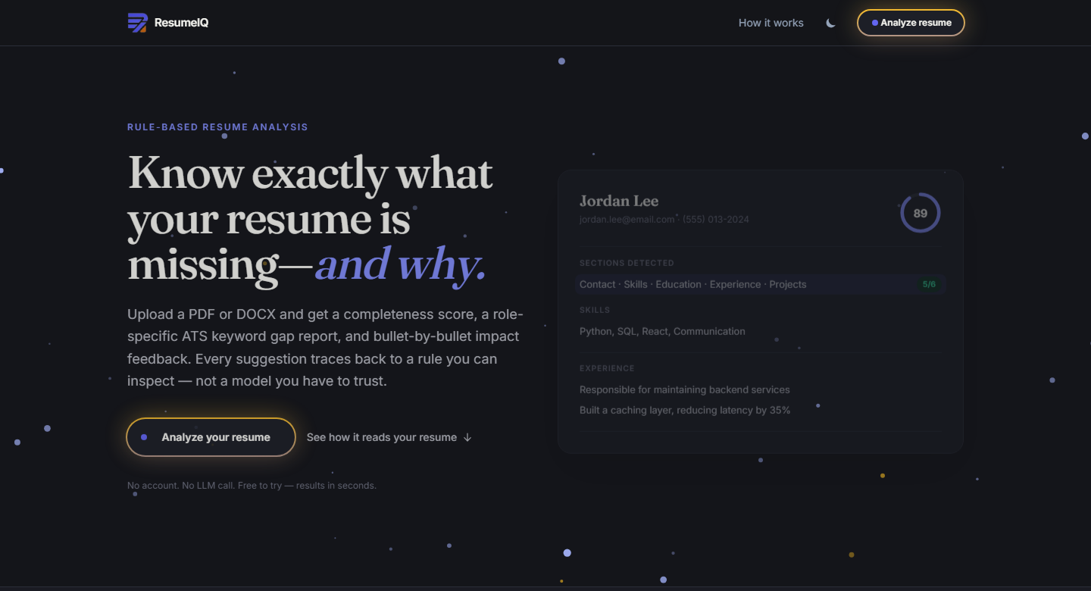
WHAT ELSE CHANGED
A visual system, not just new features
Shared button system
One neon indigo/amber component used everywhere, replacing three separate ad hoc button styles.
Particle background
A canvas-based particle field behind every page, not just the landing hero.
Accessible role picker
Full keyboard support -- arrows, Home/End, Enter, Escape, typeahead -- via aria-activedescendant, plus a no-JS fallback.
16

Slide 17
Thank you
Know exactly what your resume is missing.
Live app
resumeiq-s3xc.onrender.com
Repository
github.com/AdityaParthasarathy/resumeiq
Questions?

