Slide 1

Sales Forecast
DS 636
Aditya Patel - ap2935@njit.edu

Slide 2
About Data

Slide 3
Sales Daily historical data 01/2013 - 10/ 2015.
The dataset consist of 6 tables. Where 4 tables of imporatnce are as follows.
Sales table having data about of count of product sold, item sold, and location of sale.
Items table, contatining category of items , item name and , item id.
Shops table, contating omformation about shop name and shop id
Test table , mentioning the paremeter to make sales forecast.
The item price is not fixed, hence the sales is not only dependant on Item counts but also on item price.

Slide 4
Exploratory data analysis

Slide 5
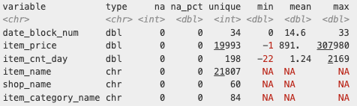
The images define the different data types and provide a quantitative summary for each.

Slide 6
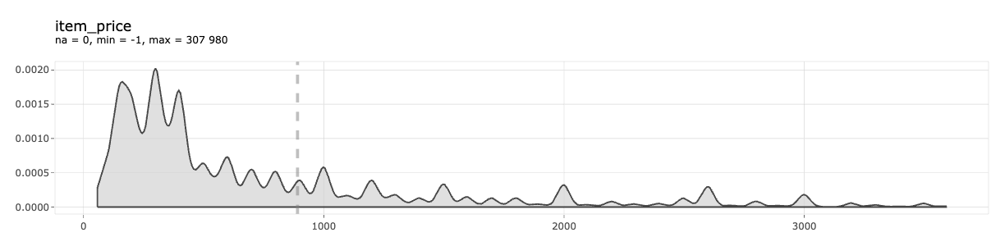
The mean of 891 and the maximum value of 307980 suggest the presence of products with high value, possibly luxury products. The graph is right-skewed, indicating the presence of outliers in item prices.

Slide 7
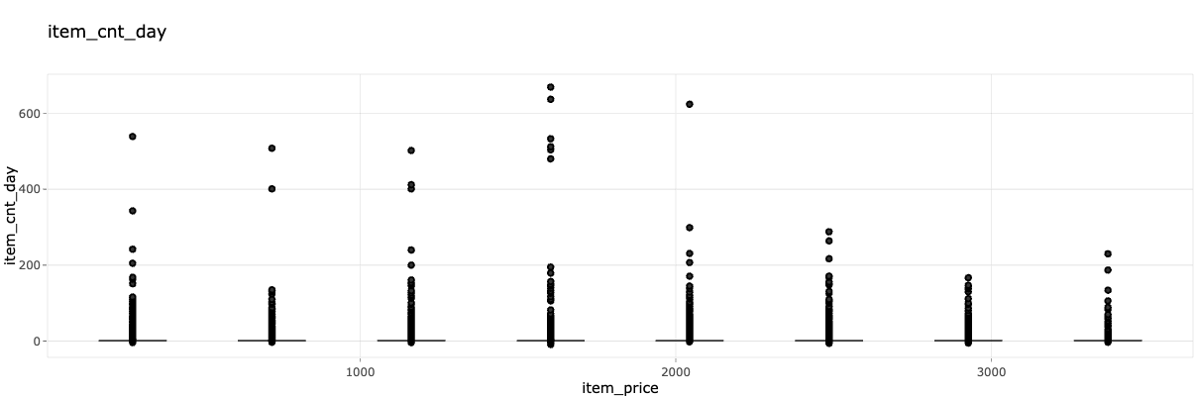
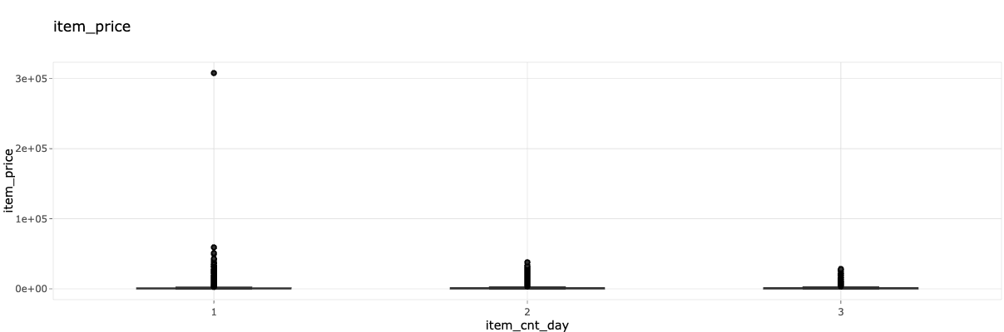

Slide 8
DATA Cleaning
We remove outliers, such as luxury products and products with low sales counts, as they do not contribute significantly to overall sales. We then group the data by item ID and identify outliers for each item ID using the quartile function, subsequently removing them.

Slide 9
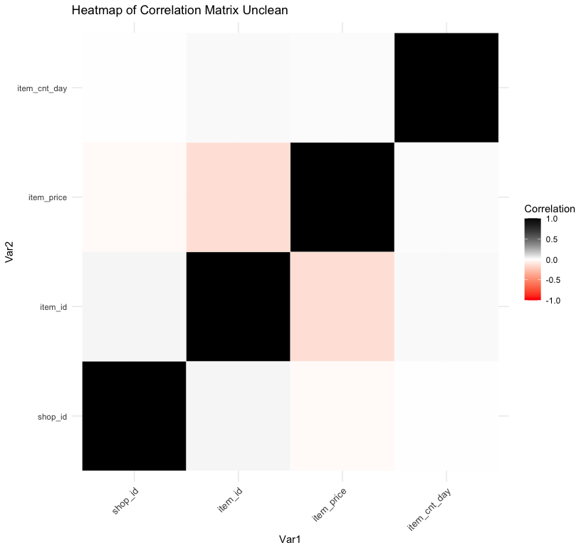
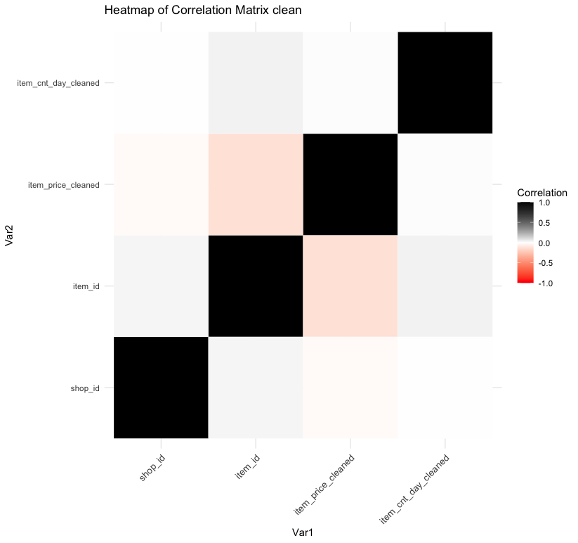

Slide 10
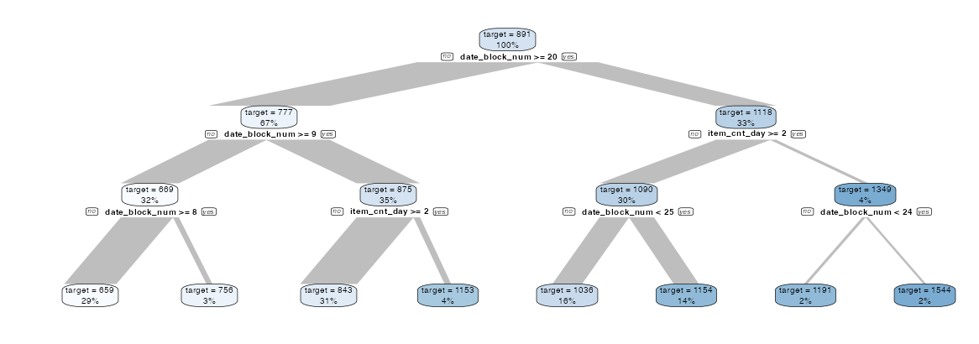
Problems in data

Slide 11
Limited Features, the only feature we have is item name , shop name, and count and price. where the item name , shop name are categorical data.
Count alone and price alone cannot be useful for prediction as there might be item with low count but that may be due to reason that it is luxurt product or it might be an unsought products like smoke alarm, fire detector , you dont buy it very month !
After the removal of outliers, no significant changes were observed in the data.
There is very little correlation observed among the different features of the dataset.

Slide 12
Machine learning Model

Slide 13
A classification task cannot be perfomed the set of data , due to infinite possible nodes , which will not converge to conclusive data.
The regrssion task with low number of feature will be best suited to linear regresion to avoid overfitiing.

Slide 14
Multivariate Linear Regression Model

Slide 15
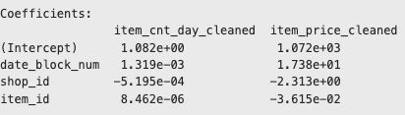
We trained the model using cleaned data, which had no outliers according to the Interquartile Range (IQR) rule. All available features were utilized to predict both item_cnt_day and item_price.
Training RMSE for item_cnt_day: 1.5
Test RMSE for item_price: 1687.9
Training RMSE for item_price: 1685.2
Test RMSE for item_cnt_day: 1.3

Slide 16
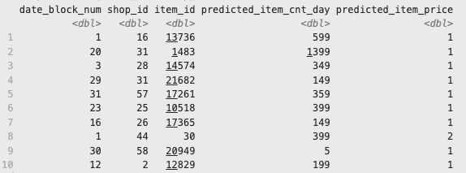
Predicted data using the test dataset

Slide 17
Arima Model

Slide 18
To perform ARIMA, we initially calculate sales by multiplying item_count with item_price. Next, we group the data by date, shop ID, and item ID, aggregating the sales on a daily basis, sorted in ascending order. Finally, we drop all other columns and convert the sales into time series data.

Slide 19
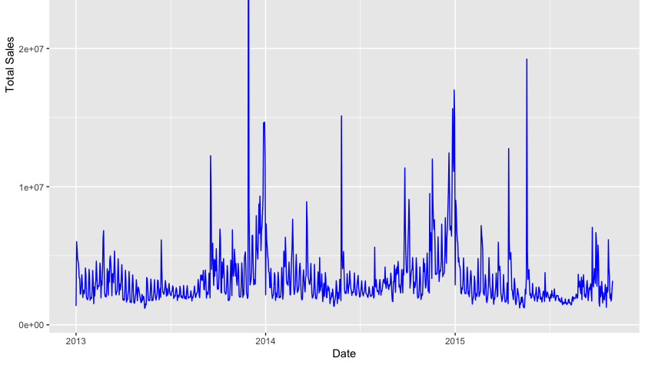

Slide 20
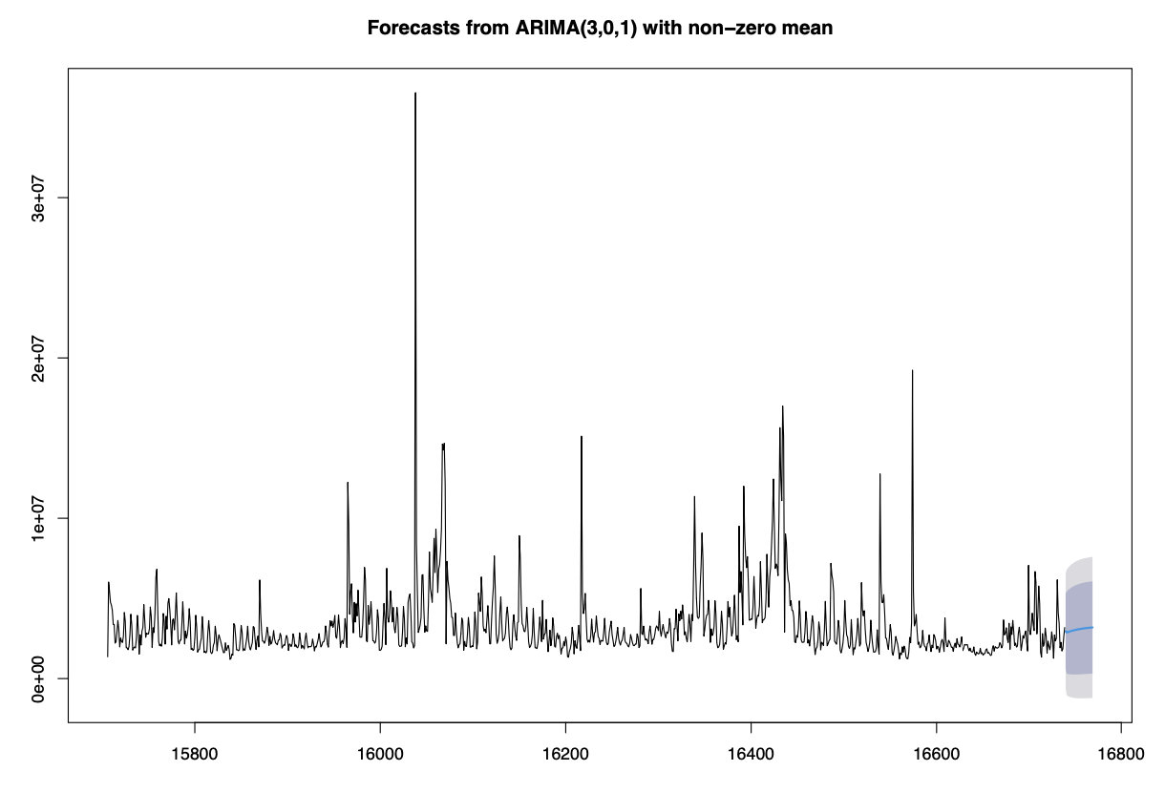
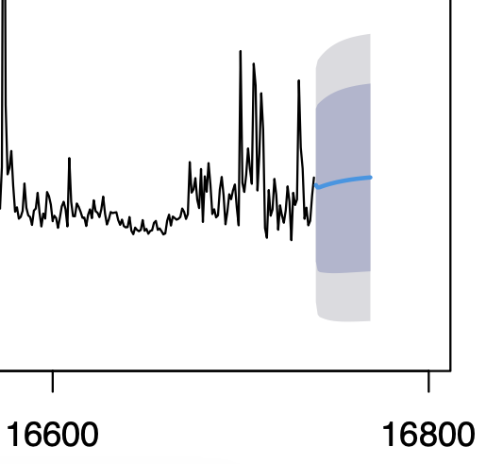

Slide 21
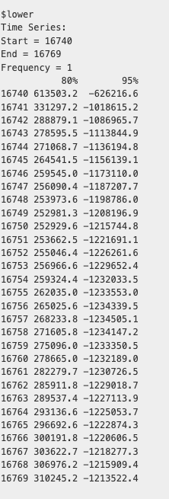
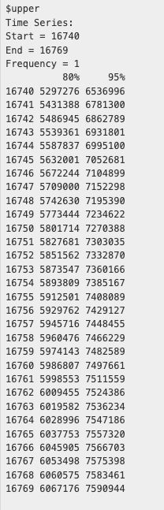
Mean Sales
2955390
2881342
2887912
2908978
2929453
2948271
2965895
2982545
2998302
3013212
3027322
3040672
3053304
3065257
3076566
3087268
3097394
3106975
3116041
3124619
3132736
3140416
3147684
3154560
3161066
3167223
3173048
3178560
3183776
3188711

Slide 22
Conclusion
At the end, we can conclude that if additional numeric features were present in the data, machine learning could have been performed with better performance and lower loss. While the ARIMA model provided a rough estimation of sales, incorporating additional numeric features could have enhanced its accuracy. This improvement could have led to more optimized business decisions and improved sales forecasting on a per-shop or per-item basis.

