Slide 1


Product Review and Visual Categorization using Deep
Government College of Engineering & Research Avasari Khurd, Savitribai Phule Pune University
Final Year Project, 2024-25 Semester I
Computer Engineering Department
Guide: K.B. Sadafale
Members :
21121036 Aditya Pawar
21121007 Atmaram Kambli
21121004 Swastik Gupta
22221078 Atharva Pawar

Slide 2
Problem Statement and Motivation
Online platforms have transformed the way consumers make purchasing decisions, with product reviews and accompanying images becoming crucial sources of information. Extracting valuable insights from these vast amounts of data presents a significant challenge. Traditional methods for sentiment analysis and image categorization have limitations in handling complex linguistic patterns and visual features.
The increasing availability of large-scale datasets and advancements in deep learning have opened new avenues for addressing these challenges. By combining natural language processing and computer vision techniques, we can develop sophisticated models capable of understanding the nuances of human language and interpreting visual content.
This research is motivated by the need for a comprehensive approach to analyze product reviews and images. By accurately determining sentiment and categorizing visual content, businesses can gain a deeper understanding of customer preferences, identify product strengths and weaknesses, and make data-driven decisions to improve product offerings and marketing strategies.

Slide 3
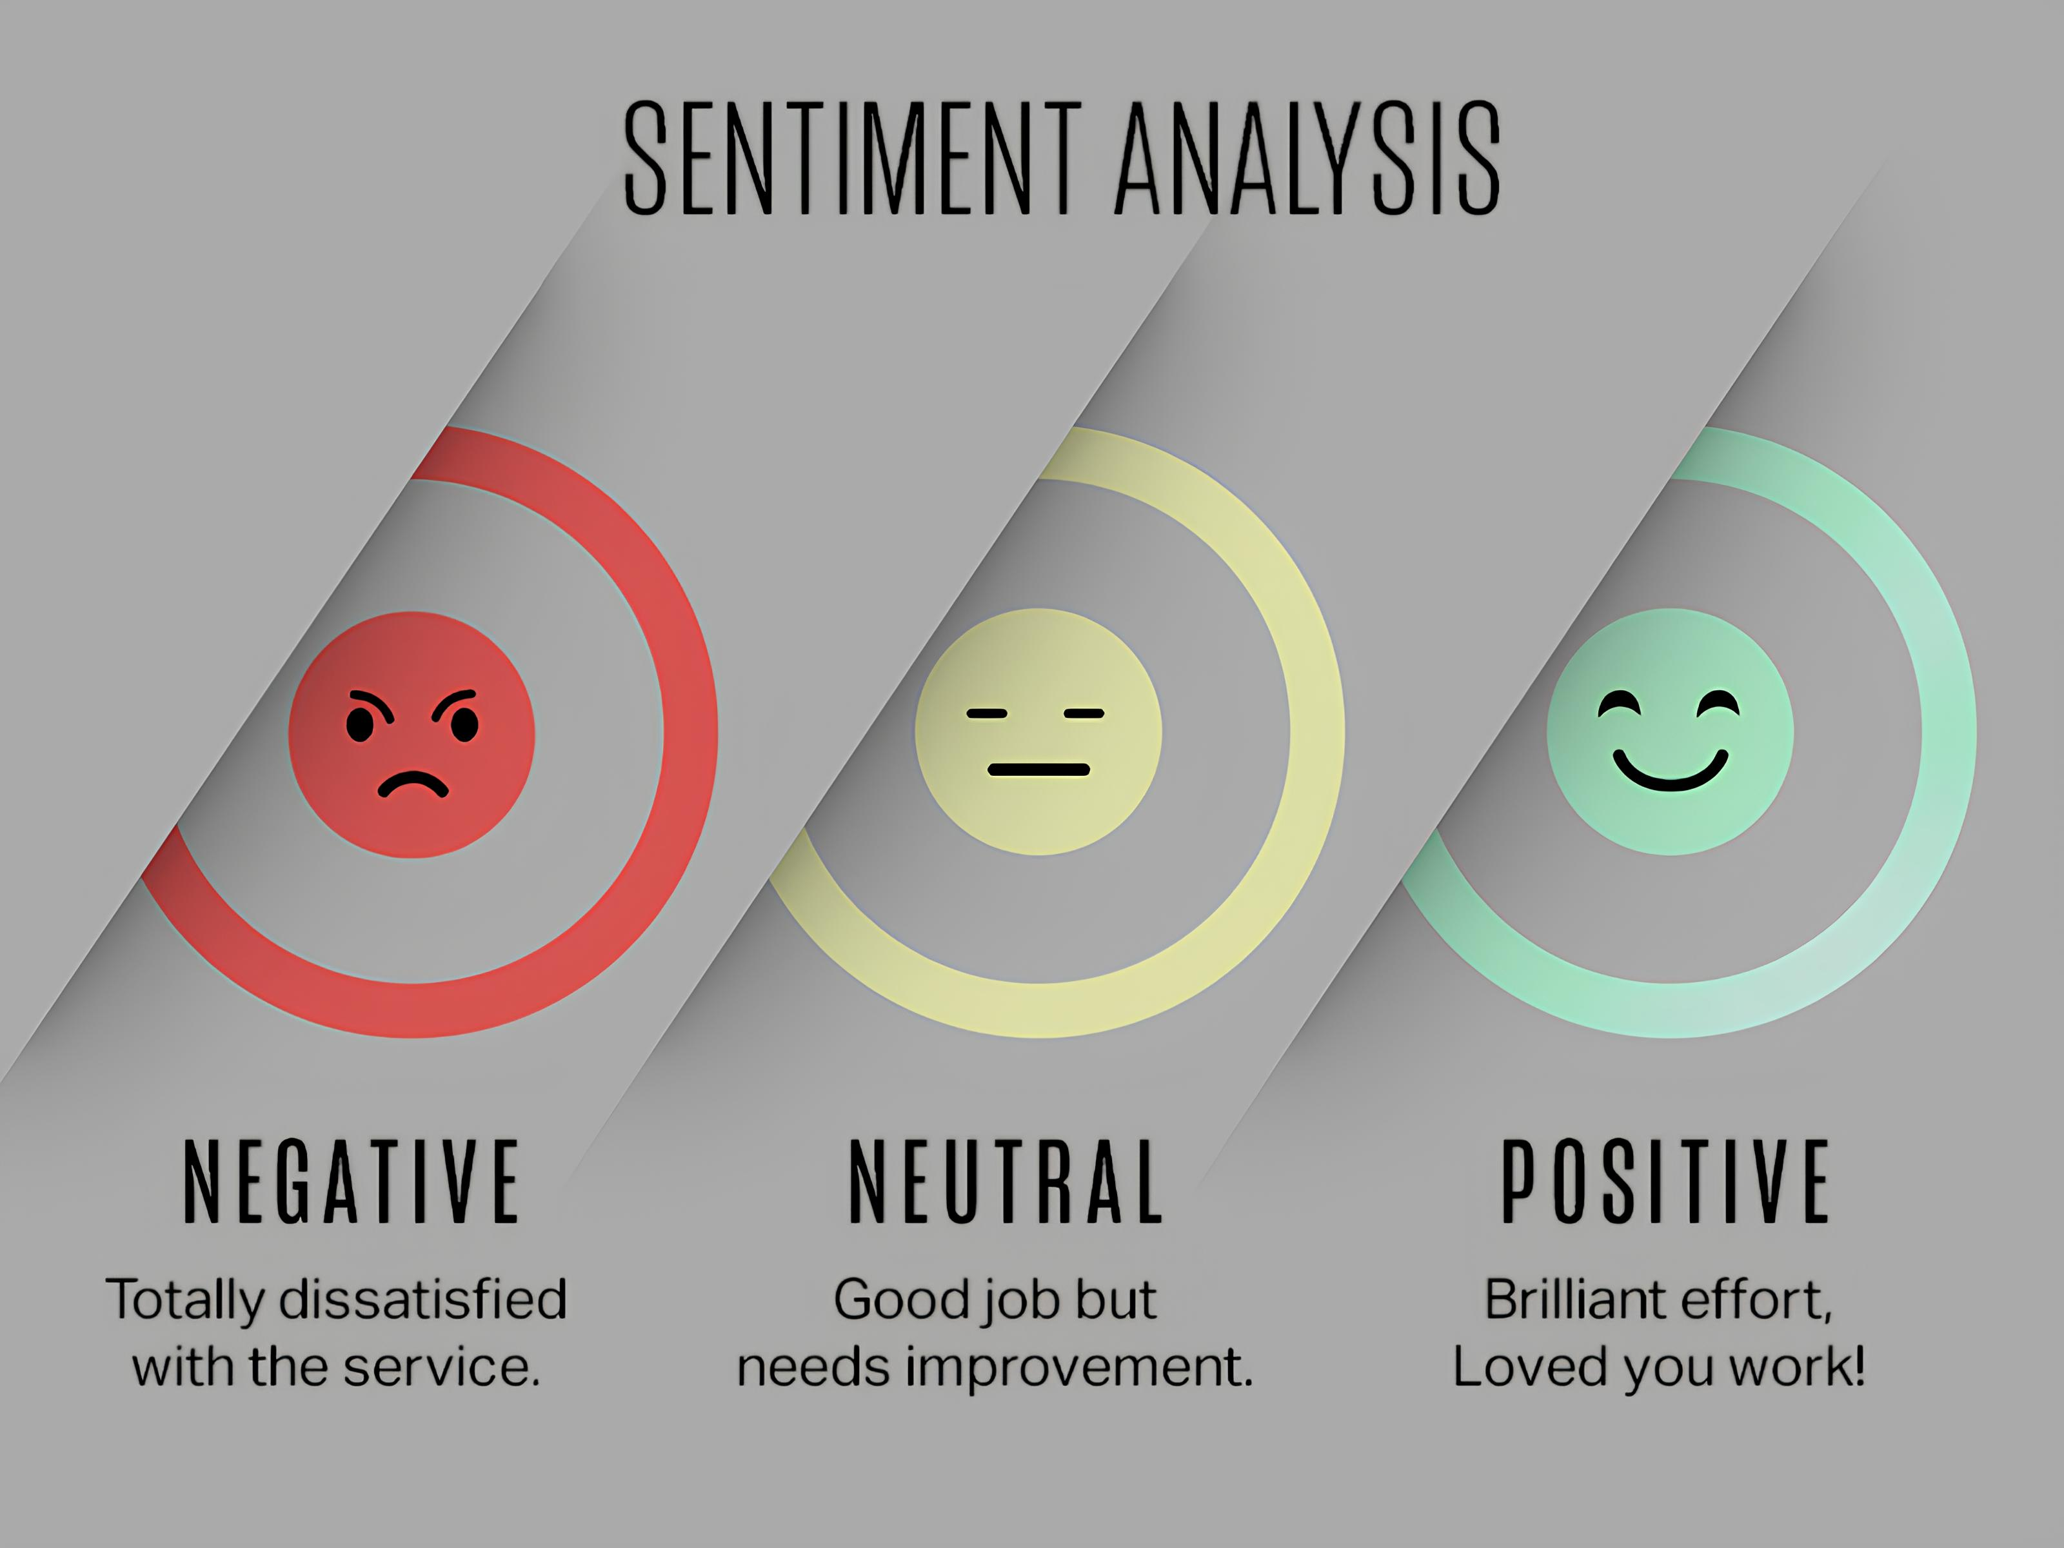
Literature Survey and Existing Approach
Sentiment Analysis
Sentiment analysis, or opinion mining, has been extensively studied. Early approaches relied on rule-based and machine learning techniques, focusing on identifying sentiment polarity (positive, negative, neutral). Recent research has delved into aspect-based sentiment analysis, aiming to determine sentiment towards specific product features.

Slide 4

Literature Survey and Existing Approach
Image Categorization
Image categorization has also witnessed significant advancements. Traditional methods employed handcrafted features and machine learning classifiers. However, deep learning-based approaches, especially Convolutional Neural Networks (CNNs), have dominated the field. Pre-trained models like AlexNet, VGG, and ResNet have been successfully adapted for various image categorization tasks.

Slide 5

Literature Survey and Existing Approach
Multimodal Sentiment Analysis and Image Categorization
The integration of text and image data for sentiment analysis and image categorization is a relatively new research area. Early studies focused on feature-level fusion, combining text and image representations before classification. Recent research has explored attention mechanisms to weigh the importance of different modalities.

Slide 6
Objective of Proposed Work
Develop a deep learning model capable of accurately classifying the sentiment expressed in product reviews.
Create a robust image categorization system that can effectively classify product images into predefined visual categories.
Design a multi-modal framework that can jointly analyze product reviews and images to enhance sentiment analysis and image categorization performance.
Evaluate the proposed models on a large-scale dataset to demonstrate their effectiveness and generalizability.
Explore potential applications of the developed models in various domains, such as product recommendation, market research, and customer feedback analysis.

Slide 7

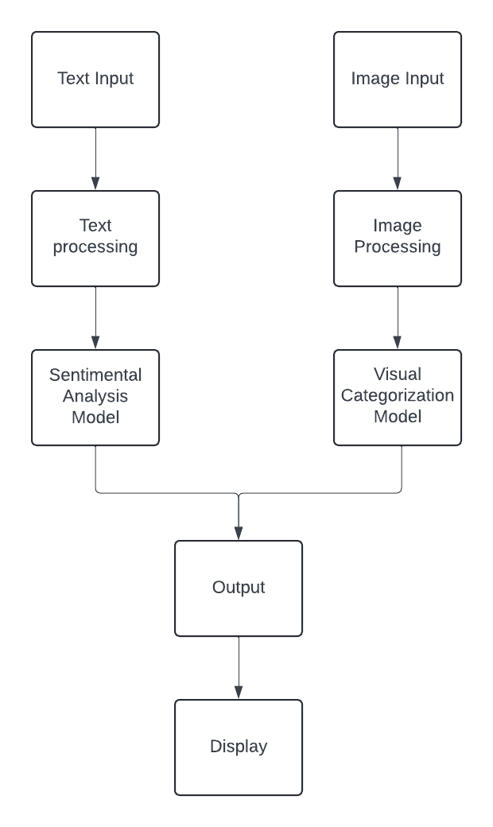
Methodology
Our project employs a dual-stream approach, incorporating both text-based sentiment analysis and image-based product categorization. The system architecture consists of two main pipelines that converge into a unified interface for user interaction.

Slide 8
Methodology
Data Ingestion Layer
Preprocessing Layer
Text input module for product reviews
Image upload module for product images
Text cleaning and tokenization for reviews
Image resizing and normalization

Slide 9
Methodology
Deep Learning Models Layer
Output Processing Layer
Sentiment Analysis model (BERT-based)
Visual Categorization model (CNN-based)
Sentiment classification post-processing
Category prediction post-processing

Slide 10
Methodology
User Interface Layer
Results display and visualization
User interaction handling

Slide 11


Hardware and Software Requirements
Hardware Requirements
Software Requirements
Processor: Multi-core processor (Intel Core i5 or equivalent) for efficient computation.
Memory (RAM): Minimum 8GB RAM, preferably 16GB or more for handling large datasets and complex models.
Storage: Sufficient storage capacity (SSD recommended) to accommodate datasets, models, and intermediate results.
GPU: A dedicated GPU (NVIDIA GeForce GTX or RTX series) is highly recommended for accelerating deep learning computations.
Operating System: Windows 10 or later, macOS, or Linux (Ubuntu preferred).
Deep Learning Framework: TensorFlow, PyTorch, or Keras for model development and training.
Programming Language: Python as the primary programming language for data preprocessing, model development, and evaluation.
Development Environment: Integrated Development Environment (IDE) like PyCharm, Jupyter Notebook, or Visual Studio Code.
Libraries: NumPy, Pandas, Matplotlib, OpenCV, NLTK, Scikit-learn, TensorBoard
Database: For storing processed data and model artifacts (optional).

Slide 12
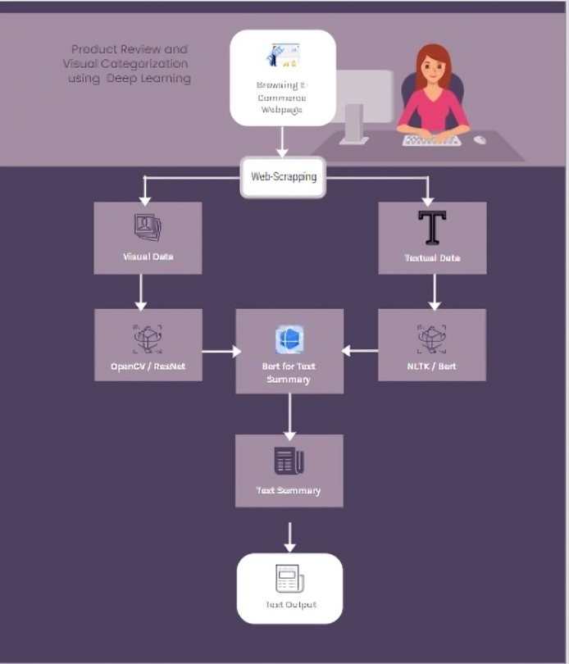
Output

Slide 13

References
Lu, Yaojie., Liu, Qing., Dai, Dai., Xiao, Xinyan., Lin, Hongyu., Han, Xianpei., Sun, Le., & Wu, Hua. (2022). Unified Structure Generation for Universal Information Extraction. , 5755-5772 . http://doi.org/10.48550/arXiv.2203.12277
Manek, Asha S., Shenoy, P., Mohan, M., & Venugopal, K. R. (2017). Aspect term extraction for sentiment analysis in large movie reviews using Gini Index feature selection method and SVM classifier. The Computer Journal, 60(9), 137-143.
Perakakis, E., Triantafyllidis, G., & Arvanitis, K. G. (2021). Improving sentiment analysis with multimodal information fusion. Information Processing & Management, 58(3), 102532.
Poria, S., Cambria, E., Hazarika, D., & Vij, P. (2017). A deeper look into sarcastic tweets using deep convolutional neural networks. IEEE Access, 6, 540-548.
Zhang, Xiang., Zhao, Junbo., & LeCun, Yann. (2015). Character-level convolutional networks for text classification. , 649-657 . http://doi.org/10.48550/arXiv.1509.01626
Zhang, Yin., & Wallace, Byron C. (2015). A Sensitivity Analysis of (and Practitioners’ Guide to) Convolutional Neural Networks for Sentence Classification. , 253-263 . http://doi.org/10.48550/arXiv.1510.03820
Qian, Qingyu., Chen, Siyuan., Zhu, Lei., Nie, Liqiang., & Wu, Xueming. (2019). Two-stream solution for multiple aspects and opinions multi-modal summarization. Multimedia Tools and Applications, 78, 15299-15315.
Sari, Y. (2016). FastText-Based Sentiment Analysis on Large Movie Review Datasets. Journal of Computer Science Research, 2(1), 1-7.

Slide 14

Conclusion
The evolution of online platforms has revolutionized consumer purchasing behaviors, elevating the importance of product reviews and images as key decision-making factors. However, effectively extracting insights from this data poses considerable challenges. Traditional methods like sentiment analysis and image categorization, while useful, struggle with the intricate linguistic nuances and diverse visual features present in online content. As such, advancing technologies are needed to better handle these complexities and provide more accurate and meaningful analyses for businesses and consumers alike.

Slide 15
Thank You!

