Slide 1


Project Synopsis Presentation on CitizenSphere: Bridging Politics and People
Presented by
Aditya Pradhan (202222017)
Under the Guidance of
Mr. Gaurav Pradhan, Asst. Professor, Dept of CA, SMIT
Mr. Logesh R, Tech Co-Founder, NE Developers

Slide 2
Content
Introduction
General Overview of the Problem
Feasibility Study
Literature survey
Problem Definition
Proposed Solution Strategy
Project Plan
H/W & S/W Requirements, Team Structure, Gantt-Chart
Conclusion
References

Slide 3
Introduction
In the ever-changing landscape of modern politics, efficient communication and, getting in touch with the public are integral components of a successful political party.
So, we are developing a website that is decked out with a user-friendly, interface that encourages the interaction between the party and the public.
Homepage is in the centre. And the users can navigate to “Make a Donation”, “Be a volunteer, and “Join Party”.
This website will also act as a repository of information about the party’s organizational structure, leaders, policies, and initiatives.

Slide 4
General Overview of the Problem
Lack of transparency and communication between political parties and the general public.
Lack of public to party communication channel.
Hostile communication environment.

Slide 5
Feasibility Study
Technical Feasibility:
This application will be using the react.js framework as it has a component-based architecture, which will help make dynamic content.
Firebase is used in back-end, which will provide a real-time update for the dynamic content.
Firebase will be used to host the React.js application.
Scalability of the application will also be ensured using Firebase as it comes equipped with the ability to handle potential increases in user traffic and data volume.

Slide 6
Feasibility Study
Contd..
Operational Feasibility:
The user interface will be interactive so that the end-users can efficiently and easily complete their task.
The existing data will be transferred to Firebase.
React.js and Firebase has a good community support which will be of great help while troubleshooting.

Slide 7
Feasibility Study
Contd..
Economical Feasibility:
This application is being built by a team of college students for their Major Project, so there will be no cost for hiring developers.
The Meta owned React.js no longer requires licensing.
Firebase has a Spark Plan that will give authentication, cloud storage, hosting, real-time database, and test lab at no cost.

Slide 8
Feasibility Study
Contd..
Schedule Feasibility:
Requirement Gathering and Analysis: 2 weeks.
Design: 2 weeks.
Implementation: 7 weeks.
Testing: 3 weeks.
Deployment: 2 weeks.

Slide 9
Literature Survey
Serial No. | Name of article | Findings | Research Gap | Relevant to Proposed work
1. | Rui Yao et. al. “A Sensitive Words Filtering Model Based on Web Text Features”[1] 2018 ACM | The K-means clustering algorithm and the vote by majority strategy has the best accuracy and error rate, i.e., 81%. | The method mentioned in this paper is very strict and may miss some false propaganda text strategy. | DFA algorithm.
Table. Literature Survey

Slide 10
Literature Survey
Contd..
Serial No. | Name of article | Findings | Research Gap | Relevant to Proposed work
2. | Shengyi Jiang et. al. “An Improved K-nearest-neighbour algorithnm for text categorization”[4] 2012 ELSEVIER | The INNTC has a significant boost in performance when compared with KNN, NB, SVM, and other classifiers in dealing with large-scale, high dimensional and imbalanced text data. | INNTC is only compared with traditional text categorization techniques. | KNN.
Table. Literature Survey

Slide 11
Problem Definition
Lack of transparency of political parties.
Absence of communication between the general public and political party.
Use of sensitive language.
Feedback Management.
Troll or spam submission.
User anonymity.
Data security and compliance.

Slide 12
Proposed Solution Strategy
Repository.
Grievance resolution mechanism.
Define a list of unwanted words.
Dropdown Box.
CAPTCHA.
Limitations regarding how their query is handled
Encryption.

Slide 13
Project Plan
Hardware Requirement | Software Requirement
Processor: Dual-core or higher Memory: 2GB DDR3 RAM Storage: SSD storage for better performance. | Microsoft Windows, Linux, or Mac. IDE: Virtual Studio v1.86.2. Npm v10.4.0 Node.js v20.11.1 React.js Mozilla Firefox v123.0 Git v2.44.0.windows.1

Slide 14
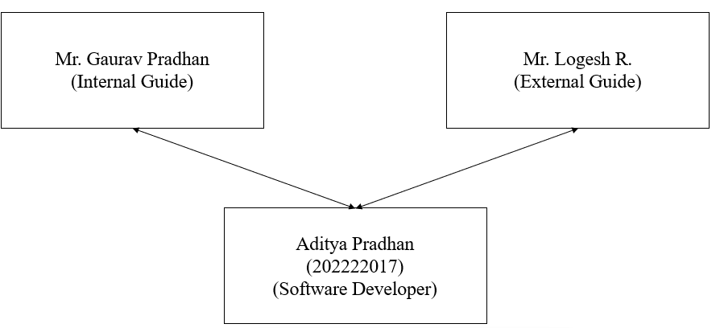
Project Plan
Contd..
Fig. Team Structure

Slide 15
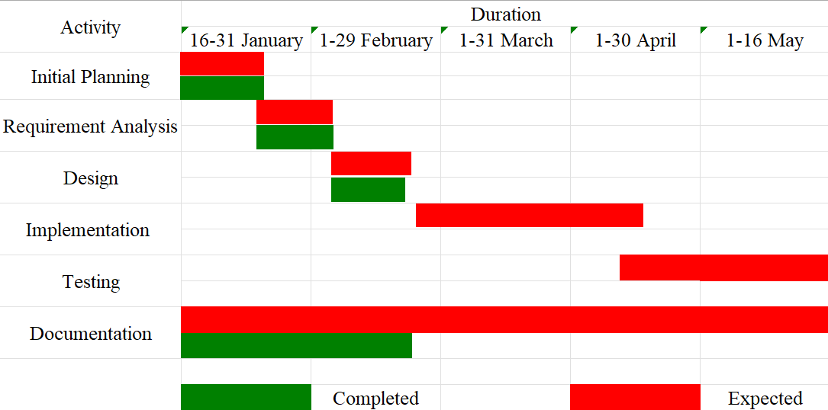
Project Plan
Contd..
Fig. Gantt Chart

Slide 16
Conclusion
Facilitate contact between the public and political parties.
Homepage, Donation page, Membership page, Volunteer page.
React.js and Firebase.
CAPTCHA and SSL.
Feedback system enables citizens to express opinions and concerns directly.
The testing will be done thoroughly, to ensure that the application has as little flaw as possible.

Slide 17
References
[1] R. Yao, Y. Cao, Z. Ding, and L. Guo, “A sensitive words filtering model based on web text features,” ACM Int. Conf. Proceeding Ser., pp. 516–520, 2018, doi: 10.1145/3297156.3297232.
[2] S. Nugroho, S. Hadi, and L. Hakim, “Comparative Analysis of Software Development Methods between Parallel, V-Shaped and Iterative,” Int. J. Comput. Appl., vol. 169, no. 11, pp. 7–11, 2017, doi: 10.5120/ijca2017914605.
[3] F. Wu and Y. Cai, “A Chinese Message Sensitive Words Filtering System based on DFA and Word2vec,” Procedia Comput. Sci., vol. 139, pp. 293–298, 2018, doi: 10.1016/j.procs.2018.10.271.
[4] S. Jiang, G. Pang, M. Wu, and L. Kuang, “An improved K-nearest-neighbor algorithm for text categorization,” Expert Syst. Appl., vol. 39, no. 1, pp. 1503–1509, 2012, doi: 10.1016/j.eswa.2011.08.040.
[5] K. Bielak, B. Borek, and M. Plechawska-Wójcik, “Web application performance analysis using Angular, React and Vue.js frameworks,” J. Comput. Sci. Inst., vol. 23, no. December 2021, pp. 77–83, 2022, doi: 10.35784/jcsi.2827

Slide 18
Thank You!

