Slide 1
LEARNIX
AN EXPLAINABLE, STEERABLE COURSE RECOMMENDER SYSTEM
B.Tech. Project Presentation
Aditya Pradhan
Roll No: 23108A0010 | Branch: EXCS A

Slide 2
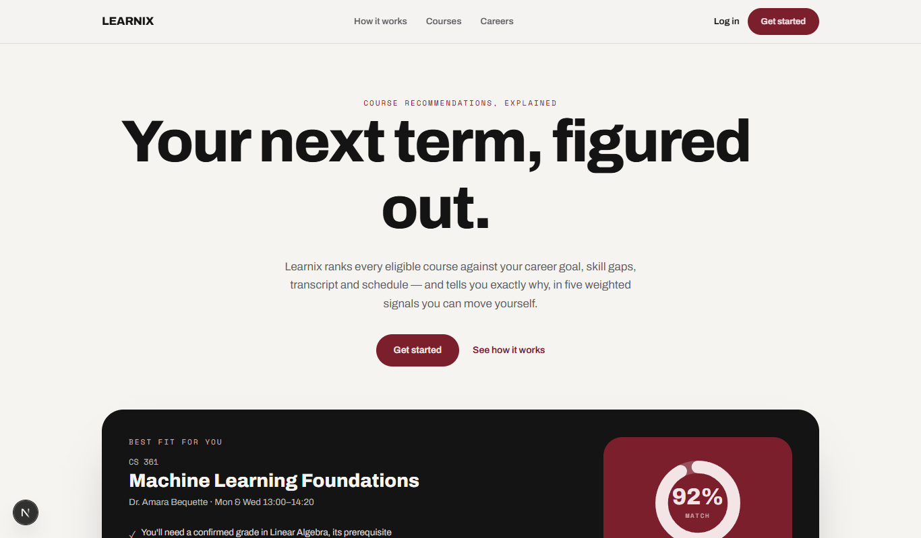
THE PROBLEM
Choosing courses is a high-stakes guess
• No relevance ranking — catalogue browsers list every course but rank none of them against a student's actual career goal.
• No feasibility check — students manually cross-reference transcripts against prerequisites and guess whether a schedule fits.
• No explainability — where recommendations exist at all, they are a black box with no inspectable reasoning.
• No steerability — a one-size-fits-all formula can't reflect that different students value different things.
LEARNIX
2

Slide 3
OBJECTIVES
What Learnix sets out to do
• 1. Rank courses against a career-goal skill profile with no historical-interaction data required.
• 2. Derive a student's current skill level purely from their confirmed transcript — never fabricated.
• 3. Decompose every score into explainable subscores with plain-language reasons.
• 4. Let the student steer the ranking by adjusting each subscore's weight.
• 5. Catch unmet prerequisites and schedule conflicts before they become a registration problem.
• 6. Persist every piece of student state server-side for a consistent cross-device experience.
LEARNIX
3

Slide 4
TECHNOLOGY STACK
Production-shaped, end to end
Framework
Next.js 16 (App Router, Turbopack)
Language
TypeScript (strict)
UI
React 19 · Tailwind CSS v4 · Framer Motion
Database
PostgreSQL
ORM
Prisma
Auth
Auth.js v5 (Credentials + bcrypt)
Validation
Zod
Client state
Zustand
Testing
Vitest + Testing Library
LEARNIX
4

Slide 5
SYSTEM ARCHITECTURE
A layered, server-first design
lib/scoring/
The recommendation engine — skill vectors, subscore formulas, ranking, reasons. Pure, framework-free, unit-tested.
lib/data/repository.ts
The single seam to Postgres — every read & write in the system passes through here.
auth.ts / proxy.ts
Auth.js v5 session management with edge-safe route protection.
prisma/schema.prisma
The full relational schema — 11 models.
app/(app)/
The authenticated app shell: nav + all nine student-facing screens.
app/onboarding/
A four-step wizard, rendered outside the app shell.
LEARNIX
5

Slide 6
DATABASE DESIGN
Fully relational, nothing derived is stored
User
Profile
WeightsProfile
NotificationSettings
Career
Course / Instructor / Review
ProgramRequirement
TranscriptEntry
SavedCourse / HiddenCourse
Notification / NotificationRead
Degree-requirement progress and GPA are deliberately NOT stored — derived live from the transcript.
LEARNIX
6

Slide 7
THE RECOMMENDATION ALGORITHM
Five explainable subscores (0–99 each)
goals
Skill-vector similarity to the career target, boosted by stated interests.
gap
Weighted by how far current skills fall short of the target — closing a bigger gap scores higher.
history
Halved if a checkable prerequisite isn't confirmed on the transcript.
schedule
Discounted if the course eats an outsized share of the weekly time budget.
cost
A fixed credit-value score.
LEARNIX
7

Slide 8
THE RECOMMENDATION ALGORITHM
Weighted match % and explanation
Match % = Σ(subscore × weight) / Σweight
• Weights are normalised on every read — a student's sliders never need to sum to 100.
• Three bands — ≥ 85 “Great fit”, ≥ 72 “Good fit”, else “Okay fit.”
• Explanation — top-contributing signals map to a plain-language reason shown everywhere the course appears.
• Exclusion & conflicts — hidden courses and day conflicts are removed before ranking, not scored low; saved courses are checked pairwise for overlap.
LEARNIX
8

Slide 9
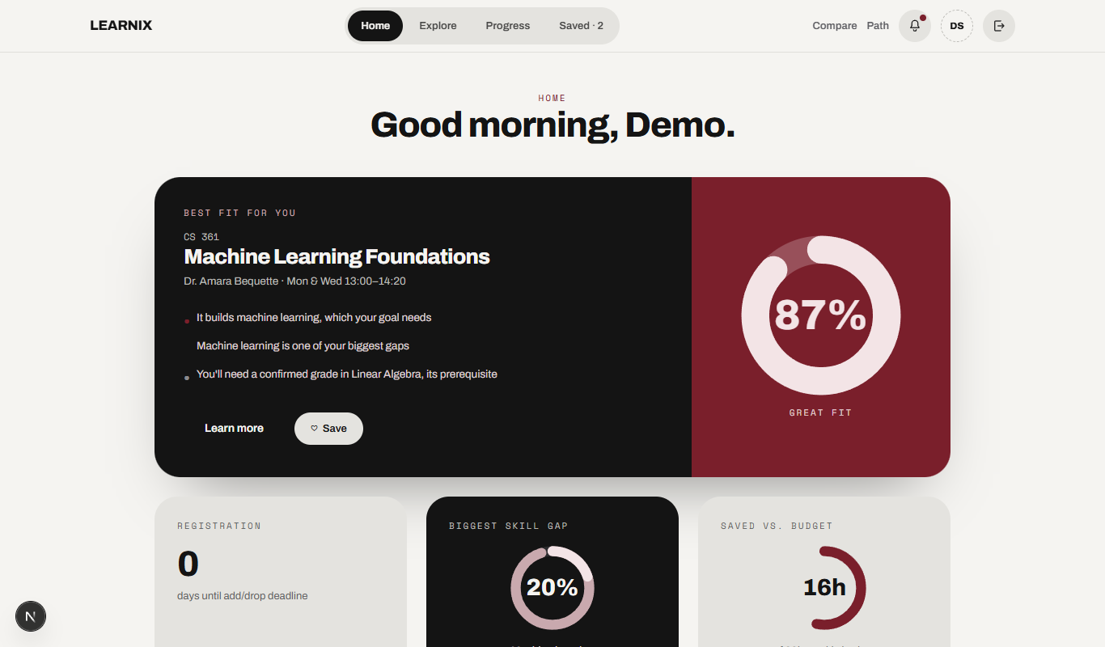
APPLICATION WALKTHROUGH
Home
Best-match hero course with live reasoning, plus a ranked rail of alternatives.
LEARNIX
9

Slide 10
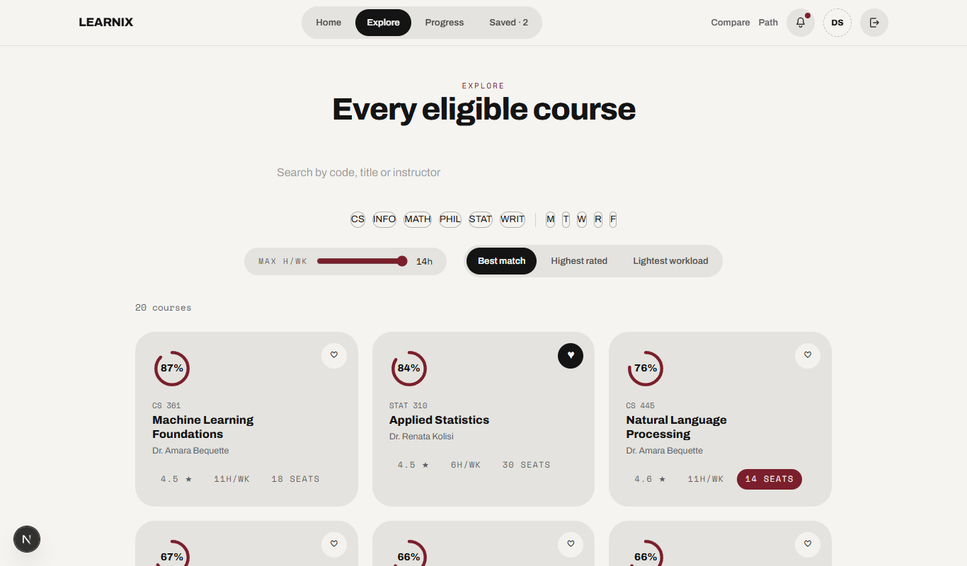
APPLICATION WALKTHROUGH
Explore
Every eligible course, ranked and filterable by department, hours and day.
LEARNIX
10

Slide 11
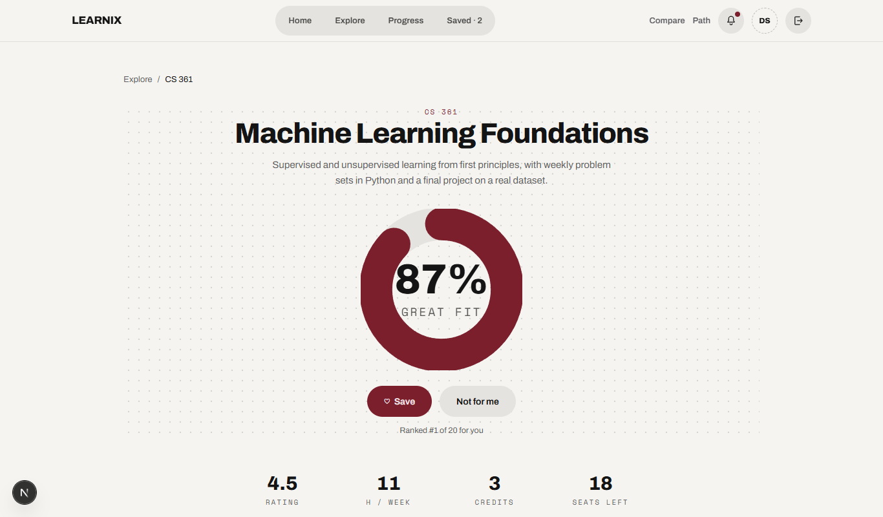
APPLICATION WALKTHROUGH
Course Detail
Full subscore breakdown, instructor profile, syllabus and reviews.
LEARNIX
11

Slide 12
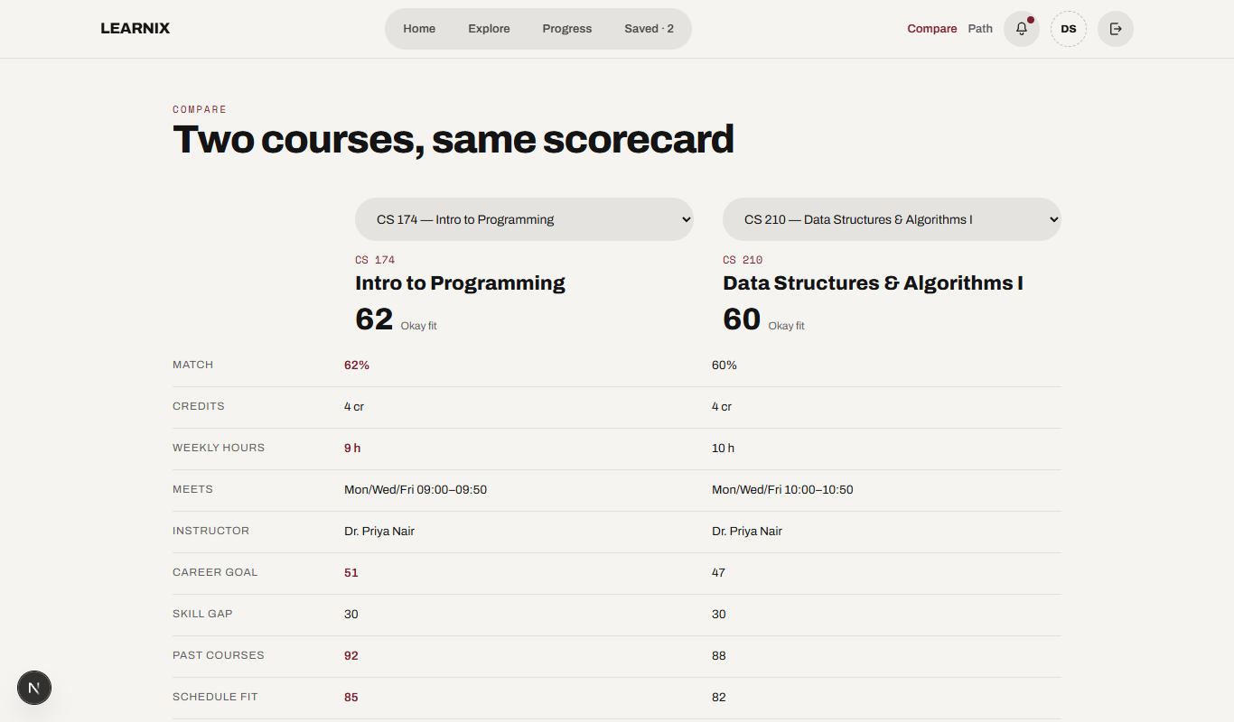
APPLICATION WALKTHROUGH
Compare
Two courses side by side across schedule, workload and skill fit.
LEARNIX
12

Slide 13
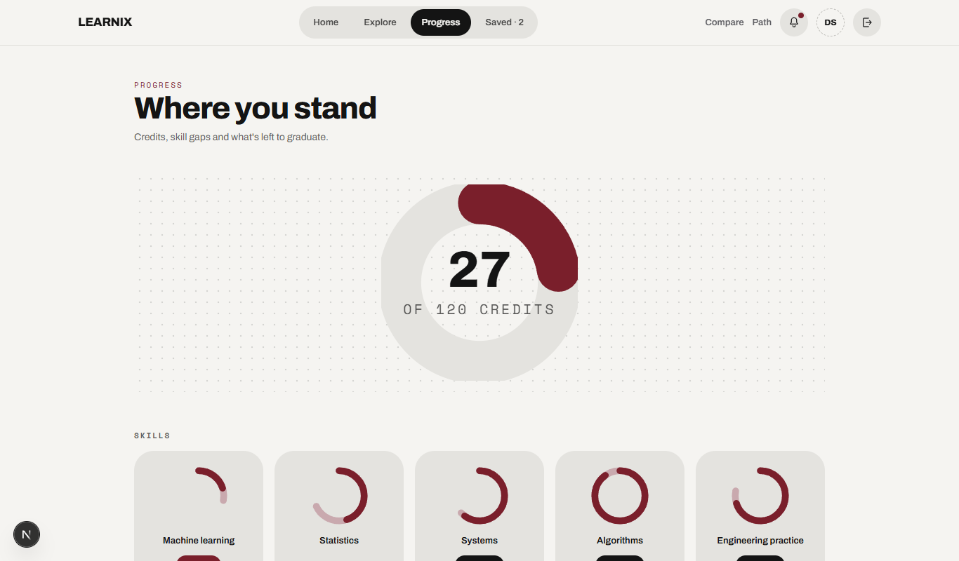
APPLICATION WALKTHROUGH
Progress
Degree-requirement completion and GPA, derived live from the transcript.
LEARNIX
13

Slide 14
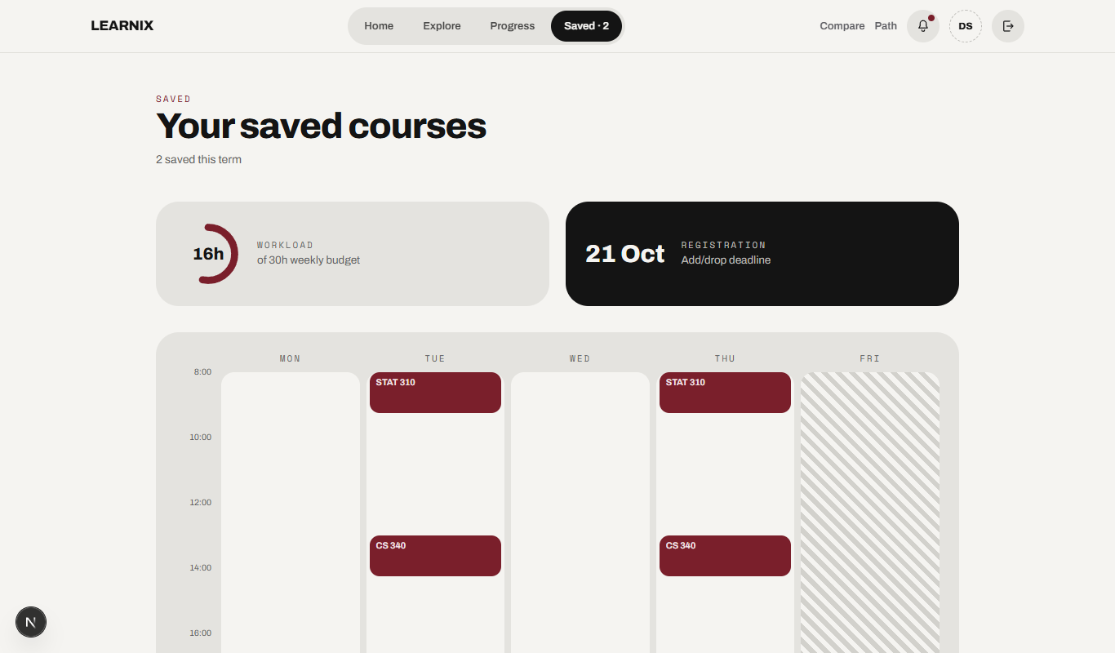
APPLICATION WALKTHROUGH
Saved
The student's shortlist, with a live running total against their weekly budget.
LEARNIX
14

Slide 15
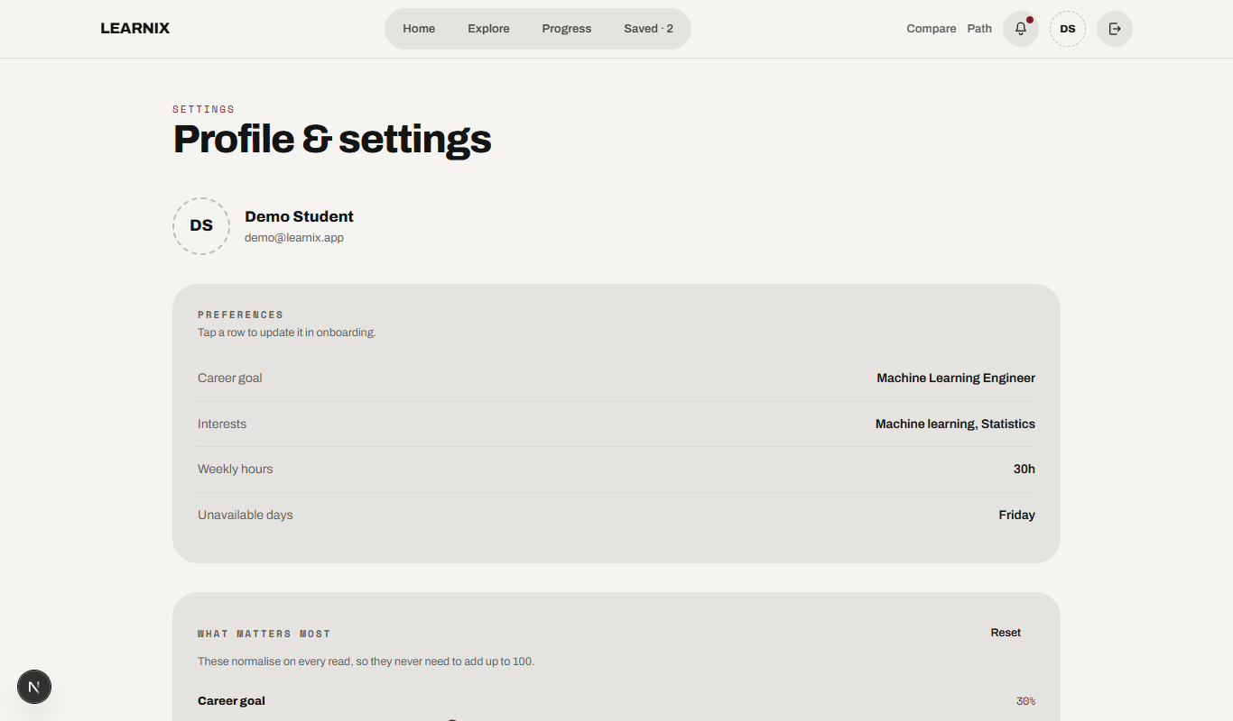
APPLICATION WALKTHROUGH
Settings
The five steerable weight sliders, plus preferences and accessibility.
LEARNIX
15

Slide 16
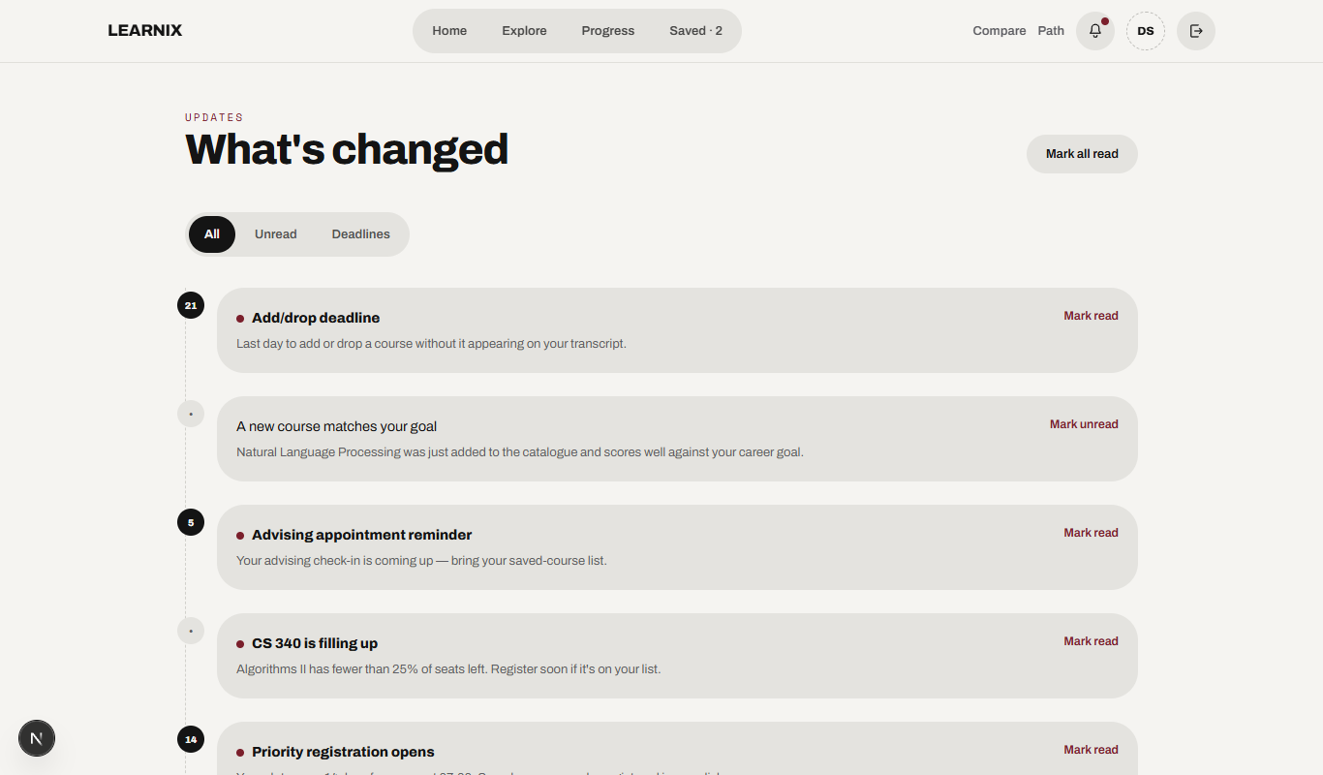
APPLICATION WALKTHROUGH
Updates
Registration deadlines, seat alerts and new-course notifications.
LEARNIX
16

Slide 17
DESIGN SYSTEM
“Salt & pepper + Gothic noir”
• Palette — warm off-white (#F5F4F1) through deep oxblood (#7A1F2B).
• Type — Archivo for headings/body, Space Mono for small uppercase labels.
• Shape language — 28px tile radii, fully pill-shaped buttons, chips and toasts.
• Motion — Framer Motion entrance/ambient animation, respects prefers-reduced-motion, never hides content if a script fails to load.
Salt
#F5F4F1
Ink
#1A1A1A
Oxblood
#7A1F2B
LEARNIX
17

Slide 18
PERFORMANCE ENGINEERING
Caching for a remote, pooled database
• Request-level memoization — every read in lib/data/repository.ts is wrapped in React's cache().
• Cross-request caching — catalogue and per-student data additionally use Next.js's unstable_cache, since the production database is a pooled remote Postgres instance.
• Targeted invalidation — every mutation revalidates precisely what it changed, so a student's own edit is always reflected immediately.
• Result — warm navigations dropped from multi-second cold loads to a consistent sub-second baseline.
LEARNIX
18

Slide 19
TESTING
The scoring engine is the correctness-critical core
• 27 unit tests (Vitest) over subscore formulas, weighted ranking, band classification, exclusion filtering and schedule-conflict detection.
• Strict TypeScript compilation and ESLint enforced on every change.
• Isolated from I/O — the scoring engine is pure functions with no database or React dependency, so tests run instantly and deterministically.
LEARNIX
19

Slide 20
CONCLUSION & FUTURE SCOPE
Rigorous and legible, by design
Learnix shows a recommender can be both rigorous and explainable — every ranking traces to a named, student-adjustable signal. No cold-start problem, no black box.
• Multi-term degree planner — sequencing courses across future terms by prerequisite topology and budget (prototyped in lib/data/path.ts).
• Instructor/section-level signals — historical grade-distribution data where institutions permit.
• Collaborative signals — layered atop the existing explainable base, not replacing it.
LEARNIX
20

