Slide 1
BDA MINI PROJECT: STOCK TRADING PLATFORM

Slide 2
1.
WHAT IS OUR PROJECT

Slide 3
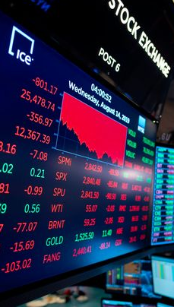
GOAL
Stock trading requires a lot of expertise and experience
This scares away people who want to get into the venture
Our goal is to make a platform that uses ML algorithms and easy to understand charts to make the venture more accessible

Slide 4
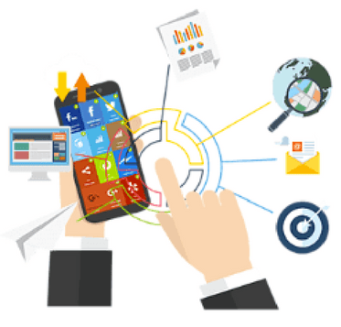

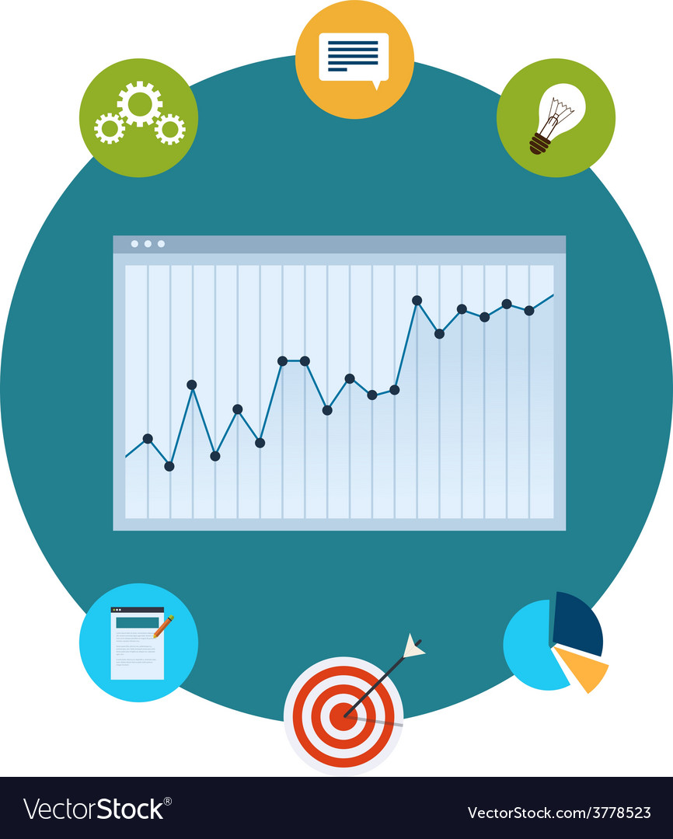
THE STRUCTURE
USER DASHBOARD
Gives the general information about the users stock portfolio and basic info about the stocks they own.
TRADING BOT SUGGESTION
A reinforcement bot will make suggestion on what stocks to sell or buy.
FORECAST CHART
Charts to show the forecasted values of the stocks they own with the candle

Slide 5

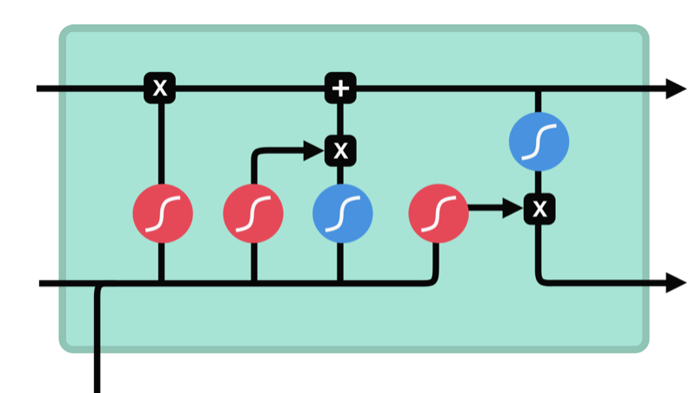
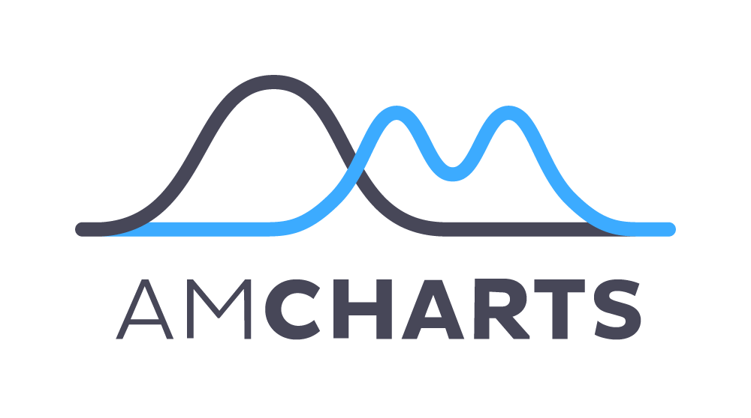



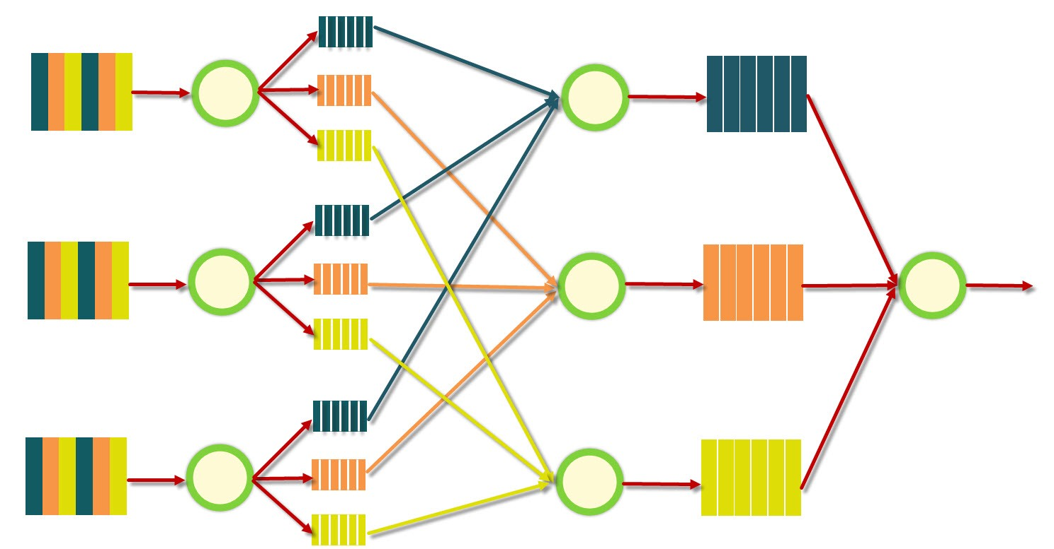
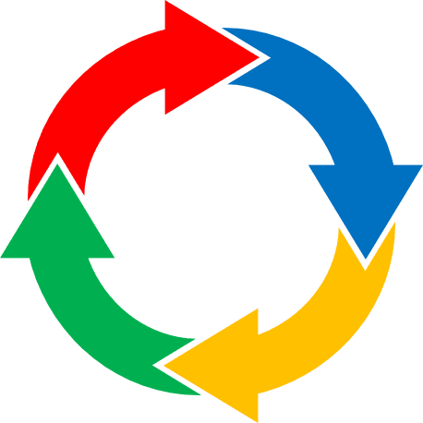
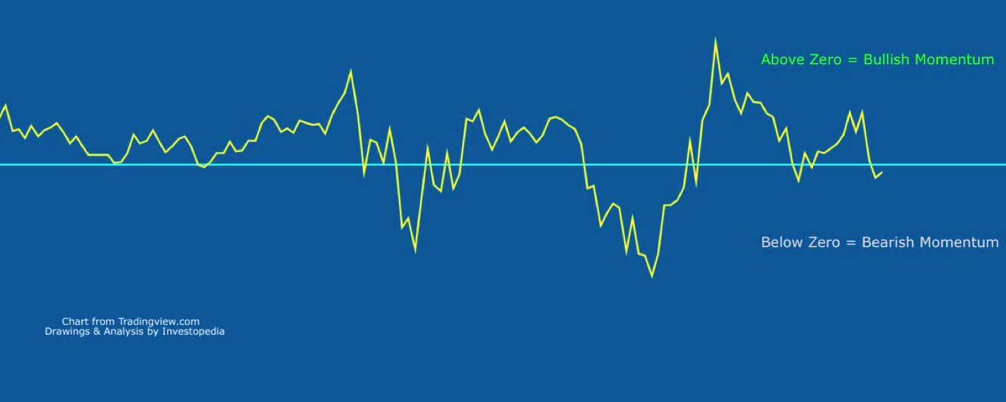
FLOW OF THE SYSTEM
MongoDB DATABASES
LSTM CELL
AAPL
MSI
SBUX
CHARTS AND PLOTS
RL BOT
TRADING SUGGESTIONS
SELECTION AND FILTER
MapReduce
DATA IN SIMPLE CSV FORMAT
MOMENTUM AND OTHER CENTRAL TENDENCIES

Slide 6
2.
MongoDB AND MapReduce

Slide 7


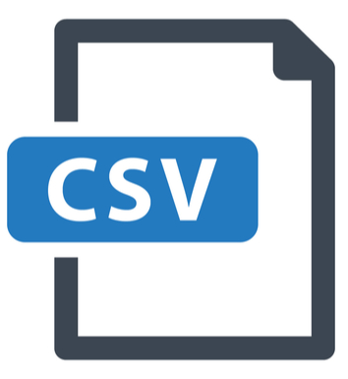
GETTING THE DATA
AAPL
MSI
SBUX
The MongoDB database of each company database stores the day, the stock price and the type of stock.
From this database, we need to extract the common stocks prices
Pymongo
.find({type:”COMMON”})
CREATING VECTORS
For this, we have used the PyMongo library in python 3.6 with other data handling libraries like Pandas and NumPy
FROM PANDAS DATAFRAME

Slide 8
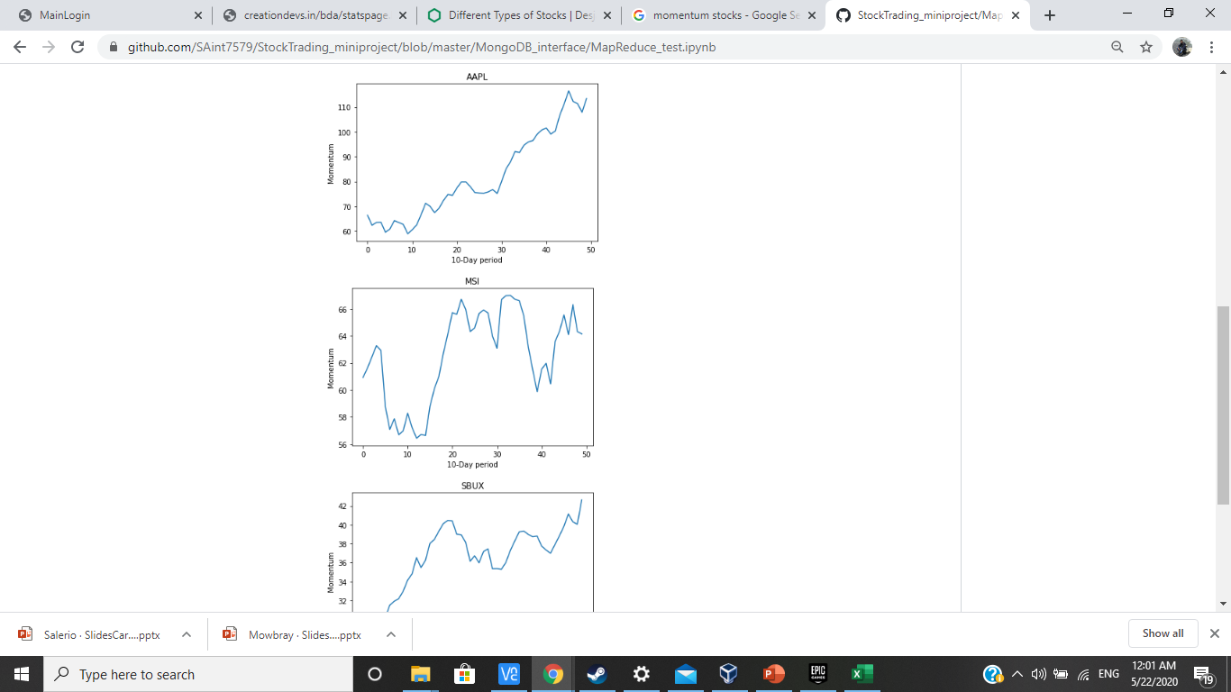
MOMENTUM IN STOCKS
DATE | STOCK PRICE
12/08 | P1
13/08 | P2
14/08 | P3
15/08 | P4
16/08 | P5
17/08 | P6
18/08 | P7
SBUX
Momentum is the measure of how fast is the stock is moving in what direction.
This is calculated by taking the moving average of a time period and then plotting them.
EXTRACT A VECTOR
MOMENTUM
M_{i} = α*M_{i-1} + (1- α )*P_{i}
M₀ = 0
This value is calculated using the moving vector of a sequence of days and making a line plot of the same

Slide 9
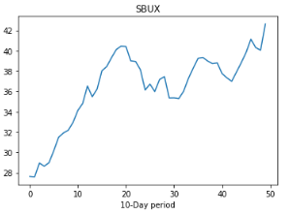
MOMENTUM WITH MapReduce
DATE | STOCK PRICE
12/08 | P1
13/08 | P2
14/08 | P3
15/08 | P4
16/08 | P5
17/08 | P6
18/08 | P7
DAY 1-5
M
DAY 6-10
M
5 Day Vectors
M
DATE | STOCK PRICE
1-5 | M1
6-10 | M2
11-15 | M3
EXTRACT THE VECTOR
REDUCE EACH VECTOR TO FIND MOMENTUM
START FROM THE DB OF ONE COMPANY
SAVE THE MOMENTUM DATA
PLOT THE CHART

Slide 10
3.
ANALYTICS AND ARTIFICIAL INTELIGENCE

Slide 11
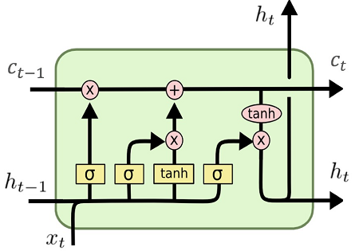
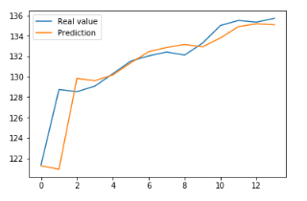
FORECASTING PRICES
SEEDING
This problem comes under time series analytics.
The goal is to estimate the future prices based on the near past trends.
PRED T-2
PRED T-1
PRED T
T-2
T-1
T
A popular architecture for such sequence analysis is to use Long Short Term Memory networks with Sequence to Sequence forecasting.
PRICE T-3
PRICE T-2
PRICE T-1
PRED T+1
PRED T+2
PRED T+3
T+1
T+2
T+3
FORECASTING PERFORMANCE
PRED T
Seq2Seq FORECAST

Slide 12

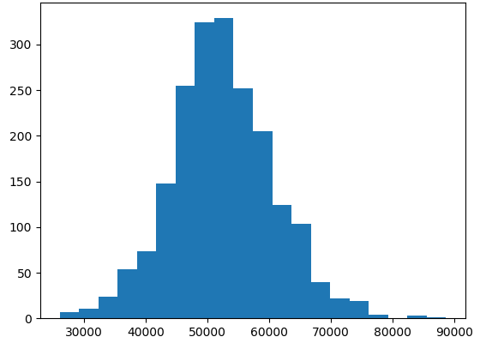
TRADING BOT
The goal of this bot is to make the most optimal move of buying or selling stocks based on the current market status
The bot will directly give the number of stocks to be bought or sold instead of an analysis.
These come under the problem of Reinforcement Learning and the bot in this case is trained using the Q Learning algorithm which lets the bot learn from experience in real time.
PERFORMANCE OF THE BOT

Slide 13
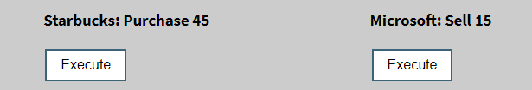
OPERATION OF THE BOT
REWARD SYSTEM
:
CHANGE IN PORTFOLIO
AAPL
MSI
SBUX
STOCK TRADING ENVIRONMENT
REWARD
CURRENT STOCK PRICES
STOCK TRADING VECTOR
RL BOT

Slide 14
4.
DATA VISUALIZATION

Slide 15

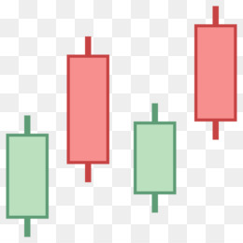
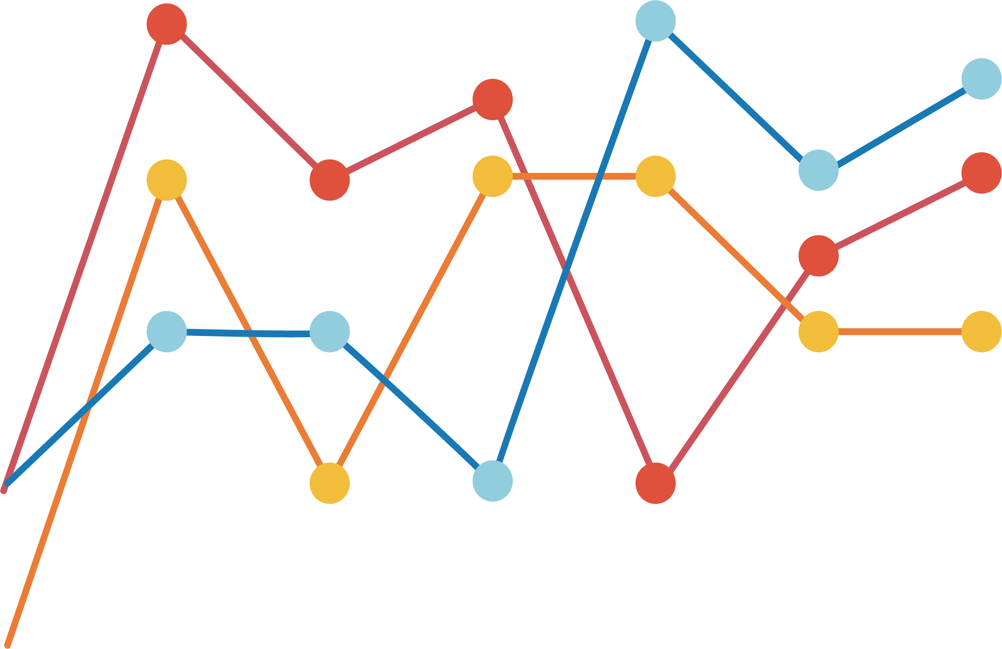
METHODS USED
LINE CHART
This is to show the trend of stock prices, the forecast and the momentum which are needed to be plotted on a time axis.
PIE CHART
This is used to represent the accuracy of the forecast by showing by how many times did it miss the mark
CANDLESTICK CHART
This is used to show the daily variation of the stock prices by representing various aspects of the prices with box-plot like

Slide 16


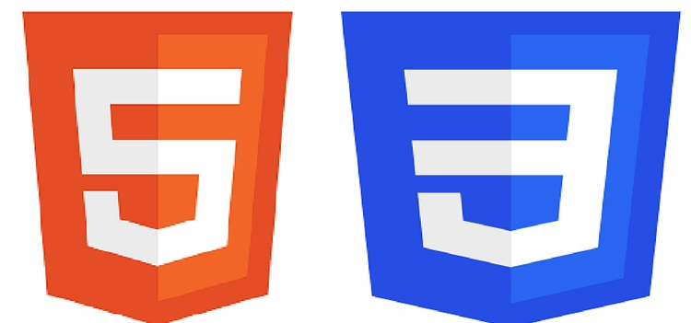
TECHNOLOGY STACK
Python
The MongoDB interface and the code for both the ML algorithms are written in version 3.6.
MongoDB
This is used as the NoSQL structure to save and retrieve the stock data. To interface with the database, PyMongo is used
JavaScript
This is used to make the front end page dynamic and to plot the charts using the graphic libraries
TensorFlow
The LSTM network for the forecast is made using the version 1.4 of TensorFlow
D3 and AmCharts
These JavaScript libraries are used to make the visualization on the webpage.
HTML and PHP
These are used to design the frontend of the webpage.

Slide 17
THANKS!
TEAM:
ADITYA KHOCHARE: PA13
SUYASH LADDA: PC12
VISHWA SINGH: PC14
DHEERAJ KOMANDUR: PC23

