Slide 1
GRAPH
NON-LINEAR DATA STRUCTURE

Slide 2
What is graph?
A graph ’G’ consists of a non-empty set ‘V’ called the set of (vertices) of the graph, and a set ‘E’ which is the set of edges of graph. It is also convenient to write:
G= (V, E)

Slide 3
Applications of Graph
electronic circuits
networks (roads, flights, communications)
CS16
JFK
LAX
LAX
STL
HNL
DFW
FTL

Slide 4
Basic terminologies of graph
Vertex
Edge
Neighbor vertex or adjacent vertex
Loops and multiple edges
Degree of vertex
Order of graph or vertex cardinality
Size of graph
Isolated vertex
Walk
Trail
Path
cycle

Slide 5
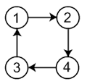
Vertex
Vertices are the nodes in the given graph.
Here, the vertices of given graph are 1,2 3 and 4
V(G) = {1,2,3,4}

Slide 6
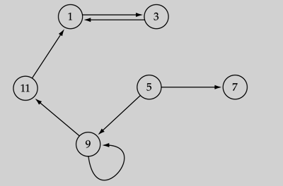
Edges
An edge is a pair of vertices (i.e. e = (v_{i} ,v_{J}).
The set of edges E(G), describe relationships among the vertices
E(G) = ((1,3), (3,1), (5,9), (9,11), (9,9), (11,1), (5,7))

Slide 7

Neighbor vertex or adjacent vertex
Formally, given a graph G = (V, E), two vertices v_{i} , v_{j} Î V are said to be neighbors, or adjacent nodes, if ( v_{i} , v_{j} ) Î E.
Vertex u and v are neighbor because they are connected by an edge (u,v)

Slide 8
Loops/sling and multiple edges
A loop is an edge whose endpoints are equal i.e., an edge joining a vertex to it self is called a loop. We say that the graph has multiple edges if in the graph two or more edges joining the same pair of vertices.
loop

Slide 9
Degree of vertex
The degree deg(v) of vertex v is the number of edges incident on v or equivalently, deg(v) = |N(v)|.
In a directed graph, we have
Indegree(v): number of incoming edges
Outdegree(v): number of outgoing edges

Slide 10
Examples
Degree(0) = 2
0
Degree of undirected graph
Degree(0) = 3
Degree(2) = 3
Degree(1) = 3
0
1
2
1
2
3
4
5
6
Degree(1) = 3
Degree (2)= 3
G1
1
1
1
3
G2
1
Degree (3)= 3
0
In(0):1, out(0): 1
Degree of directed graph
in-degree
out-degree
1
In(1): 1, out(1): 2
2
In(2): 1, out(2): 0
G3

Slide 11
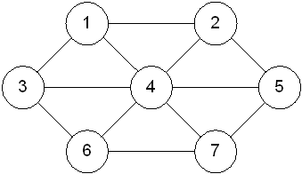
Order of graph / vertex cardinality
The number of vertices, the cardinality of V, is called the order of graph and devoted by |V|.
Order of given graph = 7

Slide 12
Size of graph
The number of edges, the cardinality of E, is called the size of graph and denoted by |E|.
Size of given graph = 12

Slide 13
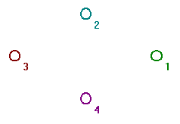
Isolated vertex
In a graph, a node which is not adjacent to any other node is called an isolated node
Here, all the nodes are isolated nodes

Slide 14
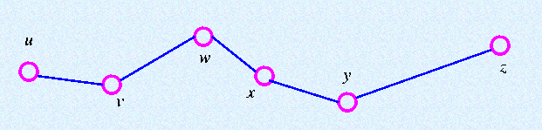
Walk
A walk of length k in a graph G is a succession of k edges of G of the form uv, vw, wx, . . . , yz.
We denote this walk by uvwx . . yz and refer to it as a walk between u and z.

Slide 15
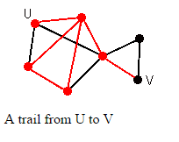
Trail
If all the edges (but no necessarily all the vertices) of a walk are different, then the walk is called a trail.
The walk ”uwxywjv” is a trail since the vertices w occur twice.
w
z
x
j
y

Slide 16
Path
If all the vertices are different, then the walk is called path.
The walk ”vwxyz” is a path since the walk has no repeated vertices.

Slide 17
cycle
A path which originates and end at the same vertex, is called a cycle

Slide 18
Types of graph
Directed graph
Undirected graph
Mixed graph
Null graph
Complete graph
Simple graph
Multi-graph
Weighted graph
Cyclic graph
Acyclic graph
Connected graph
Disconnected graph
Subgraph
Regular graph

Slide 19
Undirected graph
A graph in which every edge is undirected, is called undirected graph

Slide 20
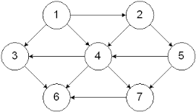
Directed graph
A graph in which every edge is directed is called a directed graph or a diagraph

Slide 21
Null graph
The graph consisted only isolated nodes is called a null graph
The set of edges in a null graph is empty

Slide 22
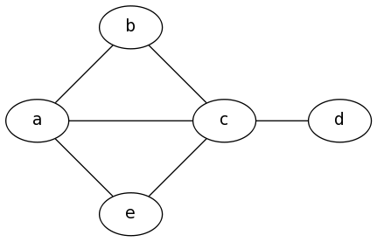
Simple graph
Ina graph, if there is no more than one edge between a pair of nodes then such a graph is called simple graph.

Slide 23
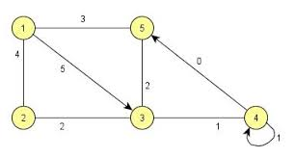
Mixed graph
A graph in which some of the edges are directed and some are undirected in a graph, then the graph is called mixed graph

Slide 24
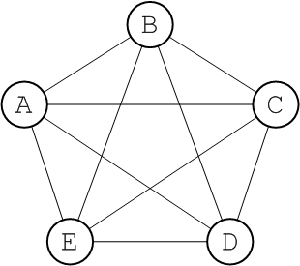
Complete graph
A complete digraph is a graph in which every pair of distinct vertices is connected by a pair of unique edges (one in each direction).
The complete graph with n graph vertices is denoted as Kn and has n*(n-1)/2 (the triangular numbers) undirected edges. In older literature, complete graphs are sometimes called universal graphs.

Slide 25
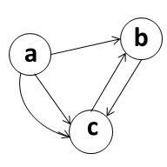
Multi-graph
Any graph which contains some parallel edges, is called multi-graph

Slide 26
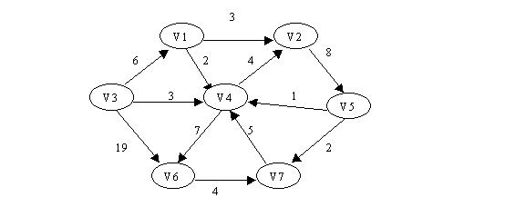
Weighted graph
A graph in which weights are assigned to every edge is called a weighted graph

Slide 27
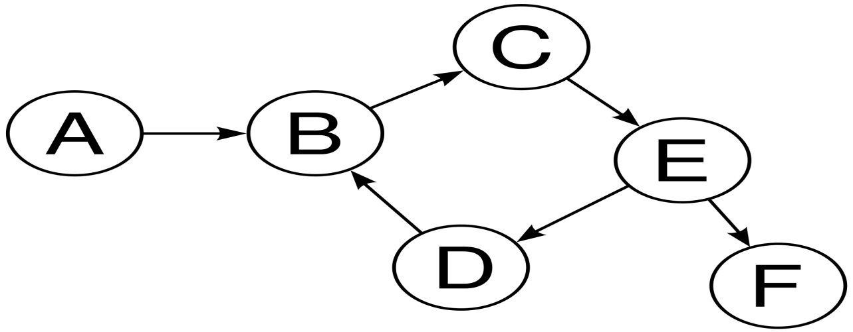
Cyclic graph
A graph which contain cycle is called cyclic graph
Cycle: a path which originates and end in the same order is called a cycle

Slide 28
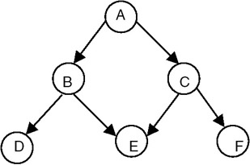
Acyclic graph
A simple diagraph which does not have any cycle is called acyclic.

Slide 29
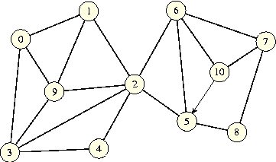
Connected graph
A graph is connected when there is a path between every pair of vertices. In a connected graph, there are no unreachable vertices.

Slide 30
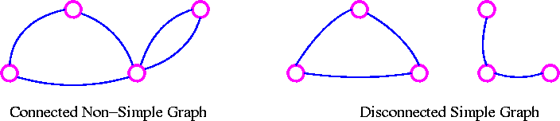
Disconnected graph
A graph G is connected if there is a path in G between any given pair of vertices, otherwise it is disconnected. Every disconnected graph can be split up into a number of connected sub-graphs, called components.

Slide 31
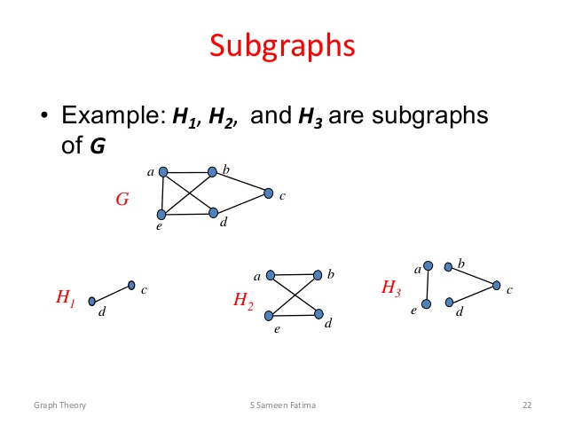
Sub-graph
Let G be a graph with vertex set V(G) and edge-list E(G). A sub-graph of G is a graph all of whose vertices belong to V(G) and all of whose edges belong to E(G).

Slide 32
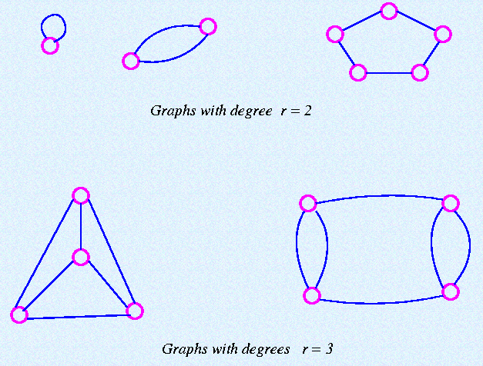
Regular graph
A graph is regular if all the vertices of G have the same degree. In particular, if the degree of each vertex is r, the G is regular of degree r.

Slide 33
Representation of graphs
Normally a graph can be represented by two representations and those are :
Adjacency matrix
Adjacency list

Slide 34
Adjacency Matrix Representation
In this representation, each graph of n nodes is represented by an n x n matrix A, that is, a two-dimensional array A
A[i][j] = 1 if (i,j) is an edge
A[i][j] = 0 if (i,j) is not an edge

Slide 35
Adjacency matrix
1
2
3
4
5

Slide 36
Adjacency Lists Representation
A graph of n nodes is represented by a one-dimensional array L of linked lists, where
L[i] is the linked list containing all the nodes adjacent from node i.
The nodes in the list L[i] are in no particular order

Slide 37
Adjacency List
1
2
1
2
3
4
5
2 3 4
1 4
1 4 5
3
4
1 2 3 5
3 4
5

Slide 38


