Slide 1
Module 4

Slide 2
Topics
Module-4 Queue, Stack and Linked List
Representing Queues using Arrays
Representing Stacks using Arrays
Polish and Reverse polish Notations, Infix to Postfix conversion
Postfix expression evaluation
Linked lists: Operations (insert)
Linked lists: Operations (delete & search)
Stack & Queue implementation using Linked List
Circular Queues, Priority Queues, Circular Linked List
Doubly linked lists
Polynomial representation & operations using Linked List

Slide 3
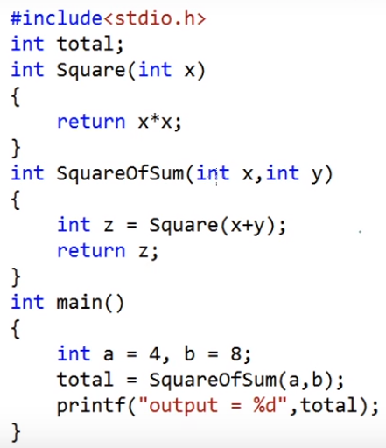
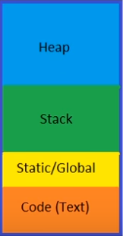
Dynamic memory allocation
STACK
Application’s memory
Function calls and local variables
Global and static data
Instructions
GLOBAL
Notes:
https://www.youtube.com/watch?v=_8-ht2AKyH4

Slide 4
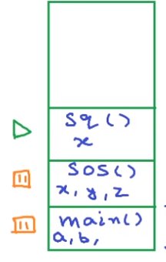
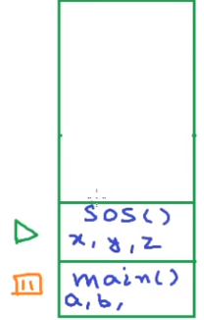
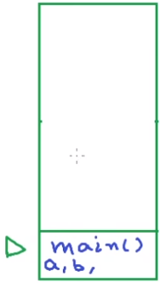
STACK FRAME
total
total
total
Global
Global
Global

Slide 5
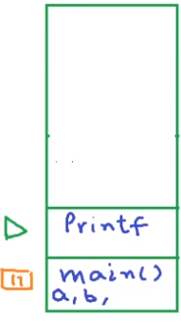

stack
stack
OS allocates some amount of space for stack at compile time but stack frames and local variables are allocated at run time
If stack grows beyond the reserved space (eg: bad recursion), stack overflow occurs because stack cannot grow at run time
total
Global
Global
Unlike stack, heap is not fixed. Its size can vary during the lifetime of the application. A programmer can totally control how much memory to use from heap.
Notes:
We should assign a variable global only if is needed at multiple places in multiple functions and needed for whole lifetime of the program otherwise it is just waste of memory

Slide 6
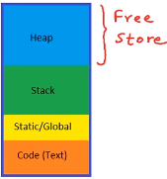

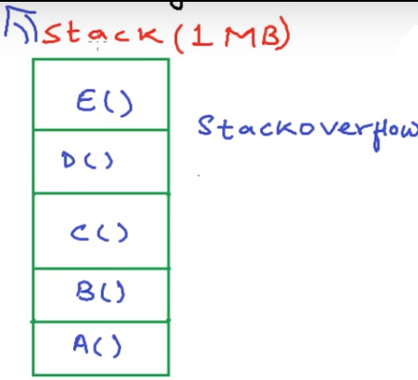
malloc
calloc
realloc
free
Heap is also called dynamic memory and using the heap is referred to as dynamic memory allocation

Slide 7
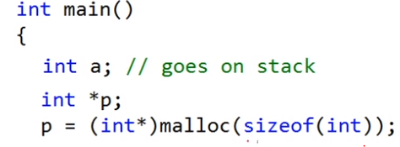

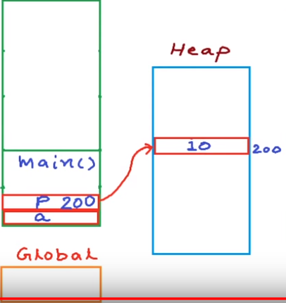

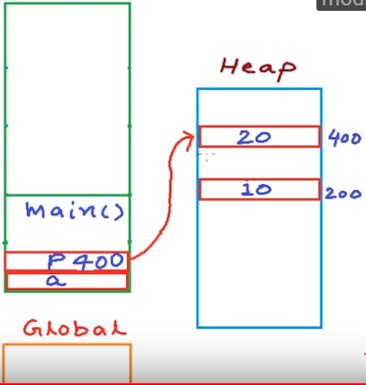
Clear the memory using free

Slide 8

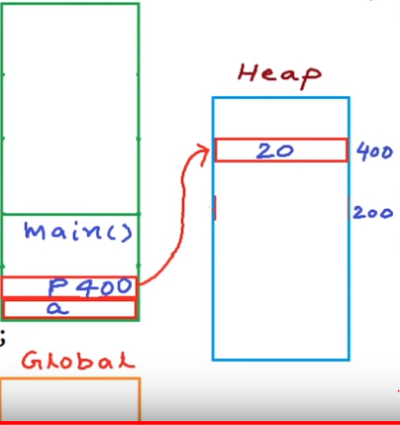
?

Slide 9
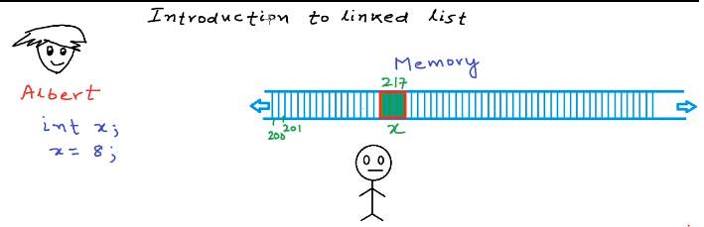
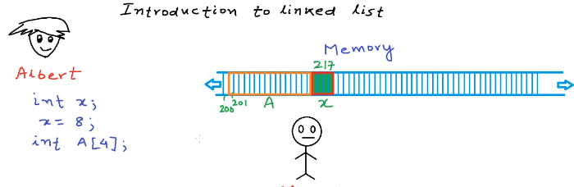
Storing an integer value in memory,
int x=8;
Memory Manager
Storing a list of numbers in memory: Using array we can store list of number of same type, array is always stored as one contiguous block of memory
Memory Manager

Slide 10
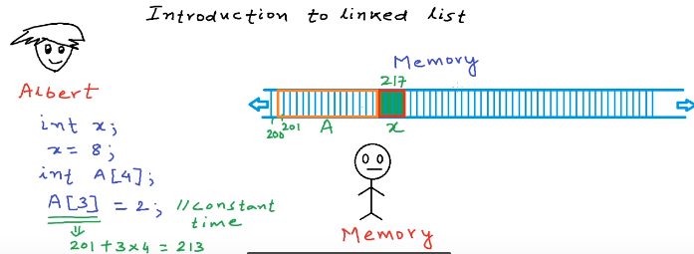
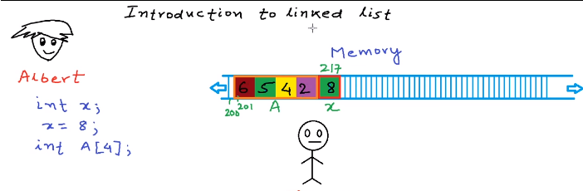
Irrespective of the size of arrays, an application can access any of the elements in array in constant time(Random access)
Memory Manager
Storing elements in array: a[0]=6; a[1]=5; a[2]=4; a[3]=2;
Memory Manager

Slide 11
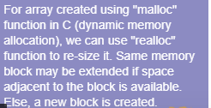
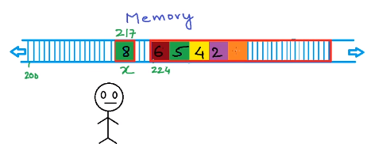
Now, adding one more element to the array won't be possible in the same location, therefore the array is copied to a different memory area where the sufficient space is available
Memory Manager
Memory Manager
Creation of entirely new array is costly. Solution to this problem is linked list data structure
Creation of entirely new array is costly. Solution to this problem is linked list data structure
Memory Manager

Slide 12
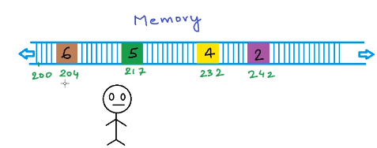
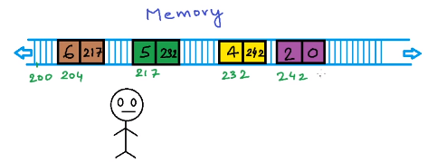
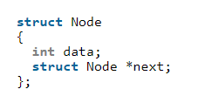
If we request for one element at a time, instead of getting one contiguous block of memory we get these disjoint, non-contiguous block of memory
Memory Manager
Now we need to link these newly created blocks. To link these blocks, we store some extra information with the block.
Memory Manager
Request MM for 2 blocks where 1st block stores the value and other variable stores the address of the next block in order to create a link

Slide 13

Linked List vs Array
Both Arrays and Linked List can be used to store linear data of similar types, but they both have some advantages and disadvantages over each other.
Following are the points in favor of Linked Lists.
(1) The size of the arrays is fixed: So we must know the upper limit on the number of elements in advance. Also, generally, the allocated memory is equal to the upper limit irrespective of the usage, and in practical uses, upper limit is rarely reached.
(2) Inserting a new element in an array (sorted) of elements is expensive, because room has to be created for the new elements and to create room existing elements have to shifted.
Linked lists have following drawbacks 1) Random access is not allowed. We have to access elements sequentially starting from the first node. So we cannot do binary search with linked lists. 2) Extra memory space for a pointer is required with each element of the list.
Logical representation of linked list. Each node stores the data and address to the next node. First node also called as head node and the only information about the list that we keep all the time is address of the first node. The address of the last node is null.

Slide 14

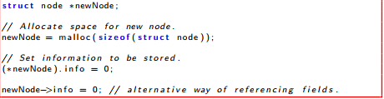
Linked list operations
Operations on Linked Lists Declaring a Node Type Linked list is a collection of data item, where each item is stored in a structure (node). The structure for node can be declared as follows:
Operations on Linked Lists
1. Creating Nodes

