Slide 1
Unit 5 ORACLE & DB2 Architecture

Slide 2
ORACLE Architecture (Instance)

Slide 3
Oracle Instance
Every running Oracle database is associated with an Oracle instance.
When a database is started on a database server (regardless of the type of computer), Oracle allocates a memory area called the System Global Area (SGA) and starts one or more Oracle processes.
This combination of the SGA and the Oracle processes is called an Oracle instance.
The memory and processes of an instance manage the associated database's data efficiently and serve the one or multiple users of the database.

Slide 4
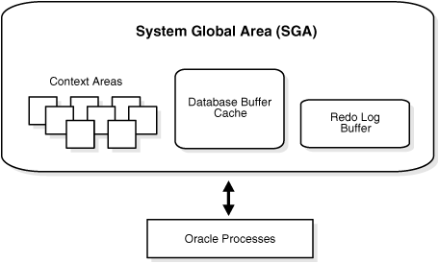
Oracle Instance

Slide 5
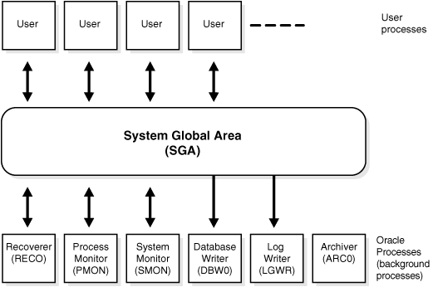
Oracle Instance (in detail)

Slide 6
USER Processes
When a user runs an application program (such as a Pro*C program) or an Oracle tool (such as Enterprise Manager or SQL*Plus), Oracle creates a user process to run the user's application.
Connection and session are closely related to user process but are very different in meaning.
A connection is a communication pathway between a user process and an Oracle instance. A communication pathway is established using available inter-process communication mechanisms (on a computer that runs both the user process and Oracle) or network software (when different computers run the database application and Oracle, and communicate through a network).
A session is a specific connection of a user to an Oracle instance through a user process. For example, when a user starts SQL*Plus, the user must provide a valid user name and password, and then a session is established for that user. A session lasts from the time the user connects until the time the user disconnects or exits the database application.

Slide 7
ORACLE Processes
This section describes the two types of processes that run the Oracle database server code (server processes and background processes).

Slide 8
ORACLE Processes (Server Processes)
Server processes (or the server portion of combined user/server processes) created on behalf of each user's application can perform one or more of the following:
Parse and run SQL statements issued through the application
Read necessary data blocks from data files on disk into the shared database buffers of the SGA, if the blocks are not already present in the SGA
Return results in such a way that the application can process the information

Slide 9
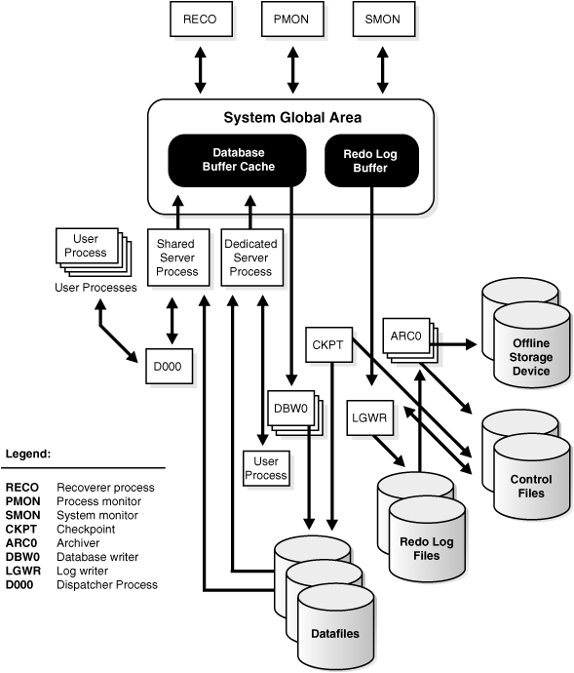
ORACLE Processes (Background Processes)

Slide 10
ORACLE Processes (Background Processes)
The database writer process (DBWn) writes the contents of buffers to datafiles.
The log writer process (LGWR) is responsible for redo log buffer management—writing the redo log buffer to a redo log file on disk. LGWR writes all redo entries that have been copied into the buffer since the last time it wrote.
The archiver process (ARCn) copies redo log files to a designated storage device after a log switch has occurred. ARCn processes are present only when the database is in ARCHIVELOG mode, and automatic archiving is enabled.

Slide 11
ORACLE Processes (Background Processes)
When a checkpoint occurs, Oracle must update the headers of all datafiles to record the details of the checkpoint. This is done by the CKPT process.The CKPT process does not write blocks to disk; DBWn always performs that work.
The system monitor process (SMON) performs recovery, if necessary, at instance startup. SMON is also responsible for cleaning up temporary segments that are no longer in use and for coalescing contiguous free extents within dictionary managed tablespaces.
The process monitor (PMON) performs process recovery when a user process fails. PMON is responsible for cleaning up the database buffer cache and freeing resources that the user process was using. For example, it resets the status of the active transaction table, releases locks, and removes the process ID from the list of active processes.

Slide 12
ORACLE Processes (Background Processes)
The recoverer process (RECO) is a background process used with the distributed database configuration that automatically resolves failures involving distributed transactions. The RECO process of a node automatically connects to other databases involved in an in-doubt distributed transaction.
Job queue processes are used for batch processing. They run user jobs. They can be viewed as a scheduler service that can be used to schedule jobs as PL/SQL statements or procedures on an Oracle instance. Given a start date and an interval, the job queue processes try to run the job at the next occurrence of the interval.
The queue monitor process is an optional background process for Oracle Streams Advanced Queuing, which monitors the message queues. You can configure up to 10 queue monitor processes. These processes, like the job queue processes, are different from other Oracle background processes in that process failure does not cause the instance to fail.

Slide 13
ORACLE Architecture (Database)

Slide 14
ORACLE Database
After starting an instance, Oracle associates the instance with the specified database. This is a mounted database. The database is then ready to be opened, which makes it accessible to authorized users.
A database is a collection of data on disk in one or more files on a database server that collects and maintains related information.
The database consists of various physical and logical structures. The table is the most important logical structure having rows and columns.
A database provides a level of security to prevent unauthorized access to the data

Slide 15
Starting a database
Starts an Instance: When Oracle starts an instance, it allocates an SGA, which is a shared area of memory used for database information, and creates background processes. At this point, no database is associated with these memory structures and processes.
Database is Mounted: The instance mounts a database to associate the database with that instance. To mount the database, the instance finds the database control files and opens them. Control files are specified in the CONTROL_FILES initialization parameter in the parameter file used to start the instance. Oracle then reads the control files to get the names of the database's data files and redo log files.
Open the Database: Either in READ Only mode or WRITE mode.

Slide 16
Database Shutdown
Close the Database: Oracle writes all database data and recovery data in the SGA to the data files and redo log files, respectively. Next, Oracle closes all online data files and redo log files.
Unmount the Database: After the database is closed, Oracle unmounts the database to disassociate it from the instance. At this point, the instance remains in the memory of your computer. After a database is unmounted, Oracle closes the control files of the database.
Shutdown an Instance: The final step in database shutdown is shutting down the instance. When you shut down an instance, the SGA is removed from memory and the background processes are terminated.

Slide 17
ORACLE SQL Processing

Slide 18
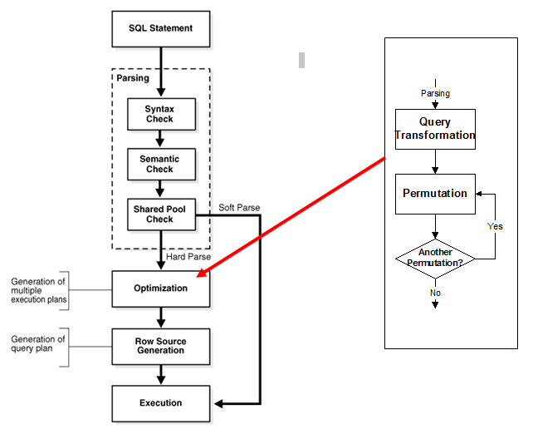
ORACLE SQL Processing

Slide 19
DB2

Slide 20
Introduction
DB2 is a database product from IBM. It is a Relational Database Management System (RDBMS).
DB2 is designed to store, analyze and retrieve the data efficiently.
DB2 product is extended with the support of Object-Oriented features and non-relational structures with XML.

Slide 21
DB2 Instance
An Instance is a logical environment for DB2 Database Manager. Using instance, you can manage databases. Depending on our requirements, you can create multiple instances on one physical machine.
The contents of Instance directory are:
Database Manager Configuration file
System Database Directory
Node Directory
Node Configuration File [db2nodes.cfg]
Debugging files, dump files
For DB2 Database Server, the default instance is “DB2”. It is not possible to change the location of Instance directory after its creation. An instance can manage multiple databases. In an instance, each database has a unique name, its own set of catalog tables, configurations files, authorities and privileges.

Slide 22
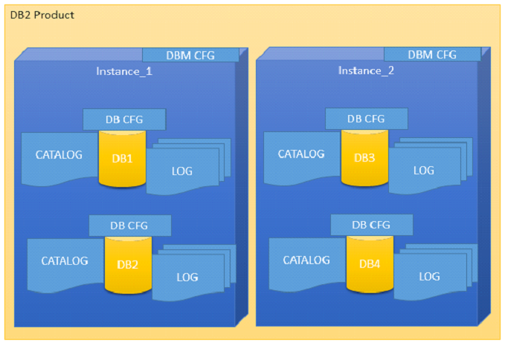
DB2 Instance Architecture

Slide 23
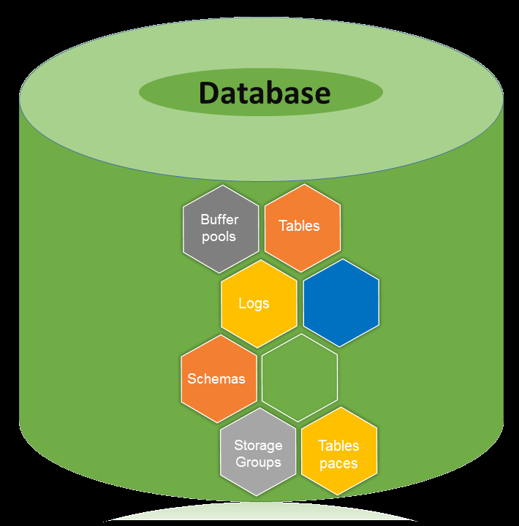
DB2 Database
A database is a collection of Tables, Schemas, Bufferpools, Logs, Storage groups and Tablespaces working together to handle database operations efficiently.
Database directory is an organized repository of databases. When you create a database, all the details about database are stored in a database directory, such as details of default storage devices, configuration files, and temporary tables list etc.

Slide 24
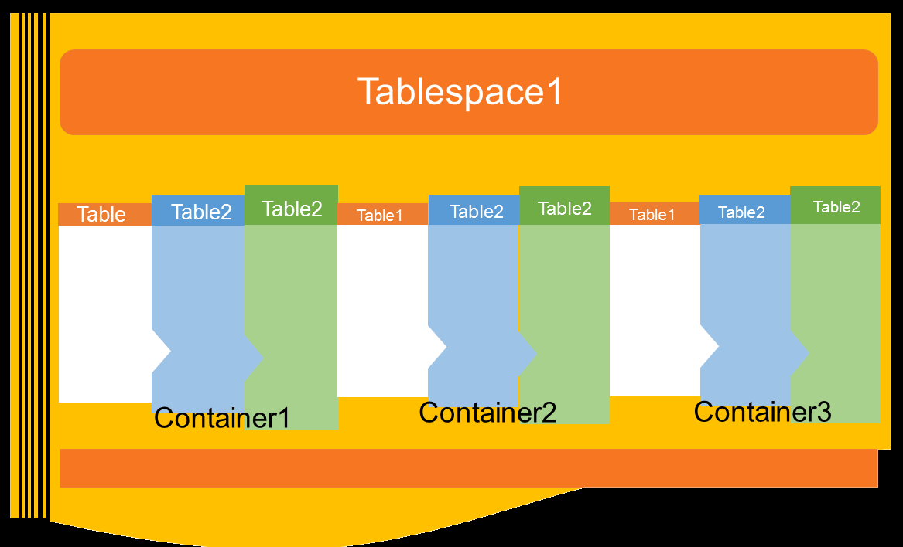
DB2 Tablespaces
A table space is a storage structure, it contains tables, indexes, large objects, and long data. It can be used to organize data in a database into logical storage group which is related with where data stored on a system. This tablespaces are stored in database partition groups
Tablespaces contains one or more containers. A container can be a directory name, a device name, or a filename. In a database, a single tablespace can have several containers on the same physical storage device.
Default Tablespace:
Catalog tablespace
User tablespace
Temporary tablespace

Slide 25
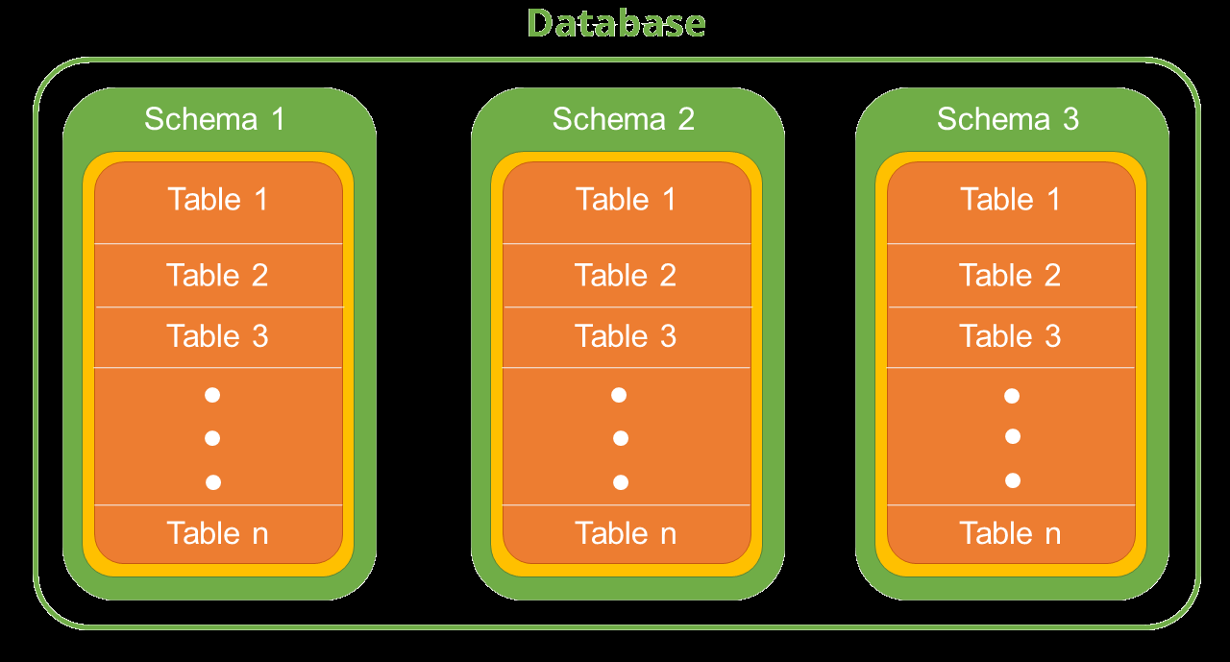
DB2 Schema
A schema is a collection of named objects classified logically in the database.
In a database, you cannot create multiple database objects with same name. To do so, the schema provides a group environment. You can create multiple schemas in a database and you can create multiple database objects with same name, with different schema groups.
A schema can contain tables, functions, indices, tablespaces, procedures, triggers etc.

