Slide 1
DISTRIBUTED COMPUTING

Slide 2
CONTENTS
CENTRALISED VS DISTRIBUTED COMPUTING
INTRODUCTION
ARCHITECTURE
HISTORY
GOAL
CHARACTERISTICS
EXAMPLES OF DISTRIBUTED COMPUTING
TYPICAL DISTRIBUTED COMPUTING
ADVANTAGES
DISADVANTEGES
ISSUES AND CHALLENGES

Slide 3
Lets Start !!

Slide 4
CENTRALISED VS DISTRIBUTED COMPUTING
1

Slide 5
“The purpose of computing is insight not numbers”
– Richard Hamming

Slide 6
Centralised vs Distributed Computing
Centralised
Early processing was performed on a single processor. Uni processor computing can be called Centralised Computing.
Distributed
A Distributed system is a collection of independent computers, interconnected via a network, capable of collaborating on a task.

Slide 7
INTRODUCTION
DEFINITON:-
A distributed system consists of multiple autonomous computers that communicate through a computer network
Distributed computing utilizes a network of many computers, each accomplishing a portion of an overall task, to achieve a computational result much more quickly than with a single computer.
Distributed computing is any computing that involves multiple computers remote from each other that each have a role in a computation problem or information processing.

Slide 8
Distributed computing is any computing that involves multiple computers remote from each other that each have a role in a computation problem or information processing.
In the term distributed computing, the word distributed means spread out across space. Thus, distributed computing is an activity performed on a spatially distributed system.
These networked computers may be in the same room, same campus, same country, or in different continents.

Slide 9
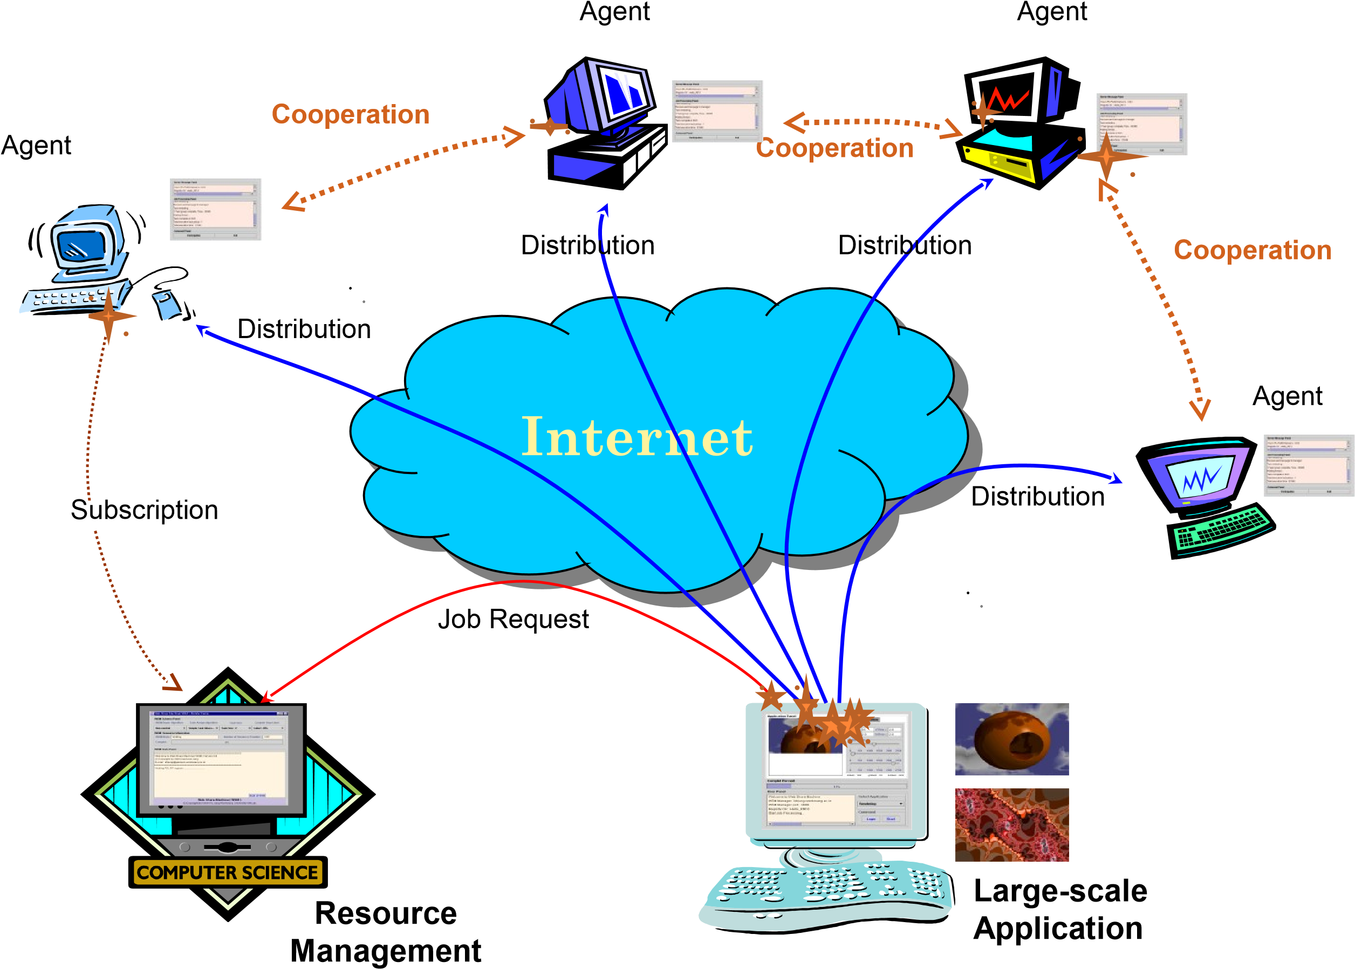

Slide 10
ARCHITECTURE
2

Slide 11
ARCHITECTURE
Distributed programming typically falls into one of several basic architectures or categories: Client-server, 3-tier architecture, N-tier architecture, Distributed objects, loose coupling, or tight coupling.
Client-server — Smart client code contacts the server for data, then formats and displays it to the user. Input at the client is committed back to the server when it represents a permanent change.
3-tier architecture — Three tier systems move the client intelligence to a middle tier so that stateless clients can be used. This simplifies application deployment.
N-tier architecture — N-Tier refers typically to web applications which further forward their requests to other enterprise services. This type of application is the one most responsible for the success of application servers

Slide 12
Tightly coupled (clustered) — refers typically to a set of highly integrated machines that run the same process in parallel, subdividing the task in parts that are made individually by each one, and then put back together to make the final result.
Peer-to-peer —an architecture where there is no special machine or machines that provide a service or manage the network resources. Instead all responsibilities are uniformly divided among all machines, known as peers. Peers can serve both as clients and servers.
Space based — refers to an infrastructure that creates the illusion (virtualization) of one single address-space. Data are transparently replicated according to application needs. Decoupling in time, space and reference is achieved.

Slide 13
HISTORY
3

Slide 14
HISTORY
1975 -1995
Parallel computing was favoured in early years
Primarily vector based at first
Gradually more thread-based parallelism was introduced
The first distributed computing programs were a pair of programs called Creeper and Reaper invented in 1970s
Ethernet that was invented in 1970s.
ARPANET e-mail was invented in the early 1970s and probably the earliest example of a large-scale distributed application.
Massively parallel architectures start rising and message passing interface and other libraries developed
Bandwidth was a big problem

Slide 15
The first Internet-based distributed computing project was started in 1988 by the DEC System Research Centre.
Distributed.net was a project founded in 1997 - considered the first to use the internet to distribute data for calculation and collect the results.
1995-TODAY
Cluster/grid architecture increasingly dominant
Special node machines eschewed in favour of COTS technologies
Web-wide cluster software
Google take this to the extreme (thousands of nodes/cluster)
SETI@Home started in May 1999 - analyse the radio signals that were being collected by the Arecibo Radio Telescope in Puerto Rico.

Slide 16
GOAL
4

Slide 17
GOAL
Making Resources Accessible
Data sharing and device sharing
Distribution Transparency
Access, location, migration, relocation, replication, concurrency, failure
Communication
Make human-to-human comm. easier. E.g.. : electronic mail
Flexibility
Spread the work load over the available machines in the most cost effective way
To coordinate the use of shared resources
To solve large computational problem

Slide 18
CHARACTERISTICS
5

Slide 19
CHARACTERISTICS
Resource Sharing
Openness
Concurrency
Scalability
Fault Tolerance
Transparency

Slide 20
EXAMPLES
6

Slide 21
EXAMPLES OF DISTRIBUTED COMPUTING
Network of workstations (NOW) / PCs: a group of networked personal workstations or PCs connected to one or more server machines.
Distributed computing using mobile agents
The Internet(World Wide Web)
An intranet: a network of computers and workstations within an organization, segregated from the Internet via a protective device (a firewall).
JAVA Remote Method Invocation (RMI)

Slide 22
TYPICAL DISTRIIBUTED COMPUTING
7

Slide 23
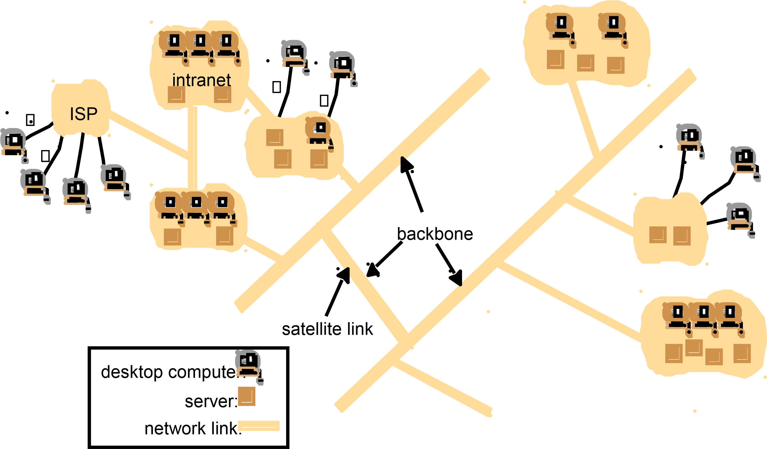

Slide 24
ADVANTAGES
8

Slide 25
ADVANTAGES
Cost : Better price / performance as long as everyday hardware is used for the component computers – Better use of existing hardware
Performance : By using the combined processing and storage capacity of many nodes, performance levels can be reached that are out of the scope of centralised machines
Scalability : Resources such as processing and storage capacity can be increased incrementally
Inherent distribution : Some applications like the Web are naturally distributed
Reliability : By having redundant components the impact of hardware and software faults on users can be reduced

Slide 26
DISADVANTAGES
9

Slide 27
DISADVANTAGES
Multiple Points of Failures: the failure of one or more participating computers, or one or more network links, can generate trouble.
Security Concerns: In a distributed system, there are more opportunities for unauthorized attack.
Software: Distributed software is harder to develop than conventional software; hence, it is more expensive

Slide 28
ISSUES AND CHALLENGES
10

Slide 29
ISSUES AND CHALLENGES
Heterogeneity of components :-
Variety or differences that apply to computer hardware, network, OS, programming language and implementations by different developers
All differences in representation must be deal with if to do message exchange.
Example : different call for exchange message in UNIX different from Windows.
Openness:-
System can be extended and re-implemented in various ways.
Cannot be achieved unless the specification and documentation are made available to software developer.
The most challenge to designer is to tackle the complexity of distributed system; design by different people.

Slide 30
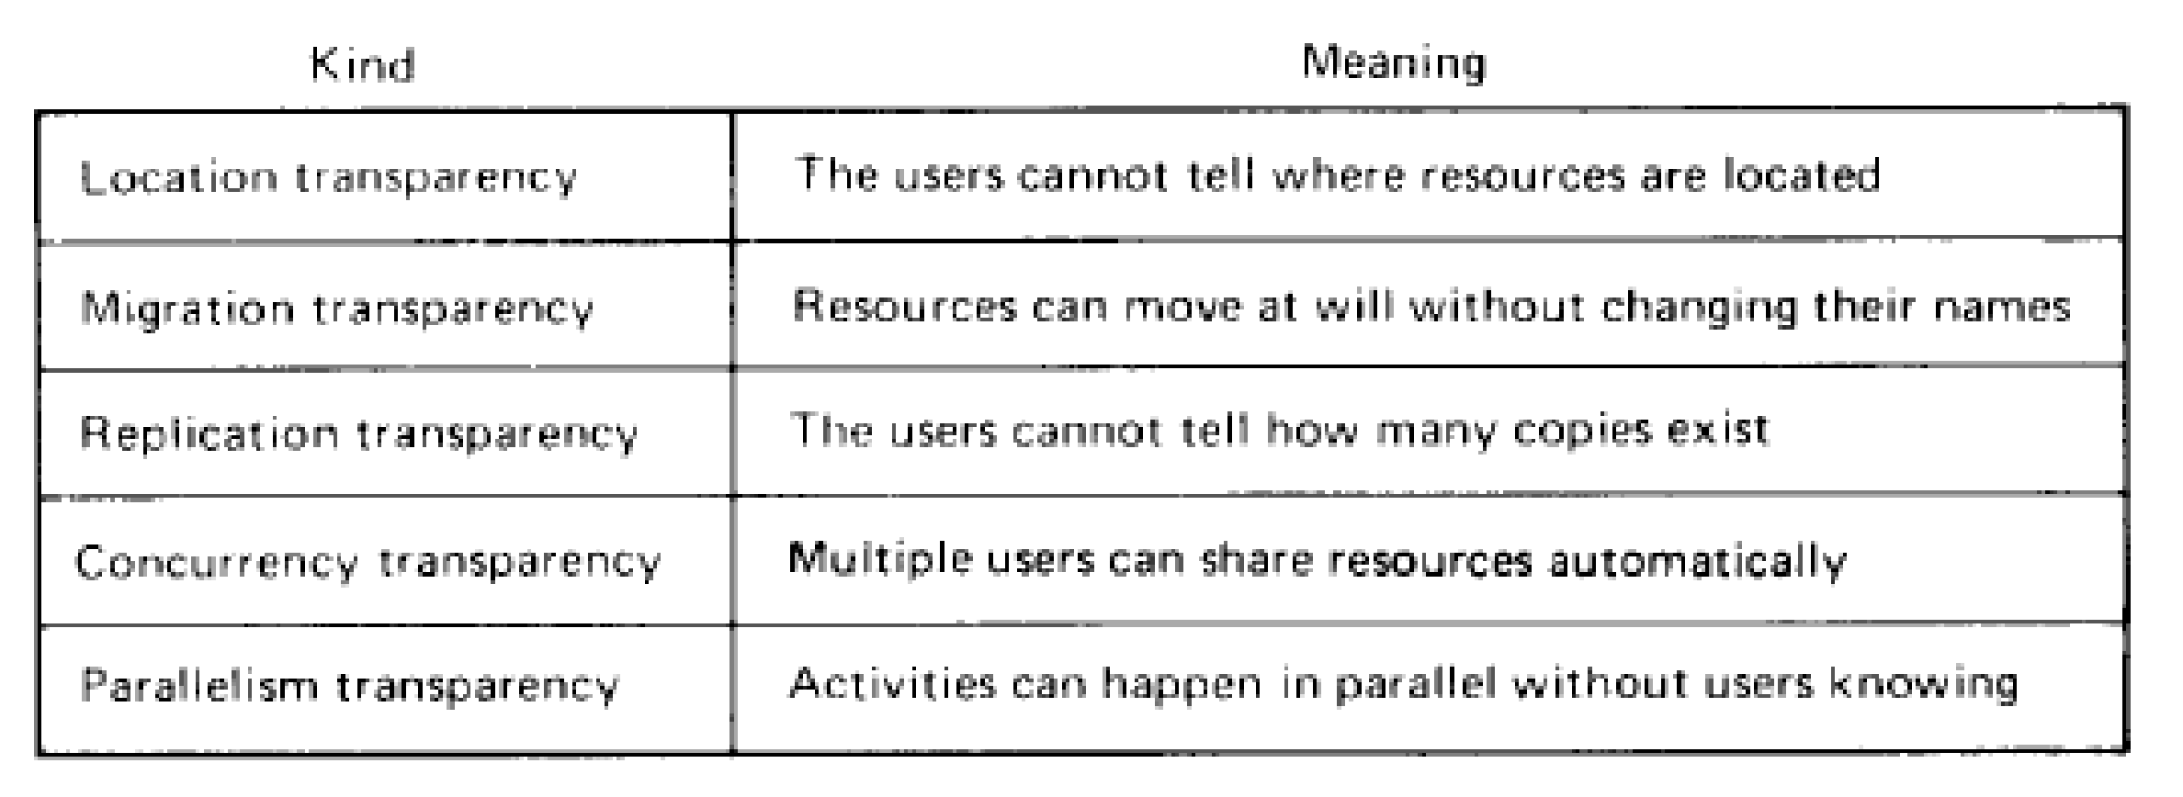
ISSUES AND CHALLENGES
Transparency:-
Aim : make certain aspects of distribution are invisible to the application programmer ; focus on design of their particular application.
They not concern the locations and details of how it operate, either replicated or migrated.
Failures can be presented to application programmers in the form of exceptions – must be handled.

Slide 31
ISSUES AND CHALLENGES
Security:
Security for information resources in distributed system have 3 components :
Confidentiality : protection against disclosure to unauthorized individuals.
Integrity : protection against alteration/corruption
Availability : protection against interference with the means to access the resources.
The challenge is to send sensitive information over Internet in a secure manner and to identify a remote user or other agent correctly.

Slide 32
ISSUES AND CHALLENGES
Scalability :-
Distributed computing operates at many different scales, ranging from small Intranet to Internet.
A system is scalable if there is significant increase in the number of resources and users.
The challenges is :
controlling the cost of physical resources.
controlling the performance loss.
preventing software resource running out.
avoiding performance bottlenecks.

Slide 33
ISSUES AND CHALLENGES
Failure Handling :-
Failures in a distributed system are partial – some components fail while others can function.
That’s why handling the failures are difficult
Detecting failures : to manage the presence of failures cannot be detected but may be suspected.
Masking failures : hiding failure not guaranteed in the worst case.
Concurrency :-
Where applications/services process concurrency, it will effect a conflict in operations with one another and produce inconsistence results.
Each resource must be designed to be safe in a concurrent environment.

Slide 34
Thanks!
Any questions?

