Slide 1
B.TECH CSE with Specialization in
Big Data Overview
Big Data Ecosystem
Notes:
Notes for the Facilitator:
Tell the participants that you will talk to them about ‘Big Data Ecosystem’ in this module.
Notes for the Participants:
You will learn about ‘Big Data Ecosystem’ in this module.

Slide 2

Module Learning Objectives
Module 7: Big Data Ecosystem
At the end of this module, you will be able to:
Explain how scalability can be achieved in Big Data Storage.
Understand and describe the basics of Big Data Processing.
Explain how Data Processing is done using MapReduce.
List and explain the different user interfaces in MapReduce, its daemons, the benefits of using MapReduce and use cases.
Understand and explain Data Locality, its categories, the advantages and disadvantages of implementing Data Locality.
Explain about resilience and fault tolerance in Big Data Systems.
Notes:
Notes for the Facilitator:
Reiterate the module objectives for the participants.
Notes for the Participants:
Take note of the module objectives in this module.

Slide 3
Module Topics
Module 7: Big Data Ecosystem
Let us take a quick look at the topics we will cover in this module:
The Big Data Ecosystem
Scalable Storage
Scalable Processing Using MapReduce
Data Locality
Resilience and Fault Tolerance
Notes:
Notes for the Facilitator:
Tell the participants that the list of topics that they will be covering can be seen on the slide.
Notes for the Participants:
Look at the topics you will be learning about in this module.

Slide 4
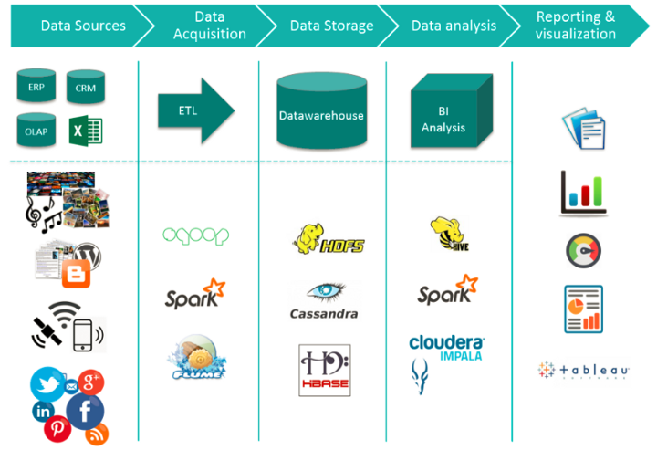
The Big Data Ecosystem
Module 7: Big Data Ecosystem
Notes:
Notes to the Facilitator:
Explain the participants about the big data ecosystem and the processes and technologies associated with it.
Notes to the Participants:
In the previous modules we learnt about data in general, its types, big data, its sources and its characteristics. Now we’ll see an overview of the big data ecosystem, its components and the processes involved. In the forthcoming semesters you will learn about the individual components of the big data ecosystem, tools and technologies associated with them and applications.
The big data ecosystem is a collection of components for data source, acquisition, storage, processing and analysis and data visualization.
Data can come from multiple sources and we have seen about the sources of big data in earlier module. The incoming has to be subjected to Extract, Transform, Load (ETL) process for acquiring it into the system for further processing. Some examples for the tools available for ETL are listed above: Sqoop, Flume, Spark, etc.
Once data is acquired, it needs to be stored in a suitable storage system. We have learnt that big data is mostly unstructured. NoSQL databases are best suited for storage. To make the data highly available, distributed file systems like HDFS are commonly used storing big data. We’ll learn about these databases and file systems in detail in the upcoming semesters.
Data available in the storage systems is then processed and analyzed for extracting the right insights out of it. Data processing frameworks like Hadoop MapReduce and Spark are used commonly for this purpose. We’ll learn about the MapReduce framework in detail in the upcoming sections in this module.
The final step is to present the data in visually appealing formats, so that non-technical people will also understand it better. Tools like Tableau are commonly used for it.
We have learnt about data sources in earlier modules, we’ll now move on to learn more about big data storage systems.

Slide 5
2. Big Data storage
Module 7: Big Data Ecosystem
The exponential increase in the volume of data generated every day.
Compute-and-storage architecture that collects and manages large data sets and enable real-time analytics.
Factors to consider:
Storage specs
Factors
Data Protection
Infrastructure choice
Analytics
Fault tolerance
Scalability
High availability
Notes:
Notes for the Facilitator:
Explain the participants the basic concepts of Big Data Storage and the important factors to consider while making a decision on storage systems.
Notes for the Participants:
In the previous modules, we have learnt enough and more about Big Data and its characteristics. We have also learnt that the amount of data generated around us keeps growing by the second. All this data needs to be sent, stored or processed to analyze and derive the right value. We have come across several data storage mechanisms like Relational and Non-relational Databases.
Big data has become a buzz, because of its use in providing actionable insights. Organizations can leverage the potential of big data by using analytics applications to extract information and derive insights. Big data sets include huge volumes of unstructured data and include variety of data types include emails, sensor data, log files, social media data, business transactions and a lot more.
Big data storage is a compute-storage architecture that collects and manages large data sets and enables real-time data analytics. The storage system needs to be highly scalable and available to handle the huge volumes of data generated. The methodology selected to store big data needs to reflect the application and its use cases. We will now have a brief overview of the factors to be considered while making a decision on the choice of big data storage systems.
Storage specs
Big data applications for each and every organization vary. There are two major categories: large-scale applications and performance-intensive analytics applications. For large scale applications, bandwidth needed to transfer data needs to be really high and they should be able to handle large number of files as the number of files keeps increasing. For performance-intensive applications, emphasis should be on fast and real-time data processing systems. Response time should be much less in these applications.
Data Protection
As data continues to grow, new challenges arise in terms of Data security. The system should be able to secure the massive, multi-petabyte data sets associated with big data architectures.
Infrastructure choice
Object-based systems and scale-out file systems are the most suitable choice for handling the requirements associated with big data. Storage systems need to handle huge volumes of data and they need to keep scaling to keep up with data growth. The systems need to provide input/output operations necessary for sending the data to analytics tools.
Analytics
Big data often deals with very large unstructured data sets and is dependent on rapid analytics. The storage system has to be capable of processing data real-time, as it comes in. For example, organizations like Facebook, LinkedIn, Google, etc. analyze user data and provide real-time suggestions to the users. For applications like these, real-time processing of data is critical, as batch processing will not work. The system needs to have the capability of rapid data analytics.
Fault-tolerance
The most important factor to be considered while selecting a data storage system is fault-tolerance. Data needs to be stored in distributed systems to handle failures. If one of the servers fails, the backup servers need to take charge and handle data storage and retrieval.
Scalability
Storage systems need to be highly scalable for processing large amounts of data. Choice of database has to be based on the ability of the database to scale out.
High availability
Storage systems need to have the ability to handle and recover from the failures in a very short time. Before the failure has an impact on the end user, systems need to manage with the help of backup machines, to ensure that data is available all the time.
Two major storage options are considered for storage of big data.
NoSQL databases
Distributed File Systems
We’ll see about these two in detail in the upcoming sections.

Slide 6

2.1. Group Discussion
Module 7: Big Data Ecosystem
Notes:
Notes for the Facilitator:
Divide the students into multiple groups.
Facilitate a discussion on various types, sources and characteristics of Big Data, which play a critical role in selecting the storage option.
Let the participants come up with additional factors which can be considered while selecting the storage systems for Big Data.
Notes for the Participants:
Discuss the various types, sources and characteristics of Big Data and how these are important while making a decision on the storage options.
Also try to come up with different factors that could be considered while selecting the storage option.

Slide 7

3. NoSQL Databases
Module 7: Big Data Ecosystem
Non-relational, Open-source, Distributed and Horizontally scalable Databases.
No predefined schema and these databases do not rely on structures like tables, columns, rows, etc.
Very flexible data models and updates to databases can be done easily.
Best suited for storing huge volumes of Unstructured Data - makes it ideal for storing Big data.
DATABASE Management Big Data Volume
Information Transactions
Storage PETABYTES
Search NAS SAN
Technology ANALYSIS Software
Education Internet Large
Records INFRASTRUCTURE
Notes:
Notes for the Facilitator:
Reintroduce the concept of NoSQL databases to the participants and ask them to recollect the characteristics of them. Explain to them why NoSQL is ideal for Big Data Storage.
Notes for the Participants:
You might already be proficient with NoSQL databases, as we have already learnt about them and the categories in a previous module. Let’s quickly revisit the concepts and understand how they are suitable for storing big data.
NoSQL is a class of database management systems that do not use SQL as the query language. NoSQL (Not only SQL) databases provide a way to store and retrieve data that is modelled in a way different from relational databases. NoSQL is not a complete replacement for RDBMS, but a compensation to the technical deficiencies exhibited by them. There is no prescriptive definition for NoSQL, but it is an aggregation of common characteristics.
NoSQL initially started out as an in-house solution for the problems faced by big enterprises, such as storage and processing enormous volumes of data in real-time. Some of the products are Amazon’s DynamoDB, Google’s BigTable, LinkedIn’s Voldemort, Twitter’s FlockDB, Facebook’s Cassandra and Yahoo’s PNuts, among others. NoSQL was found as an alternative to traditional approaches as it solved three major problems:
Unprecedented data transaction volumes
Expectations of low-latency access to massive datasets
Near-perfect availability of services while operating in an unreliable environment
NoSQL databases are ‘scaled out’ (horizontal scaling) by spreading the load. This means adding more machines to a cluster without any downtime, instead of adding hardware to a single server. Horizontal scalability offers linear effects on storage and processing abilities. Also, there is no upper limit for the number of machines that can be added.
NoSQL is the best way to store and retrieve large volumes of unstructured data, with the database running on clusters. Most common examples of unstructured data include user and session data; chat, messaging and log data; time series data like IoT and device data; large objects like videos and images.
Some of the common NoSQL databases include DynamoDB, Redis, MemcacheDB, MongoDB, BigTable, Cassandra, Hadoop HBase, Neo4J, FlockDB.

Slide 8
4. Distributed File Systems
Module 7: Big Data Ecosystem
A part of Distributed systems, defined as a collection of independent computers (nodes) that appear to its users as a single coherent system.
Distributed implementation of the classical time-sharing model of file systems.
Definition - a file system that resides on different machines but offers an integrated view of the data stored on remote disks.
Overall storage comprises multiple smaller storage spaces located remotely.
Multiple users share files and resources.
Client
Network
Client
File Servers
Client
Client
Notes:
Notes for the Facilitator:
Introduce the concept of Distributed Systems to the participants. Explain them about Distributed File Systems, examples for them and how they are used for Big Data Storage.
Notes for the Participants:
With the advent of internet-scale companies, the amount of data generated and data that needs to be processed has grown in an exponential phase and it keeps growing by the time. Irrespective of the source, type and use case, generated data needs to be stored for future reuse and sharing among users. Data retrieval also needs to be quick. These data files can be stored either in a local file system or a distributed file system (DFS).
The Local file system is useful in quick data retrieval but might not be suitable for storing huge amounts of data. In these circumstances, the distributed file systems are very useful as they are highly available, scalable, reliable, secure and have the capacity to handle huge volumes of data. Distributed file system (DFS) is a part of Distributed Systems. A Distributed System can be defined as “a collection of independent computers (nodes) that appears to its users as a single coherent system.” In a Distributed System, better performance can be achieved by adding new computers to the existing system. DFS does not directly serve to data processing. They allow users to store and share data. The users are also allowed to work with the data as if the data is stored on the user’s own computer.
Compared to a traditional client-server setup, where data is stored in one single server, in a DFS, important or frequently required data can be stored on several nodes. The data in a DFS is protected from node failure. Even during the failure of one of the nodes, the other nodes will make up for it. Files in a DFS can be moved along nodes. This is done for improving load-balancing among nodes.
Some of the examples of distributed file systems include:
Hadoop Distributed File System (HDFS) - most common choice for big data storage
Ceph
GlusterFS
Google File System (GFS)
Sun Microsystem - Network File System (NFS)

Slide 9
5. Big Data Processing
Module 7: Big Data Ecosystem
Two major approaches to Big Data Processing
Batch Processing
Real-time Processing
Several Terabytes or Petabytes of data.
High-volume, high-velocity and high-variety information assets.
Data processed for deriving value out of data.
Notes:
Notes for the Facilitator:
Explain the participants the need to process Big Data and the two major approaches to Data Processing.
Notes for the Participants:
We have learnt in the previous modules about the characteristics of big data, volume, velocity and variety. These three characteristics impact the processing efforts to a great extent. Processing big data to derive the value out of it is not an easy task. Data processing has four major steps:
Data acquisition
Data storage
Data analysis
Results
There are two major approaches to big data processing:
Batch processing
Batch processing is scalable and can handle large amounts of static data. This method helps handle the issues that arise due to the volume dimension of big data. This method of data processing is fault tolerant, but latency is very high. Results cannot be expected immediately after the data is loaded on to the processing system.
Real-time processing
Real-time processing is suitable for continuous, unbounded streams of data. Real-time processing is also known as stream processing. Real-time processing has an advantage over the batch processing and the latency is low. Real-time data processing systems collect and aggregate the data as soon as changes are made in the database. This type of processing requires a continual input, constant processing, and steady output of data. This type of processing is best suited for analysing traffic data, social media data, patient health data, credit card fraud detection, e-commerce order processing, radar systems etc.
One variant to real-time data processing is near real-time (NRT) data processing, where data integration occurs periodically. Data collection happens immediately, but is not necessarily integrated instantly. At the discretion of the user, NRT data integration solutions can be programmed to process the data it collects every day, every hour, or even every few minutes. NRT processing is done when speed is important, but processing time in minutes is acceptable in place of seconds. Common examples are background processes in social media, e-commerce customer support, web analytics tools, etc.
The forthcoming sections will walk you through MapReduce, the data processing framework of Hadoop. This is one of the batch processing technologies.

Slide 10
What did you Grasp?
Module 7: Big Data Ecosystem
Which of the following is the data store used by Facebook?
BigTable
Cassandra
Voldemort
DynamoDB
In a distributed file system, servers can be located in multiple remote locations.
True
False
Notes:
Notes for the Facilitator:
Answers:
1. B. Cassandra
2. A. True

Slide 11
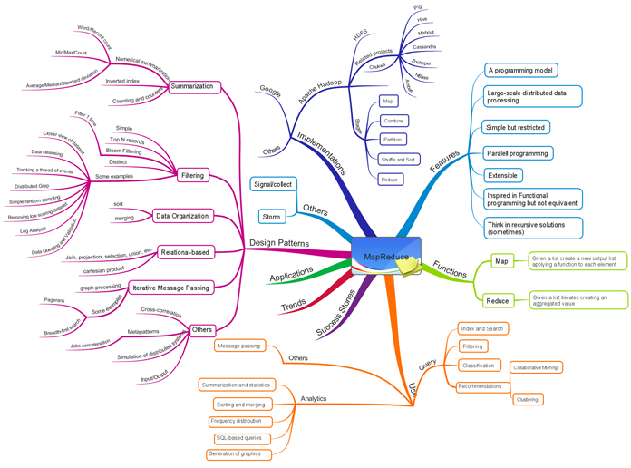
6. MapReduce - An Introduction
Module 7: Big Data Ecosystem
A programming model and associated implementation for processing and generating large data sets.
Image source: http://blog.iquestgroup.com/en/files/2013/06/MapReduce-thumb.png
Notes:
Notes for the Facilitator:
Explain the participants, the basics of MapReduce and how it is used for processing large data sets.
Notes for the Participants:
MapReduce is considered to be the heart of Apache Hadoop. It is the original framework developed for writing applications that can process large amounts of structured and unstructured data stored in Hadoop Distributed File Systems (HDFS). The MapReduce allows for massive scalability across hundreds or thousands of servers in a Hadoop cluster. HDFS was initially a tightly coupled entity with MapReduce. Later, Hadoop became open to other data processing engines that can run alongside MapReduce. A typical MapReduce computation is used for batch processing of terabytes or petabytes of data on thousands of machines.
The basic unit of information used in MapReduce is a (Key, Value) pairs, called Tuples. All structured and unstructured data has to be converted to this basic unit before processing. A MapReduce job divides a large data set into independent chunks and organizes them into Tuples for parallel processing. The advantage of this parallel processing is that it improves the speed and reliability of the cluster as the solutions are returned more quickly, with a greater reliability.
MapReduce actually refers to two separate and distinct tasks that Hadoop programs perform.
The first is the Map job, which takes a set of data and converts it into another set of data, where individual elements are broken down into tuples.
The Reduce job picks it up from there, i.e, the output from the map job is the input for the Reduce job, combining the Tuples into smaller sets.
There are two interfaces Mapper and Reducer implemented by applications, which perform these Maps and Reduce jobs. As the name implies, the Reduce job is always performed after the map job. We will now learn in detail, about the Map and Reduce jobs and how the Data Processing is done using these processes.

Slide 12
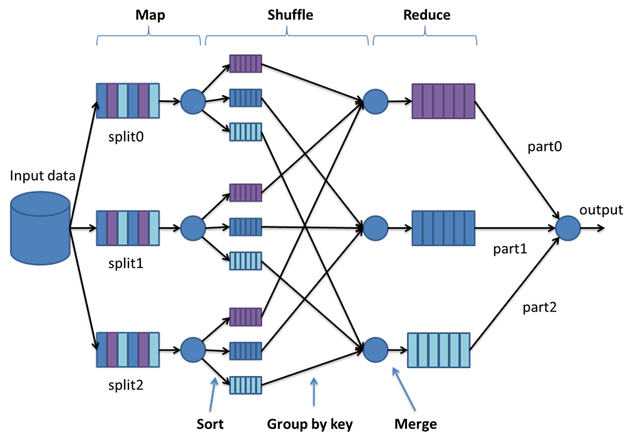
6.1. Map
Module 7: Big Data Ecosystem
Map function enables handling of unstructured data.
Mapper maps input key/value pairs to a set of intermediate key/value pairs.
Maps transform the input records to intermediate records.
Output from Mapper are sorted and partitioned per reducer by a Partitioner.
Given input may map to zero or many output pairs.
Notes:
Notes for the Facilitator:
Explain the Map job in detail to the participants and how the Data Processing is initiated by the Map job.
Notes for the Participants:
As mentioned in the previous slide, the applications implement two interfaces, Mapper and Reducer, that carry out the map and reduce jobs, respectively.The Map function initiates the data processing by collecting the data and transforming them into intermediate key/value pairs. The MapReduce logic works in a way that is different from the other Data Processing Systems and is not restricted to the Structured Data Sets. The Map stage is critical for enabling the system to handle large volumes of Unstructured Data. The Mapper interface brings structure to the Unstructured Data.
The Mapper interface maps the input key/value pairs to a set of intermediate key/value pairs. The Map function divides the input into ranges using the InputFormat interface and creates a map task for each range in the input. The JobTracker (a daemon of MapReduce) distributes those tasks to the worker nodes. The output of each Map task is partitioned into a group of Key-value pairs for each Reduce. It is important to think of the map operation as stateless, that is, its logic operates on a single pair at a time (even if in practice, several input pairs are delivered to the same Mapper).
It is not necessary that the intermediate record is of the same type as that of the input record. The input may map to zero or many output pairs. The applications can also use a Reporter interface to report progress and set application-level messages.
All the intermediate values associated with a given output key are subsequently grouped by the framework and passed to the reducer. The Users can also make use of a comparator to control the grouping process. Outputs from Mapper are partitioned Reducer. The total number of partitions will be the same as that of the number of reduce tasks for that job. The Users can use a custom Partitioner to control which record goes to which Reducer.The Users can also specify an optional Combiner, which aggregates the intermediate outputs locally, which helps in cutting down the amount of data that is transferred to the Reducer.
Once the Map job is complete, the entire data set will have a structure in the form of key/value pairs, thus enabling the system to handle Unstructured Data.
The number of maps is generally determined based on the total size of the input. The ideal level of parallelism for Maps seems to be around 10-100 Maps per node. In some cases, like CPU-light map tasks, this has been set up to 300 maps. The Task setup takes some time, so it is best if the maps take at least a minute to execute. Thus, there will be 82,000 maps for an input data of 10TB and a block size of 128MB.
We will now move on to see how the Reduce job is carried out.

Slide 13
6.2 Reduce
Module 7: Big Data Ecosystem
Reducer interface reduces a set of intermediate values which share a key to a smaller set of values.
Reduce function pulls the relevant partitions created from map process and writes the output back to the HDFS. There are three phases in Reduce job.
Phases of Reduce
Shuffle
Reduce
Sort
Notes:
Notes for the Facilitator:
Explain the participants about the Reduce job and the phases involved in it.
Notes for the Participants:
To give an overview of the Reduce job, the Reduce function collects the intermediate outputs from map function and combines them to answer the larger problem that the Master node needs to solve. Each Reduce pulls the relevant partition from the machines where the maps are executed and write the output back into HDFS. Thus, the Reduce job collects the data from all the maps for the keys and combines them to solve the problem.
The Reducer interface first reduces a set of intermediate values which share a key to a smaller set of values. The User sets the number of reduces for the job. The Reducer has three major phases:
Shuffle
The Sorted output from the Mappers serves as input for the Reducer. In the shuffle phase, using an HTTP request, the framework fetches the relevant partition of the output of all the mappers.
Sort:
In the Sort phase, the framework groups Reducer inputs based on the keys, since different mappers may have the output for the same key. The shuffle and sort phases occur in parallel. The Map outputs are merged while being fetched.
Secondary Sort
If equivalence rules for grouping the intermediate keys are required to be different from those for grouping keys before reduction, then a user may specify a Comparator. The user can also control how intermediate keys are grouped, these can be used in conjunction to simulate the secondary sort on values.
Reduce
In this phase, the Reduce method is called for each <key, (list of values)> pair in the grouped inputs. The output of the reduce task is written to the FileSystem. Applications can use the Reporter to report progress, set application-level status messages or just indicate that they are alive. The output of the Reducer is not sorted.
Increasing the number of reduces increases the overhead on the framework, but increases load balancing and lowers the cost of failures. The scaling factors are slightly less than whole numbers to reserve a few reduce slots in the framework for speculative-tasks and failed tasks.
Reducer NONE
It is possible to set the number of reduce-tasks to zero if no reduction is desired. In this case, the outputs of the map-tasks go directly to the FileSystem, into the output path. The framework does not sort the map-outputs before writing them out to the FileSystem.
Overall, a program in the MapReduce paradigm can consist of many rounds (usually called jobs) of a different map and reduce functions, performed sequentially one after another.

Slide 14
6.3 Other User Interfaces of MapReduce
Module 7: Big Data Ecosystem
Common user interfaces of MapReduce other than Mapper and Reducer
Partitioner
Reporter
Output Collector
Notes:
Notes for the Facilitator:
Explain the participants about the three other user interfaces and their functions of a MapReduce framework:
Partitioner
Reporter
OutputCollector
Notes for the Participants:
There are three other important user interfaces, apart from Mapper and Reducer. There are other interfaces as well, like JobConf, JobClient, InputFormat, OutputFormat and OutputCommitter among others. Hadoop MapReduce comes bundled with a library of generally useful mappers, reducers, and partitioners. We’ll learn in detail about the three important interfaces:
Partitioner
Partitioner partitions the key space. It controls the partitioning of the keys of the intermediate outputs generated from the map function. The key (or a subset of the key) is used to derive the partition, typically by a hash function. The total number of partitions is the same as the number of reduce tasks for the job. Hence this controls which of the intermediate keys (and hence the record) are sent to for reduction. HashPartitioner is the default Partitioner.
Reporter
The reporter is a facility for MapReduce applications to report progress, set application-level status messages and update Counters. Mapper and Reducer implementations can make use of the Reporter to report progress or just indicate that they are alive. In applications which take a significant amount of time to process individual key/value pairs, this is crucial since the framework might assume that the task has timed-out and kill that task. Another way to avoid this is to set the configuration parameter mapred.task.timeout to a high-enough value (or even set it to zero for no time-outs). Applications can also update Counters using the Reporter.
OutputCollector
OutputCollector is a generalization of the facility provided by the MapReduce framework to collect the Data Output by the Mapper or the Reducer (either the intermediate outputs or the output of the job).

Slide 15
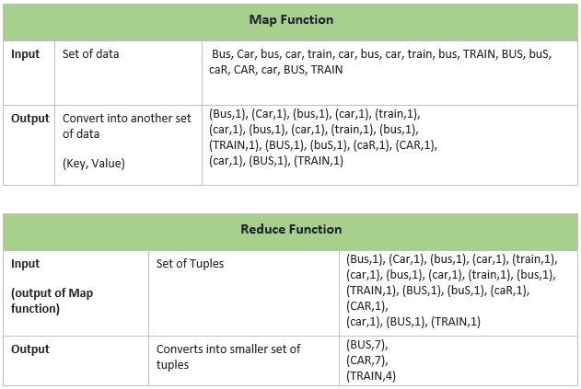
6.4 An Example for MapReduce - Wordcount
Module 7: Big Data Ecosystem
A basic word count example is given below:
Notes:
Notes to the Facilitator:
Explain the above wordcount example to the participants.
Notes to the Participants:
We learnt about the map and reduce functions in the earlier sections. Now, let’s look at a simple example to understand the concept better.
The input consists of a set of data as follows: Bus, Car, bus, car, train, car, bus, car, train, bus, TRAIN,BUS, buS, caR, CAR, car, BUS, TRAIN. Now, MapReduce has to count the number of occurrences of each word in the given input set.
As we know, the first step is the Map function, where a set of data is taken as input and converted into another set of data, where individual elements are broken down into tuples, also called Key-Value pairs. Splitting and mapping are the two major steps happening during this phase. The splitting parameter can be anything, e.g. splitting by space, comma, semicolon, or even by a new line (‘\n’). As given in the table above, mapping is done once splitting completes and the output of map function is a set of tuples, which has a word as the key and the number of occurrences as value. Once the key-value pair are generated, the program then moves on to Reduce function.
There is an intermediate splitting step that happens before Reduce function. This step is where similar Keys are grouped together in placed on one single cluster, which will then be reduced by Reduce function.
The output of Map function is taken as input for the Reduce function. The data tuples generated by Map function are combined to form smaller set of tuples. Reducing and Combining are the two major steps happening during the Reduce function.

Slide 16
6.5 Daemons of MapReduce
Module 7: Big Data Ecosystem
The two Daemons of MapReduce:
JobTracker
TaskTracker
TaskTracker
TaskTracker
TaskTracker
Notes:
Notes for the Facilitator:
Explain the participants about the two Daemons of MapReduce: JobTracker and TaskTracker.
Notes for the Participants:
A Daemon is more like a helper. In computing systems, Daemons are programs that run as a background process, rather than being under the direct control of the user. Daemon programs forward the requests to other programs as required.
There are two daemons in MapReduce framework. These two daemons exhibit a master-slave relationship.
JobTracker
JobTracker is the master that creates and runs a job. The JobTracker is the service within Hadoop that farms out MapReduce tasks to specific nodes in the cluster, ideally, the nodes that have the data, or at least are in the same rack. Client applications first submit the jobs to the JobTracker. The JobTracker communicates with the NameNode (the primary server in an HDFS) to determine the location of the data. The JobTracker searches for the TaskTracker nodes with available slots at or near the data and submits the work to the chosen TaskTracker nodes. The TaskTracker nodes are constantly monitored. If any of them fails,the job is scheduled on a different TaskTracker. TaskTracker notifies the JobTracker when a task fails. The JobTracker decides if the job has to be submitted elsewhere, if the specific record has to be avoided or if the TaskTracker has to be blacklisted as unreliable. When the work is completed, the JobTracker updates its status and client applications can poll the JobTracker for information.
The JobTracker is a point of failure for the Hadoop MapReduce service. If it goes down, all running jobs are halted.
TaskTracker
TaskTracker is the slave that follows the instructions of a JobTracker. A TaskTracker is a node in the cluster that accepts tasks like the Map Reduce and Shuffle operations, from a JobTracker. Every TaskTracker is configured with a set of slots, that indicate the number of tasks that it can accept. The JobTracker, while assigning a job, first looks for an empty slot on the same server that hosts the DataNode containing the data, and if not, it looks for an empty slot on a machine in the same rack.
The TaskTracker initiates a separate process to do the actual work; this is to ensure that process failure does not take down the TaskTracker. The TaskTracker monitors these spawned processes, capturing the output and exit codes. When the job is done, the TaskTracker notifies the JobTracker. The TaskTrackers also send out heartbeat messages to the JobTracker, usually every few minutes, to reassure the JobTracker that it is still alive. These messages also inform the JobTracker of the number of available slots, so that the JobTracker can stay up to date, wherein the cluster work can be delegated.

Slide 17
6.6. Key Benefits of using MapReduce
Module 7: Big Data Ecosystem
The following picture lists the key benefits of Data Processing using MapReduce.
Simplicity
Scalability
Speed
Recovery
Minimal Data Motion
Notes:
Notes for the Facilitator:
Explain the participants about the key benefits of using MapReduce.
Notes for the Participants:
The most important benefits of using MapReduce as a Data Processing Framework are listed below:
Simplicity: MapReduce offers a great flexibility with respect to the programming languages used for writing applications. The developers can use any language like Java, C++ or Python. MapReduce can easily be used for running the jobs.
Scalability: MapReduce is highly scalable and can process petabytes of the data stored in HDFS on a cluster.
Speed: MapReduce does parallel processing. Compared to a typical data processing framework that takes days for processing and solving problems, MapReduce just takes minutes or hours.
Recovery: MapReduce has the ability to handle failures efficiently. It is designed in a way that key/value pair of the same data is available on multiple machines. When one machine with a copy of data fails, there will be a backup machine with the same key/value pair takes charge and carries out the same task. The JobTracker of MapReduce keeps complete track of it.
Minimal Data Motion: With MapReduce, compute processes are moved to the data stored on HDFS and not the other way. This processing is done at the same node where the data resides. This is a significant contributor to data processing speed of Hadoop by reducing the network I/O patterns.
To summarize, MapReduce offers:
Automatic parallelization and distribution
Fault-tolerance
I/O scheduling
Status and monitoring

Slide 18




6.7. Use case examples
Module 7: Big Data Ecosystem
Major corporates who have implemented MapReduce
Notes:
Notes for the Facilitator:
List out some of the large enterprises who use MapReduce, and the use cases of MapReduce in these organizations.
Notes for the Participants:
Since MapReduce has the abilities to handle huge volumes of both structured and unstructured data, it finds its place in large enterprises. Some of the organizations where MapReduce is implemented and the use cases are listed below.
Google:
Index building for Google Search
Article clustering for Google News
Statistical machine translation
Yahoo:
Index building for Yahoo! Search
Spam detection for Yahoo! Mail
Facebook:
Data mining
Ad optimization
Spam detection
At Amazon:
Product clustering
Statistical machine translation

Slide 19

6.8. Activity
Module 7: Big Data Ecosystem
Notes:
Notes for the Facilitator:
Explain the following activity to the participants, so that they can understand the concept of MapReduce better.
Let’s imagine, we have five files, and each file contains two columns (a key and a value in Hadoop terms) that represent a city and the corresponding temperature recorded in that city on various days. In this example, the City is the Key and temperature is the Value. The Data in the first file is as follows:
Chennai, 20
Mumbai, 25
Delhi, 22
Kolkata, 32
Chennai, 4
Kolkata, 33
Delhi, 18
Out of all the data collected, we want to find the maximum temperature for each city across all the data files (note that each file might have the same city represented multiple times). Using the MapReduce framework, we can break this down into five map tasks, where each mapper works on one of the five files and the mapper task goes through the data and returns the maximum temperature for each city.
For example, the results produced from one mapper task for the data above, i.e., the intermediate output, would look like this:
(Chennai, 20) (Mumbai, 25) (Delhi, 22) (Kolkata, 33)
Let’s assume the other four mapper tasks (working on the other four files not shown here) produced the following intermediate results:
(Chennai, 18) (Mumbai, 27) (Delhi, 32) (Kolkata, 37)(Chennai, 32) (Mumbai, 20) (Delhi, 33) (Kolkata, 38)(Chennai, 22) (Mumbai, 19) (Delhi, 20) (Kolkata, 31)(Chennai, 31) (Mumbai, 22) (Delhi, 19) (Kolkata, 30)
All five of these output streams would be fed into the reduce tasks, which combine the input results and output a single value for each city, producing a final result set as follows:
(Chennai, 32) (Mumbai, 27) (Delhi, 33) (Kolkata, 38)
A real application will not be quite so simple, as it is likely to contain millions or even billions of rows, and they might not be neatly formatted rows at all; in fact, no matter how big or small the amount of data you need to analyze, the key principles covered, remain the same.
Based on this example, give them sample data and ask them to come up with the intermediate outputs and the final result set.
Notes for the Participants:
Perform the activity as explained by your facilitator, by which you can understand the MapReduce concept in a better way.

Slide 20
What did you Grasp?
Module 7: Big Data Ecosystem
Fill in the blank:
MapReduce is a -------------- processing technology.
Real-time
Batch
Both a & b are correct, it can be used as per the requirement.
Notes:
Notes for the Facilitator:
Answer:
1. B. Batch

Slide 21
What did you Grasp?
Module 7: Big Data Ecosystem
Which of the following is true about MapReduce?
Application must be written in Python for using MapReduce to run jobs.
With MapReduce, the data is moved to the node where the compute process happens.
MapReduce is capable of doing parallel processing.
MapReduce can handle only GB-scale data.
The intermediate key/value pair generated at the end of the Map job should be of the same type as that of input data.
True
False
Notes:
Notes for the Facilitator:
Answers:
2. C. MapReduce is capable of doing parallel processing
3. B. False

Slide 22
7. Data Locality
Module 7: Big Data Ecosystem
‘Proximity’ of the data with respect to the Mapper tasks working on the data.
Data Locality
Rack
Rack
Data Local
Node A
Rack Local
Data
Node B
Node B
Data & Map
Map
Node D
Node D
Rack 1
Rack 2
Different Rack
Node A
Node w
Node B
Data
Map
Node Y
Node D
Node D
Notes:
Notes for the Facilitator:
Explain the participants about Data Locality and why it is needed for better Data Processing.
Notes for the Participants:
In Hadoop, Data Locality refers to the process of moving the computation closer to the data than moving the data towards computation. Data Locality is important for minimizing network congestion and increasing the overall throughput of the system.
In Hadoop Data is stored in HDFS. The Data is divided into individual blocks and stored across Data Nodes in a Hadoop cluster. To execute a MapReduce job, data needs to be on the same node where it is being executed. When a MapReduce job is executed against a dataset, individual Mappers will process the blocks. When data is not available in the same node, it has to be copied from the node where the data resides to the node where the job is executed. If a MapReduce job has over 100 Mappers and each Mapper is trying to copy data from another DataNode in the cluster at the same time, there’s a possibility for serious network congestion. It is always effective and cheap to move the computation closer to the data than to move the data closer to the computation. As we studied earlier, this is one of the biggest benefits of using MapReduce.
When a JobTracker receives a request to run a job, it looks for nodes in the cluster that has sufficient TaskTrackers to execute the Map and Reduce functions. During this process, we need to decide, based on the data location, on which nodes the individual Mappers will be executed.
The important conditions to be satisfied by the system to reap the advantages of Data Locality are:
All the clusters need to have the appropriate topology and Hadoop code should be capable to read data locality.
Hadoop should know the topology of the nodes where the tasks are executed and Hadoop should be aware of the data location.

Slide 23
7.1. Categories of Data Locality
Module 7: Big Data Ecosystem
Three categories of Data Locality:
Data Local
Rack Local (Intra-rack)
Inter-rack
Notes:
Notes for the Facilitator:
Explain the participants about the three categories of Data Locality.
Notes for the Participants:
There are three categories of Data Locality.
Data Local
When the data is located on the same node as the Mapper working on the data, it is referred to as Data Local. In this case, the proximity of the data is closer to the computation. The JobTracker prefers the node which has the data that is needed by the Mapper to execute the Mapper.
Rack Local (Intra-rack)
Though preferred, it is not always possible to execute the Mapper on the same node as the data due to resource constraints on a busy cluster. In such instances it is preferred to run the Mapper on a different node but on the same rack as the node which has the data. In this case, the data will be moved between nodes from the node with the data to the node executing the Mapper within the same rack.
Inter-rack
In a busy cluster, sometimes Rack Local could also be not implemented. In that case, a node on a different rack is chosen to execute the Mapper and the Data will be copied from the node which has the data to the node executing the Mapper between racks. This is the least preferred scenario.

Slide 24
7.2. Advantages of Data Locality
Module 7: Big Data Ecosystem
Moving the computation closer to the data has some important advantages.
Faster execution
Reduction in network congestion
High throughput
Notes:
Notes for the Facilitator:
Explain the advantages of Data Locality in Hadoop.
Notes for the Participants:
There are three major advantages to Data Locality.
Faster execution
In data locality, the program is moved to the node where the data resides instead of moving large data to the node. This makes Hadoop system faster. Because the size of the program is always lesser than the size of data, so moving the data is a bottleneck of network transfer.
Reduction in network congestion
One of the major drawbacks of Hadoop is cross-switch network traffic, because of the huge volume of the data that comes in. If multiple Mappers try to copy the data from one node to another node, the network congestion increases. Data Locality refers to the ability of the Hadoop system to move the computation near the node where the data resides. This minimizes network traffic to a great extent.
High throughput
Data locality results in the fast overall execution of the full data set distributed across the multiple nodes. The Parallel processing is achieved with data locality, increasing the throughput of the system.

Slide 25
7.3. Challenges and Ways to Optimize Data Locality
Module 7: Big Data Ecosystem
Scenarios where implementation of data locality may be challenging
Speculative Execution in Hadoop
Heterogeneous clusters
Data distribution and placement
Data Layout
Input Splitter
Notes:
Notes for the Facilitator:
Explain the various factors that are responsible for the challenges caused by the Hadoop system due to Data Locality.
Notes for the Participants:
Data Locality is one of the major advantages of Hadoop MapReduce since the map task is executed on the same node where the data exists. However, because of the factors like speculative execution, heterogeneous cluster, data distribution and placement, and data layout and input splitter, challenges arise while implementing data locality.
In large clusters, if the number of nodes and data is more, the locality will be less and challenges will become more prevalent. Because some nodes in large clusters are faster and newer than the others. This creates an imbalance in the data to compute the ratio. Large clusters will be heterogeneous. In speculative execution, data might not be local, but a lot of computing power is utilized. Data placement and layout and the input splitter serve as the root cause for this. The Scalability issues arise when non-local data processing adds strain to the network. This way, the network itself becomes a bottleneck.
Ways to Optimize Data Locality:
The Data locality can be improved by detecting which of the map jobs face the locality issue.
The Problem-solving involves changing the data placement and data layout or by using a different scheduler.
By changing the number of Mapper and Reducer slots for a job.
By Verifying if the new execution of the same workload has a better Data Locality ratio.

Slide 26
What did you Grasp?
Module 7: Big Data Ecosystem
Which of the following is the most preferred way of implementing Data Locality?
Data local
Rack local
Inter-rack
None of the above
Data locality decreases the overall performance of the system.
True
False
Notes:
Notes for the Facilitator:
Answer:
1. A. Data local
2. B. False

Slide 27
8. Resiliency
Module 7: Big Data Ecosystem
Resilient - “having the ability to spring back”
Ability of a server, storage system, network or a Data Centre to recover quickly and continue to operate even after a failure.
Achieved through use of redundant components, subsystems, systems or facilities.
An important characteristic to be maintained by storage systems for disaster management.
Versus
Notes:
Notes for the Facilitator:
Explain the participants about resiliency and how important it is for storage systems to be resilient to come back from failures.
Notes for the Participants:
With the increase in data volume, the amount of storage required to support the production environment increases too. Such rapid and enormous growth puts increased strain on the network for data creation and information sharing, but also for archiving and disaster recovery. Meeting user expectations for data availability and access requires a redesign of the storage and networking infrastructure.
Enterprises are already leveraging some of the best methods for protecting data. For example, most have implemented various forms of the server or storage-based snapshots or replication for enhanced information availability, scalability and disaster recovery. The real advantage comes in using a combination of traditional methods, along with new and emerging methods that are designed to accommodate such expansive data growth. The following approaches are essential for achieving resiliency in Big Data systems.
A consistent data capture strategy should be developed for the computing environments to address data synchronization concerns and facilitate cross-platform workload processing.
The storage hierarchies and tiering should be implemented to enable auto-assignment of data to the most available and appropriate storage system, on the needs of applications like replication, archiving and resilience. Establishing a hierarchy and tiering system enables organizations to effectively identify and manage the number of data copies required to maintain resilience.
Defining Data and categorizing data based on business value, then mapping back to the storage hierarchy is important for inclusion in the organization’s data capture and replication strategies. Data protection designs need to be in place to ensure data accuracy, availability and integrity to be in alignment with the structured, hierarchical approach to business protection.
The Organizations need to validate the methods employed by users to manage and protect data backup, snapshot and replication to ensure accessibility and alignment with user expectations. An integrated approach to the server- and storage-based replication needs to be identified and validated based on stated recovery objectives. This approach helps the organization verify that overall system, application and data integrity are in place to deliver the desired user experience.

Slide 28
9. Fault Tolerance
Module 7: Big Data Ecosystem
Ability of systems to provide uninterrupted and expected performance even after failures.
Important for recovery from failures, reduced downtime, reduced cost and improved performance.
Achieved by having multiple instances of the application in different machines, thus preventing unavailability during failures.
………
………
………
………
………
………
………
………
Notes:
Notes for the Facilitator:
Explain the participants about Fault tolerance and need for the storage systems to be Fault Tolerant.
Notes for the Participants:
Achieving fault tolerance is an important issue in big data; it is concerned with the techniques that are needed to enable a system to tolerate software faults remaining in the system after its development. The main benefits of implementing fault tolerance in Big Data include failure recovery, lower cost, improved performance etc. When multiple instances of an application are running on several nodes, and one of them goes down, the application might become unavailable. The Storage systems need to be fault tolerant to prevent application downtime during failure.
Fault tolerance is a setup or configuration that prevents a computer or network device from failing in the event of an unexpected problem or error. To make a system fault tolerant, it requires an analysis of the possible causes of the failure and to take steps that help prevent that type of failure.
A system is said to fail when it does not function in an expected manner. An error leads to a failure. Faults may be transient, intermittent or permanent faults, design faults or operational faults.

Slide 29
9.1. Fault Tolerance in Hadoop
Module 7: Big Data Ecosystem
Fault Tolerance (DataNode Failure)
Hadoop Distributed File System - composed of NameNode (master node) and DataNodes (slave nodes).
NameNode - single central node, containing all the information of the Hadoop system.
DataNodes - several Data Nodes that have the data stored in them as blocks. Same data located in multiple DataNodes.
Fault Tolerance achieved by: Replication and Checkpointing.
NameNode
BackupNode
Blocks are auto-replicated on remaining nodes to satisfy replication factor
DataNode
DataNode
DataNode
DataNode
DataNode
Notes:
Notes for the Facilitator:
Explain the methodologies through which fault tolerance can be achieved in Hadoop.
Notes for the Participants:
We have seen in one of the sections about data storage in HDFS. We will now look at the ways through which fault tolerance can be achieved in Hadoop.
Replication
In this method, the same copy of data is copied on several different Data Nodes, when a copy of that data is required, it is provided by any of the DataNodes that is not busy in communicating with other nodes. One major advantage of this technique is that it provides instant recovery from failures. But to achieve tolerance, very large amount of memory is consumed in storing data on different nodes, i.e., wastage of a large amount of memory and resources. As the data is duplicated across various nodes there may be a possibility of data inconsistency. But as this technique provides instant and quick recovery from failures, it is the frequently used method compared to checkpoint and recovery.
Checkpoint and Recovery (Rollback)
At regular intervals, a snapshot of the base file system (fsimage) is taken and saved. During a failure, the system just rolls back to the last savepoint with the most recent file image and from there it starts performing the transaction again. This method uses a concept called Rollback. A Rollback operation brings the system to its previous working condition. But this method increases overall execution time because the rollback operations need to go back and check for the last saved consistent stage. One major drawback of this method is that it is very time consuming compared to the former, but it requires less additional resources.

Slide 30
What did you Grasp?
Module 7: Big Data Ecosystem
Which of the following is a way to achieve fault tolerance in Hadoop?
Checkpointing
Batch computing
Batch processing
None of the above
Notes:
Notes for the Facilitator:
Answer:
1. A. Checkpointing

Slide 31

In a nutshell, we learnt:
Module 7: Big Data Ecosystem
Scalability can be achieved in Big Data storage using NoSQL, object-oriented storage and hyperscale computing systems.
The basics of Big Data Processing.
Scalable Data Processing using MapReduce; map and reduce tasks, MapReduce daemons: JobTracker and TaskTracker
The benefits of using MapReduce for data processing
Implementation of Data locality for minimizing network congestion and achieving high throughputs.
Resilience and fault tolerance in Big Data processing environments.
Notes:
Notes for the Facilitator:
Reiterate the salient points that the participants have learnt about in this module.
Notes for the Participants:
Take note of the salient points you have learnt about in this module.

