Slide 1
QUANTUM PHYSICS
PART-I
Dr. Kamalpreet Kaur
Assistant Professor
Department of Physics
UPES, Dehradun.

Slide 2
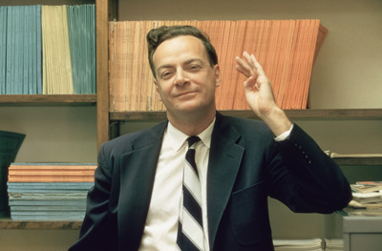
Quantum physics is an exceedingly complex and theoretical field, usually described only with the help of advanced math. Nobel-prize winning physicist Richard Feynman alleged with confidence that there was "nobody" who really understood quantum physics.
Dr. Kamalpreet Kaur

Slide 3
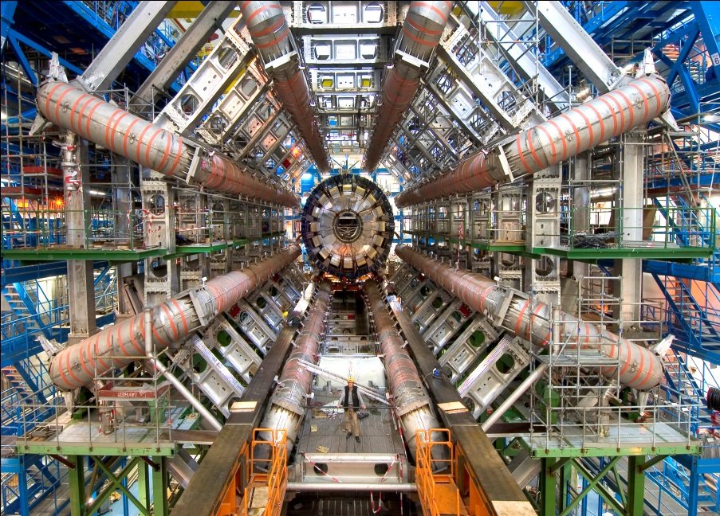
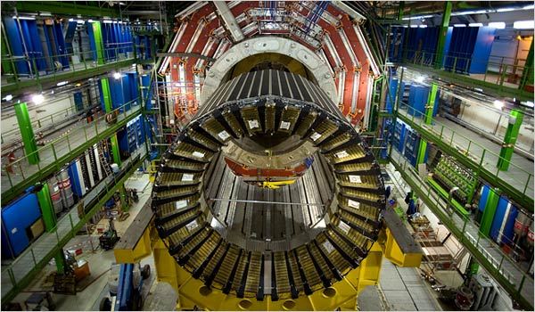
Recent happenings in Quantum physics
1
2
The Large Hadron Collider (LHC) at the CERN facility.
The actual machine, built in a circular tunnel the earth, is about 27 kilometers (16.8 miles) long. The LHC will help us test quantum theories that could not be tested before.
Dr. Kamalpreet Kaur

Slide 4
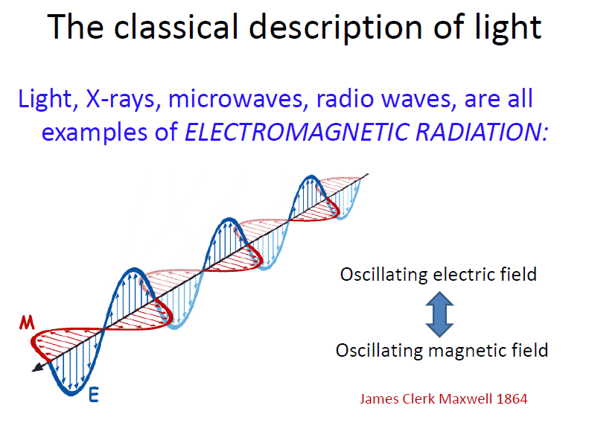
Dr. Kamalpreet Kaur

Slide 5
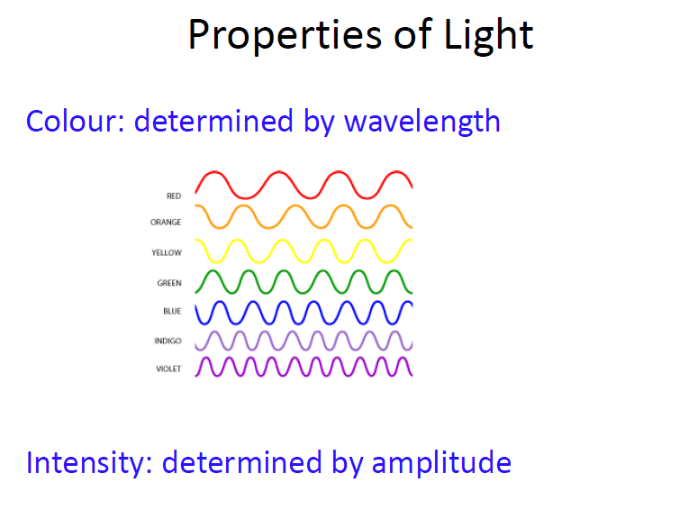
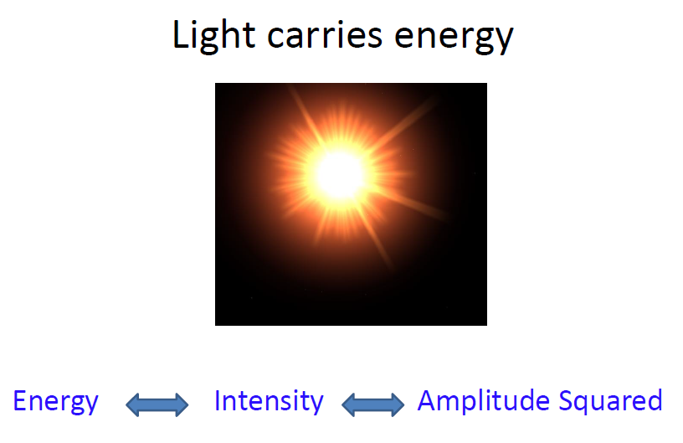
Dr. Kamalpreet Kaur

Slide 6
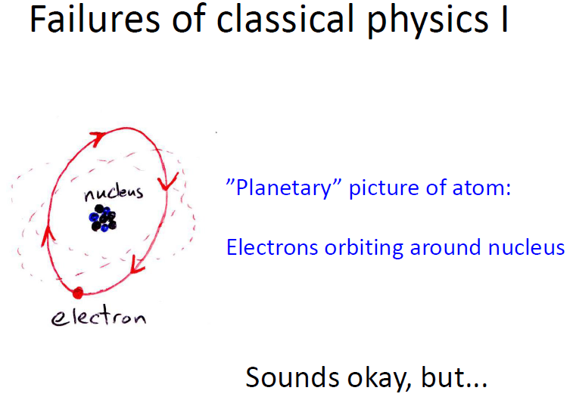
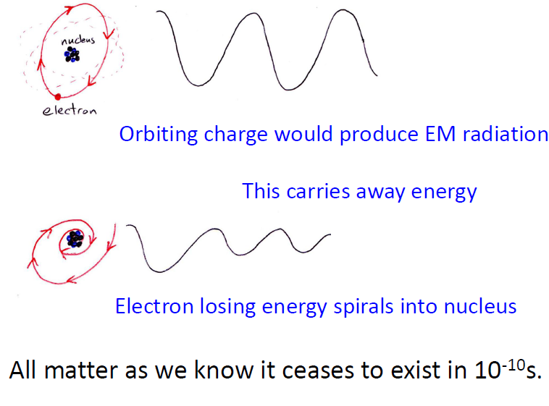
Dr. Kamalpreet Kaur

Slide 7
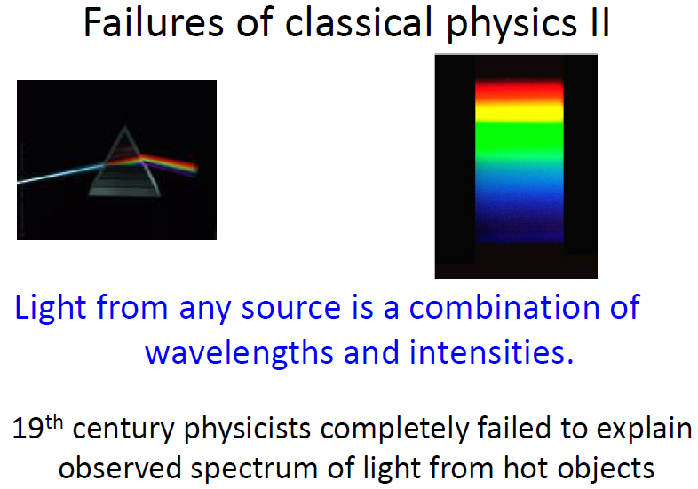
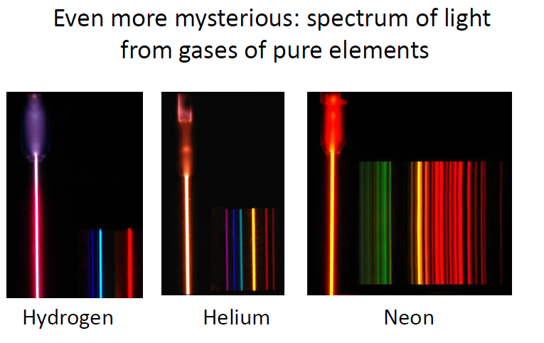
Dr. Kamalpreet Kaur

Slide 8
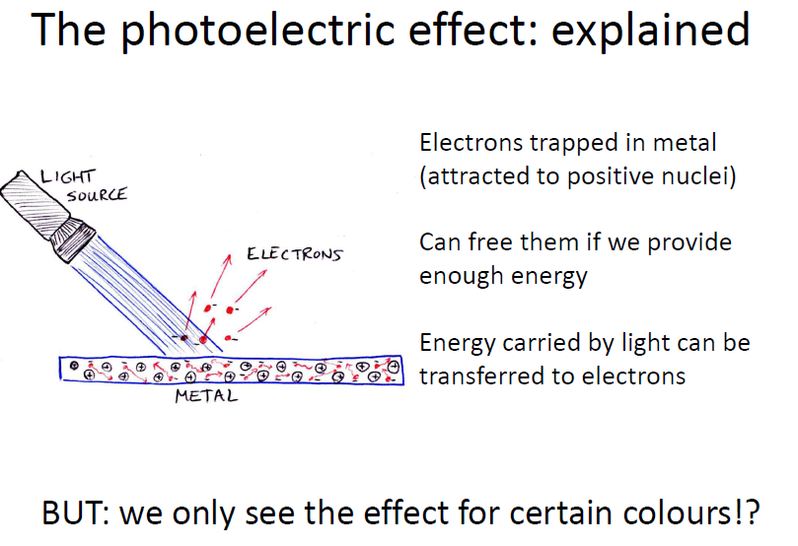
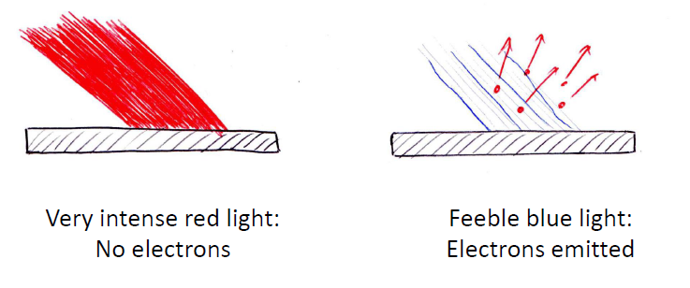
Dr. Kamalpreet Kaur

Slide 9
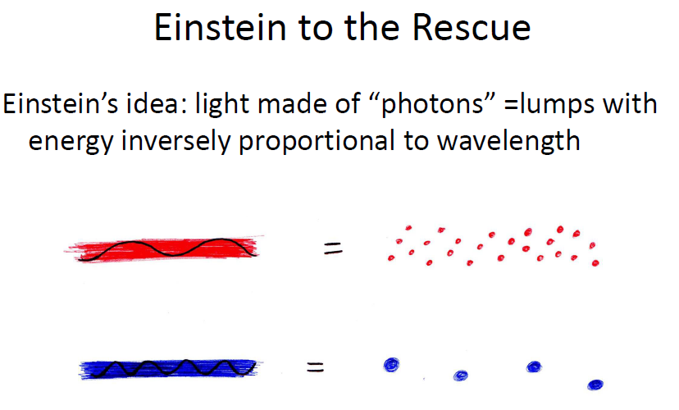
Dr. Kamalpreet Kaur

Slide 10
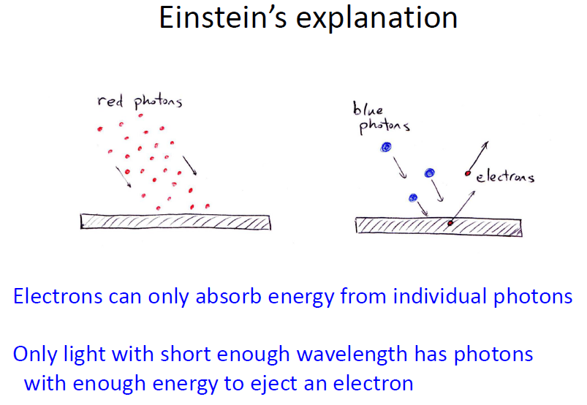
Dr. Kamalpreet Kaur

Slide 11
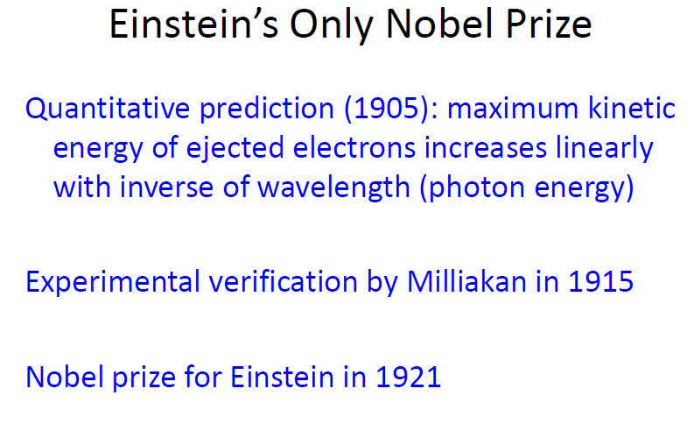
Dr. Kamalpreet Kaur

Slide 12
Difficulties with Classical Physics
It could not explain the motion of the microscopic bodies like atoms, electrons protons etc. which move with the relativistic speeds.
It could not explain stability of atoms. Acc. To classical electromagnetic theory atom must collapse but atom is a stable system.
It could not explain line spectra i.e. emission of radiations of some particular wavelengths and not of all wavelengths.
It could not explain variation of specific heat of solids with temperature, emission of X-rays etc.
It could not explain Photoelectric effect.
Dr. Kamalpreet Kaur

Slide 13
The classical ideas failed to explain the distribution of energy in black body radiation spectrum.
It could not explain the phenomena connected with the spin of particles and Pauli exclusion principle.
Compton effect, Raman effect, Radioactivity, scattering phenomena are not explained by classical theory.
It could not explain dispersion of light.
The difficulties faced by classical physics led the scientists to abandon classical ideas and search new ideas.
Quantum Physics came into existence after Plank’s hypothesis.
Dr. Kamalpreet Kaur

Slide 14
WHAT IS QUANTUM?
IN LATIN IT MEANS DISCREATE QUANTITY
The quantities can be momentum, energy etc.
Two stages of quantum mechanics:
Max Plank hypothesis (1900): radiations are emitted or absorbed by matter in discrete packets/ quantas.
W. Heisenberg (1925) & E. Schrӧdinger (1926): The variables like momentum and energy were found to have discrete and discontinuous values.
Dr. Kamalpreet Kaur

Slide 15
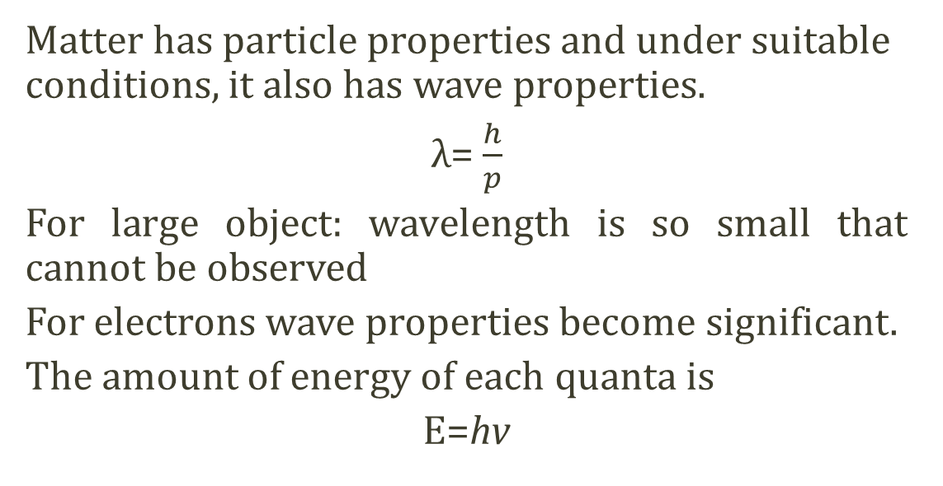
Wave particle duality
Matter has particle properties and under suitable conditions, it also has wave properties.
λ= $\frac{h}{p}$
For large object: wavelength is so small that cannot be observed
For electrons wave properties become significant.
The amount of energy of each quanta is
E=hv
Dr. Kamalpreet Kaur

Slide 16
Classical vs Quantum world
At atomic & subatomic scales,
quantum effects
are dominant & must be considered
In everyday life,
quantum effects
can be safely
ignored
This is because
Planck’s constant is so small
Laws of nature
developed without
consideration of
quantum effects do not work for atoms
Dr. Kamalpreet Kaur

Slide 17
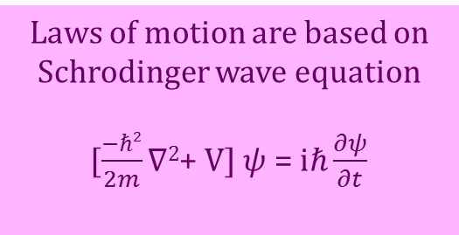
Classical vs Quantum world
Deals with the objects of macroscopic size
Deals with the objects of microscopic size
Newtonian Physics, it has been developed on the basis of Newton’s law of motion
F=m.a
Laws of motion are based on Schrodinger wave equation
[$\frac{−ℏ2}{2m}∇2$+ V] $ψ$ = $iℏ\frac{∂ψ}{∂t}$
Deals with the certainties
Deals with the probabilities
Future behavior can be predicted If the initial position and momentum are known
Uncertainty in finding the initial position and momentum as given by Heisenberg Uncertainty principle
Dr. Kamalpreet Kaur

Slide 18
Planks Quantum hypothesis
The hypothesis that energy is emitted or absorbed in a discrete manner in the form of quanta is called Plank’s quantum hypothesis.
E= nhv
n= 1,2,3,…..any positive integer, defines as energy state
h= frequency of oscillations
v= Plank’s constant (6.63 X 10⁻³⁴ Joule-sec)
Dr. Kamalpreet Kaur

Slide 19
There are a few phenomenon which the classical mechanics
failed to explain.
Relativistic motion of sub-atomic particles.
Stability of an atom
Spectral series of Hydrogen atom
Black body radiation
Max Planck in 1900 at a meeting of German Physical Society read his paper “On the theory of the Energy distribution law of the Normal Spectrum”. This was the start of the revolution of Physics i.e. the start of Quantum Mechanics.

Slide 20
The first stage began with max Plank’s hypothesis (14 Dec.’1900) according to that radiation is emitted and absorbed by matter in discrete packets. Each quantum has energy, hv, where v is frequency of radiations.
The second stage began with the concepts of W. Heisenberg (1925) and E. Schrodinger (1926). The variable like energy, momentum, now, were found to have discrete quantity.
The particle has definite position, size, mass velocity, momentum, energy and its motion is described by Newton’s Law of motion.
A Wave possesses wavelength, amplitude, frequency. It can transport energy without transport of matter. It cannot be localized and extends in space.

Slide 21
Quantum Mechanics
It is a generalization of Classical Physics that includes classical laws as special cases.
Quantum Physics extends that range to the region of small dimensions.
Just as ‘c’ the velocity of light signifies universal constant, the
Planck's constant characterizes Quantum Physics.

Slide 22
Quantum Mechanics
It is able to explain
Photo electric effect
Black body radiation
Compton effect
Emission of line spectra
The most outstanding development in modern science was the conception of Quantum Mechanics in 1925. This new approach was highly successful in explaining about the behavior of atoms, molecules and nuclei.

Slide 23
Photo Electric Effect
The emission of electrons from a metal plate when illuminated by light or any other radiation of any wavelength or frequency (suitable) is called photoelectric effect. The emitted electrons are called ‘photo electrons’.
Light
Evacuated Quartz tube
Metal plate
Collecting plate
_
+
V
^^^^^^^^
A

Slide 24
Photo Electric Effect
Experimental findings of the photoelectric effect
There is no time lag between the arrival of light at the metal surface and the emission of photoelectrons.
When the voltage is increased to a certain value say V_{o}, the photocurrent reduces to zero.
Increase in intensity increase the number of the photoelectrons but the electron energy remains the same.
3I
Photo Current
2I
I
V_{o}
Voltage

Slide 25
Photo Electric Effect
Increase in frequency of light increases the energy of the electrons. At frequencies below a certain critical frequency (characteristics of each particular metal), no electron is emitted.
There exists a characteristic frequency for each metal to observe photoelectric effect, below which there is no emission of electrons called threshold frequency.
Photo Current
v₃
v₁
v₂
Voltage

Slide 26
Einstein’s Photo Electric Explanation
The energy of a incident photon is utilized in two ways
A part of energy is used to free the electron from the atom known as photoelectric work-function (W_{o}).
Other part is used in providing kinetic energy to the emitted electron .
This is called Einstein’s photoelectric equation.

Slide 27
If , no photoelectric effect

Slide 28
If is the stopping potential, then
It is in form of . The graph with on y-axis and on x-axis will be a straight line with slope

Slide 29
Photons
Einstein postulated the existence of a particle called a photon, to explain detailed results of photoelectric experiment.
Photon has zero rest mass, travels at speed of light
Explains “instantaneous” emission of electrons in photoelectric effect, frequency dependence.

Slide 30
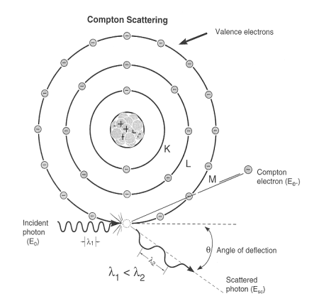
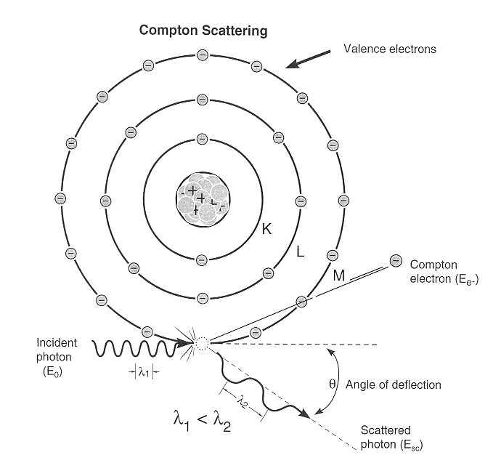
Compton Effect
When a monochromatic beam of X-rays is scattered from a material then both the wavelength of primary radiation (unmodified radiation) and the radiation of higher wavelength (modified radiation) are found to be present in the scattered radiation. Presence of modified radiation in scattered X-rays is called Compton effect.
scattered photon
incident photon
electron
recoiled electron

Slide 31
From Theory of Relativity, total energy of the recoiled electron with v ~ c is
Similarly, momentum of recoiled electron is

Slide 32
Now from Energy Conversation
(i)
From Momentum Conversation
(ii)
along x-axis
and
(iii)
along y-axis

Slide 33
Rearranging (ii) and squaring both sides
(iv)
Rearranging (iii) and squaring both sides
(v)
Adding (iv) and (v)
(vi)
From equation (i)

Slide 34
On squaring, we get
(vii)
Subtracting (vi) from (vii)

Slide 35
and
So,
But
is the Compton Shift.
It neither depends on the incident wavelength nor on the scattering material. It only on the scattering angle i.e.
is called the Compton wavelength of the electron
and its value is 0.0243 Å.

Slide 36
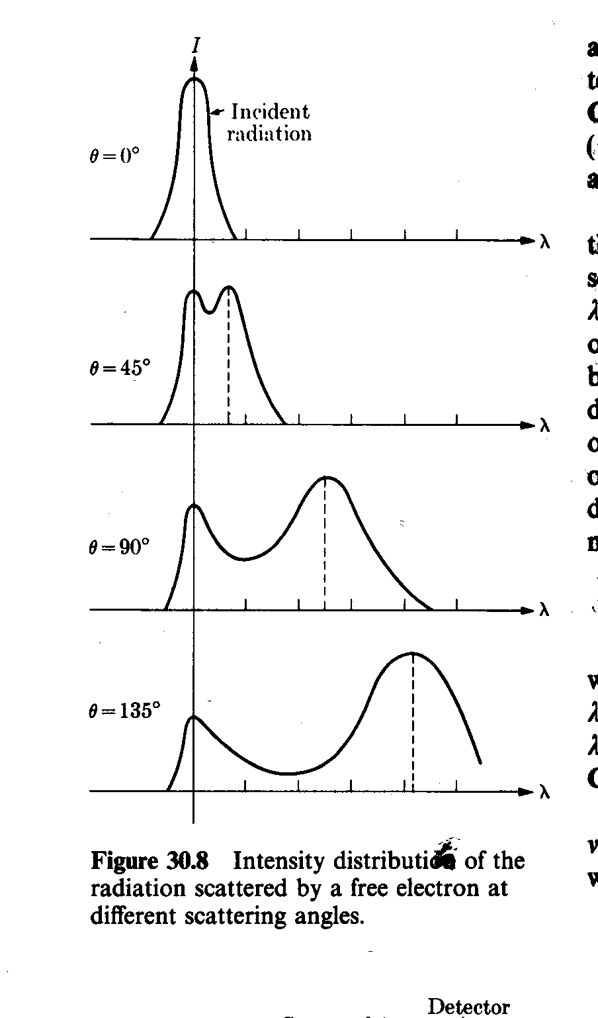
Experimental Verification
photon
Bragg’s X-ray
Spectrometer
Monochromatic
X-ray Source
θ
Graphite
target
1. One peak is found at same position. This is unmodified radiation
2. Other peak is found at higher wavelength. This is modified signal of low energy.
3. increases with increase in .

Slide 37
Compton effect can’t observed in Visible Light
0.0243 (1- cosθ) Å
is maximum when (1- cosθ) is maximum i.e. 2.
0.05 Å
So Compton effect can be observed only for radiation having wavelength of few Å.
For 1Å ~ 1%
For 5000Å ~ 0.001% (undetectable)

Slide 38
Pair Production
When a photon (electromagnetic energy) of sufficient energy passes near the field of nucleus, it materializes into an electron and positron. This phenomenon is known as pair production.
Photon
Nucleus (+ve)
In this process charge, energy and momentum remains conserved prior and after the production of pair.

Slide 39
The rest mass energy of an electron or positron is 0.51 MeV (according to E = m₀c²).
The minimum energy required for pair production is 1.02 MeV.
Any additional photon energy becomes the kinetic energy of the electron and positron.
The corresponding maximum photon wavelength is 1.2 pm. Electromagnetic waves with such wavelengths are called gamma rays .

Slide 40
Pair Annihilation
When an electron and positron interact with each other due to their opposite charge, both the particle can annihilate converting their mass into electromagnetic energy in the form of two - rays photon.
Charge, energy and momentum are again conversed. Two - photons are produced (each of energy 0.51 MeV plus half the K.E. of the particles) to conserve the momentum.

Slide 41
Pair production cannot occur in empty space
From conservation of energy
here m_{o} is the rest mass and
In the direction of motion of the photon, the momentum is conserved if

Slide 42
(i)
Momentum of electron and positron is
Equation (i) now becomes
But
and

Slide 43
But conservation of energy requires that
Hence it is impossible for pair production to conserve both the energy and momentum unless some other object is involved in the process to carry away part of the initial photon momentum. Therefore pair production cannot occur in empty space.

Slide 44
Wave Particle Duality
Light can exhibit both kind of nature of waves and particles so the light shows wave-particle dual nature.
In some cases like interference, diffraction and polarization it behaves as wave while in other cases like photoelectric and compton effect it behaves as particles (photon).

Slide 45
De Broglie Waves
Not only the light but every materialistic particle such as electron, proton or even the heavier object exhibits wave-particle dual nature.
De-Broglie proposed that a moving particle, whatever its nature, has waves associated with it. These waves are called “matter waves”.
Energy of a photon is
For a particle, say photon of mass, m

Slide 46
Suppose a particle of mass, m is moving with velocity, v then the wavelength associated with it can be given by
or
(i) If means that waves are associated with moving material particles only.
(ii) De-Broglie wave does not depend on whether the moving particle is charged or uncharged. It means matter waves are not electromagnetic in nature.

