Slide 1
Coordinate systems
Dr Piyush Kuchhal

Slide 2
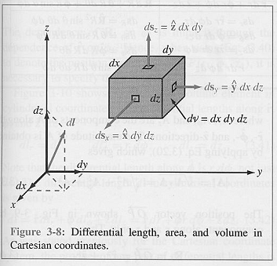
Cartesian Coordinate system

Slide 3
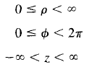
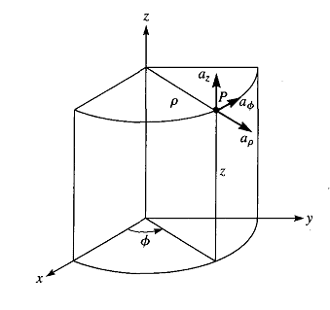

Cylindrical Coordinate System
A=

Slide 4
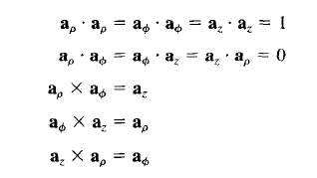
Cylindrical Coordinate System

Slide 5
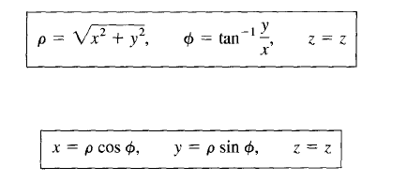
Cylindrical Coordinate System

Slide 6
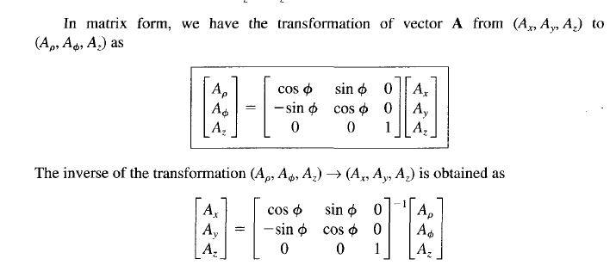
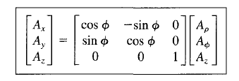
Cylindrical Coordinate System

Slide 7
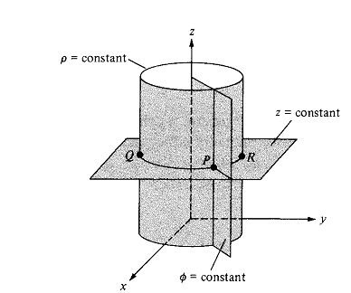

Slide 8
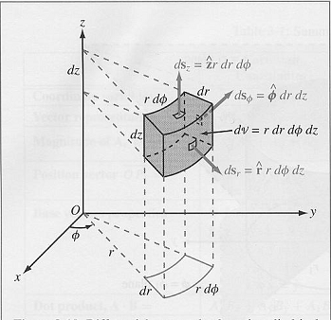

Slide 9
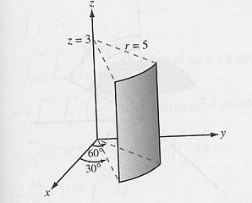

Slide 10
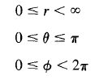
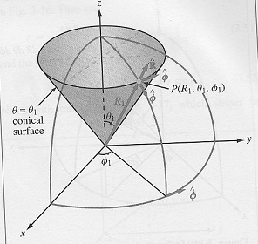
Spherical Coordinate Systems
A =

Slide 11
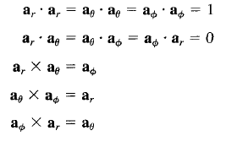
Spherical Coordinate Systems

Slide 12
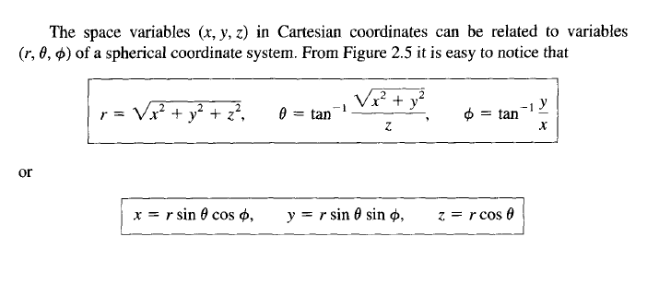
Spherical Coordinate Systems

Slide 13
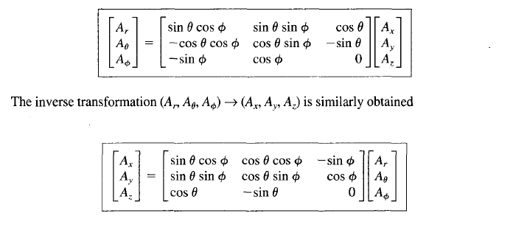
Spherical Coordinate Systems

Slide 14
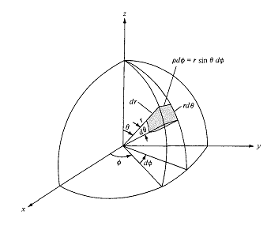

Slide 15
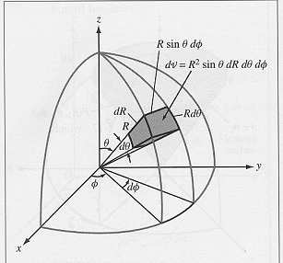

Slide 16
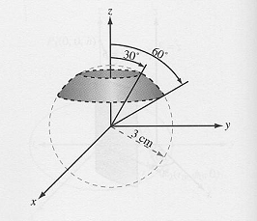

Slide 17
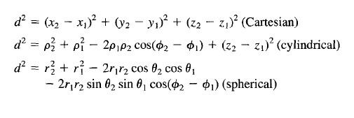
Distance between two points in different coordinate systems

Slide 18

Cartesian Coordinate System

Slide 19

Cyliderical Coordinate System

Slide 20

Spherical Coordinate System

