Slide 1
Data Lake

Slide 2
What is Data Lake?
The Data Lake is a data-centered architecture featuring a repository capable of storing vast quantities of data in various formats.
Data from webserver logs, data bases, social media, and third-party data is ingested into the Data Lake.
Curation takes place through capturing metadata and lineage and making it available in the data catalog.
Security policies, including entitlements, also are applied.

Slide 3
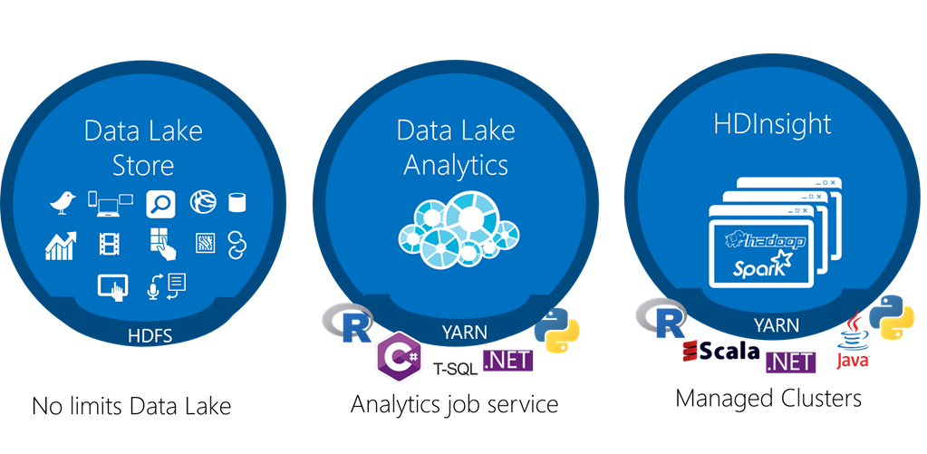

Slide 4
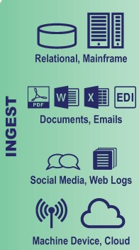
Data Sources
Data Ingestion supports:
All types of Structured, Semi-Structured, and Unstructured data.
Multiple ingestions like Batch, Real-Time, One-time load.
Many types of data sources like Databases, Webservers, Emails, IoT, and FTP.

Slide 5
Data Lake Store
Data Lake store is a hyper-scale repository for big data analytics workloads and a Hadoop Distributed File System (HDFS) for the cloud. It…
No limits to scale
Store any data in its native format
Hadoop File System(HDFS) for the cloud
Enterprise ready access control,
Encryption at rest
Optimized for analytic workload
Performance

Slide 6
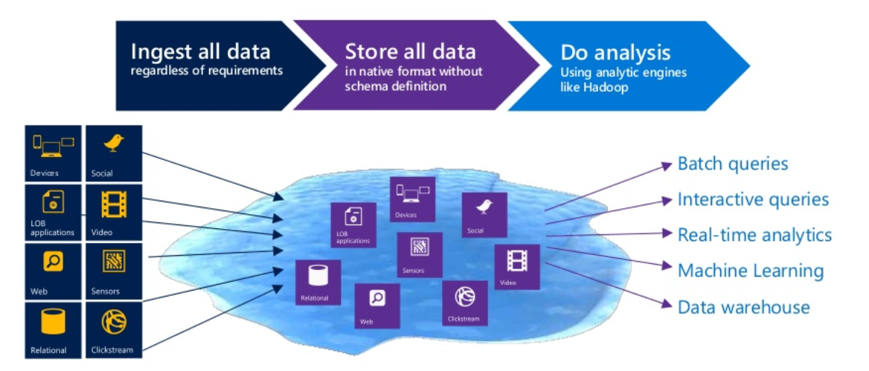

Slide 7
Data Lake store does not require a schema to be defined before the data is uploaded
It is up to the individual analytic framework to interpret the data and define a schema at the time of the analysis.

