Slide 1
Big Data Usecases

Slide 2
Behavioral Analytics
With access to data on customer behaviour, companies can learn what prompts a customer to stick around longer.
Also, learn more about their customer’s characteristics and purchasing habits in order to improve marketing efforts and boost profits.

Slide 3
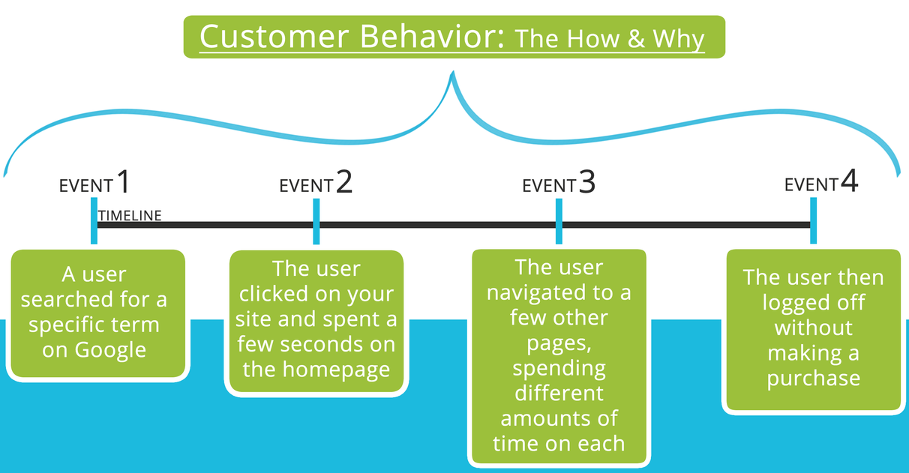
This chart shows how a number of individual actions by one user can be grouped together to describe overall user behavior on a give web application of site.

Slide 4
Example
With 1.8 billion customers, MasterCard is in unique position of being able to analyse the behaviour of customers in not only their own stores, but also thousands of other retailers.
The company teamed up with Mu Sigma to collect and analyse data on shoppers behaviour and provide the insights it finds to other retailers in benchmarking reports.

Slide 5
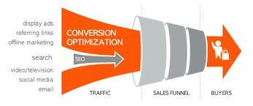
Optimize Funnel Conversion
Big data analytics allows companies to track leads through the entire sales conversion process.
From a click on an AdWords ad to the final transactional, in order to uncover insights on how the conversion process can be improved.

Slide 6
Example
Celcom Axiata Berhad adopted a big data solution in order to improve customer retention and boost its market share by improving the marketing campaign process.
The company used real-time data to create a personalized campaign for each customer based on which products or offers the customers would most want or need.

Slide 7
Customer Segmentation
By accessing data about the customer from multiple sources, such as social media data and transaction history, companies can better segment and target their customers and start to make personalized offers to those customers.
Example
Spotify uses data from user profiles and users playlists, and historical data on music played to provide recommendations for each user.
By combining data from millions of users, Spotify is able to make recommendation even if a particular user doesn’t have an extensive history with the site.

Slide 8
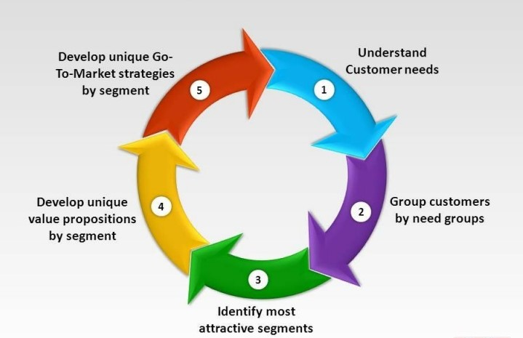

Slide 9
Predictive Support
Through sensors and other machine-generated data, companies can identify when a malfunction is likely to occur.
The company can then preemptively order parts and make repairs in order to avoid downtime and lost profits.
Example
Morgan Stanley uses real-time wire data analytics to detect problems in its applications and prioritize which issues should be addressed first.
The company also uses big data to determine the impact of a particular market event, as well as its original cause.

Slide 10
Market Basket Analysis and Pricing Optimization
By quickly pulling data together from multiple sources, retailers can better optimize their product selection and pricing, as well as decide where to target ads.
Example
Coca-Cola uses an algorithm incorporates satellite imagery, crop yields, customer preferences and details about the flavours that make up a a particular fruit in order to determine how the juice should be blended

Slide 11
Predict Security Threats
Big data analytics can track trends in security breaches and allow companies to proactively go after threats before they strike.
Example
With more than 1.5 billion items in its catalog, Amazon has a lot of product to keep track of and protect. It uses its cloud system, S3, to predict which items are most likely to be stolen, so it can be better secure its warehouses.

Slide 12
Fraud Detection
Financial firms use big data to help them identify sophisticated fraud schemes by combining multiple points of data.
Example
Memorial Health Care uses data analytics to vet vendors and to uncover unethical activities, such as bid rigging.

Slide 13
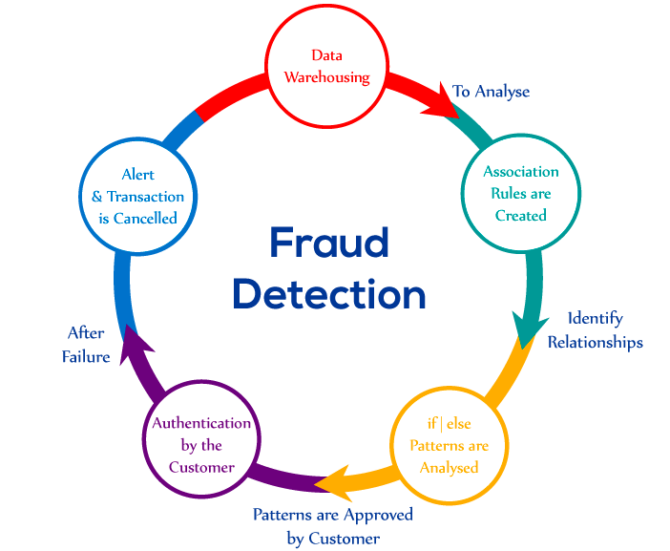

Slide 14
Industry Specific
Virtually every industry has invested in big data to help solve specific challenges those industries face.
Healthcare, for example, uses big data to improve patient outcomes and agriculture uses data to boost crop yields.
Example
Shell uses sensor data to map its oil and gas wells in order to increase output and boost the efficiency of its operations.
The data received from the sensors is analysed by artificial intelligence and rendered in 3D and 4D maps.

Slide 15
Data Warehouse Offload
Big data tools can be used to remove some of the burden from their data warehouses.
Data warehouse technology tends to be very costly to purchase and run and business leaders have begun demanding more reports and insights from BI teams.
To solve this problem, many enterprises use an open source big data solution like Hadoop to replace or compliment their data warehouses. Hadoop-based solutions often provide much faster performance while reducing licensing fees and other costs.

Slide 16
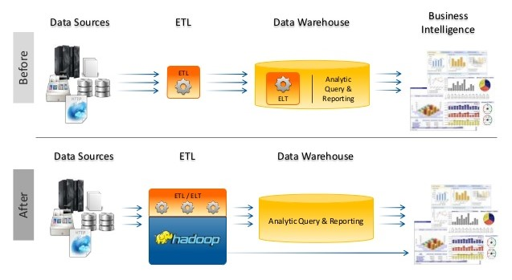

Slide 17
Internet of Things
Industries are using sensors to collect data that they can then analyse to achieve actionable insights.
They might track customer or product movement, monitor the weather or keep an eye on security camera footage.
As with big data itself, the number of ways in which analytics can be applied to IoT solutions seems to be endless.

Slide 18
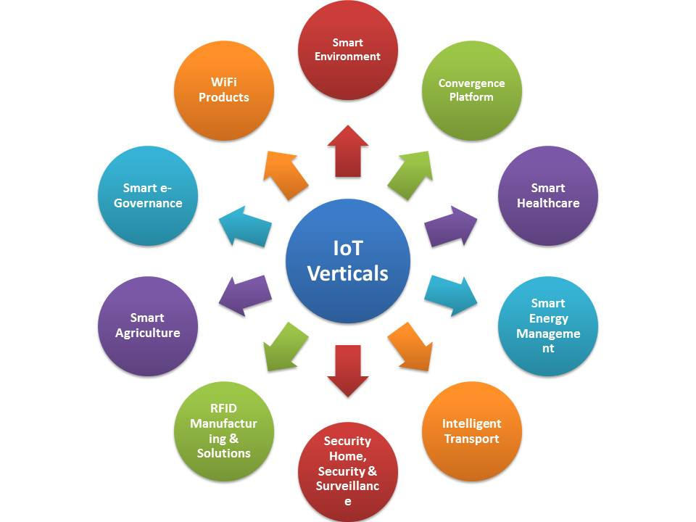

Slide 19
Deep Learning
Large model combined with large datasets are increasingly the top performers in benchmark tasks for vision, speech, and Natural Language Processing.
One needs to train a deep neural network from a large corpus of data.
The largest applications so far are to image recognition and scientific studies of unsupervised learning with 10 million images and up to 11 billion parameters.

Slide 20
Healthcare/Life Sciences
Pathology Imaging
3D pathology imaging is made possible through 3D laser technologies or serially sectioning hundreds of tissue sections onto slides and scanning them into digital images.
Segmenting 3D microanatomic objects from registered serial images could produce tens of millions of 3D objects from a single image.
This provides a deep “map” of human tissues for next generation diagnosis. 1TB raw image data + 1TB analytical results per 3D image and 1PB data per moderated hospital per year.

