Slide 1
LIQUID FUELS Petroleum and its fractionation

Slide 2

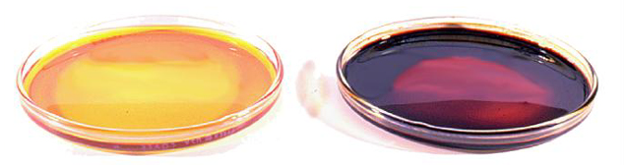
Petroleum
Light Sweet Crude Oil
Heavy Sweet Crude Oil
Petroleum is a mixture of thousands
of different types of hydrocarbons.

Slide 3
Where We Get Oil?
The world's top five crude oil-producing countries are:
Saudi Arabia
Russia
United States
Iran
China India????????????

Slide 4
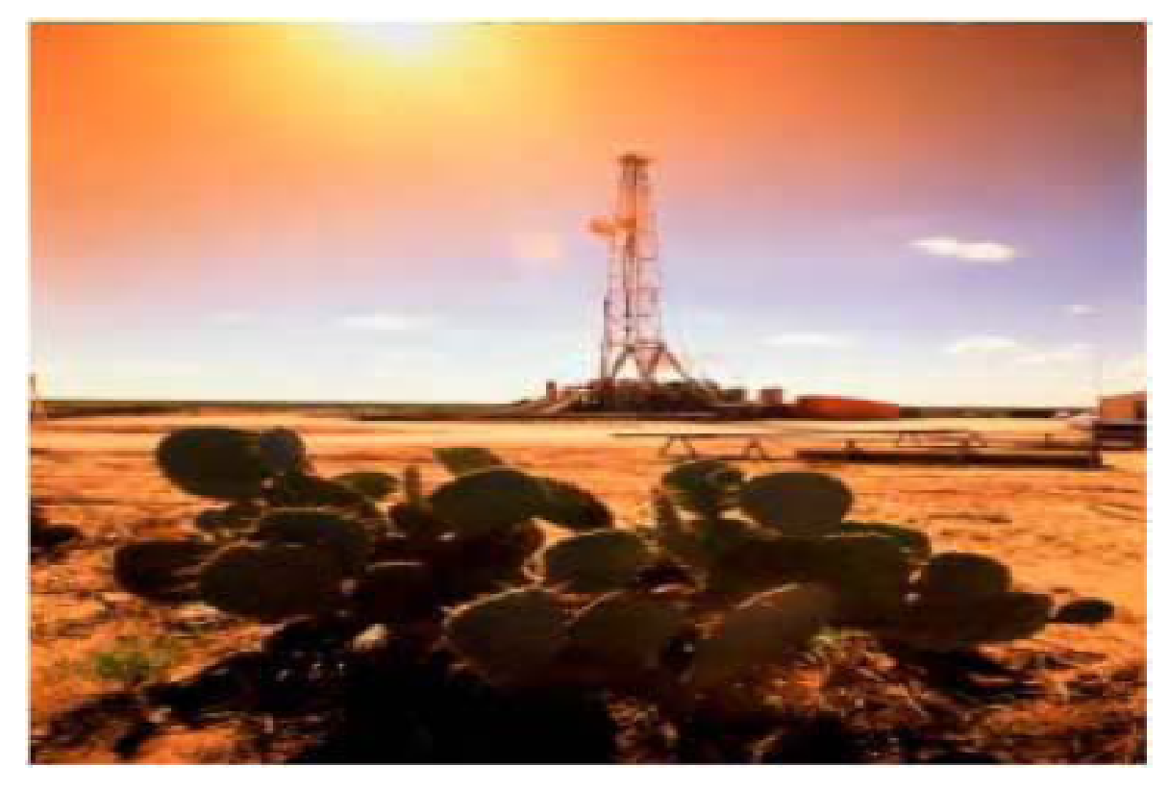

Slide 5
Petroleum Hydrocarbon Structures
Paraffins
Hydrocarbons
Naphthenes

Slide 6
Composition of petroleum
C : 80-87%
H : 15%
S,N,O : 1%

Slide 7

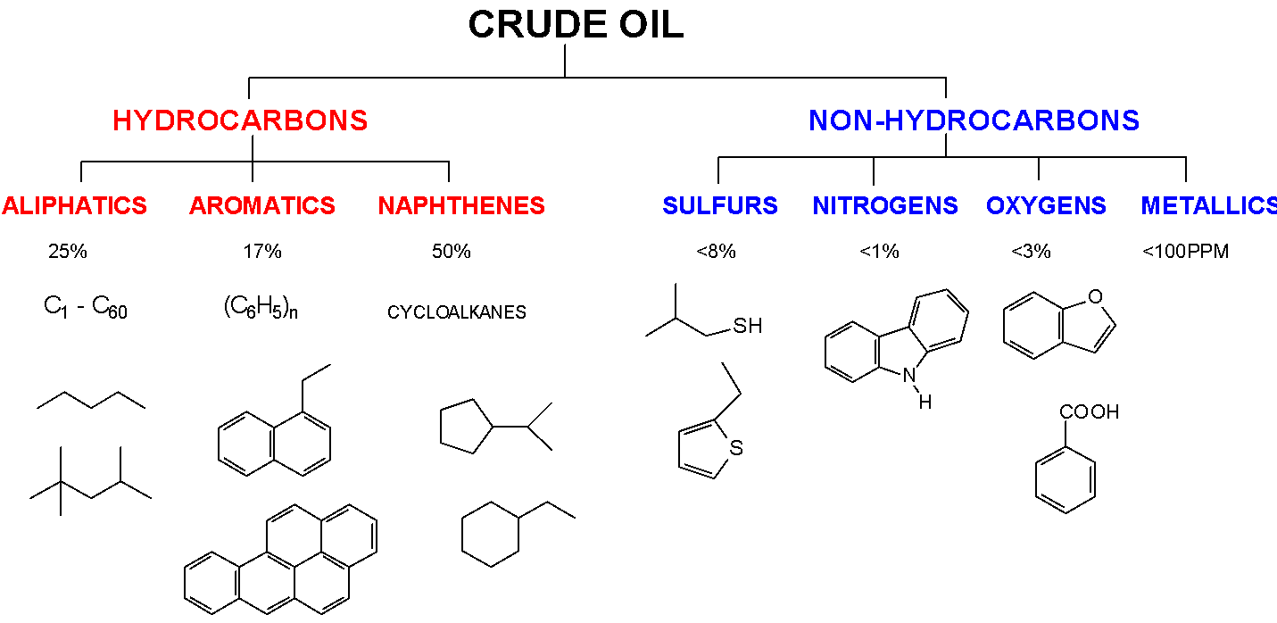
Composition of Crude Oil

Slide 8
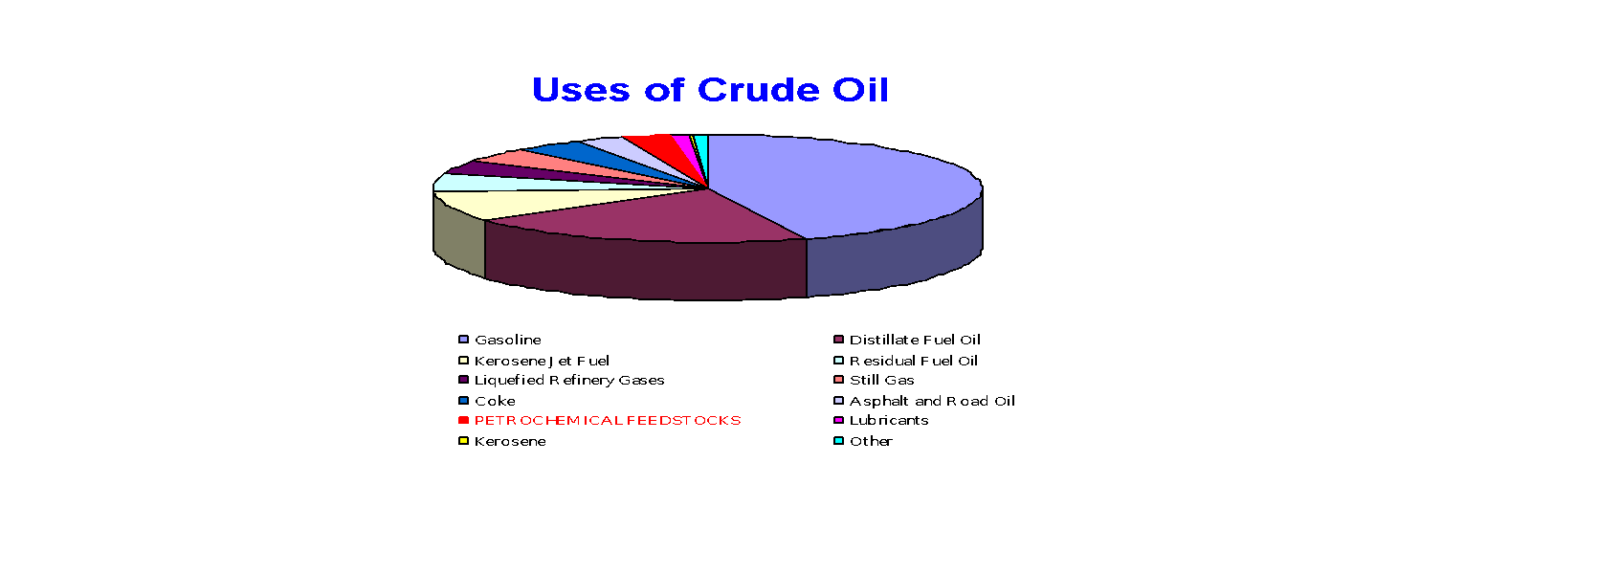
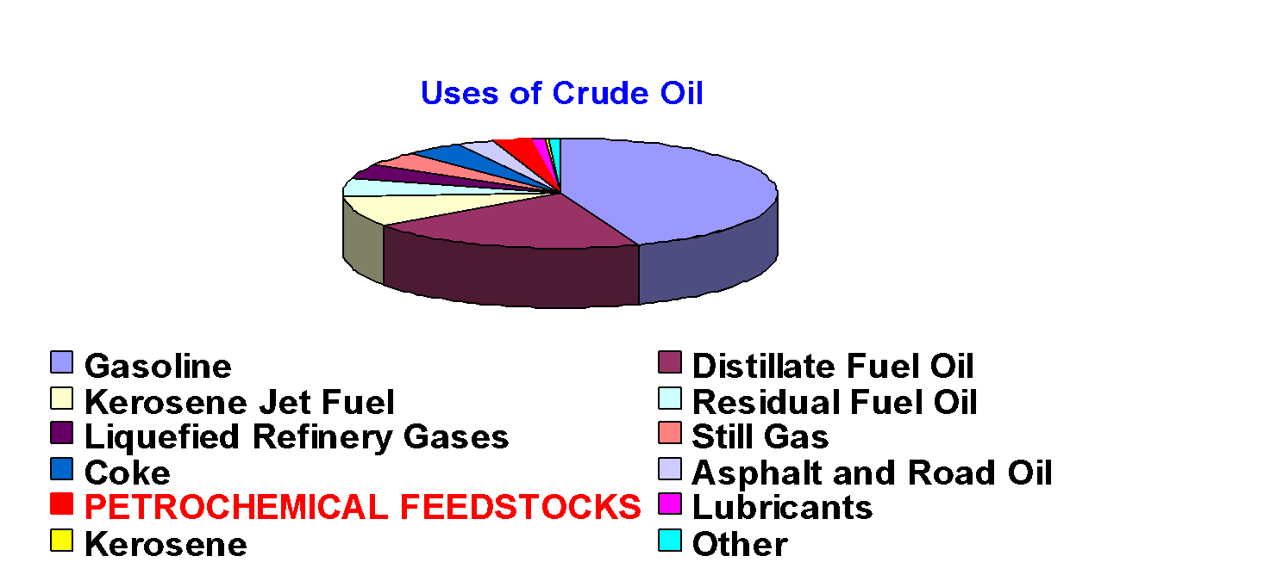
The Uses of Crude Oil

Slide 9
Fractional Distillation of Petroleum
Petroleum can be separated into different fractions by fractional distillation.
The process is called oil refining and the device perform this is called oil refinery
This separation can take place because petroleum is a mixture of substances with different boiling points.

Slide 10
Conditions for Oil Refining
Petroleum is heated to 360°C in the absence of air in a furnace to vaporize it before fractional distillation.

Slide 11

Question
Why must petroleum be vaporized in the absence of air at 360°C?
It may ignite and cause an explosion due to combustion!!!!!!!!!!!!!!!!!!!!

Slide 12
Oil Refining Production Process
Desalting and Dewatering
Distillation
Reforming
Cracking
Alkylation
Isomerisation
Polymerisation
Hydrotreating

Slide 13
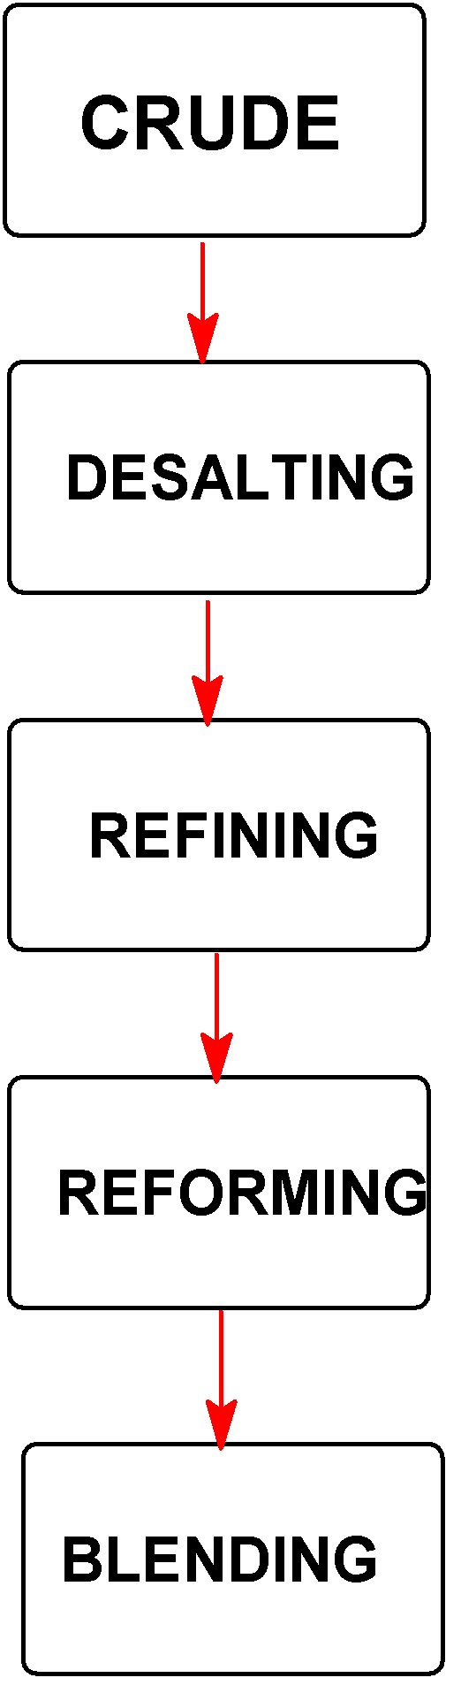
Petroleum delivered from well field
Water washing to remove impurities
Distillation to separate by boiling point ranges
Conversion reactions to alter molecular structures
Mixing to obtain maximum commercial characteristics

Slide 14
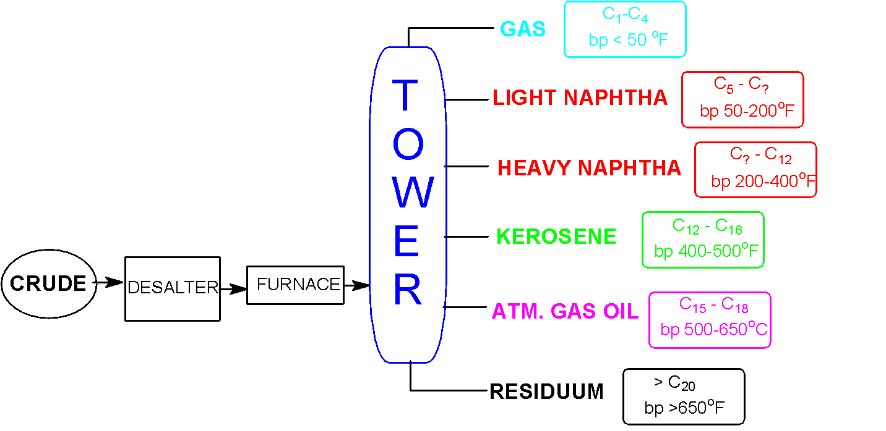
Petroleum Refining
Distillation – separation by boiling point

Slide 15
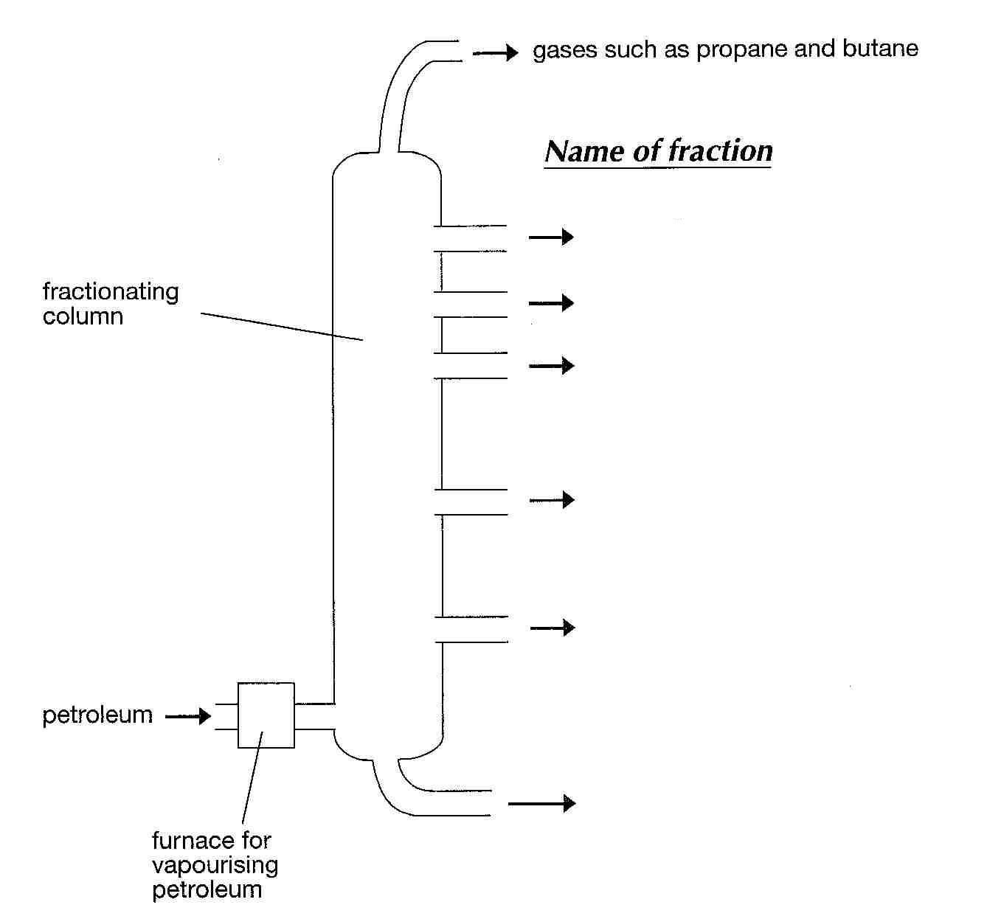
(Petroleum Gas)
Petrol
Naphtha
Temperature increases down the column
Kerosene
Diesel
Lubricants
Bitumen

Slide 16
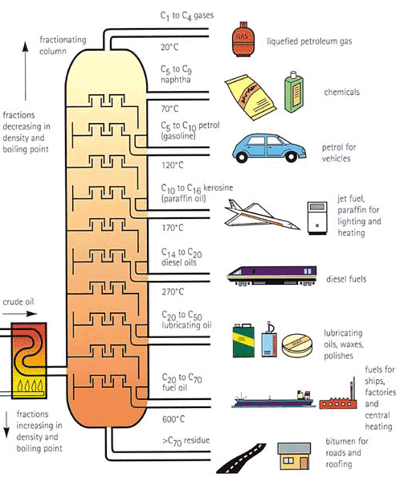

Slide 17
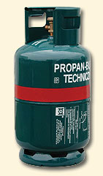
Fractions of Petroleum
Fraction | Boiling Range /°C | No of carbon atoms per molecule | Uses
Petroleum Gas | Below 40 | 1 - 4 | Fuel for cooking

Slide 18

Fractions of Petroleum
Fraction | Boiling Range /°C | No of carbon atoms per molecule | Uses
Petrol (Gasoline) | 40 - 75 | 5 -10 | Fuel for car engines

Slide 19

Fractions of Petroleum
Fraction | Boiling Range /°C | No of carbon atoms per molecule | Uses
Naphtha | 75 - 150 | 7 - 14 | Chemical feedstock

Slide 20
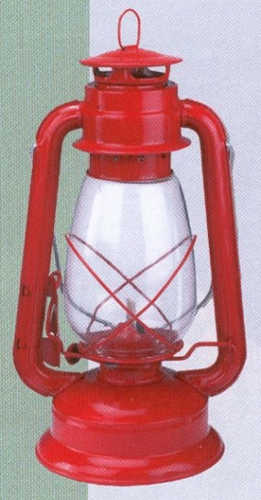
Fractions of Petroleum
Fraction | Boiling Range /°C | No of carbon atoms per molecule | Uses
Kerosene | 160 - 250 | 11 - 16 | Fuel for jet engines, cooking and heating

Slide 21
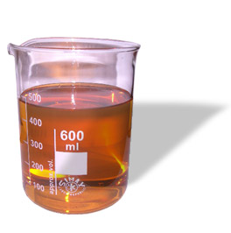
Fractions of Petroleum
Fraction | Boiling Range /°C | No of carbon atoms per molecule | Uses
Diesel | 250 - 300 | 16 - 20 | Fuel for diesel engines

Slide 22

Fractions of Petroleum
Fraction | Boiling Range /°C | No of carbon atoms per molecule | Uses
Lubricants | 300 - 350 | 20 - 35 | Making waxes and lubricating oils

Slide 23
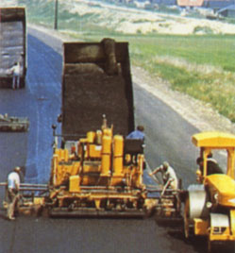
Fractions of Petroleum
Fraction | Boiling Range /°C | No of carbon atoms per molecule | Uses
Bitumen | Above 350 | More than 70 | Paving roads

Slide 24
LPG (bottled gas or refinery gas)
Constituents: n-butane+isobutane+butene+propane
Preparation: Obtained as a bye product during
heavy oil cracking and from natural gas
Dehydrated
Desulphurised
Odorous organic sulphides(mercaptanes) added
Supplied under pressure
Calorific value: 27,800KCal/kg

Slide 25
GASOLENE (PETROL)
Obtained between 40-120ºC as a mixture of
Hydrocarbons C₅H₁₂ -C₈H₁₈
Comp: C = 84%, H = 15%, N+S+O = 1%
Calorific value: 11,250Kcal/kg
Usage: mainly in ic engines

Slide 26
Synthetic petrol
Bergius process:
Low ash coal
Add heavy oil, make paste
Add H₂ at 450ºC, 200-250Atm
Sat. hydrocarbons
fractionated

Slide 27
Fractional distillation of crude oil
Heavy oil
Middle oil
gasoline
Gasoline thus obtained is to be refined

Slide 28
FisherTropsch method
n CO + 2n H₂ → CnH_{2n} + n H₂O
n CO + (2n+1) H₂ → CnH_{2n+2} + n H₂O

Slide 29
Refining of gasoline
Desulphuing:
2 RSH + Na₂PbO₂ Pb(SR) ₂ + 2NaOH
Pb(SR) ₂ + S PbS + RSSR
Sweetening of gasoline

Slide 30
Reforming
Reforming is a process which uses heat, pressure and a catalyst (usually containing platinum) to bring about chemical reactions which upgrade naphthas into high octane petrol and petrochemical feedstock.

Slide 31
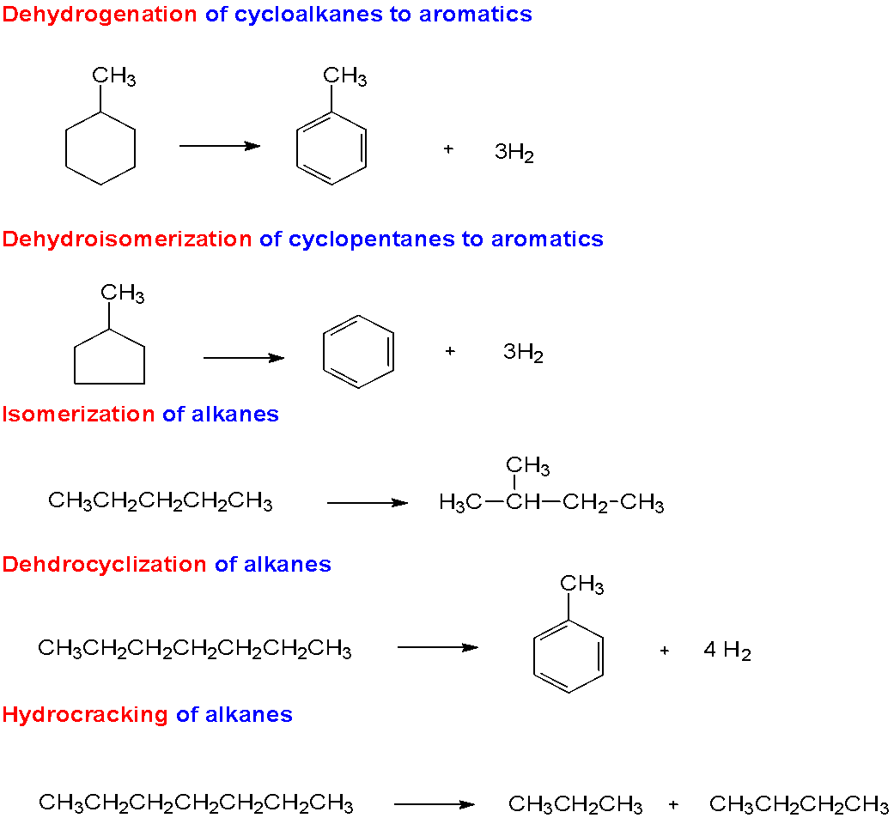
Catalytic Reforming – Conversion Reactions

Slide 32
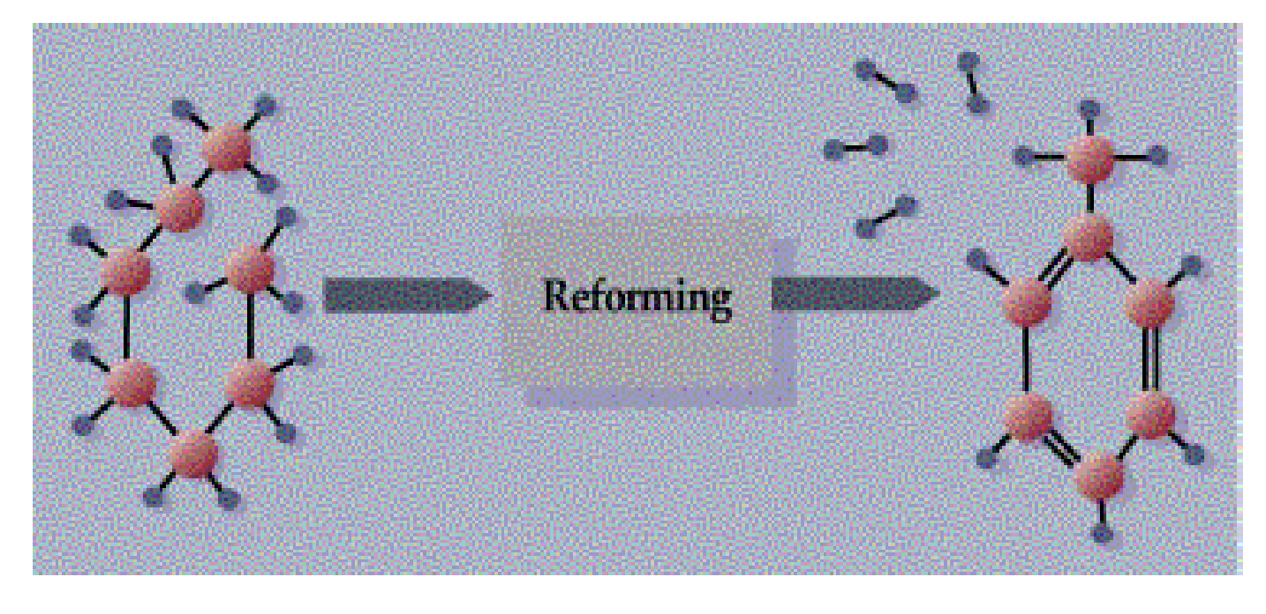

Slide 33
Cracking
Cracking processes break down heavier hydrocarbon molecules (high boiling point oils) into lighter products such as petrol and diesel. These processes include:
catalytic cracking
thermal cracking
hydrocracking

Slide 34
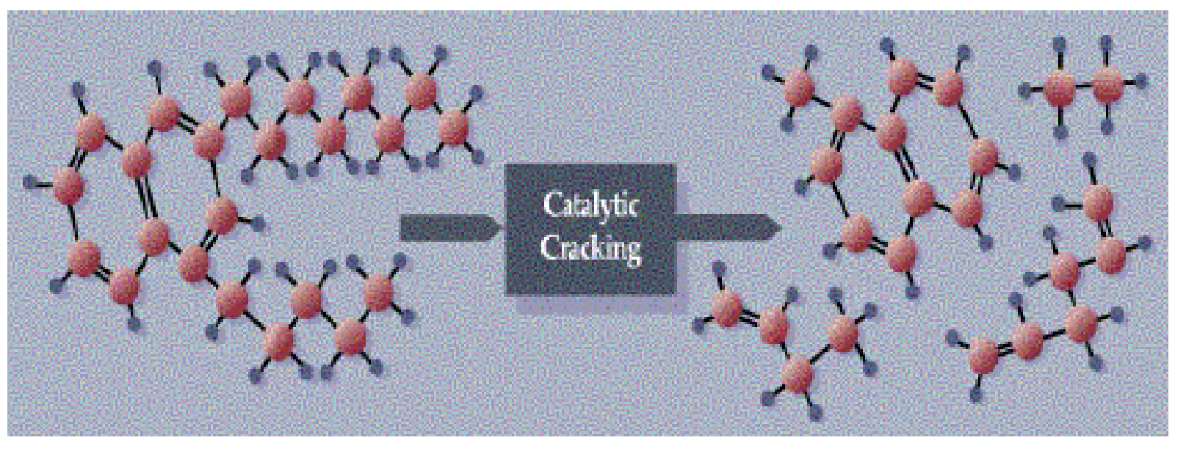

Slide 35
Alkylation
Alkylation refers to the chemical bonding of these light molecules with isobutane to form larger branched-chain molecules (isoparaffins) that make high octane petrol.

Slide 36
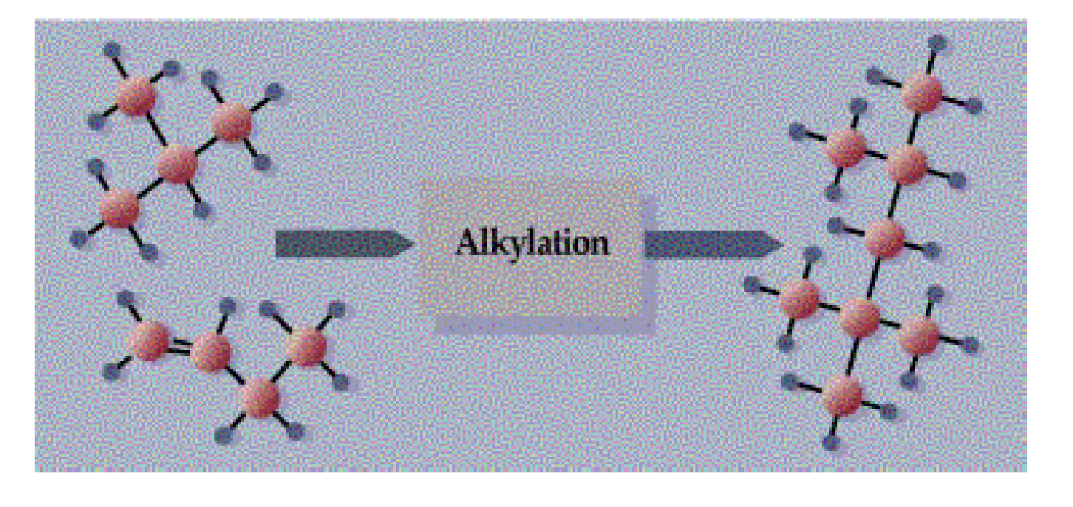
IOCL Project

Slide 37
Isomerisation
Isomerisation refers to chemical rearrangement of straight-chain hydrocarbons (paraffins), so that they contain branches attached to the main chain (isoparaffins).

Slide 38
Polymerisation
Under pressure and temperature, over an acidic catalyst, light unsaturated hydrocarbon molecules react and combine with each other to form larger hydrocarbon molecules. Such process can be used to react butenes (olefin molecules with four carbon atoms) with iso-butane (branched paraffin molecules, or isoparaffins, with four carbon atoms) to obtain a high octane olefinic petrol blending component called polymer gasoline.

Slide 39
Hydrotreating
Hydrotreating is one way of removing many of the contaminants from many of the intermediate or final products. In the hydrotreating process, the entering feedstock is mixed with hydrogen and heated to 300 - 380oC. The oil combined with the hydrogen then enters a reactor loaded with a catalyst which promotes several reactions:
hydrogen combines with sulphur to form hydrogen sulphide (H₂S) .

Slide 40
Petroleum Products
Aviation Gasoline
Gas Diesel Oil/(Distillate Fuel Oil)
Heavy Fuel Oil Residual
Kerosene
Jet Fuel
LPG
Motor Gasoline
Naphtha
Petroleum Coke
Refinery Gas

Slide 41
Products Made From Oil
Ink Toys Dolls Tires Tents ShoesGlue Skis Dyes Cameras Combs Dice Mops Purses Dresses Pajamas Pillows Candles Boats Crayons Caulking Balloons Curtains Milk jugs Putty Tool racks Slacks Yarn Roofing Luggage Fan belts Carpeting Lipstick Aspirin Dishwashing liquids Unbreakable dishes Car sound insulation Motorcycle helmets Refrigerator linings Electrician's tape Roller-skate wheels Permanent press clothes Soft contact lenses Food preservatives Transparent tape Disposable diapers Sports car bodies Electric blankets Car battery cases Synthetic rubber Vitamin capsules Rubbing alcohol Ice cube trays Insect repellent Roofing shingles Shower curtains Plywood adhesive Beach umbrellas Faucet washers Antihistamines Drinking cups Petroleum jelly Tennis rackets Wire insulation Ballpoint pens Artificial turf Artificial limbs Shaving cream

Slide 42
Paint brushes Telephones Insecticides Antiseptics Fishing lures Deodorant Linoleum Sweaters Paint rollers Floor wax Plastic wood Model cars Trash bags Soap dishes Hand lotion Clothesline Shampoo Panty hose Fishing rods Oil filters Anesthetics Upholstery TV cabinets Cassettes Salad bowls House paint Awnings Ammonia Safety glass Hair curlers VCR tapes Eyeglasses Movie film Ice chests Loudspeakers Ice buckets Credit cards Fertilizers Water pipes Toilet seats Fishing boots Life jackets Garden hose Golf balls Umbrellas Detergents Rubber cement Sun glasses Cold cream Bandages Hair coloring Nail polish Guitar strings False teethToothpaste Golf bags Toothbrushes Perfume Folding doors Shoe polish Shower doors Cortisone Heart valves LP records Hearing aids Vaporizers Wading pools Parachutes

Slide 43
Oil and The Environment
Air
Water
Land

Slide 44
Air
Preserving air quality around a refinery involves controlling the following emissions:
sulphur oxides
hydrocarbon vapours
smoke
smells

Slide 45
Water
The majority of the water discharged from the refinery has been used for cooling the various process streams. The cooling water does not actually come into contact with the process material and so has very little contamination.

Slide 46
Rainwater falling on the refinery site must be treated before discharge to ensure no oily material washed off process equipment leaves the refinery.
Process water has actually come into contact with the process streams and so can contain significant contamination.

Slide 47
Land
The refinery safeguards the land environment by ensuring the appropriate disposal of all wastes.
Within the refinery, all hydrocarbon wastes are recycled through the refinery slops system. This system consists of a network of collection pipes and a series of dewatering tanks. The recovered hydrocarbon is reprocessed through the distillation units.

Slide 48
FUELS
PART-II
Comparison of solid, liquid & gaseous fuels
Knocking
Octane number
Cetane number
Synthetic petrol

Slide 49
Comparison between solid, liquid and gaseous fuels
Properties | Solid fuels | Liquid fuels | Gaseous fuels
Price | Cheap and easily available | Costly | Costly except natural gas
Transport and storage | easy | Transported easily though pipelines but must be stored in closed containers carefully | Transported through pipelines and are stored in leak proof tanks

Slide 50
Combustion | slow | quick | Very fast
Fire hazards | Less risk | Greater risk | Even greater than liquid fuels
Smoke and ash | Always produced and reduces calorific value | Ash is not produced but smoke is produced | Neither ash nor smoke is produced
Calorific value | least | higher | Highest

Slide 51
KNOCKING
The metallic sound produced due to the irregular burning of the fuel.
Causes loss in power of engine.
Reason: Mistimed ignition due to increase in temperature of the cylinder resulting from the heat of compression.
Knocking α 1 α 1
Octane number Fuel efficiency
Knocking among different categories of compounds:
Straight chain paraffins > branched chain paraffins > olefins > naphthenes > aromatics.

Slide 52
OCTANE NUMBER
O.N. signifies the ignition quality of gasoline in automobile engines.
For grading gasoline(Petrol)
Isooctane = 100
n-heptane = 0
The % of isooctane present in the mixture of isooctane and n-heptane which has the same knocking property as the fuel itself.
More the octane number, better the fuel efficiency.

Slide 53
Reasons for opting the blend of iso-octane & n-heptane:
The different hydrocarbon in gasoline:
Straight chain paraffin
Iso-paraffins
Naphthenes
Aromatics
For the same Carbon No; straight chain paraffin have lowest octane No.
Branched chain paraffin (isomers), Naphthenes have higher octane No.
Olefins also have high O.N. but they cause gum deposits in the fuel tank and are not desirable.
Aromatic have high O.N. but their content is being restricted due to their carcinogenic nature.

Slide 54
Octane numbers of few hydrocarbons:
Carbon | Hydrocarbon | Octane No.
C₆ – Straight chain | n- Hexane | 28.8
C₆ – Isomer | Methyl Pentane | 73.4
C₆ – Isomer | Dimethyl Butane | 91.8
C₆ – Napthenes | Cyclohexane | 83
C₆ – Aromatic | Benzene | 98
C₇ – Paraffin | n - Heptane | 0
C₇ – Isomer | Dimethyl Pentane | 88
C₈ – Isomer | Iso – Octane | 100
C₇ – Aromatics | Toluene | 107

Slide 55
Methods to increase octane number:
By adding the antiknocking agent: e.g. TEL (about 1.0-1.5ml /lt. petrol) along with some ethylene dibromide.
By isomerisation
By alkylation
By aromatisation

Slide 56
CETANE NUMBER
Reverse of Octane No.
Normal paraffin's have highest cetane no. followed by naphthenes, isoporaffins, olefins and aromatics.
For grading diesel oil.
Hexadecane (cetane) = 100
α- methyl naphthalene = 0
The % of cetane present in the mixture of cetane and α-methyl naphthalene which has the same ignition property as the fuel itself.
More the cetane number, better the fuel efficiency.

Slide 57
Conversion of coal into liquid fuels (Synthetic Petrol)
Two methods:
1)Bergius process
2)Fischer Tropsch method

Slide 58
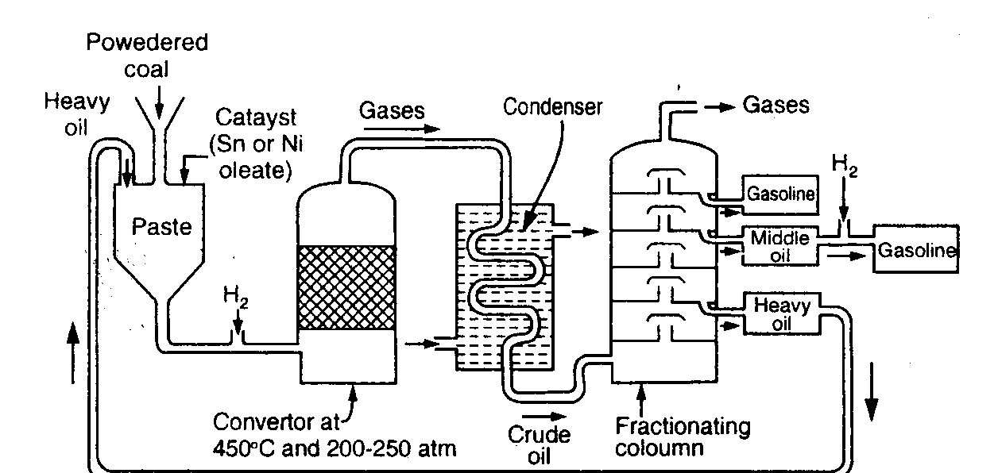
Bergius method

Slide 59
Low ash coal
Add heavy oil & catalyst
(tin+nickel oleate)
Make paste
Heat with H₂ at 450ºC, 200-250atm
for about 1.5 hrs
Saturated hydrocarbons
Fractionated
Low boiling liquid hydrocarbons + Gases
Gases cooled in condenser

Slide 60
Liquid resembling crude oil
Fractionation
Gasoline + middle oil + heavy oil
Middle oil
Vapor phase hydrogenation
Gasoline
(Total gasoline : about 60% of wt. of coal dust)

Slide 61
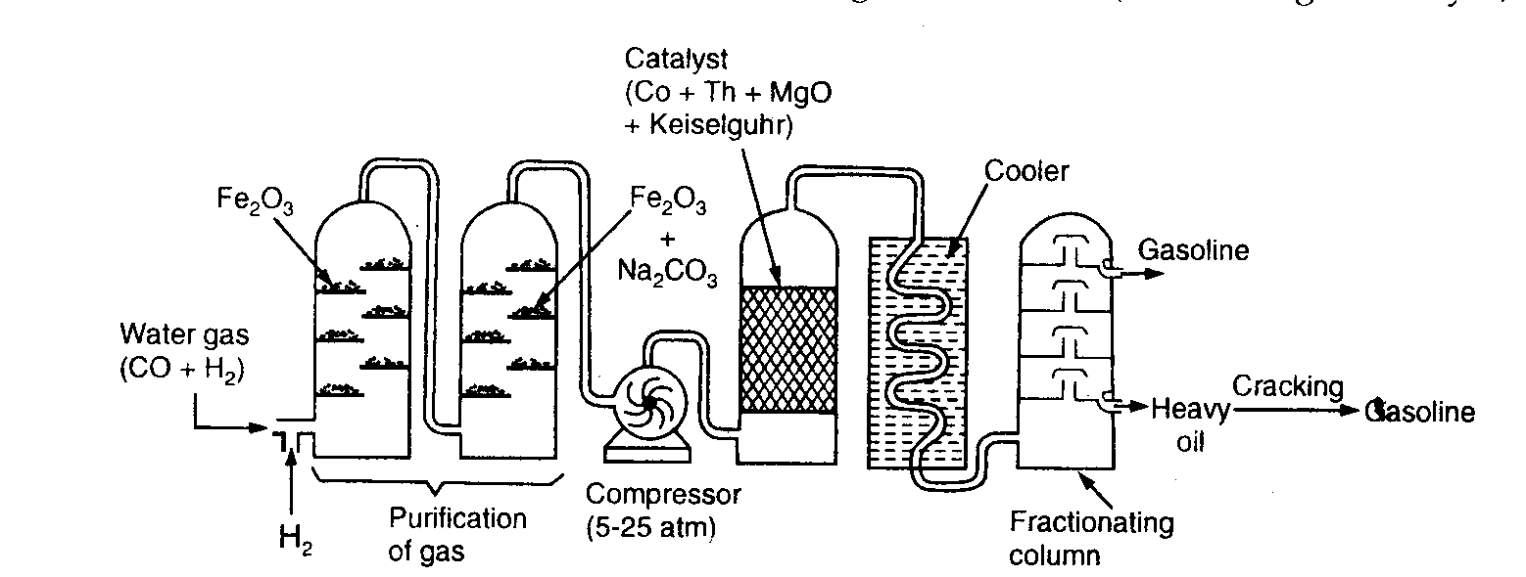
Fisher-Tropsch method

Slide 62
Water gas (CO+H₂) + some more hydrogen
Passed through a tower containing Fe₂O₃
(Removal of H₂S)
Passed through a tower containing Fe₂O₃.Na₂CO₃
(Removal of organic sulfur compounds)
Purified gas
Compressed at 5-25 atm
Passed to converter containing catalyst mixture
(100 parts cobalt, 5 parts thoria, 8 parts magnesia & 200 parts
kieselgurh earth) maintained at 200-300°C

Slide 63
Mixture of saturated and unsaturated hydrocarbons
nCO+2nH₂ C_{n}H_{2n}+nH₂O
nCO+(2n+1)H₂ C_{n}H_{2n+2}+nH₂O
(Exothermic reaction)
Product gases are cooled
Liquid resembling crude oil
Fractionation
Gasoline + heavy oil

Slide 64
Refining of gasoline
Removal of sulfur (Desulfuring/sweetening):
2 RSH + Na₂PbO Pb(SR) ₂ + 2NaOH
Pb(SR) ₂ + S PbS + RSSR
Removed by Extracted with a
filtration suitable solvent
Removal of olefins & coloring matter: By adsorption on ‘fuller’s earth’.
Addition of inhibitors.
Blending.

