Slide 1
Big Data platform
Introduction
Big data platform is a type of IT solution that combines the features and capabilities of several big data application and utilities within a single solution.
It is an enterprise class IT platform that enables organization in developing, deploying, operating and managing a big data infrastructure /environment.

Slide 2
Big Data platform
Platform for Data-Driven Applications
The success of a big data platform depends on the number and variety of applications it supports.
For example, data engineers use a big data platform to parse, clean, transform, aggregate, and prepare data for analysis. Business users use it to run SQL and NoSQL queries against the platform. Data scientists use it to discover patterns and relationships in large data sets using machine-learning algorithms. Organizations build custom applications on big data platforms to calculate customer loyalty, identify next-best offers, spot process bottlenecks, predict machine failures, monitor the health of core infrastructure, and so on.

Slide 3
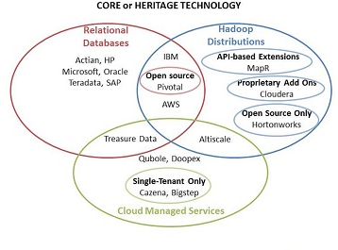
Big Data platform
Classifying Big Data Platforms
The Big data platform can be divided into three categories based on their heritage technology:
Relational databases
Hadoop distributions
Cloud managed services.
Each category also appeals to different types of customers, sometimes within the same organization.
Notes:
Relational databases: Big data platforms include relational database vendors (such as Actian, SAP, Teradata, Oracle, Microsoft, and HP) as well as upstarts (such as Pivotal). Their relational databases have powered many generations of data warehouses, data marts, operational data stores, and analytic applications. These systems use structured query language (SQL) to process and manipulate structured data stored in relational tables linked together using primary and secondary keys.
Hadoop distributions: Big data platforms based on Hadoop are market newcomers that have appeared within the past several years. The primary vendors in this space (MapR, Hortonworks, and Cloudera) run Hadoop as their core data processing platforms, which they supplement with a blizzard of open source software and, in some cases, proprietary software.
Cloud managed services: This category includes pure-play cloud service providers that manage and operate big data platforms on behalf of subscribers in the cloud. More than a platform-as-a-service, a cloud managed service lets customers focus solely on analyzing data and building data-driven applications rather than data infrastructure. In addition, cloud managed services provide a quick and easy way for customers without information technology experts or available servers to try out or deploy a big data platform. Leading cloud managed service providers include Altiscale, Qubole, Treasure Data, Cazena, and Amazon Web Services (AWS).

Slide 4
Big Data platform
Market Strategies
The vendors in each of these three product categories have adopted different strategies to gain traction in a fast-moving market.
Connect, integrate, and imitate: For example, relational database vendors see big data as both a competitive opportunity and a threat. On the one hand, big data opens up new data sources and applications for its products.
Open source and then some: For their part, Hadoop distribution vendors use some variation of the open source model to compete against relational vendors and each other.
The outsourced cloud: Finally, although most relational databases and Hadoop distributions now run in the cloud to some degree and some vendors offer their own cloud public clouds, Altiscale, Treasure Data, Qubole, Cazena, and others can be considered true cloud managed services.

