Slide 1
Unit 2 Governance of Open Standards

Slide 2
What is IT Governance?
Governance is the set of organizational regulations and standards exercised by management to provide strategic direction and ensure that objectives are achieved, risks are managed appropriately, and resources are used responsibly”

Slide 3
An IT governance framework should answer some key questions such as:
How the IT department is functioning overall?
What key metrics management needs?
What return IT is giving back to the business from the investment it’s making?

Slide 4
Open Source Governance
Open source governance is the way an organization controls the use of Open Source Software within their products and services, supply chains and business management activities, and the associated business and legal processes.
This system of management is used to ensure compliance, and is a closed-loop process that monitors the state of a system and reports if it’s meeting its goals.

Slide 5
Open source governance is part of the broader category of IT governance which, according to the IT Governance Institute:
helps ensure that IT supports business goals
maximizes business investment in IT
appropriately manages IT-related risks and opportunities.

Slide 6
Need for Open Source Governance & its importance
"Planning complex IT projects involves an array of political, organizational, legal, technical, cultural, and personnel issues best dealt with by a team charged with the responsibility for the successful outcome of those projects”.
As the use of open source software has grown and matured, the need for open source governance has become an integral part of typical IT development.

Slide 7
There are many frameworks and regulations related to IT, and hence open source governance. COBIT (control objectives for information and related technologies) is one of the well know IT frameworks from ISACA (Information Systems Audit and Control Association).
One more framework is ITIL (IT Infrastructure Library), developed on behalf of the British government for best practices with IT service management. Both are useful in designing, planning and implementing open source governance.

Slide 8
Today it may be difficult to find an enterprise that does not use open source software. Open source acceptance and adoption is widespread across many industries, including commercial software development, and it is expanding rapidly. Such a broad adoption is clear, since enterprises want to save money, and want to enjoy the savings while leveraging high quality and flexibility in their IT infrastructure.
Hence, proper open source software governance is becoming vital to ensure long-term feasibility of open source projects across the enterprise.

Slide 9
Why open standards?
Open standards are the subject of much discussion, but:
why are they important?
what constitutes an ‘open’ standard?
how can the transition be made to use in practice?
how open standards are governed ?

Slide 10
The importance of standards
For organizations, having the means to exchange information efficiently with other organizations is becoming increasingly important. We can refer to this as interoperability, the ability of organizations to Cooperate, in particular by means of electronic information interchange.
In order for interoperability to be achieved, agreements are needed, agreements about the content of the exchanged information, its meaning and the techniques to be used. In some cases, these are specific agreements between two organizations, but more frequently an agreement will apply to a whole industry or a specific general application. In the latter case, the agreement is a standard.

Slide 11
Governance of Open Standards
Here we want to understand the ways in which open standards are created and used. Certainly, very diverse institutional processes are involved in creating, administering and enforcing standards for areas as different as software, hardware, mobile phones, pollution and employment practices.
Governance is a stepwise process of working towards more efficient adoption, implementation and use of open standards.

Slide 12
Standards and Externalities
Externalities are dealt with standards by actors. An externality occurs whenever one actor’s conduct affects the well-being of another.
Familiar examples could be a
manufacturing firm that dumps pollutants in a river, decreasing water quality downstream, or
factory smoke that fouls residential air that affects others.
A technological externality may be a situation where the production function of one firm is favorably or unfavorably affected by the production function of other firms.

Slide 13
Governance processes
Two types of governance processes are prevalent in generation of standards.
The first is dispersed and market-based, where individual firms create their own standards, by including/expressing them in their products, and sometimes by publishing specifications, where other firms respond by adopting those standards, modifying them or creating competing standards. This typically leads to coordination on a single standard or a few competing standards. However the process often remains dynamic, for example, we know about the proprietary Windows standard, which appeared to have captured the computer operating system market, but a rejuvenated Apple and Linux (Open standards) have injected new uncertainty.

Slide 14
In the second process, formal organizations are involved, exclusively private and mixed public & private, where firms develop common standards for products and services. The best example is the International Organization for Standardization (whose very acronym is standardized in all languages as “ISO”). ISO is made up of standard setting organizations from over 100 member countries and it is most representative. A majority of these are either government agencies or publicly chartered bodies, but private organizations form the mainstay of ISO.

Slide 15
Organizations
For example, US representative is the American National Standards Institute (ANSI), a private federation of standard setting organizations.
Similar organizations, such as the European Committee for Standardization (CEN) and Bureau of Indian standards (BIS) operate regionally.

Slide 16
Normally market standard setting favors large, influential producers.
Also, the market approach favors those firms that are innovative, as it eliminates the need to obtain institutional approval for new technologies.
On the other hand, the institutional approach benefits weak players, like firms that are small or lack in innovation.

Slide 17
Since, private producers often dominate public standard setting organizations.
On the other hand, private standards organizations mimic public bodies in their structures and procedures, apparently to increase institutional legitimacy.
Governments support and utilize private standard setting in many ways. As regulators, they incorporate private standards into building codes, telecommunication protocols and other rules as a low-cost way of ensuring interconnectivity.

Slide 18
Private enterprises and governments as well, prefer private standard setting in network externality settings for numerous reasons. The main advantage private actors have is better information regarding production processes, the effects and costs of particular standards, etc.
Private producers continuously monitor technological and market trends since they have every incentive to modify product standards rapidly in response to change. Also private firms are less hindered by political and procedural constraints. Finally, private producers are best able to ensure that agreed standards are implemented.

Slide 19
Sometimes public and private actors both find exclusive private governance inappropriate and seek public intervention, typically to redress institutional problems.
Sometimes, private actors may be unable to create connectivity and interoperability standards because of conflicting interests, concerns of secrecy or negotiating problems.
private producers and their governments might be locked into their own technologies that they cling to multiple standards, limiting network economies. At such conditions, intervention by an international private or public organization may ease the deadlock and promote coordination among contending groups.

Slide 20
Secondly, when there exist irregularities within an industry, private standard setting may lead to inferior outcomes.
The biggest problem is the dominance of a private monopoly based on a proprietary standard. Case against Microsoft by the US Justice Department’s case is well known. Big players and first movers benefit when standards are set through market actions or competing private standards organizations.

Slide 21
The choice among governance types
We have seen that no single form of governance can handle all problems effectively, neither no single blend of governance forms is best for all situations. The best combination will vary with each issue that needs to be addressed.
For example, powerful actors may control standard setting, with undesirable effects. In such situations it is necessary to strengthen the position of less developed countries bargaining with multinational firms under privately-created standards. Public monitoring may be needed to safeguard broader representation when standards have significances beyond the immediate network.

Slide 22
Choosing levels of governance
National, regional or global level governance, which is best?
National, regional or global level governance, which is best?
The answer could be found by looking into the European Union principle of “subsidiarity”.

Slide 23
In current context, standards should be set and implemented at the lowest level, able to address them effectively, mainly because of concerns for representativeness. But the subsidiarity principle finds that action at higher levels is often applicable, depending on the scope or outcome of the problem or the proposed action. Further that subsidiarity should be interpreted broadly to focus on governance, including private governance and to recognize that effective governance may require the involvement of multiple levels.

Slide 24
International governance can discipline national governance, without replacing it, by applying rules and procedures that serve as checks against the capture of national decision-making by narrow or provincial interests. International forums could provide an opportunity to scrutinize national policies in a setting insulated from national politics, and often governed by rules or norms.
Mixture of international and national governance will be the optimal choice. National institutions have better local knowledge and usually better capacities for combining preferences. International governance institutions bring together transnational expertise and interests, and can force states to face their policy externalities. Each can serve as a check on the other, safeguarding that neither private nor national interests improperly frustrate public and global purposes.

Slide 25
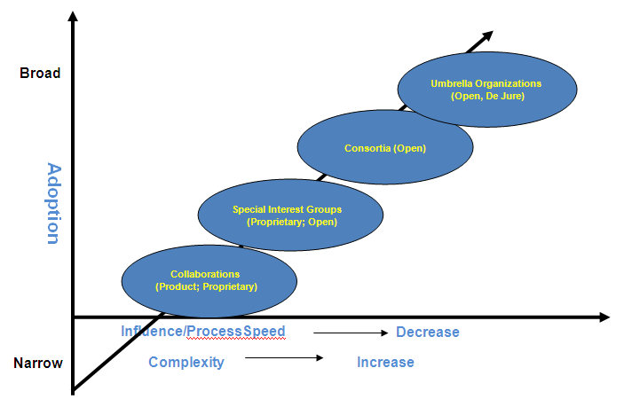
The below figure illustrates the types of standard organizations in relation to adoption of standards, their influence & process speed and complexity of technologies handled.

Slide 26
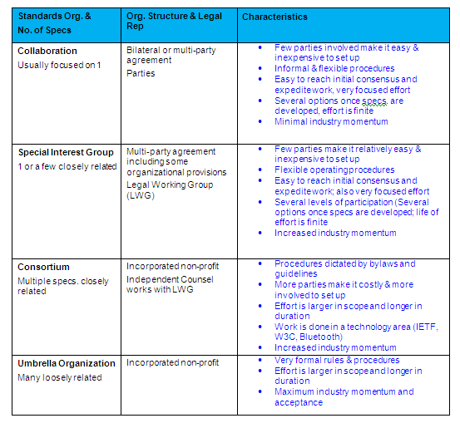

Slide 27
Governance Structure of ISO
The three primary governance groups of ISO are:
The ISO General Assembly, which is the annual meeting of all ISO members, and its agenda typically, includes actions relating to the review of the ISO annual report, approval of ISO’s multi-year strategic plan, and ISO’s finances.

Slide 28
The ISO Council, which meets twice a year and is responsible for the development of ISO’s multi-year strategic plan, the development of the ISO annual budget, ISO’s relations with other external organizations, and other political/strategic decisions and the general operations of ISO. The ISO Council consists of the principal officers of ISO and eighteen elected member bodies, including ANSI for the USA. ANSI is one of five permanent members to the ISO Council.

Slide 29
The ISO Technical Management Board (ISO/TMB), which meets three times each year and reports to and advises the ISO Council on all matters concerning the organization, coordination, strategic planning, and programming of the technical work of ISO. The ISO/TMB consists of the ISO Vice President for Technical Management and twelve elected member bodies, including ANSI for the USA. ANSI is one of four permanent members of the ISO TMB.

Slide 30
Governance of technical work at ISO
The technical work is carried out under the overall management of the Technical Management Board (TMB). The Technical Management Board reports to the ISO Council and its role is defined in the statutes of the organization.

Slide 31
ISO TMB’s duties could be summarized as follows:
To report to and, when relevant, advise Council on all matters concerning the organization, coordination, strategic planning, and programming of the technical work of ISO.
To examine proposals for new fields of ISO technical activity, and to decide on all matters concerning the establishment and dissolution of technical committees.
On behalf of ISO, to keep the ISO/IEC Directives for the technical work under review, to examine and coordinate all proposals for amendments and to approve appropriate revisions.

Slide 32
To act, within the framework of established policies relating to the technical work, on the following matters:
monitoring of the work of technical committees and project management requirements;
approval of titles, scopes and programs of work of individual technical committees;
allocation or reallocation of secretariats of technical committees and, in the case of there being more than one candidate, allocation or reallocation of secretariats of subcommittees;
appointment of chairmen of technical committees;
appeals against technical committee and subcommittee action or inaction;
resolution of technical coordination issues between ISO technical committees, and vis-à-vis IEC, other international organizations, and regional organizations;
advising the Secretary-General on technical interface questions between ISO and IEC, and with respect to technical collaboration with other international standardizing bodies.

Slide 33
To appoint registration authorities and maintenance agencies for the implementation of International Standards.
To establish (and dissolve) Technical Advisory Groups (TAG) in order to obtain expert advice, and to appoint their members and chairmen.
To establish (and dissolve) committees on general standardization principles and to appoint their chairmen.

Slide 34
The primary duty of a technical committee or subcommittee is the development and maintenance of International Standards, one such committee related to information & communication technologies is ISO/IEC JTC 1.
ISO/IEC JTC 1 (JTC 1) is the standards development environment where experts come together to develop worldwide ICT standards for business and consumer applications. Additionally, JTC 1 provides the standards approval environment for integrating diverse and complex ICT technologies. These standards rely upon the core infrastructure technologies developed by JTC 1 centers of expertise complemented by specifications developed in other organizations. As a joint technical committee of ISO and IEC, JTC 1 has the qualities and strengths of ISO and IEC standardization.

Slide 35
JTC 1’s scope is “International standardization in the field of Information Technology”. Information Technology includes the specification, design and development of systems and tools dealing with the capture, representation, processing, security, transfer, interchange, presentation, management, organization, storage and retrieval of information.
JTC 1's current strength lies in core technologies, providing the foundation for ICT applications and services: coded character sets, cultural and linguistic adaptability, biometrics, IC cards, security, multimedia, databases interface, etc. The work of JTC 1 in these fields also includes proper maintenance of its previous existing standards to secure the investment in products, processes and applications implementing those specifications.

Slide 36
In addition to this well-established focus of work, JTC 1 positions itself as a system integrator to complement its current program of work, especially in areas of standardization where many consortia/fora are active. JTC 1 recognizes and appreciates the diversity and range of standards setting organizations in the ICT sector.

Slide 37
Also, JTC 1 acts as system integrator:
Reach out to other standards setting organizations, including referencing of relevant standards
Share information with relevant standards setting organizations, for example about market requirements and inventories of relevant standards.
Establish relationships that facilitate collaboration with external organizations.
Encourage development of international standards that respond to market needs.
Provide a mechanism for standards developed outside JTC 1 to be quickly approved as international standards
Develop profiles as appropriate to cope with the needs of specific applications

Slide 38
Governance of Open standards by Consortia
A consortium is formed typically with a small group of founding companies as members, with no office location, and no network infrastructure. At the beginning, a consortium may be not much except its corporate documents, the founding members aspirations, and perhaps some contributed intellectual property.
For potential members, standards consortia represent both an opportunity and a risk. On the positive side, they have an opportunity to help develop or accelerate an entire industry and maximize their ability to capitalize on it.

Slide 39
However, participation has it risks and costs including:
Consumption of key resources
Potential loss of control over IP or trade secrets Implementation issues with evolving specifications and
Possible antitrust liabilities

Slide 40
To overcome the prospective members' concerns, consortia must present more than just an attractive market opportunity and business case for the standard. They need to show prospects that they have a structure in place that encourages participation and productivity while minimizing the risks and costs. Meeting this challenge requires organizational discipline, strong governance, and a supporting infrastructure that encodes and helps enforce the consortium’s bylaws, IPR policies and operating policies and procedures

Slide 41
The figure below helps in understanding where existing standards organizations fit along the dual axes - formal vs. informal and exclusive vs. inclusive.
Formal – operates under strict, detailed, well-documented policies and procedures
Informal – operates loosely without explicitly policies or guidelines
Exclusive – Limits participation either explicitly (by invitation only) or implicitly (e.g. high membership fees )
Inclusive – operates transparently with membership or participation open to all. Seeks global input.

Slide 42
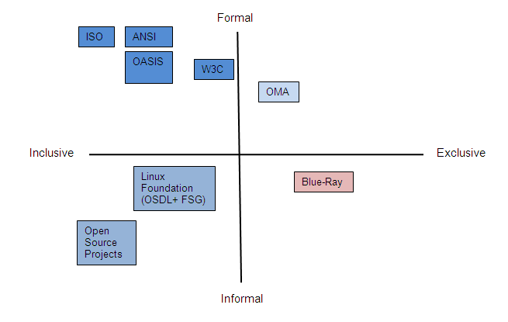

Slide 43
OASIS (Organization for the Advancement of Structured Information Standards), which is a not-for-profit consortium that drives the development, convergence and adoption of open standards for the global information society. The consortium produces more Web services standards than any other organization along with standards for security, e-business, and standardization efforts in the public sector and for application-specific markets. Founded in 1993, OASIS has more than 5,000 participants representing over 600 organizations and individual members in 100 countries.

Slide 44
OASIS is distinguished by its transparent governance and operating procedures. Members themselves set the OASIS technical agenda
The structure of OASIS governance:
The OASIS Board of Directors is comprised of executive-level officers, experienced in managing organizational growth, defining policies and dedicated to advancing open standards for interoperability
The OASIS Technical Advisory Board (TAB) advises the OASIS Board of Directors, staff, and membership on matters related to the technical agenda of OASIS. The TAB focuses on improving the standards development process, improving the quality of OASIS Standards

Slide 45
The technical work related to standard’s creation is carried out by the Technical Committees (TC).

Slide 46
Sources of information on standards
ISO has just launched a new database that will make the benefits of using standards easier to achieve, provide users with new possibilities for achieving such benefits and cut the time necessary to develop and revise standards.
ISO Concept Database
no platform was available to bring together in a single source
A challenge

Slide 47
To tackle this challenge, the ISO Central Secretariat in Geneva, Switzerland, has developed a new application, the ISO Concept Database (ISO/CDB), which provides a harmonized platform for search, development and maintenance of concept content throughout the ISO standards portfolio.
Most of the content of the ISO/CDB is publicly accessible at http://cdb.iso.org or from ISO's Web site www.iso.org . An online tour of the CDB is available under http://www.iso.org/iso/demo_ISO-CDB.html
The ISO/CDB will allow standards users in companies and other organizations to easily access standardized reference data, with the possibility of re-using them in their own applications.

Slide 48
World Standards Services Network (WSSN)
The most reliable sources of information on standards are the organizations which developed these standards. The World Standards Services Network (WSSN) is the most comprehensive portal of links to the Web sites of international, regional and national standards developing organizations including ISO and IEC Web sites.http://www.wssn.net/WSSN/index.html

Slide 49
Open Group Standards Information Base
The Open Group is a global consortium that enables the achievement of business objectives through IT standards. With more than 400 member organizations, we have a diverse membership that spans all sectors of the IT community — customers, systems and solutions suppliers, tool vendors, integrators and consultants, as well as academics and researchers to:
Capture, understand and address current and emerging requirements, and establish policies and share best practices
Facilitate interoperability, develop consensus, and evolve and integrate specifications and open source technologies
Offer a comprehensive set of services to enhance the operational efficiency of consortia Operate the industry’s premier certification service
Operate the industry's premier certification service
http://www.opengroup.org/sib.htm

Slide 50
NSSN
Another database for standards maintained by ANSI is, the NSSN, a National Resource for Global Standards is a search engine that provides users with standards related information from a wide range of developers, including organizations accredited by ANSI, other U.S. private sector standards bodies, government agencies and international organizations.
http://www.nssn.org/

Slide 51
Governing open standards via IT governance in organizations
Open source enhanced interoperability and reduces dependencies on suppliers.
Adopting open standards means including them in the selection and decision-making processes for IT needs.
IT governance processes give direction to IT activities and projects. If these processes promote the application of open standards, their implementation and actual use in those activities and projects will increase.
But this process is crucial.

Slide 52
The relationship between IT governance and open standards
Governance Process
IT governance is the leadership and the organizational structures and processes necessary in order to develop information technology which is in line with the needs and objectives of the organizations.
Compliance management
Compliance management for open standards comprises of periodic checking of requirements relating to open standards, such as the list of open standards and standards in legislation and regulations. Assessments are then performed to establish how these requirements can and must be fulfilled.

Slide 53
IT Policy
The IT policy includes the
strategic orientation of IT in relation to operations (e.g. ‘By 2015 we need to be able to conduct 80% of our customer contact over the internet’),
Principles concerning information sharing (e.g. ‘Our data is publicly available’ or, conversely, ‘Our information is crucial for our organization and must be kept strictly secure’).
Principles concerning utilized technology (e.g. ‘We utilize shared service centers owned by our parent company’ or ‘We use only standard products’).
Policy concerning suppliers (e.g. ‘We design our own software, but outsource building and administration’).
IT project funding.

Slide 54
However, policy itself is relatively weak mechanism; the fact that policy has been well-defined does not automatically mean that it will be implemented in the same manner. The policy must lead to specific actions and projects.

Slide 55
Architecture management
Architecture management transforms the IT policy into specific structural and organizational principles.
The strategy for information management and systems and standards which are to be used is determined by means of architecture.
In architecture, specific decisions are made concerning the open standards to be used in an organization.

Slide 56
Procurement and supplier management
The final governance process is procurement, which involves the actual acquisition of IT resources and support, as well as the control of suppliers.
Procurement involves hardware and software, both standard and customized, and the insourcing of consultancy and expertise.
The governance process of procurement also focuses on the supplier market, the strategic position of the organization in relation to suppliers, the operational side of procurement (specification documents, tenders, etc.) and the assessment of suppliers. Requirements for suppliers are highly specified. In this way, the governance process ensures continuously improving cooperation with suppliers as partners in the value chain.
In the process, the products and suppliers utilizing open standards can be given priority. Furthermore, in a number of cases, use of open standards can be specified as a requirement.
The widespread adoption of open Standards means that suppliers can base the development of their products and services on specifications that have wide acceptance in their sectors. This, in turn, means that businesses using open Standards are increasingly free to compete in many markets around the world.

