Slide 1
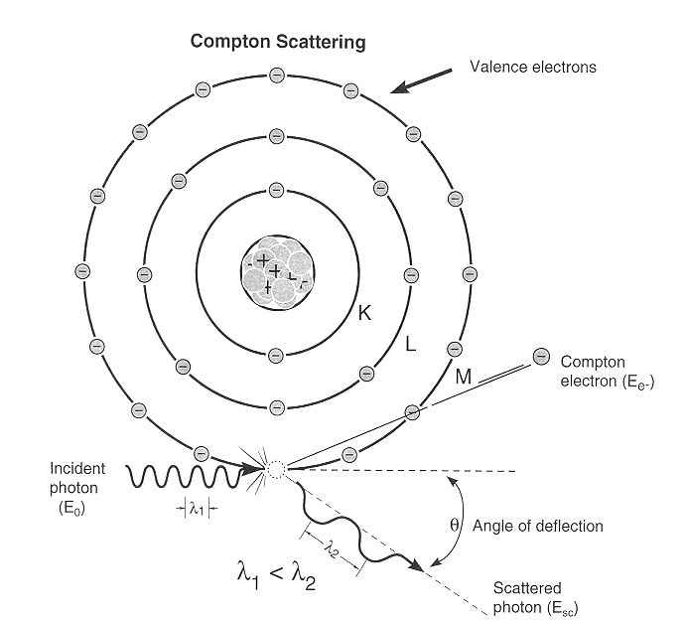
Compton Effect
When a monochromatic beam of X-rays is scattered from a material then both the wavelength of primary radiation (unmodified radiation) and the radiation of higher wavelength (modified radiation) are found to be present in the scattered radiation. Presence of modified radiation in scattered X-rays is called Compton effect.
scattered photon
incident photon
electron
recoiled electron

Slide 2
From Theory of Relativity, total energy of the recoiled electron with v ~ c is
Similarly, momentum of recoiled electron is

Slide 3
Now from Energy Conservation
(i)
From Momentum Conservation
(ii)
along x-axis
and
(iii)
along y-axis

Slide 4
Rearranging (ii) and squaring both sides
(iv)
Rearranging (iii) and squaring both sides
(v)
Adding (iv) and (v)
(vi)
From equation (i)

Slide 5
On squaring, we get
(vii)
Subtracting (vi) from (vii)

Slide 6
and
So,
But
is the Compton Shift.
It neither depends on the incident wavelength nor on the scattering material. It depends only on the scattering angle i.e.
is called the Compton wavelength of the electron
and its value is 0.0243 Å.

Slide 7
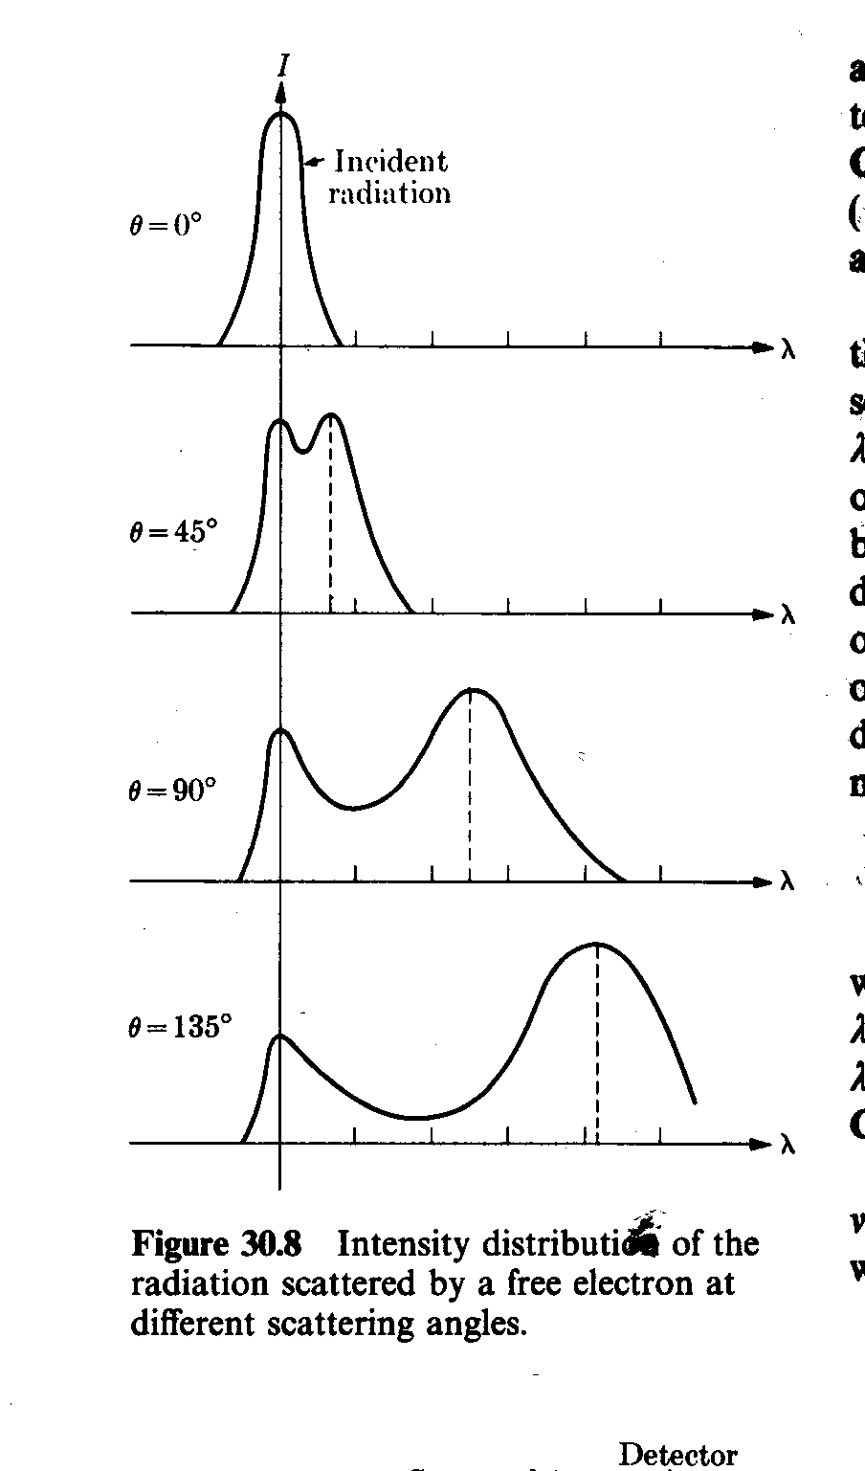
Experimental Verification
photon
Bragg’s X-ray
Spectrometer
Monochromatic
X-ray Source
θ
Graphite
target
1. One peak is found at same position. This is unmodified radiation
2. Other peak is found at higher wavelength. This is modified signal of low energy.
3. increases with increase in .

Slide 8
Compton effect difficult to observe in Visible Light
0.0243 (1- cosθ) Å
is maximum when (1- cosθ) is maximum i.e. 2.
0.05 Å
So Compton effect can be observed only for radiation having wavelength of few Å.
For 1Å ~ 1%
For 5000Å ~ 0.001% (undetectable)

Slide 9
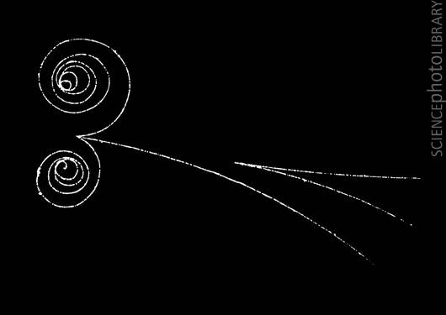
Pair Production
Here a photon passes by a nucleus and converts to a particle anti particle pair.

Slide 10
So what if a particle “decayed into two similar mass particles?

Slide 11
Pair Production
When a photon (electromagnetic energy) of sufficient energy passes near the field of nucleus, it materializes into an electron and positron. This phenomenon is known as pair production.
Photon
Nucleus (+ve)
In this process charge, energy and momentum remains conserved prior and after the production of pair.

Slide 12
The rest mass energy of an electron or positron is 0.51 MeV (according to E = mc²).
The minimum energy required for pair production is 1.02 MeV.
Any additional photon energy becomes the kinetic energy of the electron and positron.
The corresponding maximum photon wavelength is 1.2 pm. Electromagnetic waves with such wavelengths are called gamma rays .
Photon-nucleus pair production can only occur if the photons have an energy exceeding twice the rest energy (m_{e}c²) of an electron (1.022 MeV). These interactions were first observed in Patrick Blackett's counter-controlled cloud chamber, leading to the 1948 Nobel Prize in Physics.

Slide 13
If hν > 2mc² ≈ 1.02 MeV, the production of a pair of electron and positron becomes possible close to a charged massive object (eg. a nucleus) which takes away the amount of momentum needed to preserve momentum conservation during the interaction with the Coloumb field of the massive object itself.
The probability of pair production is a slowly increasing function of energy while the Compton probability decreases rapidly with increasing energy.

Slide 14
Pair Annihilation
When an electron and positron interact with each other due to their opposite charge, both the particle can annihilate converting their mass into electromagnetic energy in the form of two - rays photon.
Charge, energy and momentum are again conversed. Two - photons are produced (each of energy 0.51 MeV plus half the K.E. of the particles) to conserve the momentum.

Slide 15
The virtual particles must recombine
You would never know it happens
….unless another particle “interferes” by changing the momentum and energy of the system!

Slide 16
Pair production cannot occur in empty space
From conservation of energy
here m_{o} is the rest mass and
In the direction of motion of the photon, the momentum is conserved if

Slide 17
(i)
Momentum of electron and positron is
Equation (i) now becomes
But
and

Slide 18
But conservation of energy requires that
Hence it is impossible for pair production to conserve both the energy and momentum unless some other object is involved in the process to carry away part of the initial photon momentum. Therefore pair production cannot occur in empty space.

