Slide 1
B.TECH CSE with Specialization in Big Data
Big Data Overview
Different Data Storage Mechanisms
Notes:
Notes to the Facilitator:
Tell the participants that you will be talking about the next module in this session.
Inform them that you will discuss the different data storage mechanisms in this module.
Notes to the Participants:
You will be learning about the different data storage mechanisms in this module.

Slide 2

Module Learning Objectives
Module 3: Different Data Storage Mechanisms
At the end of this module, you will be able to:
Define Databases, their architecture and describe the purpose of using them.
Enumerate the common types of databases.
Explain Flat file databases.
Explain Tabular databases.
Explain Relational databases.
Explain NoSQL data stores.
Notes:
Notes to the Facilitator:
Reiterate the module objectives on the slide.
Notes to the Participants:
Note the module objectives. At the end of the module, you will be able to:
Define Databases and describe the purpose of using them.
Differentiate between the types of databases available.
Explain Flat file databases.
Explain Tabular databases.
Explain Relational databases.
Explain NoSQL data stores.

Slide 3
Module Topics
Module 3: Different Data Storage Mechanisms
Let us take a quick look at the topics we will cover in this module:
Introduction to data storage and databases
Introduction to
Flat file databases
Tabular databases
Relational databases
Introduction to NoSQL data stores
Notes:
Notes to the Facilitator:
Tell the participants that they will learn about the following topics:
Introduction to data storage and databases
Introduction to flat file, tabular and relational databases.
Introduction to NoSQL data stores.
Notes to the Participants:
You will learn about the following topics:
Introduction to data storage and databases
Introduction to flat file, tabular and relational databases.
Introduction to NoSQL data stores.

Slide 4
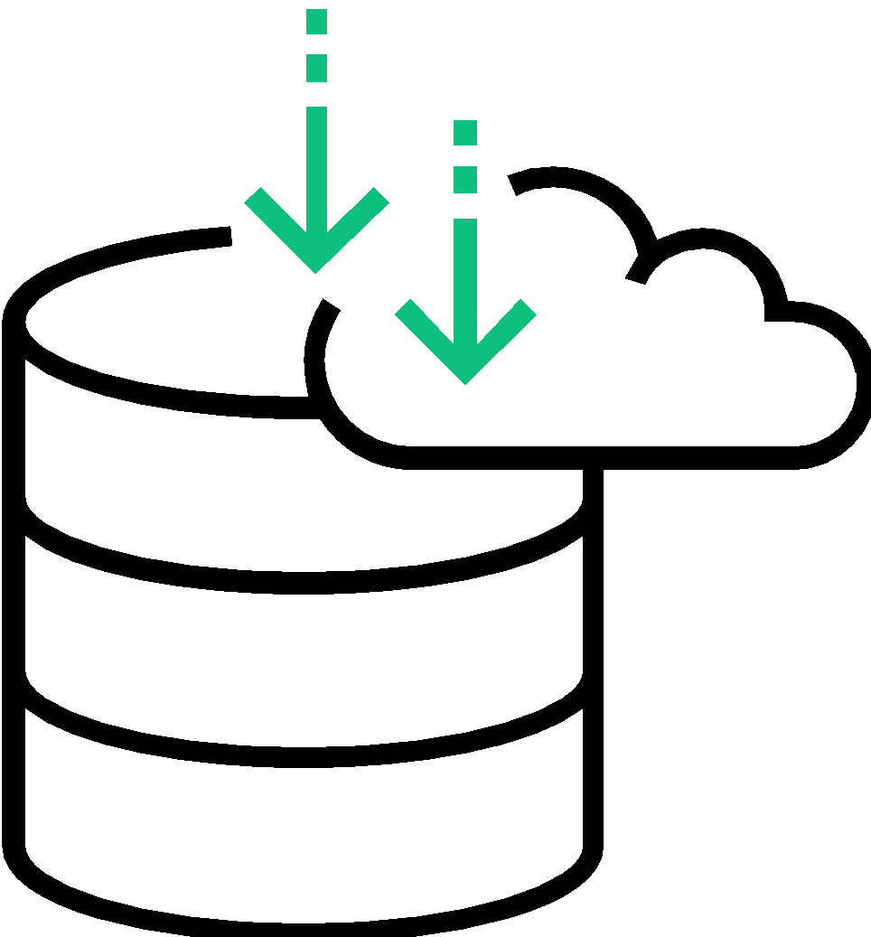
1. Data Storage - An Introduction
Module 3: Different Data Storage Mechanisms
Loads and loads of data generated by individuals and enterprises on a day-to-day basis.
Data is stored in a physical or virtual medium using different mechanisms.
The term ‘storage’ refers to devices and data connected to the system through input/output (I/O) operations.
Storage may be done in primary or secondary storage devices.
Notes:
Notes to Facilitator:
Give an introduction to Data storage. Explain about the storage media and mechanisms associated with data storage.
Notes to the Participants:
Imagine the amount of data generated by the individuals and enterprises on a daily basis. Where is all this data stored and how it is stored?
Data, irrespective of the size, is stored in physical devices or on the cloud using different mechanisms. Enterprise data storage is primarily classified into primary and secondary storage.
Storage media:
Primary storage refers to the data that is stored in the computer’s memory (random access memory or RAM) and the other built-in devices. Secondary storage refers to the data on hard disks, tapes and other devices that require I/O operations. The Secondary storage media is often used for cloud storage.
Traditional storage devices
1. Tape Drives - Reads and writes data on a Magnetic tape – up to 140 MB/s
Used for archival storage.
Very high access time.
2. Hard Disk Drives - Reads and writes data on a rotating magnetic disk (platter) – from 130 to 450 MB/s (Depends on RPM)
General purpose storage device.
Moderate access time with good IOPS (Input/output operations per second).
Greater storage capacity.
3. Solid State Drives - Reads and writes data to integrated circuit assemblies – up to 1 GB/s
Used for high input /output intensive operations.
Very less access time with outstanding IOPS and data transfer rate.
Cost is quite high.

Slide 5
2. Mechanisms of data storage
Module 3: Different Data Storage Mechanisms
Mechanisms refer to the way in which data is stored in the Storage Media.
File systems are a traditional way of storing data in individual, unrelated files. These files make up directories.
Database is an organized way of storing data, helps in overcoming the limitations associated with file systems.
File systems
Databases
A
B
Notes:
Notes to the Facilitator:
Introduce the data storage mechanisms to the participants. Give them an introduction to the File systems and Databases.
Notes to the Participants:
Introduction to file systems:
File system is a way to organize, store, retrieve, and manage the information on a permanent storage medium. File systems have the structure and logic rules to manage the collection of information and their names. Being an integral part of all operating systems, file systems manage the permanent storage. A file system serves the purpose of the whole storage and it is also a part of an isolated storage segment – a disk partition. In a nutshell, a file system is a structured way of representing data and a set of metadata describing the stored data.
Traditionally, each application program in an organization uses its own file. For example, each department in a university might have its own set of files: the Records department might have the information of the students, their grades, certificates, etc.; the Scheduling department might have the list of professors, their biography, the classes they teach, etc.; similarly, the Payroll department might have the list of all employees, their personal details, salaries, etc.
This way managing information and correlating them when needed becomes a tedious task.
There are several disadvantages of storing data in file systems, such as data redundancy and inconsistency, lack of data integration, poor data control, limited data sharing capabilities, poor data manipulation capacities, and so on.
File systems are specific to the operating system. Some of the common file systems include:
Windows - File Allocation Table (FAT); New Technology File System (NTFS); Resilient File System (ReFS)
MacOS - Hierarchical File System Plus (HFS+); Apple File System (APFS)
Linux - ext* family file systems (ext2, ext3, ext4); ReiserFS; Journaled File System (JFS)
Unix - Unix File System (UFS); Fast File System (FFS); NFS (predominantly Unix)
Irix - XFS
Databases are a very good alternative to the traditional file systems and play a significant role in overcoming the challenges faced due to file systems.

Slide 6
3. Introduction to Databases
Module 3: Different Data Storage Mechanisms
A Database can be defined as a structured collection of related data, typically stored on a disk and can possibly be accessed by many concurrent users.
Databases are defined, created and managed by Database Management Systems (DBMS).
It is the DBMS that allows controlled access to the data in the database.
DBMS
Components of DBMS
Programmers
Users
DBA
Hardware
Application programs
Queries
Database scheme
DBMS
Software
DML preprocessor
Query processor
DDL compiler
Data
Program object code
Database manager
Dictionary manager
User
Access methods
File manager
Procedures
System buffers
Database and system catalog
Notes:
Notes to the Facilitator:
Introduce the concept of Database to the participants.
Notes to the Participants:
There is no single universally accepted definition for a Database. A Database is generally a collection of logically related and coherent data used by the application programs in an organization.
Compared to the file systems, databases provide a lot of advantages. Some of them are:
Less data redundancy.
Inconsistency can be avoided.
Efficiency.
Efficient data integration.
Coordination of multiple users accessing the same data.
Restriction of unauthorized access.
Independent of the OS control systems.
Data manipulation is done effectively using Programming languages.
Easy retrieval of information using queries.
Maintenance of confidentiality.
The system that defines, creates and manages the database is called Database Management System (DBMS). A database has five components:
Hardware: The physical computer system that allows access to the data.
Software: The program that allows users to access, maintain and update the data in a database. The software also takes care of access control.
Data: Data is stored physically on the storage devices. In a DBMS, data is a separate entity from the software.
Users: From a DBMS viewpoint, there are two major user categories: the end users and the application programs
Procedures: Procedures or rules defined and followed by the users of the database.

Slide 7
3.1 Database Architecture
Module 3: Different Data Storage Mechanisms
Three-level DBMS architecture established by ANSI-SPARC
User 1
User 2
User n
External Level
View 1
View 2
View n
Conceptual Level
Conceptual
Schema
Internal Level
Internal
Schema
DB
Notes:
Notes to the Facilitator:
Explain the architecture of Database as given in the picture.
Notes to the Participants:
The American National Standards Institute/Standards Planning and Requirements Committee (ANSI/SPARC) has established a three-level architecture for a DBMS. Here, the database schema is defined at three levels.
Internal level: Describes how the data is stored in a database. This level determines where the data is stored on the storage devices. It is about the low-level access methods and explains how data is transferred to and from the storage devices. This is how the DBMS and operating system (OS) perceive the database.
Conceptual level: Describes what data is stored in the database and also explains the relationships among data. This level deals with the logic of the data. The Data model is defined in this level and this is where the main functions of the DBMS, like queries are available. This serves as an intermediary between the internal and external level. This is how database administrators (DBA) and programmers perceive it.
External level: Describes the part of database relevant to the user. This level interacts directly with the users, end users or application programs. Data from the conceptual level is changed to a format that is understandable by users. It is the users’ view of the database and how the users perceive it.

Slide 8
What did you Grasp?
Module 3: Different Data Storage Mechanisms
What are the two user categories from a DBMS viewpoint?
Application programs.
End users.
Admin users.
Both a and b.
Which level in the Database architecture serves as an Intermediary between the User interface and the Internal schema?
Internal level
Conceptual schema
External level
None of the above
Notes:
Answer:
D. Both A and B
B. Conceptual schema

Slide 9
3.2 Common Database Types
Module 3: Different Data Storage Mechanisms
Flat File Databases
Tabular Databases
Relational Databases
NoSQL Datastores
Notes:
Notes to the Facilitator:
Tell the participants about the common types of databases as listed on the slide.
Notes to the Participants:
We’ve now seen the basics of Data Storage and important concepts of Databases and Database Management Systems. Now let’s look at the most common types of databases.
Flat file databases
Tabular databases
Relational databases
NoSQL datastores

Slide 10
3.2.1 Flat file databases
Module 3: Different Data Storage Mechanisms
FIELD NAME | DATA TYPE
Customer_ID | AutoNumber
TITLE | Text
SURNAME | Text
STREET | Text
TOWN | Text
COUNTRY | Text
PHONE_NUMBER | Text
DATE_OF_BIRTH | Date/Time
MEDICAL_CONDITIONS | Data/Time
TREATMENT | Text
In a Flat file database, data is organized in a single table so it is suitable for many small applications.
A Flat file database is similar to a spreadsheet and is two-dimensional.
These databases organize data using data structures called files, records, fields and characters.
A Flat file database has no related files or tables and is easy to create and use.
Data in a flat file is often repeated and the size of the database might be quite large.
Notes:
Notes to the Facilitator:
Introduce Flat file databases and its characteristics to the participants.
Notes to the Participants:
You will learn about the Flat file databases now.
A flat file database is one that stores data in a plain text file. Each record is stored in one single line, rows, and the fields are separated by commas, or tabs. In a flat file database, data is organized in a single table and so it is suitable for many small applications. A flat file database uses a very simple structure and it cannot contain multiple table like that of a relational database. For example, a spreadsheet application like Microsoft Excel can be used as a flat file database. Each row in a worksheet can be a record and each column, a field. The worksheet is effectively a table. Many database programs like Microsoft Access and FileMaker Pro have the ability to import flat file databases and it can be used in a large relational database.
A flat file system should not be confused with flat file database. A flat file system is a type of computer file system, that stores all data in a single directory. No folder or path is used to organize data. This might be a simple way to store data, but becomes inefficient as the amount of data increases.

Slide 11
3.2.1.1 Advantages and disadvantages of flat file databases
Module 3: Different Data Storage Mechanisms
Flat files are familiar and conceptually simpler to use.
Flat files are portable.
These are readable by most of the statistical and graphics software.
Flat file databases require no additional layer to master.
Advantages
The system will have more data to read through and the information access might be slower.
Searching the information might not be straightforward if the file has large amount of data.
Data will be repeated which may result in the input errors or inconsistencies.
Due to repeated data, file sizes may become large.
Data integrity is poor in flat file databases.
Since there is no relationship among data, the data will become redundant.
Disadvantages
Notes:
Notes to the Facilitator:
Explain the advantages and disadvantages of flat file databases to participants.
Notes to the Participants:
Flat file databases have their own advantages and disadvantages.
Advantages include:
Flat file databases are simple, straightforward and are easier to work with, compared to other databases
Most of the software include free access to data. For a small number of cases, flat databases do a reasonably fair job.
Data in flat file databases are readable by many of the available statistical, analytical and graphics software.
These types of databases do not require any additional layer to master.
Disadvantages include:
Flat file databases consume a lot of storage space, by requiring it to keep all the information on items that are logically not available.
Flat databases are not conducive to complex search queries.
Increased data redundancy which may result in errors or inconsistencies
Data integrity or reliability is always an issue with flat file databases
File sizes become large with repeated data

Slide 12
What did you Grasp?
Module 3: Different Data Storage Mechanisms
Which of the following is INCORRECT with respect to the Flat file databases?
Data integrity is poorly maintained in a Flat file system.
Flat file database is unidimensional.
Data redundancy causes input errors in a Flat file database.
A record is one of the data structure in a Flat file database.
Notes:
Notes to the Facilitator:
Answer:
1. B. Flat file database is unidimensional

Slide 13
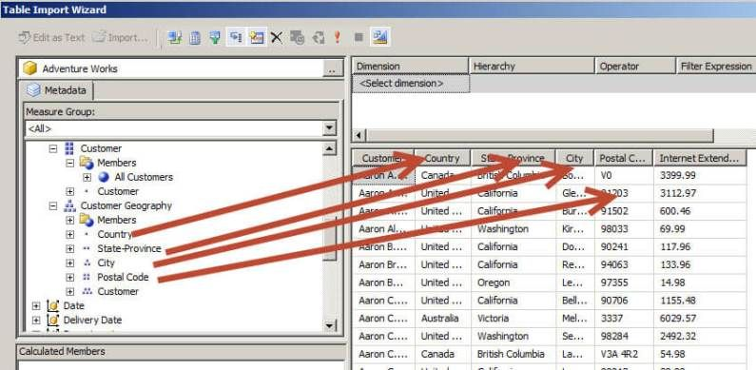
3.2.2 Tabular databases
Module 3: Different Data Storage Mechanisms
A Database that is structured in a tabular form.
The Data elements are arranged in columns and rows. The intersection of a column and a row creates a cell.
There is a unique numbering for each row and column, to keep the table, orderly and efficient.
For mass data storage, this type of database offers a virtually infinite range.
Notes:
Notes to Facilitator:
Introduce the Tabular databases to the participants and explain the characteristic features of the same.
Notes to Participants:
As obvious from the name, this database is structured in a Tabular form, which has rows and columns. Using tabular structure may be one of the simplest and oldest methods of data storage.
Tabular databases have the following features:
These databases share the same set of properties per record. Each row has the same set of column titles.
Metadata is usually assigned to a column as its header title.
If any of the rows for a corresponding column lacks data, a missing value gets stored in the cell, which is related to the column’s metadata.
These databases access records through unique identifiers.
In a tabular database, each of the tables contains a set of information that is related to each other and is connected to the database through key fields that describe the rows. In case of a query, the system searches for the record using the key fields.

Slide 14
3.2.2.1 Advantages and Limitations of tabular databases
Module 3: Different Data Storage Mechanisms
An oldest form of organizing data and is simple
Ideal for applications with smaller amounts of data
Simple queries will fetch the required information if amount of data is less
Preferred format for data collected as long time series.
Advantages
Possibility of data redundancy.
Might not be suitable for complex data.
Bulk updation of data could be a problem.
Problems with the addition of incomplete data.
Problems in removing group of data.
Disadvantages
Notes:
Notes to the Facilitator:
Explain the advantages and disadvantages of tabular databases to the participants.
Notes to the Participants:
Go through the table and understand the advantages and disadvantages of tabular databases.
Advantages
Tabular databases are best suited for applications for very small amounts of data. In these situations, data can be queried using simple queries. Organizing data in the form of tables is a primitive way of storing and querying data and is relatively simple and straightforward.
Disadvantages
As with flat file databases, data redundancy is poorly controlled in a tabular database. For complex data, this type might not be suitable. In a table or CSV, bulk updation of data could be an issue and a table will be completely updated only if all the columns corresponding to a row are updated. Errors or inconsistencies may arise if group of data is removed.

Slide 15
What did you Grasp?
Module 3: Different Data Storage Mechanisms
Tabular databases are well suited for complex data.
True
False
Notes:
Notes to the Facilitator:
Answer:
1. B. False

Slide 16
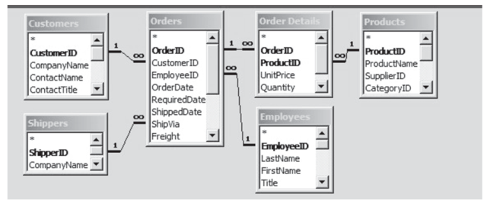
3.2.3 Relational databases
Module 3: Different Data Storage Mechanisms
Collection of data with predefined relationships among them, data is usually stored as a set of tables with columns and rows.
Table refers to a relation - collection of objects of the same type (rows).
Each column in a table holds a certain kind of data and a field holds the actual value of an attribute.
Each row has a unique identifier, called the primary key and rows in different tables can be related using a foreign key
Notes:
Notes to the Facilitator:
Introduce the concept of the Relational database to the students. Explain them, the basic concepts of a Relational database, like tables, columns, rows, schema, primary key and foreign key.
Notes to the Participants:
A Relational database is a collection of data stored in one or more tables. Relational databases require the schema to be predefined before data is populated in the database.
A schema is the description of data in terms of the data model. The Schema defines the tables and their attributes, field or column.
A Relational Database Management System (RDBMS) is a software that handles the way data is stored, maintained and retrieved in a relational database.
RDBMS provides query and manipulation interface to the data.
Common examples of RDBMS are:
MySQL
Microsoft SQL Server
Oracle
MariaDB
PostgreSQL
SQLite

Slide 17
3.2.3.1 Important aspects of relational databases
Module 3: Different Data Storage Mechanisms
Overall completeness, accuracy and consistency of data
Integrity constraints
Atomicity, consistency, Isolation, Durability
To maintain data integrity
SQL
Transactions
Structured Query Language
Primary interface to communicate with relational databases
Data Integrity
ACID compliance
One or more SQL statements executed as sequence of operations
‘All-or-nothing’ proposition
Notes:
Notes to the Facilitator:
Explain the four important concepts of relational databases:
SQL
Data Integrity
Transactions
ACID compliance
Notes to the Participants:
SQL
Structured Query Language serves as the primary interface to communicate with the relational databases. In 1986, SQL became one of the standards of the American National Standards Institute (ANSI). ANSI SQL is supported by all major relational database engines, and many of these have an extension ANSI SQL to support the functionalities of that engine. SQL is used in managing all the aspects of a database, including adding, updating or deleting rows of data and retrieving subsets of data for transaction processing and analytics applications.
Data Integrity
Data integrity refers to the overall completeness, accuracy, availability and consistency of data. Relational databases follow certain integrity rules or constraints to maintain data integrity. The constraints include Primary Keys, Foreign Keys, ‘Not NULL’ constraint, ‘Unique’ constraint, ‘Default’ constraint and ‘Check’ constraints.
As a first rule, in a relational database. All rows need to be distinct. In case of duplicate rows, issues like correctness of rows selected might occur. To overcome this, users can specify that rows should not be duplicated. If this is specified, the DBMS will prevent the addition of duplicate rows in an existing row. If each row is distinct, rows can be identified by using one or more columns. This unique column or group of columns is referred as Primary Key.
The second rule is that column values must not be repeating groups or arrays. A third aspect of data integrity involves the concept of a null value. A database takes care of situations where data may not be available by using a null value to indicate that a value is missing. It does not equate to a blank or zero. A blank is considered equal to another blank, a zero is equal to another zero, but two null values are not considered equal.
Any column that is part of a primary key cannot be null; if it is null, the primary key would not be a complete identifier. This is called Entity integrity.
Transactions
One or more SQL statements executed as a sequence of operations that form a single logical unit of work is called a database transaction. Database transactions provide an ‘all-or-nothing’ proposition. The entire transaction must be complete as a single unit and written to the database, or no individual component of the transaction should go through. From a relational database viewpoint, a database transaction will result in a ‘Commit’ or a ‘Rollback’. Each transaction is carried out in a coherent and reliable way independent of other transactions.
ACID Compliance
A relational database transaction needs to be ACID (Atomicity, Consistency, Isolation, Durability) compliant to maintain data integrity.
Atomicity: A transaction, on the whole, should be successfully executed. If any part of the transaction fails, then the entire transaction becomes invalid.
Consistency: Data written to the database must adhere to all defined rules and restrictions including constraints, cascades, and triggers for it to be consistent.
Isolation: Isolation is important for controlling concurrency and to make sure that each transaction is independent of other transactions.
Durability: Once a transaction is complete, all changes made to a database should be permanent.

Slide 18
3.3 Entity Relationships and Tables
Module 3: Different Data Storage Mechanisms
Entities are real-world objects to be modelled in a database. One object is distinguishable from the other objects.
Entities can be related to each other by means of
One-to-one relationships
One-to-many relationships
Many-to-many relationships
Entities are stored in tables, also called ‘relations’.
Each row, a tuple, stores one record and each column stores an attribute per record.
Notes:
Notes to the Facilitator:
Explain the concept of Entities and tables and the relationships that exist between them in a relational database, such as:
One-to-one relationships
One-to-many relationships
Many-to-many relationships
Explain how values are stored in a table and identified by keys.
Notes to the Participants:
Entities are the real-world objects that are to be modelled in a database. Three different types of relationships occur between entities.
The concept of entities and tables and the relationships that exist between them in a relational database. Explain the concept of
One-to-one relationships
One-to-many relationships
Many-to-many relationships
Consider an example of an article published in a journal. A journal can have many articles (one-to-many), but an article can appear in only one journal (one-to-one).
An author can have many articles (one-to-many) and an article can have many authors (one-to-many).
A relation has the following attributes.
Name: Each table (relation) must have a name that is unique among other relations.
Attributes: Each column in a table is called an Attribute. The Attributes are generally represented by Column Headings
Tuples: Each row in a table is called a tuple. A tuple is a collection of attribute values. The total number of rows in a Relation is called the Cardinality of the Relation. Note that the cardinality of a relationship changes when Tuples are added or deleted. This makes the database dynamic.

Slide 19
3.4 Example for relations in a relational database
Module 3: Different Data Storage Mechanisms
Title
AuName
ISBN
Price
AuID
AuTel
∞
Written by
∞
Authors
Books
∞
1
Published by
Is
1
1
Publisher
Coauthors
PubID
PubTel
CoauID
CoauTel
PubName
CoauName
Notes:
Notes to the Facilitator:
Explain the above example to the participants and the types of relationships that exist between them.
Notes to the Participants:
In this example:
Rectangles represent the entity sets
Rounded rectangles represent the attributes.
Diamonds represent the relationship sets
Lines link attributes to entity sets and entity sets to relationship sets
Consider the above example. ∞ refer to many relationships and 1 represents one relationship. Books and authors share a many-to-many relationship. A publisher can publish many books (one-to-many) and a book will be published by one publisher (one-to-one). Similarly, an author can be a co-author for another book.
Consider the table’s Books, Authors, Publisher and Co-authors. ISBN, AuID, PubID, and CoauID are all unique identifiers for the respective tables (relations) are the Primary keys. A foreign key links one table to another by the other table’s Primary key.

Slide 20
3.4.1 Example Table
Module 3: Different Data Storage Mechanisms
EMPLOYEE TABLE
COLUMNS
PRIMARY KEY
Employee ID | First Name | Last Name | Sex | DOB | Department | Monthly Salary (Rs)
101 | Sachin | Tendulkar | Male | 25.04.1975 | Sales | 75,000
102 | Rahul | Dravid | Male | 18.05.1977 | Research | 75,000
103 | Sindhu | PV | Female | 12.03.1987 | Sales | 50,000
ROWS
Notes:
Notes to the Facilitator:
Explain the Database table and the concepts of rows, columns and primary key to the participants.
Notes to the Participants:
Look at the following table. Understand that:
The convention is to give a singular name to tables (e.g. employee as opposed to employees).
Each row within a table has the same number of columns.
The data in each column is of the same data type (that is character, numeric or date). There are other data types as well, but only these three are used here.
Each row has a column (or group of columns) whose value must identify that row, uniquely. For example, in the employee table above, an employee's ID, which is the primary key, is used to uniquely identify an individual employee. A table must have one, and only one, primary key defined.

Slide 21
3.4.2 Relational Database Operations
Module 3: Different Data Storage Mechanisms
In a Relational Database, several operations can be defined to create new relations (tables) based on the existing ones. These operations can be performed by using SQL commands.
Two major categories of commands
Data Manipulation Language (DML) commands
Data Definition Language (DDL) commands
SELECT
CREATE TABLE
INSERT
DROP TABLE
DELETE
ALTER TABLE
UPDATE
Notes:
Notes to the Facilitator:
Explain the operations that can be performed on a relational database table and the SQL commands used to perform them.
Notes to the Participants:
Several operations can be performed on relational database tables using SQL commands. There are two major categories SQL commands.
Data Manipulation Language (DML) commands - used for retrieving or modifying data to keep it up-to-date.
Data Definition Language (DDL) commands - used to create or change tables and other database objects such as views and indexes.
Common DML commands:
SELECT - to query and display data from a database. The SELECT statement specifies which columns to include in the result set. The vast majority of the SQL commands used in applications are SELECT statements.
INSERT - adds new rows to a table. INSERT is used to populate a newly created table or to add a new row (or rows) to an already-existing table.
DELETE - removes a specified row or set of rows from a table
UPDATE - changes an existing value in a column or group of columns in a table
Common DDL commands:
CREATE TABLE - creates a table with the column names the user provides. The user also needs to specify a type of the data in each column. Data types vary from one RDBMS to another, so a user might need to use metadata to establish the data types used by a particular database. CREATE TABLE is normally used less often than the data manipulation commands because a table is created only once, whereas adding or deleting rows or changing individual values generally occurs more frequently.
DROP TABLE - deletes all rows and removes the table definition from the database. A JDBC API implementation is required to support the DROP TABLE command as specified by SQL92, Transitional Level. However, support for the CASCADE and RESTRICT options of DROP TABLE is optional. In addition, the behaviour of DROP TABLE is implementation-defined when there are views or integrity constraints defined that reference the table being dropped.
ALTER TABLE - adds or removes a column from a table. It also adds or drops table constraints and alters column attributes
Joins:
Apart from the operations mentioned above, there is a distinguishable feature of relational databases is ‘Joins’. Join combines column from one or more tables and is used for data retrieval from more than one table. It is a way of combining one or more tables by taking advantage of the values common to both the tables. One common column that appears in two tables is mandatory for relating them.
Consider the employee table example. Imagine we have another table called ‘Department table’. This will have two columns DepartmentID and Department. This table can be related to the Employee table by using the common column ‘Department’.

Slide 22

Activity
Module 3: Different Data Storage Mechanisms
Notes:
Notes to the Facilitator:
Divide the students into multiple groups. Explain the following activity to them.
The college/university in which they study will have a database of teachers and students.
Ask them to make a list of tables they think that the database may hold.
For each of the tables identified, ask them to make a list of columns that can be there in the table.
Let them discuss the answers with rest of the students in the group.
For each of the tables identified above, ask them to indicate which column (or group of columns) can be used to uniquely identify each row (the primary key).
Notes to the Participants:
Perform the following activities by forming multiple groups.
Your college/university will have a database with the details of teachers and students. Create a list of tables that can be there in the database.
For the tables identified, create a list of columns that can be there.
For the tables created, identify which of the columns can be used to identify each row, the Primary key.
Discuss the answers with the rest of the students in your group.

Slide 23
What did you Grasp?
Module 3: Different Data Storage Mechanisms
Which of the following is a DDL command?
SELECT
CREATE TABLE
UPDATE
DELETE
As per entity integrity, which of these cannot be null?
A table
Row
Column that is part of primary key
A foreign key
Notes:
Notes to the Facilitator:
Answer:
1. B. CREATE TABLE
2. C. Column that is part of primary key

Slide 24
4. Introduction to NoSQL Datastores
Module 3: Different Data Storage Mechanisms
NoSQL – term was first introduced in 1998 to refer to a class of relational databases without SQL.
Non-relational, distributed, open-source and horizontally scalable databases.
NoSQL can mean ‘not SQL’ or ‘not only SQL’, since they use more flexible data models and do not rely on structures like tables, columns, rows or schemas.
Useful for storing unstructured data that grows more rapidly and does not fit the relational schemas of relational database management systems (RDBMS).
Notes:
Notes to the Facilitator:
Introduce the term NoSQL to the students and explain how they differ from the Relational database.
Notes to the Participants:
NoSQL is a class of database management systems that do not SQL as the query language. NoSQL (Not only SQL) databases provide a way to store and retrieve data that is modelled in a way that is different from relational databases. NoSQL is not a complete replacement for RDBMS, but a compensation to the technical deficiencies exhibited by them. There is no prescriptive definition for NoSQL, but an aggregation of common characteristics.
The term NoSQL finds its way back in 1998 when Carlo Strozzi used it to refer his lightweight, open-source relational database that did not expose standard SQL interface. It was not until 2009, the term had approximately the same meaning that it has these days.
NoSQL initially started out as an in-house solution for the problems faced by big enterprises. Some of the products are Amazon’s DynamoDB, Google’s BigTable, LinkedIn’s Voldemort, Twitter’s FlockDB, Facebook’s Cassandra and Yahoo’s PNuts, among others. NoSQL was found as an alternative to traditional approaches as it solved three major problems:
Unprecedented data transaction volumes
Expectations of low-latency access to massive datasets
Near-perfect availability of services while operating in an unreliable environment
NoSQL is the best way to store and retrieve large volumes of unstructured data, with the database running on clusters. Most common examples of unstructured data include user and session data; chat, messaging and log data; time series data like IoT and device data; large objects like videos and images.

Slide 25
4.1 Characteristics of NoSQL databases
Module 3: Different Data Storage Mechanisms
No relational model
Runs well on clusters
Open-source
No fixed schema or a formally described structure
Does not use SQL as the query language
Distributed and fault-tolerant architecture
Horizontal scalability
Joins not required, hence more flexible and horizontally scalable
BASE-compliant for scalability and better performance
Notes:
Notes to the Facilitator:
Explain the characteristics of NoSQL databases to the participants.
Notes to the Participants:
NoSQL databases have the following characteristics.
Non-relational: NoSQL employs non-relational data models which allow for more complex and sophisticated structures.
Runs well on clusters: Relational databases are designed to run well on the clusters. NoSQL model enables the users to work with large volumes of data with databases running on the clusters.
Open-source: Many NoSQL databases can be used for free as they are open-source projects. Most RDBMSs are proprietary and expensive to use. With flexible data models which are schema-less, the application development becomes faster with NoSQL databases.
Schemaless: NoSQL databases do not require a schema to be defined before the data is populated. This makes them suitable to handle the unstructured data.
NoSQL: NoSQL databases do not use SQL as the query language. NoSQL systems have their own query interfaces.
Distributed and fault-tolerant: Most NoSQL systems are distributed in nature. Several machines work together in clusters to provide data. Each piece of data is replicated over these machines, which accounts for redundancy, high-availability and fault tolerance.
Horizontal scalability: RDBMS are ‘scaled up’ by adding hardware processing power, which is vertical scaling. Vertical scaling has sublinear effects, which requires high-risk operational efforts. There is an upper limit to the amount of hardware added, that can effectively be utilized by software. In contrast, NoSQL databases are ‘scaled out’ by spreading the load. This means adding more machines to a cluster without any downtime, hence horizontal scalability. This gives linear effects on storage and processing abilities. Also, there is no upper limit for the number of machines that can be added.
Avoidance of joins: The concept of Joins is typical in databases operated by SQL. It is an expensive operation for combining records from two or more tables into one set. Apart from this, joins require strong consistency and fixed schemas. NoSQL solutions are mostly defined by the avoidance of joins. This helps in maintaining flexible and informal schemas and also helps in horizontal scalability.
BASE-Compliance:
BASE stands for Basically Available Soft-state and Eventually consistent. This is in contrast to ACID compliance exhibited by RDBMS.
Basically Available: Replication and sharding are used for reducing data unavailability. Failures are only partial with the use of sharding or partitioning data over multiple servers. This ensures high availability even if the data subsets are unavailable for short periods of time.
Soft-state: ACID systems require consistency as a hard requirement. In contrast, NoSQL allows data inconsistency and relegate designing around such inconsistencies to application developers. Soft state indicates that the state of the system may change over time even without input.
Eventually consistent: ACID systems enforce consistency during a transaction commit, but NoSQL systems guarantee consistency only at some undefined future time. These systems prefer Availability over consistency.

Slide 26

Group Discussion
Module 3: Different Data Storage Mechanisms
Notes:
Notes to facilitator:
Explain the following group discussion topic to the participants. There will be multiple groups of participants. Each member in a group should be given a topic which is one of the characteristic features of NoSQL databases. They will talk about the feature in detail during the discussion.
Notes to participants:
Form multiple groups among yourselves. We just learnt about the different characteristics that a NoSQL database possesses. Each member in a group should talk about a particular characteristic feature. The feature will be assigned to the members by the facilitator.

Slide 27
4.2 Types of NoSQL Datastores
Module 3: Different Data Storage Mechanisms
Four major categories:
1
2
3
4
Key-Value stores
Document-oriented databases
Wide-column stores
Graph Databases
DynamoDB,
Redis,
MemcacheDB,
Oracle NoSQL
CouchDB,
MongoDB,
Lotus Notes,
Redis,
Elasticsearch
BigTable,
Cassandra,
HBase,
Hadoop HBase
Neo4J,
FlockDB,
GraphBase, ArangoDB,
OrientDB
Notes:
Notes to the Facilitator:
Explain the four different types of NoSQL databases and their characteristics to the participants.
Notes to the Participants:
There are four major categories:
Key-value stores
This is one of the primitive and flexible types of databases. Key-Value is based on a hash table or a look-up table, where there are a unique key and a pointer to a particular item of data (value). This means each possible key appears only once in the collection. The fundamental data model is an associative array. A value can be any type of binary object like text, video, JSON document, etc. The Application has complete control over the data stored as the value. The number of keys can have a dynamic set of attributes in the key value databases during storage of data. Mappings are usually accompanied by cache mechanisms to maximize performance. API is typically simple, but the implementation is often complex. All CRUD (Create, Read, Update, Delete) operations can be performed on the data.
Key-value stores are very useful in accelerating an application to support high-speed read and write processing of non-transactional data. This is scalable and highly available because data is partitioned and replicated across a cluster of machines.
Key-value stores are best suited for:
Storing user session data
Maintaining schemaless user profiles
Storing user preferences
Storing shopping cart data
Examples are DynamoDB, Redis, MemcacheDB, Oracle NoSQL and BerkeleyDB
Document-oriented databases
Document-store or document-oriented databases are used for storing, retrieving, and managing semi-structured data. Documents are used as the structure for storage and queries. Documents are addressed by a key which is unique. A document may be a word or PDF, but commonly is a block of JSON or XML, that contains a description of the data type and the value for that description. Data can be added by adding objects to the database. Documents are grouped into “collections,” which serve a similar purpose to a relational table.
Popular fields in the document can be indexed to provide fast retrieval without knowing the key. Each document can have the same or a different structure. Documents can contain many different key-value pairs, or key-array pairs, or even nested documents.
Document databases are used in:
E-commerce platforms
Content management systems
Analytics platforms
Blogging platforms
Examples are CouchDB, MongoDB, Lotus Notes, Redis and Elasticsearch
Wide-column stores
Column family databases store and process very large amounts of data distributed over many machines. Data is stored in tables with columns and rows, which make the structure similar to a relational database. Columns are logically grouped into column families. Column families may contain virtually an unlimited number of columns, created at runtime or while defining the schema. Column families are groups of similar data usually accessed together. A single query can retrieve related information, since only the columns related to the query are retrieved.
Wide-column stores are used in:
Content management systems
Blogging platforms
Systems that maintain counters
Services that have expiring usage
Systems that require heavy write requests (like log aggregators)
Examples are BigTable, Cassandra, HBase, Hadoop HBase
Graph databases
Graph Databases are built on Entity - Attribute - Value model. Graph structures are used to store, map, and query relationships. These databases have with nodes and relationships between nodes are called edges. Nodes have properties, which represent attributes. Nodes represent entities and are similar in nature to the objects as in object-oriented programming. Properties are pertinent information related to nodes. Edges connect nodes to nodes or nodes to properties. An important point to note is that they provide index-free adjacency so that adjacent elements are linked together without using an index.
Graph databases find a use case in:
Fraud detection
Graph-based search
Network and IT operations
Social networks
Examples are Neo4J, FlockDB, GraphBase, ArangoDB, OrientDB.

Slide 28
4.3 Advantages and disadvantages of NoSQL
Module 3: Different Data Storage Mechanisms
Scalability
Performance
High availability
Global availability
Flexible data modelling
Agile sprints, quick schema iteration, and frequent code pushes
Can handle large volumes of rapidly changing structured, semi-structured, and unstructured data
Advantages
Lack of maturity - numerous solutions still in their beta stages
Lack of commercial support for enterprise users
Lack of support for data analysis
Maintenance efforts and skills are required - experts are hard to find
Disadvantages
Notes:
Notes to the Facilitator:
Explain the advantages and disadvantages of NoSQL to the participants.
Notes to the Participants:
Advantages of NoSQL databases:
NoSQL offers the following benefits, in comparison to RDBMS.
Scalability: NoSQL databases use a horizontal scale-out methodology. Adding or reducing capacity can be quickly and non-disruptively done with commodity hardware. This eliminates the tremendous cost and complexity of manual sharding that is necessary when attempting to scale RDBMS.
Performance: By simply adding commodity resources, enterprises can increase the performance of NoSQL databases. This enables organizations to continue to deliver reliably, fast user experiences with a predictable return on investment for adding resources, again, without the overhead associated with manual sharding.
High Availability: RDBMS architectures rely on primary and secondary nodes, which makes them complex to handle. On the other hand, NoSQL databases are designed for high availability and fault tolerance. Some NoSQL databases are built based on a masterless architecture, which means that they distribute data equally among multiple resources automatically. This makes the application highly available, even if one of the nodes fail.
Global Availability: Data is automatically replicated among multiple servers, data centres or cloud resources. As a result of this latency is minimized and a consistent user experience is ensured irrespective of the location of the users. Burdens associated with database management are significantly reduced so that teams can focus on other business priorities.
Flexible Data Modeling: With NoSQL, flexible and fluid data models can be implemented. Instead of using the data types and queries that fit the schema, developers can use the ones that are close to the specific application. By means of this, the communication between database and application becomes smoother, faster, hence more agile development.
Disadvantages of NoSQL databases:
Despite the advantages that NoSQL databases offer over RDBMS, there are still challenges associated with their use. Some of the challenges include:
Lack of maturity of the technology. Many of the solutions are still in their beta stages and cannot be used widely. SQL databases has been around for a long time now and has been subjected to rigorous tests that ensure system stability, bug identification and more questions are answered.
Many of the NoSQL databases are open-source and rely on the community support. For enterprise users, lack of commercial support means a lot of time and effort is involved in resolving issues.
Since NoSQL databases are designed to handle huge volumes of data, query options and data retrieval becomes complex. Searching relevant information is always a challenge with growing amounts of data. As a result, data analysis also becomes a challenge. Businesses might not be able to unleash the true potential of data, due to lack of necessary tools.
As the system becomes complex, maintenance efforts are also a challenge and thorough expertise is required to resolve issues. Because the technology is relatively immature, it is a challenge for businesses to find the experts who can handle the system well.

Slide 29
What did you Grasp?
Module 3: Different Data Storage Mechanisms
Which of the following is an example for NoSQL databases?
MySQL
PostgreSQL
MongoDB
Microsoft SQL server
Which of the following is true about NoSQL databases?
NoSQL databases are not suitable for unstructured data
NoSQL databases are ACID compliant
NoSQL databases are horizontally scalable
NoSQL databases have a very rigid data model
Notes:
Notes to the Facilitator:
Answer:
1. C. MongoDB
2. C. NoSQL databases are horizontally scalable

Slide 30

In a nutshell, we learnt:
Module 3: Different Data Storage Mechanisms
Basics of Databases and the purpose of using them.
Most common types of databases along with their examples.
Flat file databases, their structure and examples.
Tabular databases, their structure and examples.
Relational databases, their structure, operations performed on them and examples.
NoSQL data stores, characteristics, types and examples.
Notes:
Notes to the Facilitator:
Summarize the concepts learnt in this module.
Reiterate the salient and key points learnt in the module.
Notes to the Participants:
Take a note of the salient and key points learnt in the module.

Slide 31
Next Module 4: Characteristics of Big Data

