Slide 1

TREE

Slide 2

NATURE VIEW OF A TREE
leaves
branches
root

Slide 3

COMPUTER SCIENTIST’S VIEW
root
leaves
branches
nodes

Slide 4
BASIC TREE CONCEPTS
A tree consists of finite set of elements, called nodes, and a finite set of directed lines called branches, that connect the nodes.
Acyclic graph is called tree.
‹#›

Slide 5
Trees
A
A connected
structure which
is either empty OR
has a designated node called root, from which descends 0,1 or more sub trees which are also Trees.
B
C
F
G
H
I
J

Slide 6
Terminologies
Finite number of elements called nodes, & finite set of directed lines called branches, that connect the nodes.
Branch directed towards a node is an In-degree Branch.
Branch directed away from the node is Out-degree Branch.

Slide 7
Continued...
The node with out-degree Zero(0) is known as leaf or a terminal node.
Sum of number of In-degree and Out-degree node branches = degree of node
If Tree is not empty the first node is called as root.
Nodes that are neither root nor a leaf are known as Internal nodes.

Slide 8
Continued...
Node that has subtrees is the parent of the roots of the subtrees.
Roots of these subtrees are children of the Node.
Children of the Same Parent are Siblings.
Ancestors of a node are all the nodes along the path from the root to the node.

Slide 9
Continued...
Path is a sequence of nodes in which each node is adjacent to the next one.
Level of a node is its distance from the root.
Root is at level Zero(0).
Height(depth) of the Tree is the level of the leaf in the longest path from the root.

Slide 10

A Binary Tree

Slide 11
Binary Trees
Binary Tree is a special data structure used for data storage purposes.
A binary tree has a special condition that each node can have a maximum of two children.

Slide 12
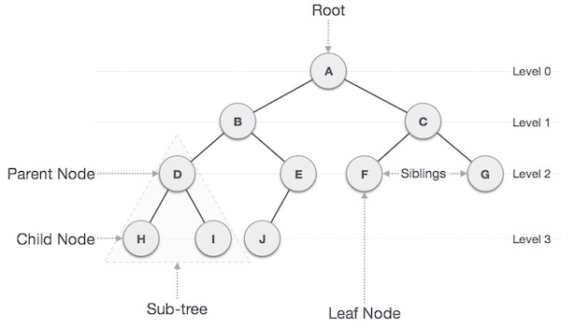

Slide 13
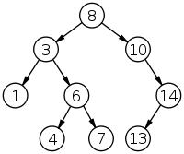
Example of a Tree
No. of nodes = 9
Height = 4
Highest Level = 3
Root Node = 8
Leaves = 1,4,7,13
Internal Nodes = 3,10,6,14
Ancestors Of 6 = 3,8
Descendents Of 10 = 14,13
Sibling Of 1 = 6

Slide 14
The depth of a node is the number of edges from the node to the tree's root node. A root node will have a depth of 0.
The height of a node is the number of edges on the longest path from the node to a leaf. A leaf node will have a height of 0.

Slide 15
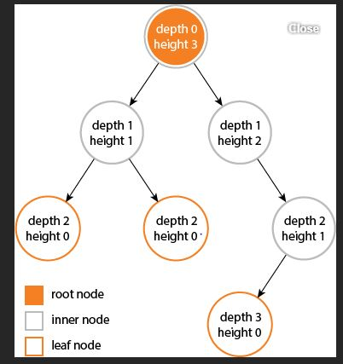

Slide 16
Maximum no.of nodes at any level is 2^{i}
Maximum no.of nodes at height h is 2^{h} -1
log₂ (n+1)< height <= 2^{h} -1

Slide 17
FULL BINARY TREE: A binary tree of height h that contains exactly (2^h)-1 elements is called a full binary tree.
In a FULL BINARY TREE each node has exactly 0 or 2 children and all leaf nodes are on the same level.
STRICT BINARY TREE: Each node has exactly 0 or 2 children.

Slide 18
COMPLETE BINARY TREE: A Binary Tree is complete Binary Tree if all levels are completely filled except possibly the last level and the last level has all keys as left as possible.
Tree should be filled from left to right.

Slide 19
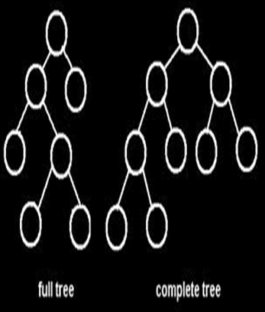
Full Binary Tree and Complete Binary Tree

Slide 20
Full Binary Tree:
Which has either 2 or zero child.
At most 2^i node at each level

Slide 21
Complete Binary tree: 1. all the leaf node should be at level n or n-1 2. Tree should be filled from left to right.

Slide 22
Tree Representation
Array Representation
Link list Representation

Slide 23
BT Traversal
Process of visiting each of the nodes in a tree and examine the value there.
Two kinds
Depth-First Tree Traversal.
Breadth-First Tree Traversal.

Slide 24
Depth First Tree Traversal
Pre-Order : Root first, Left child, Right child.
Post-Order : Left child, Right child, Root.
In-Order : Left child, Root, Right child.

Slide 25
Algorithm(Pre-order)
preorder(tree↑){
if tree ≠ NULL then
process tree↑.data ;
preorder (tree↑.left) ;
preorder(tree↑.right) ;
return.
}

Slide 26
EXAMPLE
Pre-Order : Root first, Left child, Right child.
A
Rotated node will be taken first
B
C
D
E
F
G
Pre-order traversal:
A B D E C F G

Slide 27
Algorithm(Post-order)
postorder(tree↑){
if tree ≠ NULL then
postorder (tree↑.left) ;
postorder(tree↑.right) ;
process tree↑.data ;
return.
}

Slide 28
EXAMPLE
Post-Order : Left Child, Right child, root.
A
Rotated node will be taken first
B
C
D
E
F
G
H
I
Post-order traversal:
G D H I E B F C A

Slide 29
Algorithm(In-order)
inorder(tree↑){
if tree ≠ NULL then
inorder (tree↑.left) ;
process tree↑.data ;
inorder(tree↑.right) ;
return.
}

Slide 30
EXAMPLE
In-Order : Left child, Root, Right child.
A
Rotated node will be taken first
B
C
D
E
F
H
J
I
In-order traversal:
D B I E A F C J H

Slide 31
Algorithm breadth-first-traversal(tree)
Createqueue(Q)
walkerptr←tree
while (walkerptr ≠ NULL)
process walkerptr
if (walkerptr ↑.left ≠ NULL)
Enqueue (Q,walkerptr ↑.left)
if(walkerptr ↑.right ≠ NULL)
Enqueue (Q,walkerptr ↑.right)
if (Not (empty(Q))
Dequeue (Q,walkerptr)
else walkerptr = NULL
return

Slide 32
EXAMPLE
A
Rotated node will be taken first
C
B
D
E
F
G
Breadth First Traversal:
A B C D E F G

Slide 33
Binary Search Tree(Motivation)
Insertion and Deletion in the middle of the array is very inefficient.
Search Operation in an ordered linked lists is inefficient.
To get the best of both, Binary Search Tree(BST) was introduced.
The binary search tree is widely used data-structure for information storage and retrieval as it supports many dynamic-set operations including Search, Minimum, Maximum, Predecessor, Successor, Insert and Delete.*

Slide 34
Definition(BST)
A binary search tree T for a set of keys from a total order is a binary tree in which each node has a key value and all the keys of the left subtree are less than the key at the root and all the keys of the right subtree are greater than the key at the root. This property holding recursively for the left and right subtrees of the tree T.

Slide 35
Example:
k
All<kA
All≥kk
20
10
30
8
12
25
35

Slide 36
Operations on BST
Traversal
Searching
Insertion
Deletion

Slide 37
BST Operation (Searching)
Find Smallest element
Find Largest element
Find Requested element

Slide 38
Algorithm findsmallest (bst)
if (bst ↑.left = NULL)
then return (bst ↑.data)
else
return (findsmallest ( bst ↑.left))

Slide 39
EXAMPLE
50
40
60
20
45
55
65
10

Slide 40
Algorithm findlargest (bst)
1. if (bst ↑.right = NULL)
then return (bst ↑.data)
2. else
return (findlargest (bst ↑.right))

Slide 41
EXAMPLE
50
45
70
80
40
75
85
30
42
90

Slide 42
Algorithm search(bst, data)
1. if bst = NULL
then return NULL
2. else
if (data < bst ↑.data)
search (bst ↑.left , data)
elseif (data > bst ↑.data)
search ( bst ↑.right , data)
3. else return (bst ↑.data)

Slide 43
EXAMPLE
Search 45
45<50
50
40
60
45>40
30
45
55
70

Slide 44
BST Operation-Insertion
method insert(key)
Based on comparisons of new data and the values of nodes in BST.
To insert follow the branches to an empty subtree and then insert the new node.
all inserts take place at a leaf or at a leaf like node – a node that has only one null subtree.
Elements in nodes must be comparable!

Slide 45
Algorithm
Algorithm insert_bst(bst,data);
1) if bst = NULL;
A) then
a) new(P) ;
b) P↑.data←data ;
c) P↑.left←NULL ;
d) P↑.right←NULL ;
e) bst←P ;
f) return bst .

Slide 46
Continued…
B) Else
a) if (data < bst ↑.data)
then insert_bst (bst ↑.left,data)
b) if (data ≥ bst ↑.data)
then insert_bst(bst ↑.right,data)
C) return.

Slide 47
INSERTION IN BST
Insert 42
42<50
50
40
60
42>40
30
45
55
42<45
&
45->left==NULL
70
42

Slide 48
BST Operation-Deletion
removes a specified item from the BST and adjusts the tree.
uses a binary search to locate the target items.
starting at the root it probes down the tree till it finds the target or reaches a leaf node (target not in the tree)
removal of a node must not leave a ‘gap’ in the tree.

Slide 49
Algorithm Deletion
Algorithm delete_bst (bst , data)
1) if bst = NULL
then return NULL
2) if (data < bst ↑.data)
then return delete_bst (bst ↑.left, data)
3) elseif (data > bst ↑.data)
then return delete_bst (bst ↑.right, data)

Slide 50
Continued…
4) Else
// found the node to be deleted & test whether it’s a leaf node.
a) if (bst ↑.left = NULL)
a.1) dataptr←bst
a.2) bst←bst ↑.right
a.3) free(dataptr)
a.4) return ;
b) elseif ( bst ↑.right =NULL)
b.1) dataptr←bst
b.2) bst←bst ↑.left

Slide 51
Continued…
b.3) free(dataptr)
b.4) return
c) else
∕ ∕ Node to be deleted is not a leaf or leaf like
∕ ∕ node. Find the largest node in the left subtree
c.1) dataptr←bst ↑.left
c.2) while (dataptr ↑.right ≠ NULL)
c.2.1) dataptr← dataptr ↑.right
∕ ∕ Node found.Move the Data
c.3) bst ↑.data←dataptr ↑.data
c.4) return delete_bst ( bst ↑.left, dataptr ↑.data)

Slide 52



Node to be deleted has no child Node to be deleted has one child Node to be deleted has two child (Find the Inorder successor of the node to be deleted)

Slide 53

Reconstruction of Binary Tree From given inorder and preorder we have to construct a tree From given inorder and postorder we have to construct a tree

Slide 54
Expression Tree
( a- b*c ) / ( d+ e/f )
/
-
+
a
*
d
/
b
c
e
f

Slide 55
Threaded Binary Tree
A binary tree with n nodes has 2n pointers out of which n+1 are always NULL,
So about half the space allocated for pointers is wasted
We utilize this wasted space to contain some useful information
A left NULL pointer can be used to store the address of inorder predecessor of the node
A right NULL pointer can be used to store the address of inorder successor of the node.
These pointers are called threads and a binary tree which implements these pointers is called a Threaded Binary Tree

Slide 56
Example
 | A
 | B
N | C | N
N | D | N
 | E
N | F | N
N | G | N

Slide 57
Right in-Threaded Binary Tree
 | A
 | B
N | C | N
N | D
 | E
N | F
N | G

Slide 58
LEFT in-Threaded Binary Tree
 | A
 | B
 | C | N
N | D | N
 | E
 | F | N
 | G | N

Slide 59
Fully in-Threaded Binary Tree
 | A
 | B
 | C | N
N | D
 | E
 | F
 | G

Slide 60
Drawbacks of Binary Search Tree
The Disadvantage of a Binary Search Tree is that its
Height can be as large as N.
This means that the time needed to perform Insertion
and deletion and many other operations can be O(N)
in the worst case.
Can be removed using Height Balanced Binary Tree AVL tree

Slide 61
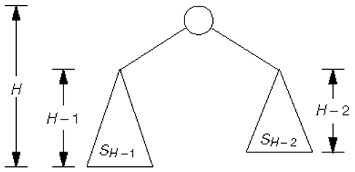
AVL-TREE
An AVL tree is a binary search tree with a balance condition.
AVL is named for its inventors: Adel’son-Vel’skii and Landis
AVL tree approximates the ideal tree (completely balanced tree).
AVL Tree maintains a height close to the minimum.

Slide 62
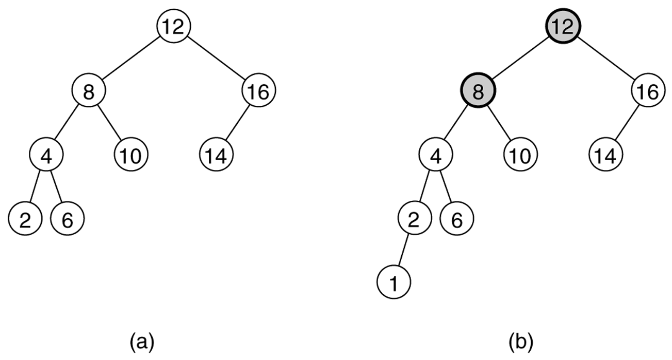
Definition:
An AVL tree is a binary search tree such that for any node in the tree, the height of the left and right subtree can differ by at most 1
Balance factor = Height of left subtree – Height of right subtree
If balance factor of all node is (-1 or 0 or 1) then the tree is said to be a Balanced Tree ( AVL-TREE)
AVL-TREE
NOT AN AVL-TREE

Slide 63
EXAMPLE
1
50
-1
40
60
0
0
30
45
1
0
55
70
0
0
42
AVL TREE

Slide 64
EXAMPLES
-3
50
0
10
-1
60
-2
2
5
23
55
65
0
0
1
2
-1
45
62
70
50
1
0
0
0
0

Slide 65
Rebalancing
Suppose the node to be rebalanced is X. There are 4 cases that we might have to fix (two are the mirror images of the other two):
An insertion in the left subtree of the left child of X,
An insertion in the right subtree of the left child of X,
An insertion in the left subtree of the right child of X, or
An insertion in the right subtree of the right child of X.
Balance is restored by tree rotations.

Slide 66
Single Rotation
A single rotation switches the roles of the parent and child while maintaining the search order
Single rotation handles the outside cases (i.e. 1 and 4)
We rotate between a node and its child.
Child becomes parent
Parent becomes right child in case 1 and left child in case 4
The result is a binary search tree that satisfies the AVL property

Slide 67
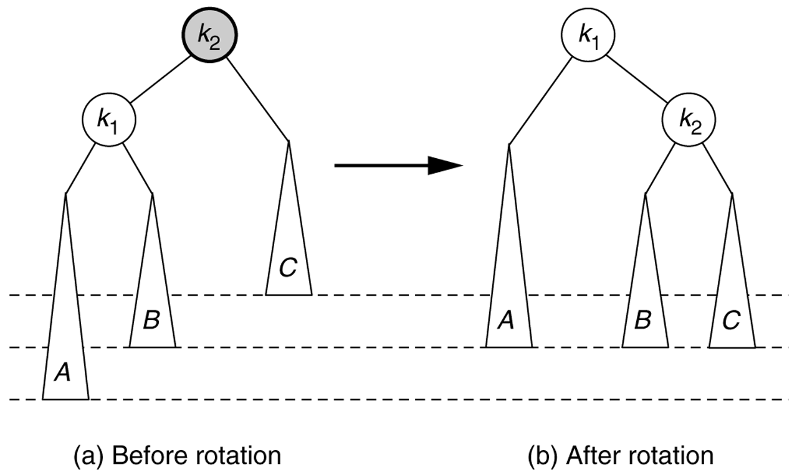
Single Rotation To Fix Case 1: Rotate Right

Slide 68
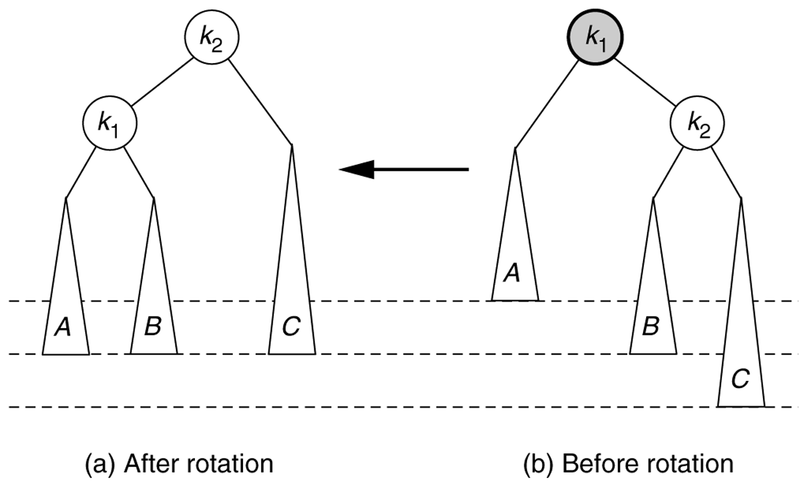
Single Rotation To Fix Case 4: Rotate Left

Slide 69
AVL Tree Rotations
Single rotations:
insert 14, 15, 16, 13, 12, 11, 10
First insert 14 and 15:
14
15
Now insert 16.

Slide 70
AVL Tree Rotations
Single rotations:
Inserting 16 causes AVL violation:
14
15
16
Need to rotate.

Slide 71
AVL Tree Rotations
Single rotations:
Inserting 16 causes AVL violation:
14
15
16
Need to rotate.

Slide 72
AVL Tree Rotations
Single rotations:
Rotation type:
14
15
16

Slide 73
AVL Tree Rotations
Single rotations:
Rotation restores AVL balance:
15
14
16

Slide 74
AVL Tree Rotations
Single rotations:
Now insert 13 and 12:
15
14
16
13
AVL violation - need to rotate
12

Slide 75
AVL Tree Rotations
Single rotations:
Rotation type:
15
14
16
13
12

Slide 76
AVL Tree Rotations
Single rotations:
15
13
16
12
14
Now insert 11

Slide 77
AVL Tree Rotations
Single rotations:
15
13
16
12
14
11
AVL violation – need to rotate

Slide 78
AVL Tree Rotations
Single rotations:
15
13
16
12
14
11
AVL violation – need to rotate

Slide 79
AVL Tree Rotations
Single rotations:
Rotation type:
15
13
16
12
14
11

Slide 80
AVL Tree Rotations
Single rotations:
13
12
15
14
16
11
Now insert 10

Slide 81
AVL Tree Rotations
Single rotations:
13
12
15
14
16
11
AVL violation – need to rotate
10

Slide 82
AVL Tree Rotations
Single rotations:
Rotation type:
13
12
15
14
16
11
10

Slide 83
AVL Tree Rotations
Single rotations:
13
11
15
10
12
14
16
AVL balance restored.

Slide 84
THANK YOU

