Slide 1
Polyglot Persistence
Introduction
Polyglot persistence refers to using different data storage technologies to handle varying data storage needs. It’s an offshoot of polyglot programming, which means using different programming languages to build an application. Simply put, it’s an application that uses more than one core database technology.

Slide 2
Polyglot Persistence
Manage Your Data Storage
A simple E-commerce platform uses:
Session data (Add to basket)
Search engine (Search for products)
Recommendation engine (Customers who purchased this item also like this)
Payment platform (Geolocation service)

Slide 3
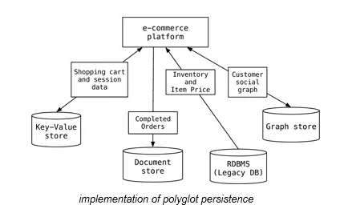
Polyglot Persistence
Implementing Polyglot Persistence
Implementing polyglot persistence allows you to fuel applications with data from different storage types. You could pull completed financial transactions from Oracle for your reports while tracking user information in MongoDB and letting Redis handle cache.

Slide 4
Polyglot Persistence
Data Storage Types
Organizations often end up using a number of different data sources to feed their applications. Let’s go over some common storage options:
Transactional (RDBMS) Databases – They provide data integrity by organizing information into tables with rows and columns. You retrieve data using syntax statements called queries. Many large organizations make heavy use of popular options like SQL Server and Oracle. One drawback to transactional databases is the difficulty in scaling as storage needs grow. Searches slow as data gets more dense and complicated to access.
Non-Transactional Databases – People often use the term NoSQL to describe these databases. They mark a shift from the use of tabular RDBMS systems, allowing for increased scalability and faster searches. They also pair well with search and analytic engines like Elasticsearch.

Slide 5
Polyglot Persistence
Data Storage Types
Non-Transactional Storage Types:
Key-Value – These databases use a key that points to the storage location of a piece of data. Some use hash-tables, while others like Redis hold its pairings in memory for quick access.
Document – These consist of key-value pairs compressed into a document that allows for structure by using some type of encoding like JSON or XML. Popular open-source versions include MongoDB and CouchDB.
Column – Data gets placed into grouped columns instead of rows like in an RDBMS structure. Cassandra and HBase use this model.
Graph – Uses graph structures along with nodes, edges, and properties to organize and retrieve data. Neo4j is an example that’s growing in popularity.

