Slide 1
File formats

Slide 2
Text Format
Text file format are files in which the bytes represent the text characters of a particular character set.
A specific system is used to relate the binary numbers in the file to the text characters of the set.
Text file format includes a number of different strategies for text files in which data fields are structured in a regular pattern.

Slide 3
DOC/DOCX
These files contain special formatting code hat identify how the text will look(bold, italic, color, etc.) as well as how the page lays out(margins, indentation, pagination, etc.)
Files saved using the .doc filename extension.
DOCX files incorporate XML(Extensible Markup Language) coding rules that help integrate a document with application.
PDF(Portable Document Format)
Use a .pdf filename extension
Captures all the elements of a printed document as an electronic image.
PDF documents cannot be readiy edited.

Slide 4
RTF
RTF documents are designed to transfer documents between word processing software
These files use .rtf filename extensions
Example: you can create columns, add page numbers, headers, or footers

Slide 5
Java Script Object Notation(JSON)
The format was specified by Douglas Crockford.
A lightweight text based data-interchange format.
It has been extended from the JavaScript scripting language.
The filename extension is .json.
Completely language independent.
Web services and APIs use JSON format to provide public data.

Slide 6
Why use JSON?
Straightforward syntax
Easy to create and manipulate
Can be natively parsed in JavaScript using eval()
Supported by all major JavaScript frameworks
Supported by most backend technologies
It can be used with modern programming languages.

Slide 7
JSON Object Syntax
Data is represented in name/value pairs
Curly braces hold objects and each name is followed by colon(:)
The name/value pairs are separated by comma(,)
Square brackets hold arrays and values are separated by comma(,)

Slide 8
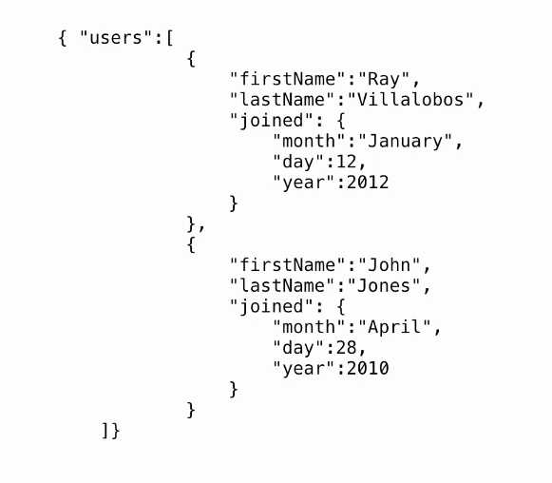
Example

Slide 9
Parsing JSON
A common use of JSON is to exchange data to/from a web server.
When receiving data from a web server, the data is always a string.
Example
Parse the data with JSON.parse(), and the data becomes a JavaScript object.

Slide 10
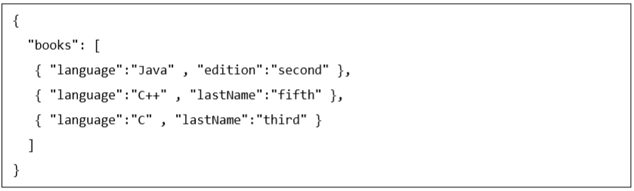
Types of Values
Array
An associative array of values.
The square brackets [ ] are used to declare JSON array
Can store string, number, Boolean, object or other array inside JSON array.
In JSON array, values must be separated by comma.
Arrays in JSON are almost the same as arrays in JavaScript.

Slide 11
Object
An associative array of key/value pairs.
JSON objects are surrounded by curly braces {}.
Written in key/value pairs.
Keys must be strings, and values must be a valid JSON data type (string, number, object, array, Boolean or null).
Keys and values are separated by a colon.

Slide 12
String
It is a sequence of zero or more double quoted Unicode characters with backslash escaping.
Character is a single character string i.e. a string with length 1.
Number
An integer.

Slide 13
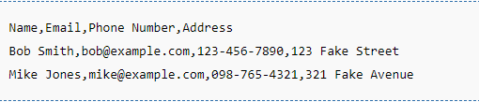
Comma Separated Values(CSV)
A delimited text file that uses a comma to separate values.
Stores tabular data (numbers and text) in plain text.
A common data exchange format that is widely supported by consumer, business, and scientific applications.

Slide 14
CSV Format
Each record is one line - A line separator(LF (0x0A) or CRLF (0x0D0A)) may also be embedded in the data making a record more than one line but still acceptable.
Leading and trailing whitespace is ignored.
Fields may always be delimited with double quotes, the delimiters will be parsed and discarded by the reading applications.

Slide 15
CSV Examples
Standard Line
This shows three fields, each with simple data.
Edoceo, Seattle, WA
Whitespace
The first field should be interpreted by reading applications as [space]Edoceo[comma][space]Inc.[space]. Whitespace also could include line breaks.
" Edoceo, Inc. ",Seattle,WA
Embedded Commas
The first field should be interpreted by reading applications as Edoceo[comma][space]Inc.
"Edoceo, Inc.",Seattle,WA

Slide 16
Why are CSV files used?
There are two primary reasons CSV files are used online
CSV files are plain-text files, which makes them easy for the website developer to create.
Because the CSV is plain-text it makes the data easy to import into any spreadsheet program or database regardless of the specific software you're using.
To better organize large amounts of data.

