Slide 1
B.TECH CSE with Specialization in DevOps
DevOps Overview
Traditional Software Development

Slide 2

Module Learning Objectives
At the end of this module, participants will be able to understand:
Software and its types
The history of software engineering and how it has evolved over time.
Different methods of software development
Waterfall method of software development, various stages involved in it, and the advantages and disadvantages of waterfall method
How conflicts between the development and operations teams impact product development
Notes:
Notes to the Facilitator:
Enumerate and list out the objectives for the module.
Notes to the Participant:
After completing this module, you will be able to understand:
Software and its categories.
The history of software engineering and how it has evolved over time.
Different methods of software development
Waterfall method of software development, various stages involved in it, and the advantages and disadvantages of waterfall method
How conflicts between the development and operations teams impact product development

Slide 3
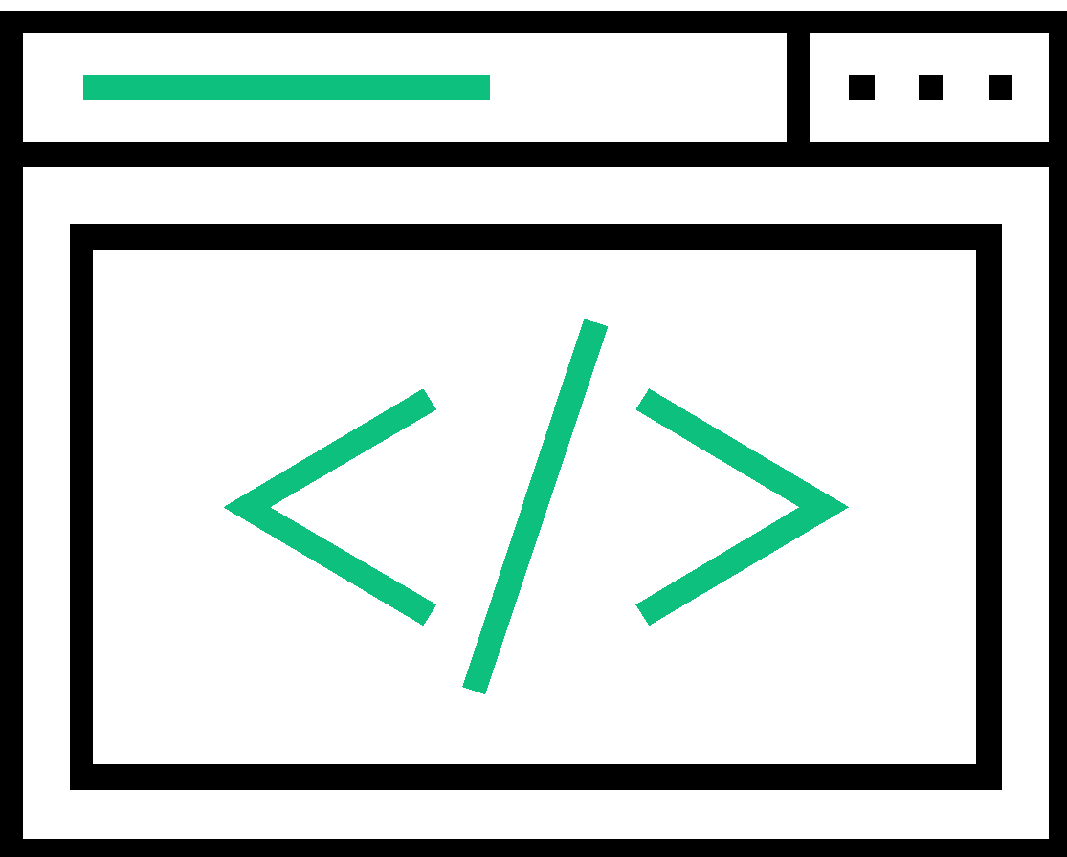
1. Software
A software is an organized information in the form of operating systems, programs, utilities and applications that enable a computer to work.
Any set of machine-readable instructions that directs a computer’s processor to perform specific operations.
Includes computer programs, libraries and their associated documentation.
Software programs are stored as files on a storage device such as hard disk, DVD or memory sticks. When needed, they are loaded into the computer’s memory (RAM).
In a nutshell, a software is everything that governs the functioning of a computer, an interface between computers and humans who use them.
Notes:
Notes to the Facilitator:
Explain participants what a software is and why is it required.
Notes to the Participant:
Computers and mobile phones have become an inevitable part of everyone’s life. On a daily basis, all of us interact with operating systems, spreadsheets, documents, games, videos and so many other applications. Ever wondered how all these things function? Behind each and every application that we use, lies a software built by developers, on multiple different programming languages. Let’s look at what a software is, how it works, different types of software, the history of software engineering and the different methods of software development.
What is a Software?
A software can be defined as an organized information in the form of operating systems, programs, utilities and applications that enable a computer to work. A software consists of carefully-organized instructions and code written by programmers in any of the different programming languages. A software is different from the physical hardware (from which the computer system is built), in a way that it contains the data or instructions which enable the system to perform. A software includes computer programs, libraries and other related non-executable data, such as online documentation or digital media.
Software controls the computer (operating systems), the communication of information (networks), and the creation and control of other programs (software tools and environments). Software also transforms information in different ways as producing, managing, acquiring, modifying, displaying, or transmitting information whether it is a computer desktop or a mobile phone.
A computer requires both hardware and software for its function. Without either, the other might not work on its own. For example, without a physical device like desktop computer or mobile phone you will not be able to use the internet, or an operating system, the browser could not run on the computer.
In today’s context, software takes on a dual role, it is a product and at the same time, the vehicle for delivering the product. As a product, it delivers the computing potential embodied by computer hardware or more broadly, by a network of computers that are accessible by local hardware. Whether it resides within a mobile phone or operates inside a mainframe computer, software is an information transformer—producing, managing, acquiring, modifying, displaying, or transmitting information that can be as simple as a single bit or as complex as a multimedia presentation derived from data acquired from dozens of independent sources. As the vehicle used to deliver the product, software acts as the basis for the control of the computer (operating systems), the communication of information (networks), and the creation and control of other programs (software tools and environments).

Slide 4
Different Types of Software
Software
System Software
Application Software
System Management Programs
System Support Programs
System Development Programs
General Purpose Applications
Special Purpose Applications
Operating systems
Operating Environments
Database Management Systems
Telecommunication Monitors
System utilities
Performance monitors
Security monitors
Programming Language Translators
Programming environments
Computer-Aided Software Engineering (CASE) Packages
Word Processing
Electronic Spreadsheets
Database Managers
Graphics
Integrated packages
Accounting software
Reservation systems
Marketing – Sales Analysis, etc.
Finance – Capital Budgeting, etc.
Notes:
Notes to the Facilitator:
Explain participants about the different types of software.
Notes to the Participant:
We’ve now learnt that a software is needed for functioning of computer systems. We will now have a look at about the different types of software.
There are two major categories of software, based on the purpose of use:
System Software
Application Software
System Software
System software is the one that operates the computer hardware and enables the functioning of the computer system. It includes operating systems, device drivers, diagnostic tools, servers, utilities, etc. The major purpose of system software is to insulate the application programmer to the extent possible from the details of the particular computer complex being used, especially memory and other hardware features, such as accessory devices as communications, printers, readers, displays, keyboards, etc. System software provides the platform for running application software. Systems software area is characterized by heavy interaction with computer hardware; heavy usage by multiple users; concurrent operation that requires scheduling, resource sharing, and sophisticated process management; complex data structures; and multiple external interfaces.
System software in turn can be classified into:
System Management Programs
Programs that are responsible for the functioning and management of computer systems. These are the ones that run manage the resources and provide common services for other software that run on top of them. System management programs include:
Operating systems
Operating Environments
Database Management Systems
Telecommunication Monitors
System Support Programs
It is a program that supports, or facilitates the smooth and efficient execution of various programs and operations of a computer. System support programs include:
System utilities
Performance monitors
Security monitors
System Development Programs
System development programs have the instructions to create and maintain computer systems. These include:
Programming Language Translators
Programming environments
Computer-Aided Software Engineering (CASE) Packages
Application software
Group of programs designed to carry out a single or a group of related tasks. Application software is actually a subclass of computer software, which leverages the capabilities of a computer directly to a task that the user wishes it to perform. Application software is looked upon as a software as well as its implementation. Application software are stand-alone programs that solve a specific business need. Applications in this area process business or technical data in a way that facilitates business operations or management/technical decision making. In addition to conventional data processing applications, application software is used to control business functions in real time
Application software can be broadly classified into:
General purpose software - General purpose application software is a type of application that can be used for a variety of tasks. It is not limited to one particular function. Different types of general purpose software include:
Word Processing software
Electronic Spreadsheets
Database Managers
Presentation Graphics
Integrated packages
Special purpose software - Special purpose application software is a type of software created to execute one specific task. Some examples for special purpose software include:
Accounting software
Reservation systems
Marketing – Sales Analysis, etc.
Finance – Capital Budgeting, etc.

Slide 5

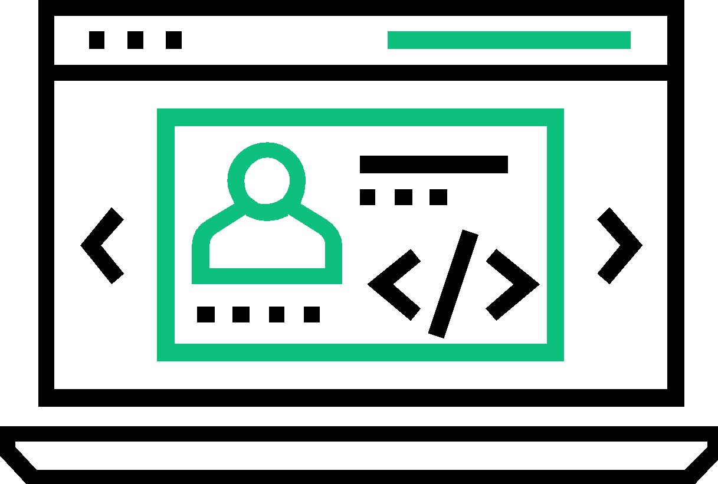
Software Engineering: Definition
Roger S. Pressman
President of R.S. Pressman & Associates
“Software engineering is the technology that encompasses a process, a set of methods and an array of tools that allow professionals to build high quality computer software.”
Source adopted from “Software Engineering: A Practitioner's Approach” written by Roger S. Pressman
Notes:
Notes to the Facilitator:
Give a brief introduction of software engineering and provide some definitions.
Notes to the Participant:
Software engineering is a detailed study of engineering to the design, development and maintenance of software. Software is important because it affects nearly every aspect of our lives and has become pervasive in our commerce, culture and everyday activities. Software engineering is important because it enables us to build complex systems in a timely manner and with high quality.
Definition of Software Engineering
IEEE Standard Glossary of Software Engineering Terminology: “The application of a systematic, disciplined, quantifiable approach to the development, operation and maintenance of software.”
IEEE Systems and software engineering - Vocabulary: “The systematic application of scientific and technological knowledge, methods, and experience to the design, implementation, testing, and documentation of software.”
Definition by Roger S. Pressman (American software engineer, author and consultant, and President of R.S. Pressman & Associates): “Software engineering is the technology that encompasses a process, a set of methods and an array of tools that allow professionals to build high quality computer software.”
Definition by Ian Sommerville (British academic and author of text books): “An engineering discipline that is concerned with all aspects of software production."
As per these definitions, a software may be very complex and beyond the handling of a single individual. As a result, a number of people are expected to work on the pieces of a software product in a cooperative manner. Also, a software product can have many versions which need to be managed. We can say, Software Engineering is also a management activity in addition to the implementation activity.

Slide 6
1.1 History of Software Engineering
(1973) C (and the Unix operating system)
(1989-90) The Web is born
(1990) Haskell
(1964) BASIC
(1980) Ada
(1980) Smalltalk
(1970) Pascal
1955
1965
1975
1985
1950
1960
1970
(1975) First interactive PC (Xerox PARC's Alto)
1980
(1985) C++
1990
(1957) Fortran
(1962) Cobol
(1986) Objective-C
(1987) Perl

Slide 7
1.1 History of Software Engineering (Contd.)
(1994) Netscape, Yahoo, and Amazon launch
(1991) Python
1995
(2000) C#
2005
2015
2025
1990
(1995) Java
(1995) Ruby
(1995) JavaScript
2000
2010
2020
2030
(2007) iPhone I released
(1992) Linux is open-sourced
Notes:
Notes to the Facilitator:
Explain to participants the classification of software engineering in various Eras.
Notes to the Participant:
The history of software engineering is rich and fascinating. Software engineering began when computer programs were just instructions to manipulate a physical device and it has crossed several key turning points that led to the commercialization and consumerization of computing technology.
Initial Days of Software
It was the computer scientist Tom Kilburn, who wrote the world’s first piece of software, run in 1948 at the University of Manchester in England. Kilburn and his colleague Freddie Williams had built one of the earliest computers, the Manchester Small-Scale Experimental Machine (also known as the “Baby”). The SSEM was programmed to perform mathematical calculations using machine code instructions. This first piece of software took 52 minutes to correctly compute the greatest divisor of 2 to the power of 18 (262,144).
Back in the late '50's and early '60's, programmers didn't interact directly with computing devices. They delivered their programs by hand to technicians and picked up the results hours later after the programs were batch processed with many others. Thus early tasks were typically geared towards mathematical computation, which required a very limited feedback loop.
For decades after this groundbreaking event, computers were programmed with punch cards in which holes denoted specific machine code instructions. Fortran, one of the very first higher-level programming languages, was originally published in 1957 by IBM, for mathematical and scientific computing. The next year, statistician John Tukey coined the word “software” in an article about computer programming. Another programming language Cobol, was released by the US Department of Defense in 1962 for use in business applications. Other pioneering programming languages like BASIC, Pascal and C arrived over the next two decades.
The Software Crisis
The transition to using a time-sharing model instead of batch processing for running programs was perhaps most significant of all because it led to a rapid growth in computing applications. Unfortunately, projects consistently failed to deliver reliably, on time and on budget. Practitioners were forced to admit that they lacked the proper best practices to implement and produce software at scale commercially. They called it the "Software Crisis".
Foundations of Software Engineering
The software crisis period taught a great lesson that designing complex software systems would require better tools and approaches than were available at the time. A conference was convened in 1968 to find a solution. It was in this conference, where the term "Software Engineering" found its roots. The conference sought to apply the best practices of project management and production to software. As a result, they produced a report which defined the foundations of software engineering. The early 70's saw the emergence of key ideas in systems thinking which allowed engineers to break these giant projects into modular (and much more manageable) pieces that communicated via interfaces.
The Personal Computing Era
In the 1970s and 1980s, software became a boom with the arrival of personal computers. C, the general-purpose programming language was originally developed by Dennis Ritchie between 1969 and 1973 at Bell Labs, and used to re-implement the Unix operating system. Apple released Apple II, its revolutionary product, to the public in April 1977. VisiCalc, the first spreadsheet software for personal computing, was wildly popular and known as the Apple II’s killer app. The software was written in specialized assembly language and appeared in 1979. The IBM PC was first launched in 1981. The next year, Time magazine selected the personal computer as its Man of the Year.
Software for productivity and business dominated these early stages of personal computing as well. Many significant software applications, including AutoCAD, Microsoft Word and Microsoft Excel, were released in the mid-1980s. Between 1980 and 1995, the major programming languages and frameworks like C++, Objective C, Perl, Haskell, Python and Java were released, and this period brought a major breakthrough in the industry.
With the advent of internet, open-source software, another major innovation in the history of software development, first entered the mainstream in the 1990s. The Linux kernel, which became the basis for the open-source Linux operating system, was released in 1991. Interest in open-source software spiked in the late 1990s, after the 1998 publication of the source code for the Netscape Navigator browser, mainly written in C and C++. Also noteworthy is the release of Java by Sun Microsystems in 1995.
Mobile Computing
In 1993, IBM first released the smartphone and in 1996, Palm OS became a hit in the market. In 1999, RIM released the very first Blackberry 850 device. In 2007, Apple changed computing with the release of the iPhone. It was only after this period, Mobile computing and mobile applications began to explode. Mobile apps use Swift (iOS) and Java (Android) as the development languages.
Some programming languages, like C and Cobol, have survived the test of time and are still in use. Other languages, such as Java and Python, are somewhat younger and have been used in countless software development projects. Still others, such as Apple’s Swift programming language for iOS or Go Open source, are relatively new and exciting.

Slide 8
1.3 Different Software Life Cycle Models
Many life cycle models have been proposed so far, with their own advantages and disadvantages. A few important and commonly applied life cycle models are as follows:
Classic Waterfall Model
V-Shaped
Model
Iterative Waterfall
Model
Prototyping
Model
Spiral
Model
Agile
Model
Notes:
Notes to the Facilitator:
Explain the participants that ‘Software development life cycle (SDLC)’ consists a series of phases that provides a common understanding of the software building process. Let the participants know that they will also learn about - How software is realized and developed from the business understanding and requirements elicitation phase to convert these business ideas and requirements into functions and features until its usage and operation to achieve the business needs.
Notes to the Participant:
Many software life cycle models have been proposed so far. Each model comes with its own set of advantages or disadvantages. A few important and commonly used life cycle models are as follows:
1. Classical Waterfall Model
The waterfall model emphasizes that a logical progression of steps be taken throughout the software development life cycle (SDLC), much like the cascading steps down an incremental waterfall. While the popularity of the waterfall model has waned over recent years in favor of more agile methodologies, the logical nature of the sequential process used in the waterfall method cannot be denied, and it remains a common design process in the industry. The steps involved in the classical waterfall model are:
Requirements
Analysis
Design
Coding
Testing
Operations/Maintenance
2. V-shaped Model
An extension to the waterfall model. The process flow doesn’t move down in a linear way. Instead, the process flow bends and moves upwards after implementation and coding phase, to form the typical V-shape. The major difference between waterfall model and V-model is that test planning and designing happen in early stages well before coding. This makes the model more successful than the classic waterfall model, as it saves a lot if time. This model suits well for small projects, where requirements are clearly defined and easily understood. The steps involved in this model are:
Requirements
System design
Architecture design
Module design
Implementation/Coding
Unit testing
Integration testing
System testing
Acceptance testing
3. Iterative Waterfall Model
Unlike the more traditional/classical waterfall model, which focuses on a stringent step-by-step process of development stages, the iterative model is best thought of as a cyclical process. After an initial planning phase, a small handful of stages are repeated over and over, with each completion of the cycle incrementally improving and iterating on the software. Enhancements can quickly be recognized and implemented throughout each iteration, allowing the next iteration to be at least marginally better than the last. This model can consist of mini waterfalls. The steps involved in this model are:
Planning and requirements
Analysis and design
Implementation
Testing
Evaluation
4. Prototyping Model
The Prototyping Model is one of the most popularly used Software Development Life Cycle Models (SDLC models). This model is used when the customers do not know the exact project requirements beforehand. In this model, a prototype of the end product is first developed, tested and refined as per customer feedback repeatedly till a final acceptable prototype is achieved which forms the basis for developing the final product. There are two approaches:
Rapid throwaway prototyping: Prototypes are first created, but they will not become a part of the finally delivered software.
Evolutionary prototyping: Prototypes gradually evolve as the final product by means of an iterative incorporation of user feedback.
Incremental prototyping: The final product is built as individual prototypes. In the end, the prototypes are merged in an overall design to get the final product.
Extreme prototyping: Most commonly used for developing web applications. Involves three phases:
Phase 1: A static prototype is built that mainly contains HTML pages
Phase 2: Screens are programmatically converted to a fully functional product using a simulated services layer.
Phase 3: Services are implemented during this phase.
5. Spiral Model
The Spiral Model is a software development methodology that aids in choosing the optimal process model for a given project. It combines aspects of the incremental build model, waterfall model and prototyping model. The Spiral Model is concerned primarily with risk awareness and management. Spiral model is distinguished by a set of six invariant characteristics:
Define artifacts concurrently
There are four essential spiral tasks
Risk determines level of effort
Risk determines degree of details
Use the anchor point milestones
Focus on the system and its life cycle
6. Agile Model
Unlike other SDLC models, Agile focuses less on specific requirements or guidelines, and far more on abstraction of these best practices to allow for greater flexibility, or agility, during the development process. Agile model emphasizes the need for every project to be handled differently, based on the individual needs of the project, the schedule, and the team behind it. You will learn about agile development in detail in the upcoming modules.

Slide 9
What did you grasp?
The process of developing a software product using software engineering principles and methods is referred to as, _______ A) Software myths B) Scientific Product C) Software Evolution D) None of the above
What is the main aim of Software engineering? A) Reliable software B) Cost effective software C) Reliable and cost effective software D) None of the above
Notes:
Answers for Facilitator:
Software Evolution
Reliable and cost effective software

Slide 10
2. Waterfall Model
Analysis
Design
Implementation
Testing
Maintenance
Analysis
Design
Implementation
Testing
Maintenance
Source adopted from “International Journal of Engineering & Technology (iJET)”
Notes:
Notes to the Facilitator:
Let the participants know that in classical waterfall model the development process begins only if the previous phase is complete. Explain to the participants why this model has been so popular.
Notes to the Participant:
The most popular way of developing a software is the ‘THE CLASSICAL WATERFALL’ model . It is the first SDLC model ,introduced to describe the software development ,in late 1950 and became popular in 1970’s by the first formal description of the waterfall model cited in an article by Winston W. Royce thou the term "waterfall" was coined by Bell and Thayer in 1976.
One of the main requirements of Software development process is the non-iterative sequential WATERFALL MODEL. The entire software development process undergoes different phases, namely requirement details/analysis, design, coding & testing, system testing & integration and maintenance respectively.
A team of experts and trained people in each department handle different phases of the Waterfall model for e.g., business and requirements analysis department, software engineering department, development and programming department, quality assurance (QA) department, and technical support department.

Slide 11
2.1 Explanation of Classical Model of Waterfall
In “The Waterfall” approach, the outcome of one phase acts as the input for the next phase sequentially
Feasibility Study
Requirement Analysis and specification design
Design Phase
Coding and Unit testing
Integration and system testing
Maintenance
Notes:
Notes to the Facilitator:
Let the participants know that in classical waterfall model the development process begins only if the previous phase is complete. Explain to the participants why this model has been so popular.
Notes to the Participant:
In “The Waterfall” approach, the whole process of software development is divided into separate phases. The outcome of one phase acts as the input for the next phase sequentially. This means that any phase in the development process begins only if the previous phase is complete. The waterfall model is a sequential design process in which progress is seen as flowing steadily downwards (like a waterfall) through the phases of Conception, Initiation, Analysis, Design, Construction, Testing, Production/Implementation and Maintenance.
As the Waterfall Model illustrates the software development process in a linear sequential flow; hence it is also referred to as a Linear-Sequential Life Cycle Model.
The first and foremost stage is the study of resources, technical & financial feasibility.
Requirement Analysis and specification design
Design Phase
Coding and Unit testing
Integration and system testing
Maintenance

Slide 12

2.1.1 First Stage – Feasibility Study
The following activities are covered during the feasibility study phase.
Financial Feasibility
Technical Feasibility
Client Visit
Study Of Input-output Data
Case Study
Notes:
Notes to the Facilitator:
Explain the participants the objective of feasibility study and how it is helpful to determine the do ability of the project.
Notes to the Participant:
The main aim of feasibility study is to determine whether it would be financially and technically feasible to develop the product. At first project managers or team leaders figure out a rough understanding of what is required to be done by visiting the client . They study different input and output data to be produced by the system. They study the required processing to be done on these data and look at the various constraints and effects on the behavior of the system. After understanding the problem(if any) they investigate the different available solutions.
Then they examine each of the solutions in terms of what kind of resources required, what would be the cost of development and what would be the development time for each solution.
Based on this analysis they pick the best solution and determine whether the solution is feasible financially and technically. They check whether the customer budget would meet the cost of the product and whether they have sufficient technical expertise in the area of development. The following is an example of a feasibility study undertaken by an organization. It is intended to give you a feel of the activities and issues involved in the feasibility study phase of a typical software project. {????????}

Slide 13
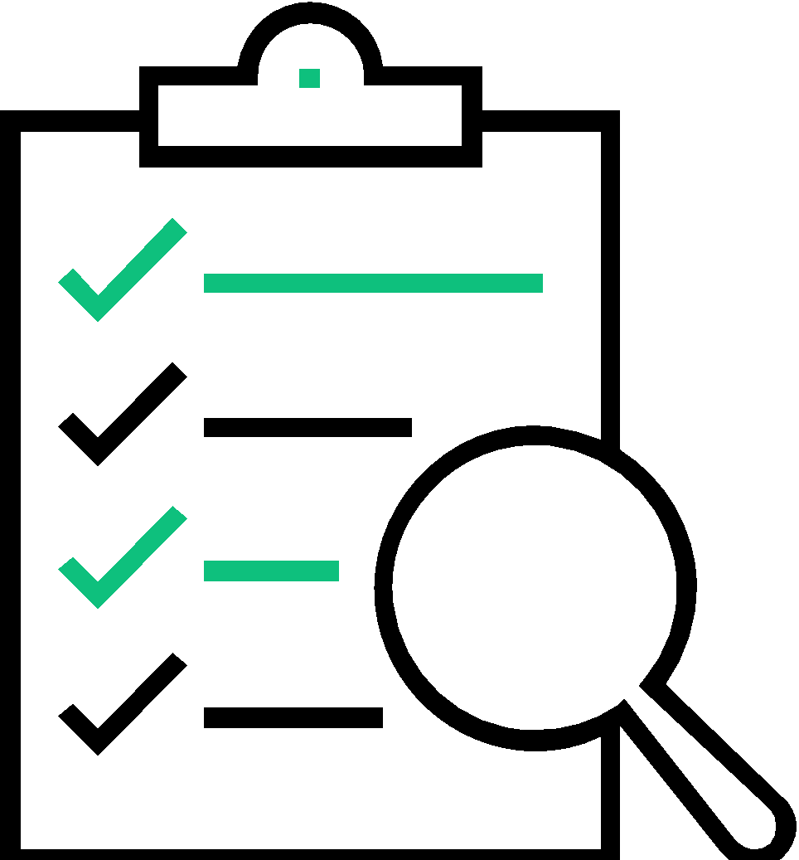
2.1.2 Second Stage – Requirements Analysis & Specification Design
The following activities are carried out during the requirements analysis and specification design phase.
Requirements gathering and analysis
Requirements specification
Notes:
Notes to the Facilitator:
Explain to participants, how In this phase, the expectations and goals of the project are defined, and risks are analyzed.
Notes to the Participant:
The aim of the requirements analysis and specification phase is to understand the exact requirements of the customer and to document them properly. This phase consists of two distinct activities-
Requirements gathering and analysis,
Requirements specification
The aim of ‘requirements gathering’ is to collect all relevant information from the customer regarding the product to be developed. Once this is done and clear understanding of the customer requirements is available then the incompleteness and inconsistencies are removed. The requirements analysis activity is started by collecting all the relevant data related to the product to be developed from the users of the product and from the customer through interviews and discussions.
For e.g., to do the analysis of a business accounting software required by an organization, the analyst should interview all the accountants of the organization to assess their requirements and expectations.
It is necessary to identify all ambiguities and contradictions in the requirements as there is a possibility that the data collected may contain several contradictions and ambiguities since each user typically has only a partial and incomplete view of the system. Therefore to resolve them through further discussions with the customer.
Once all ambiguities, inconsistencies, and incompleteness have been resolved and all the requirements/expectations have been properly understood, the requirements specification activity can start.
This activity includes the steps to systematically capture and organize the user requirements into a ‘’Software/hardware Requirements Specification’’(SRS) document.
The customer requirements identified during the requirements gathering and analysis activity are organized into a SRS document. The important components of this document are functional requirements, the nonfunctional requirements, and the goals of implementation.

Slide 14
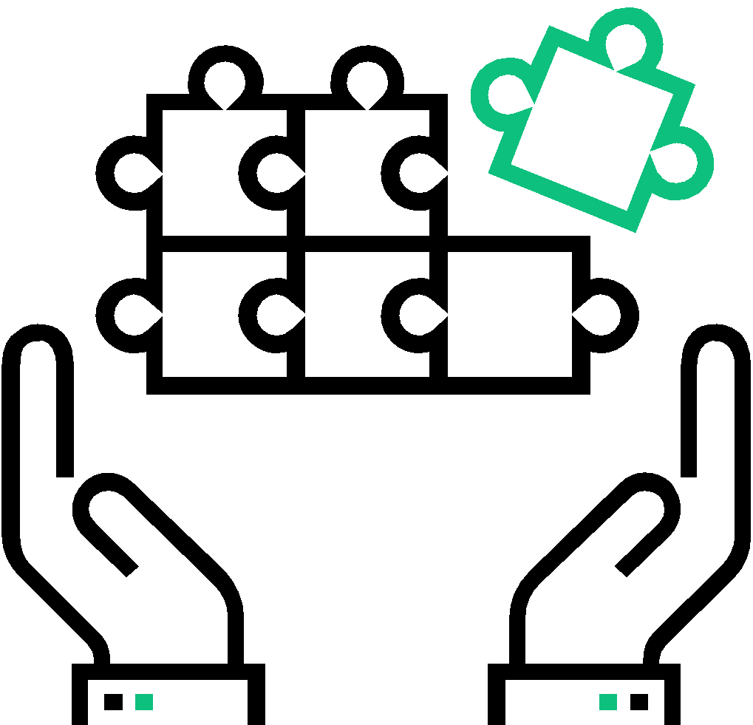
2.1.3 Third Stage – Design Phase
The following activities are covered during the design phase.
Creation of system design as per the requirements gathered during the previous phase.
Definition of overall system architecture
Documentation of design
The two Design Phases
High level design
Low level design
Notes:
Notes to the Facilitator:
Explain to participants, how a blueprint is drawn up for the developers along with a plan of meeting requirements.
Notes to the Participant:
The goal of the design phase is to transform the requirements specified in the SRS document into a structure that is suitable for implementation in some programming language. In technical terms, during the design phase the software architecture is derived from the SRS document.
The two phases of design are:
High level design
High-Level Design (HLD) involves decomposing a system into modules, and representing the interfaces and invocating relationships among modules. An HLD is referred to as software architecture. A HLD document will usually include a high-level architecture diagram depicting the components, interfaces, and networks that need to be further specified or developed. The document may also depict or otherwise refer to work flows and/or data flows between component systems.
Low level design
LLD, also known as a detailed design, is used to design internals of the individual modules identified during HLD i.e. data structures and algorithms of the modules are designed and documented. Program specifications are covered under LLD. LLD describes each and every module in an elaborate manner so that the programmer can directly code the program based on it. There will be at least one document for each module. The LLD will contain
a detailed functional logic of the module in pseudocode
database tables with all elements including their type and size
all interface details with complete API references (both requests and responses)
all dependency issues error message listings
complete inputs and outputs for a module.

Slide 15
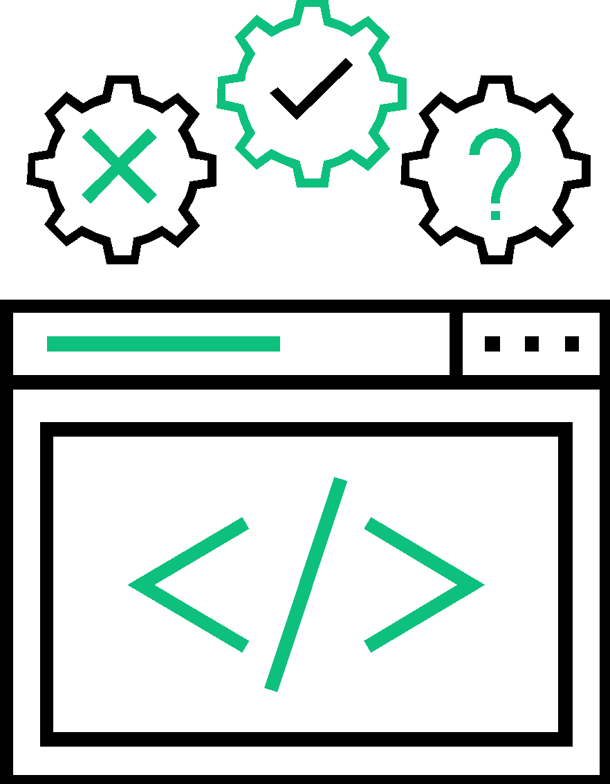
2.1.4 Fourth Stage – Coding and Unit Testing
The following activities are covered during the code and unit testing phase.
Implementation Phase
Developing Source Code
Program Modules
Testing Of Modules
Debug The Errors
Notes:
Notes to the Facilitator:
Let the participants know that this phase may be called as development, implementation or coding and how the development takes place.
Notes to the Participant:
This stage is also called the implementation phase. This stage involves the coding and unit testing of software development and to translate the software design into source code. Each component of the design is applied as a program module. The end-product of this phase is a set of program modules that have been is tested individually to ensure the correct working of all the individual modules. The testing of each module in isolation is the most ideal way to debug the errors at this stage.

Slide 16
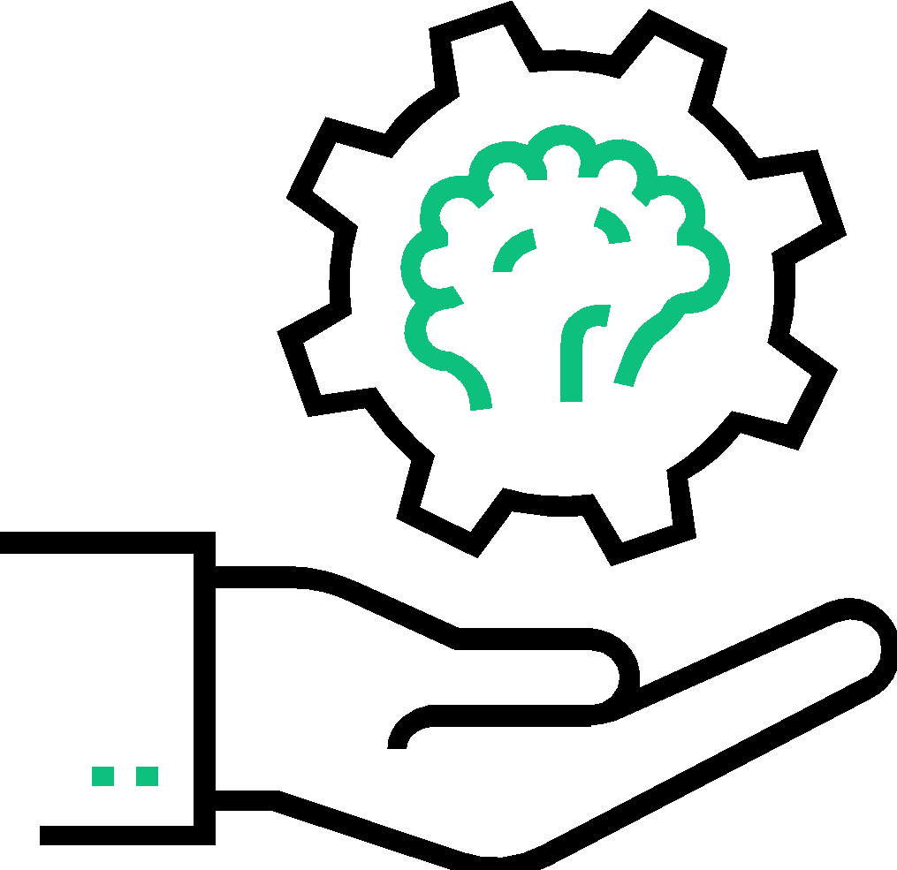
2.1.5 Fifth Stage – Integration and System Testing
The following activities are covered during the integration and system testing phase.
Integration in Planned Manner
Steps of Integration
Addition of Modules
System Testing
Notes:
Notes to the Facilitator:
Emphasis the importance of this stage to participants and how it ensures that the product meets the client’s requirements.
Notes to the Participant:
Once the modules have been coded and unit tested , Integration of different modules is undertaken . During the integration and system testing phase, The modules are integrated in a planned manner. The different modules making up a software product are almost never integrated in one shot. Integration is normally carried out progressively over a number of steps. During each integration step, the partially integrated system is tested and a set of previously planned modules are added to it. Finally, when all the modules have been successfully integrated and tested, system testing is carried out to ensure that the developed system conforms to its requirements laid out in the SRS document.

Slide 17
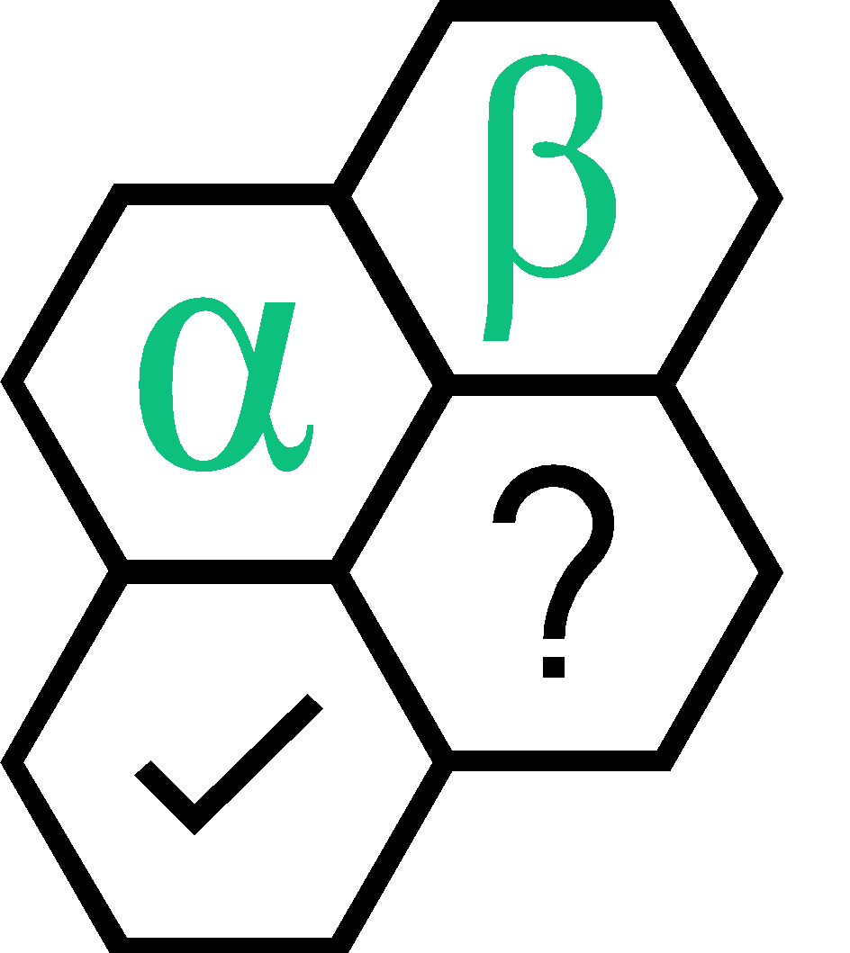
2.1.5 Fifth Stage – Integration and System Testing (Contd.)
This is a level of software testing where a complete and integrated software is tested. The various tests may include
Alpha (α ) - Testing (Development team)
Beta (β) - Testing (set of customers)
Acceptance Testing (customers)
Notes:
Notes to the Participant:
System testing usually comprises of three different kinds of testing activities:
1) α – testing: It is the system testing carried out by the development team.
2) β – testing: It is the system testing carried by a friendly set of customers.
3) acceptance testing: It is the system testing performed by the customer himself after the product delivery to determine whether to accept or reject the delivered product.
System testing is normally carried out in a planned manner according to the system test plan document.
The system test plan identifies all testing related activities to be performed, mentioning the schedule of testing, and defining the resources. This step also includes all the test cases and the expected outputs for each test case. After integrating the unit tested code ,it is made sure that it works well ,as expected and error-free .All the functional and non-functional testing activities are performed to check whether the system meets the requirement perfectly.
The progress on testing is tracked through tools like traceability metrics, ALM. Finally the progress report of testing activities is prepared.

Slide 18
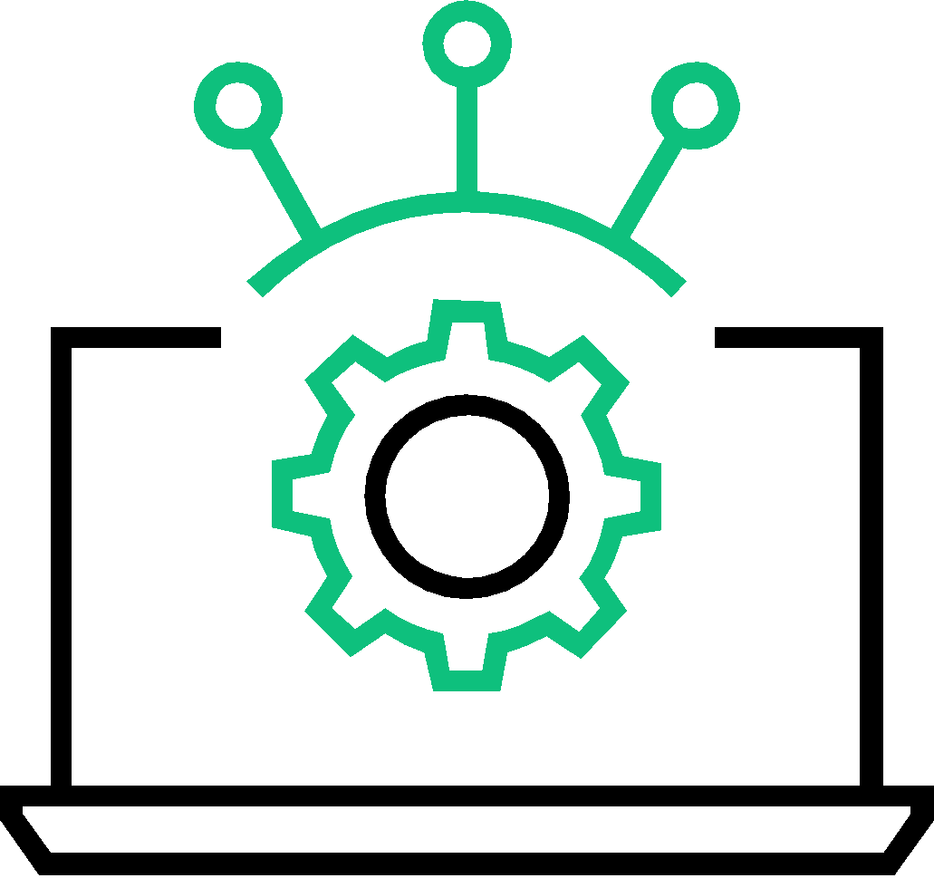
2.1.6 Sixth Stage – System Deployment and Maintenance
The following activities are covered during the system deployment and maintenance phase.
Product Deployment
Development and Maintenance
Maintenance
Corrective Maintenance
Perfective Maintenance
Adaptive Maintenance
Notes:
Notes to the Facilitator:
Explain to the participants that the product is implemented according to the agreed-upon requirements and one more round of testing and verification should be done after implementation.
Notes to the Participant:
Once the functional and non-functional testing is completed , the product is deployed in the customer environment or released in the market .
Maintenance of any software product requires much efforts than the efforts put in to develop the product. Researches confirm that the relative effort of development of a typical software product to its maintenance effort is roughly in the 40:60 ratio.
Maintenance involves performing any one or more of the following three kinds of activities:
Corrective maintenance: Correcting errors which were left undiscovered during the product development phase is the part of maintenance
Perfective maintenance: Improving the implementation of the system and enhancing the functionalities of the system according to the customer’s requirements. This is done to alter attributes or improve performance.
Adaptive maintenance: Porting the software to work in a new environment. For example, porting may be required for the smooth running of the software to work on a new computer system or with a new operating system. The defects uncovered during live use of the software are also taken care of in the maintenance stage.

Slide 19
2.2 Advantages Of Waterfall Model
Discipline
Time and Cost Effective
Quality Improvement
Every phase has a defined start and end point. The progress can be distinctly identified by both, the client and the software developer, through the use of milestones.
The emphasis on requirement and design, before writing the codes/programs ensures the minimal wastage of time, effort and cost and decreases the risk of slipping of schedule.
The flaws can be easily caught and taken care of at the design stage, much earlier than the testing stage.
Notes:
Notes to the Facilitator:
Explain the characteristics of Waterfall Model. There are many reasons why waterfall model has been so popular over years few are listed on the slide
Notes to the Participant:
The central idea of the waterfall model is to spend the majority of time, money and effort up front: 20-40% in the first two phases, 30-40% on coding / development, and the rest during implementation and maintenance.
Discipline: Every phase has a defined start and end point. The progress can be distinctly identified by both, the client and the software developer, through the use of milestones.
Time and cost effective: The emphasis on requirement and design, before writing the codes/programs ensures the minimal wastage of time, effort and cost and decreases the risk of slipping of schedule.
Quality improvement: The flaws can be easily caught and taken care of at the Design stage, much earlier than the Testing stage.

Slide 20
2.3 Shortcomings of the Waterfall Model
Possibilities of Errors
Not Suitable for All Projects
Implicit Assumptions
High Risk and Uncertainty
Non-adaptive Design Constraints
Ignores Mid-Process User/Client Feedback
Delayed testing period
Makes changes difficult
Notes:
Notes to the Facilitator:
Explain to participants that new software development models have been introduced, since waterfall model had its own disadvantages. Discuss the shortfall of waterfall model.
Notes to the Participant:
Shortcomings of waterfall model
It is assumed that no developmental error is ever committed by the engineers during any of the life cycle phases in the classical waterfall model . However, in practical development environments, large number of errors are committed in almost every phase of the life cycle.
The source of the defects can be many: due to oversight ,wrong assumptions, use of inappropriate technology, communication gap among the project engineers, etc.
In waterfall model bugs/errors are usually detected much later in the life cycle. For e.g., a defect might have gone unnoticed till the coding or testing phase. Once a defect is detected, the engineers need to go back and rectify some of the work done during that phase and the subsequent phases. Therefore, in any practical software development work, it is not possible to strictly follow the classical waterfall model.
This model is not good for those projects where the requirements keep changing.
Implicit assumptions of that the design can be translated into product can be lead to roadblock at a very later stage.
Lack of adaptability across all stages of development is the most daunting disadvantage of the waterfall model. When a test in the fifth stage reveals a fundamental flaw in the design of the system, it requires a dramatic leap backward in stages of the process. In the worst case, it leads to a devastating realization regarding the legitimacy of the entire system. While most experienced teams and developers would argue that such revelations shouldn’t occur if the system was properly designed in the first place, not every possibility can be accounted for, especially when stages are so often delayed until the end of the process.
Due to the strict incremental process that the waterfall model enforces, user or client feedback is received only during the later stages of the development cycle. While project managers can obviously enforce a process to step back to a previous stage due to an unforeseen requirement or change coming from a client, it will be both costly and time-consuming, for both the development team and the client.
Waterfall strictly introduces testing quite late into the cycle. Most bugs or even design issues won’t be discovered until very late into the process, but it also encourages poor coding practices that lack enthusiasm and determination, since testing is only an afterthought.
Waterfall is based on steps that keeps the teams strictly moving in a forward direction, there’s no room for unplanned changes or updates. If the team has strictly followed waterfall model nearly to the end of the project, and faces a sudden and unexpected change in terms of goals or scope, pivoting will become mighty difficult. Much of the work done so far may go useless.

Slide 21
What did you grasp?
Which model is also called as the classic life cycle or the Waterfall model? A) Iterative Development B) Linear Sequential Development C) RAD Model D) Incremental Development
What is the simplest model of software development paradigm? A) V-model B) Spiral model C) Big Bang model D) Waterfall model
Notes:
Answers for Facilitator:
Linear Sequential Development
Waterfall model

Slide 22
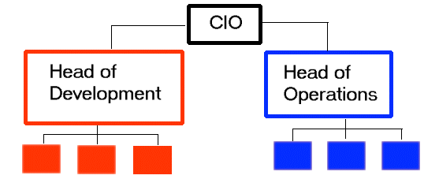
Traditional IT Organizations
Cultural hindrance between Development and Operations teams in traditional SDLC.
Development and Operations - two sides of an equation - holding their own roles and responsibilities.
Development team works independently on code.
Code sent to testing team for validation.
Operations team comes in toward the end of the process, handover of the release.
No collaboration between teams.
Notes:
Notes to the Facilitator:
Explain how Development and Operations happen in a Traditional SDLC and how conflicts emerge out of it.
Notes to the Participant:
So far we have seen about software and its types, the history of software engineering and the Waterfall model as an example for traditional software development.
Organizations that follow the traditional way of software development work with strict principles and in these organizations, the Development and Operations teams function as two separate entities. Development team tends to be driven by how many new functionalities can be churned out in a given time, therefore change is its incentive. Operations team on the other hand, tends be driven by stability of the status quo and its incentive is therefore resisting change.
There exists a cultural hindrance between Development and Operations teams in traditional SDLC. In a traditional setup, the Development team works on code which is then sent to the testing team for validation against requirements. Operation team comes in toward the end of the process, where handover of release is given.
Most of the organizations, who have adopted traditional SDLC, face a situation like this on a daily basis:
A developer produces some code and tests it in a pre-production environment.
Operations then pushes the updated code into the production environment.
Something breaks in the production environment, and the operations team reports a bug to the developer.
The developer tests the bug in the pre-production environment and cannot reproduce it.
The developer sends the bug back to operations, thinking it’s an operational issue.
The issue then goes back and forth between teams, wasting valuable time and creating the potential for end-user frustration.
This causes a disconnect and there is hardly any collaboration between the Development and Operations teams. This leads to the rise of conflicts among the teams, which has a direct impact on the software being developed and delivered to the customer. More about this will be explained in the forthcoming section.

Slide 23
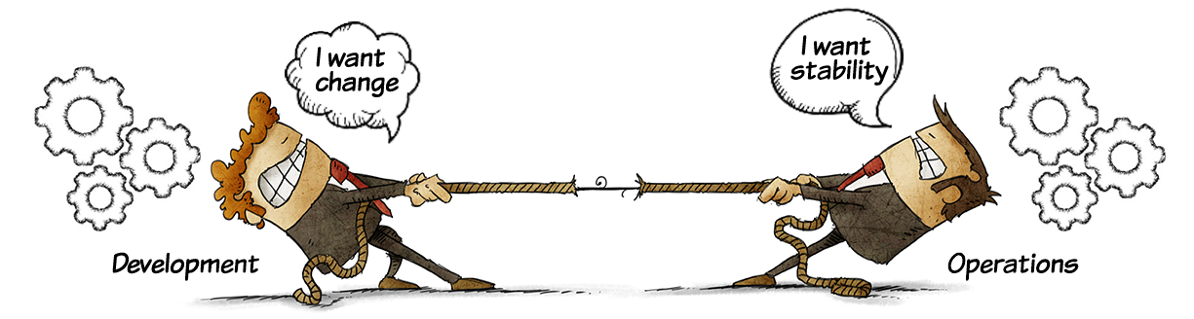
3. Developers vs IT Operations Conflict
Meaning
Development Changes
Confusions /Lack Of Communication
Operations Stability
Notes:
Notes to the Facilitator:
Explain that organizations are far from being a strategic, well-oiled discipline that directly delivers business value. Many challenges exist that hamper business operations, growth, and success.
There is tension (or wall) between Development and Operations teams in software development circles.
Ask the following questions to the participants based on the images depicted on this slide:
What is the key goal of the Development team?
What is the function of Operations team?
Is the Development and the Operations teams connected to each other?
Notes to the Participant:
Various challenges occur due to contracting goals of the various teams, especially the Development and the Operations, involved in the software development and delivery. The job of the Development team is to build software and apply changes to incorporate new features and fulfil the internal as well as the external requirements. On the other hand, the Operations team focuses on stability, reliability, and performance of the systems maintained by the team. The two competing contradicting goals of the two teams result in a wall of confusion.
The wall of confusion prevents required communication between the Development and the Operations teams and results in severe problems in production that causes blast like situations, such as: No methodical hand over to the Operations team is done leading to “half cooked meal” like situation. Consequently, the Operations team faces problems in production that they are unable to solve and look back to the Development team for resolution. This loopback delays problem resolution.
In the absence of required discussions between the Development and the Operations teams during earlier phases of development, a lot of useful information is not shared between the two teams. Such information is crucial for the Operations team to get ready for the upcoming changes to the applications under development. For example, the Operations team can share valuable information from their experience of managing Production environment. This information can help the Development team design and develop robust applications. However, due to lack of communication between the two teams, this information sharing is missed.
A critical part of transition between the Development and the Operations teams is knowledge articles. These articles help the Operations team to solve known problems. In the presence of the wall of confusion, these elaborate knowledge articles are missed. As a result, the Operations team takes extra time to solve trivial problems.
The wall of confusion is caused due to the conflicting motivations and mindset with regard to the development and operations of the software activity. This disconnect results into conflict and inefficiency which is generally a mindset called wall of confusion.

Slide 24
3.1 Problems with the Traditional Development and the Operations
Organizational Silos
Different Mindsets
Different Implementations
Different Tools
Lack of Interest in Learning Other Tools
Different Environments
Loss of Work
Blame Game
Build Rollback
Disintegrated Process
No Feedback Loop
Cohesive Team Approach
Development
Planning
Development
Testing
Quality Assurance
Operations
Infrastructure Mgt
Security & Compliance
Database Admin
Network Technician
Notes:
Notes to the Facilitator:
The slide lists some of the problems between the Development and the Operations teams due to the traditional way of developing applications.
Participant Notes:
Some of the problems with the traditional Development and the Operations teams include:
Organizational Silos: The two teams work in isolation that do not allow them to understand each other’s problems and perspectives. Every individual and every single team, whether it’s Development, Operations, Quality Assurance, or the Support team, all come across challenges on a daily basis. Regardless of who is responsible, the problem needs to be solved. Without collaboration, this process takes longer and can create further problems that may not be immediately apparent. Working together and communicating efficiently allows you to implement solutions that will help prevent similar incidents in the future.
Different Mindsets: The Development team always wants to incorporate every new technique/feature to do their work efficiently. On the other hand, changes are not at all acceptable by the Operations team because changes results in instability. Therefore, change is the biggest enemy for the Operations team.
Different Implementations: The different implementations to perform the same work by the teams results in incompatibility and lead to various bugs in the QA and the Production environments.
Different Tools: The different tools used by the two teams lead to various errors and bugs in the Production environment. For example, Development team might deploy to a Test environment using dependency management tool, while Operations team might use a home-grown script for the process.
Lack of Interest in Learning Other Tools: Each team considers its tool or style of working to be the best and does not want to learn a new tool.
Different Environments: The different environments, such as Development, Production, and Testing, is one of the biggest causes of various errors and bugs raised by the different teams.
Loss of Work: The various errors and bugs results in loss of valuable efforts.
Blame Game: A lot of differences between the teams and environments force the teams to pass on the blame of delayed delivery or build rollback on each other. It’s unnecessary placing blame and pointing fingers, the key here is to use the available time and resources to solve the issue.
Build Rollback: A build is a version of the software that is deployed and rolled out to the customer after stringent tests. During the build process, source code is converted into a standalone software artifacts, called build artifacts that can be run on computer systems. A build doesn’t always go right. Many times teams will be forced to rollback the build due to various reasons, such as incorrect client requirements, incorrect database (DB) in the QA or Production environment, incompatible tools and others.
Disintegrated Processes: Development processes do not integrate well with operations processes.
No Feedback Loop: Lack of a continuous feedback loop in development and operational processes causes gaps.
To solve the issues that arise due to the wall of confusion and the conflicts that exists between development and operations teams, in traditional IT organizations, and to develop quality software in a short time, companies have started moving from traditional approaches to DevOps.
What is the solution?
The wall of confusion between the Development and Operations teams is one of the major reasons for the emergence of DevOps. With DevOps, the Development and Operations teams work in collaboration to minimize the effort and risk involved in releasing software. Collaboration can be ensured by the Operations team by means of giving constant feedback to the Development team about the code, analyzing the impact considering end users and troubleshooting any problems together to gain stability of the product. DevOps enables a cultural change to remove the barrier between development and operations, working together for common set of objectives. Some of the approaches for solving these issues is:
Working as cohesive teams
Having shared objectives
Coordinating work and sharing information between teams
Collaboration
Use of shared tools
DevOps is fundamentally an extension to Agile and Lean principles, as it attempts to instill those same values and practices into Operations. You will learn in detail about DevOps and Agile in the forthcoming modules.

Slide 25
What did you grasp?
There is a negative effect on deployment and delivery dates in case of conflict between the developers and the IT operations. A) True B) False
Which of the following is NOT a consequence of wall of confusion? A) Lack of communication B) Errors and bugs due to the use of different tools C) Application delivery in a fast pace D) No methodical handover
Notes:
Notes to the Facilitator:
Answers:
1. A. True
2. C. Application delivery in a fast pace.

Slide 26

In a nutshell, we learnt:
The definitions available for Software and types of software.
The history of software engineering and how it has evolved over time.
Different methods of software development
Waterfall method of software development, various stages involved in it, and the advantages and disadvantages of waterfall method
How conflicts between the development and operations teams impact product development
A brief of DevOps and agile as a solution for resolving the issues between development and operations teams.
Notes:
Notes to the Facilitator:
Let us go over a quick summary of what we have learnt in this module.
Notes to the Participant:
Here we come to the end of this module. We learnt about -
The definitions available for Software and types of software.
The history of software engineering and how it has evolved over time.
Different methods of software development
Waterfall method of software development, various stages involved in it, and the advantages and disadvantages of waterfall method
How conflicts between the development and operations teams impact product development
A brief of DevOps and agile as a solution for resolving the issues between development and operations teams.

Slide 27
Next Module 2: Rise of Agile methodologies

