Slide 1
Relational Data Model Concepts
Tables − In relational data model, relations are saved in the format of Tables. This format stores the relation among entities. A table has rows and columns, where rows represents records and columns represent the attributes.
Tuple − A single row of a table, which contains a single record for that relation is called a tuple.
Relation instance − A finite set of tuples in the relational database system represents relation instance. Relation instances do not have duplicate tuples.
Relation schema − A relation schema describes the relation name (table name), attributes, and their names.
Relation key − Each row has one or more attributes, known as relation key, which can identify the row in the relation (table) uniquely.
Attribute domain − Every attribute has some pre-defined value scope, known as attribute domain.

Slide 2
Relational Constraints in DBMS
What are Constraints in DBMS ??
Database constraints are restrictions on the contents of the database or on database operations. It is a condition specified on a database schema that restricts the data to be inserted in an instance of the database.
Need of Constraints :
Constraints in the database provide a way to guarantee that :
the values of individual columns are valid.
in a table, rows have a valid primary key or unique key values.
in a dependent table, rows have valid foreign key values that reference rows in a parent table.

Slide 3
Different Types of constraints in DBMS with Example :
Domain Constraints
Tuple Uniqueness Constraints
Key Constraints
Single Value Constraints
Integrity Rule 1 (Entity Integrity Rule or Constraint)
Integrity Rule 2 (Referential Integrity Rule or Constraint)
General Constraints

Slide 4
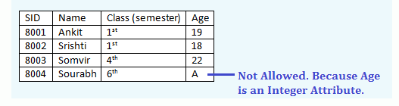
Domain Constraints –
Domain Constraints specifies that what set of values an attribute can take. Value of each attribute X must be an atomic value from the domain of X. The data type associated with domains include integer, character, date, time, currency etc. An attribute value must be available in the corresponding domain. Consider the example below –

Slide 5
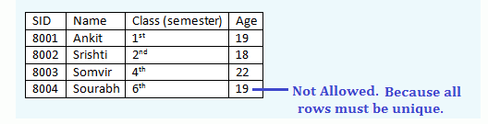
Tuple Uniqueness Constraints –
A relation is defined as a set of tuples. Suppose if in a relation, tuple uniqueness constraint is applied, then all the rows of that table must be unique i.e. it does not contain the duplicate values. For example,

Slide 6
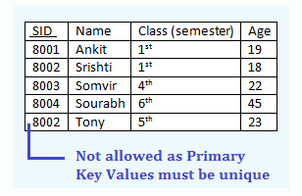
Key Constraints –
Keys are attributes or sets of attributes that uniquely identify an entity within its entity set. An Entity set E can have multiple keys out of which one key will be designated as the primary key. Primary Key must have unique and not null values in the relational table.
Example of Key Constraints in a simple relational table –

Slide 7
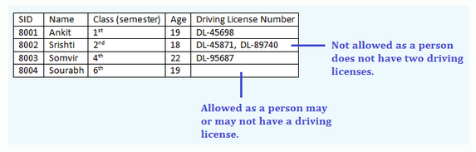
Single Value Constraints –
Single value constraints refers that each attribute of an entity set has a single value. If the value of an attribute is missing in a tuple, then we can fill it with a “null” value. The null value for a attribute will specify that either the value is not known or the value is not applicable. Consider the below example-

Slide 8
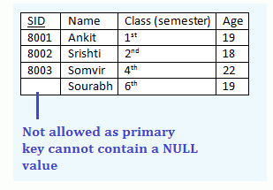
Integrity Rule 1 (Entity Integrity Rule or Constraint) –
The Integrity Rule 1 is also called Entity Integrity Rule or Constraint. This rule states that no attribute of primary key will contain a null value. If a relation have a null value in the primary key attribute, then uniqueness property of the primary key cannot be maintained. Consider the example below-

Slide 9
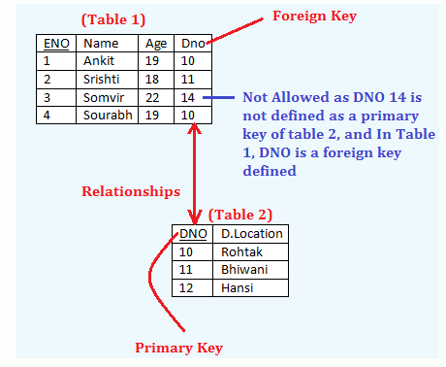
Integrity Rule 2 (Referential Integrity Rule or Constraint) –
The integrity Rule 2 is also called the Referential Integrity Constraints. This rule states that if a foreign key in Table 1 refers to the Primary Key of Table 2, then every value of the Foreign Key in Table 1 must be null or be available in Table 2. For example,

Slide 10
Some more Features of Foreign Key –
Let the table in which the foreign key is defined is Foreign Table or details table i.e. Table 1 in above example and the table that defines the primary key and is referenced by the foreign key is master table or primary table i.e. Table 2 in above example. Then the following properties must be hold :
Records cannot be inserted into a Foreign table if corresponding records in the master table do not exist.
Records of the master table or Primary Table cannot be deleted or updated if corresponding records in the foreign table actually exist.

Slide 11
General Constraints –
General constraints are the arbitrary constraints that should hold in the database. Domain Constraints, Key Constraints, Tuple Uniqueness Constraints, Single Value Constraints, Integrity Rule 1 (Entity Integrity) and 2 (Referential Integrity Constraints) are considered to be a fundamental part of the relational data model.
However, sometimes it is necessary to specify more general constraints like the CHECK Constraints or the Range Constraints etc.
Check constraints can ensure that only specific values are allowed in certain column. For example , if there is a need to allow only three values for the color like ‘Black’, ‘Grey’ and ‘White’, then we can apply the check constraint. All other values like ‘GREEN’ etc would yield an error.
Range Constraints is implemented by BETWEEN and NOT BETWEEN. For example, if it is a requirement that student ages be within 16 to 35, then we can apply the range constraints for it.

Slide 12
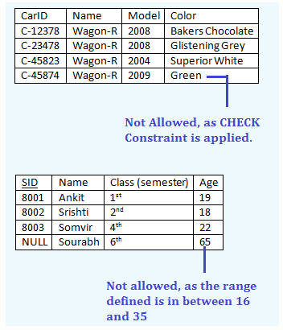
General Constraints –
The below example will explain Check Constraint and Range Constraint –

Slide 13
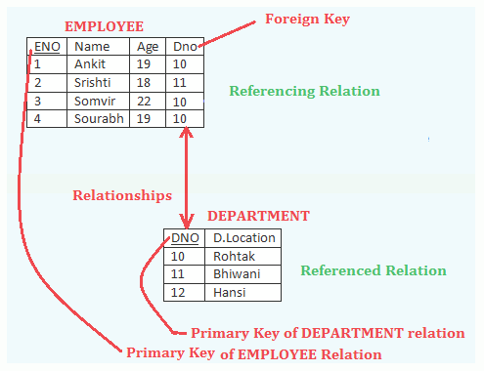
Database Operations and Constraint Violations in DBMS – The Insert Operation
Consider two existing relations named EMPLOYEE and DEPARTMENT.

Slide 14
Database Operations and Constraint Violations in DBMS – The Insert Operation
Some Basic Points about the Figure –
Here, ENO is a Primary Key and DNO is a Foreign Key in EMPLOYEE relation.
Table that contains primary key is called referenced relation and
The table containing foreign key is called referencing relation.
So, the relation DEPARTMENT is a referenced relation and
The relation EMPLOYEE is a referencing relation.

Slide 15
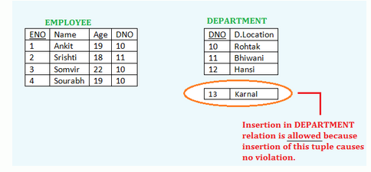
The Insert Operation :
Insertion in a Referenced Relation (DEPARTMENT) – If we insert a tuple in the referenced relation , then it causes no violation.
For example, Insertion of <13, ‘Karnal’> in DEPARTMENT relation is allowed because insertion of this tuple causes no violation.

Slide 16
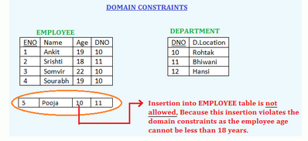
The Insert Operation :
2. Insertion in a Referencing Relation (EMPLOYEE) –
The insert operation in a referencing relation can violate any of four types of constraints –
(i) Domain Constraints –
Insertion of the value <5, ‘Pooja’, 10, 11> into EMPLOYEE table is not allowed, Because this insertion violates the domain constraints as the employee age cannot be less than 18 years.

Slide 17
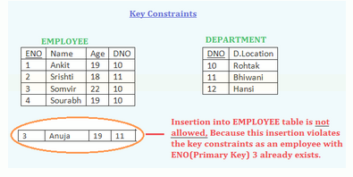
The Insert Operation :
(ii) Key Constraints –
Insertion of the value <3, ‘Anuja’, 19, 11> into EMPLOYEE table is not allowed, Because this insertion violates the key constraints as an employee with ENO(Primary Key) 3 already exists.

Slide 18
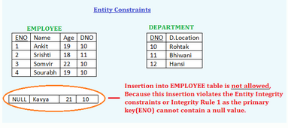
The Insert Operation :
(iii) Entity Constraints –
Insertion of the value <NULL, ‘Kavya’, 21, 10> into EMPLOYEE table is not allowed, Because this insertion violates the Entity Integrity constraints or Integrity Rule 1 as the primary key(ENO) cannot contain a null value.

Slide 19
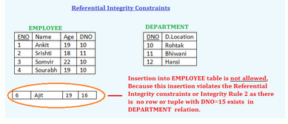
The Insert Operation :
(iv) Referential Integrity Constraints –
Insertion of the value <6, ‘Ajit’, 19, 16> into EMPLOYEE table is not allowed, Because this insertion violates the Referential Integrity constraints or Integrity Rule 2 as there is no row or tuple with DNO=15 exists in DEPARTMENT relation.

Slide 20
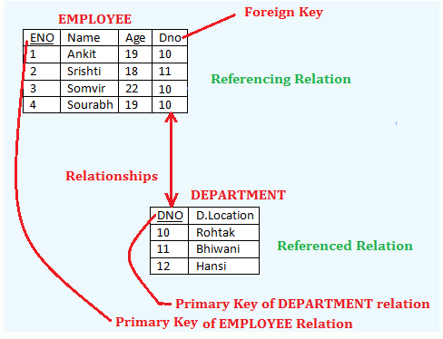
The Delete Operation :
Consider two existing relations named EMPLOYEE and DEPARTMENT. The Delete Operation violates only referential Integrity Constraints or Integrity Rule 2.

Slide 21
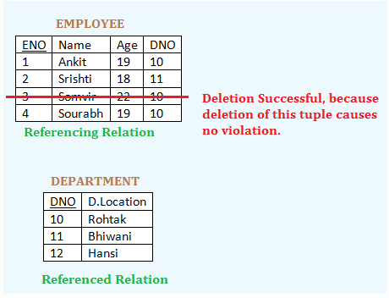
1. Deletion in a Referencing Relation (EMPLOYEE relation)
If we delete a tuple from the referencing relation, then it causes no violation. For example, Deletion of <3, ‘Somvir’, 22, 10> from EMPLOYEE relation is allowed because deletion of this tuple causes no violation.

Slide 22
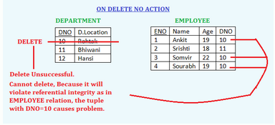
2. Deletion in a Referenced Relation (DEPARTMENT relation) –
There are three options available if a deletion causes violation :
i. Reject the Deletion – (ON DELETE NO ACTION) –
It prevents deleting a parent when there are children. It is the Default Constraint.
For example, Deletion of <10, ‘Rohtak’> from DEPARTMENT relation is not allowed because deletion of this tuple will violate referential integrity as in the EMPLOYEE relation, the tuple with DNO=10 causes problem. And therefore, reject the deletion.

Slide 23
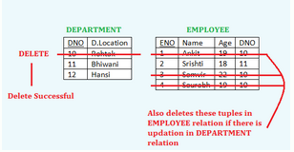
2. Deletion in a Referenced Relation (DEPARTMENT relation) –
ii. Cascade Deletion – (ON DELETE CASCADE) – If deletion causes integrity violation, then delete from both the table i.e. if the tuples are deleted from the referenced table, then the tuple will also be deleted from the referencing relation that is being deleted. For example, Deletion of <10, ‘Rohtak’> from DEPARTMENT relation will delete the following tuples in EMPLOYEE relation :
<1, ‘Ankit’, 19, 10>
<3, ‘Somvir’, 22, 10>
<4, ‘Sourabh’, 19, 10>

Slide 24
2. Deletion in a Referenced Relation (DEPARTMENT relation) –
iii. Modify the referencing Attributes – (ON DELETE SET NULL) sets null value or some valid value in the foreign key field for corresponding deleting referenced value. If there is no restriction or constraint applied for putting the NULL value in the referencing relation – then allow to delete from referenced relation otherwise prohibited.
For example, Deletion of <10, ‘Rohtak’> from DEPARTMENT relation will delete the following tuples in EMPLOYEE relation :
<1, ‘Ankit’, 19, 10>
<3, ‘Somvir’, 22, 10>
<4, ‘Sourabh’, 19, 10>
and null values will be filled in the EMPLOYEE relation on that place.

Slide 25
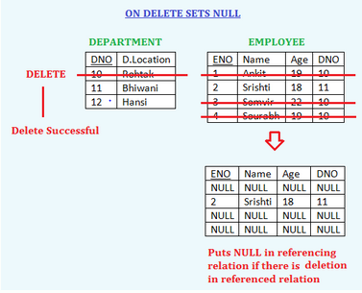
2. Deletion in a Referenced Relation (DEPARTMENT relation) –
So the relations will look like this :

Slide 26
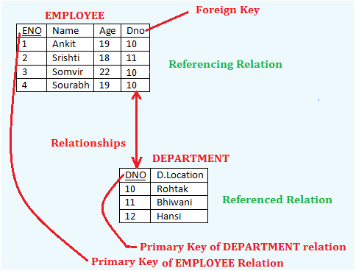
The Update Operation :
Consider two existing relations named EMPLOYEE and DEPARTMENT.
The update operation violates only referential Integrity Constraints or Integrity Rule 2

Slide 27
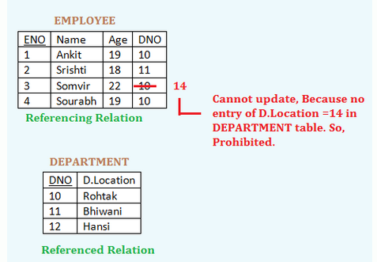
1. Updation in a referencing relation –
Updation of referencing attribute may cause referential integrity violation. The Updation is restricted if it causes violation.
For Example,

Slide 28
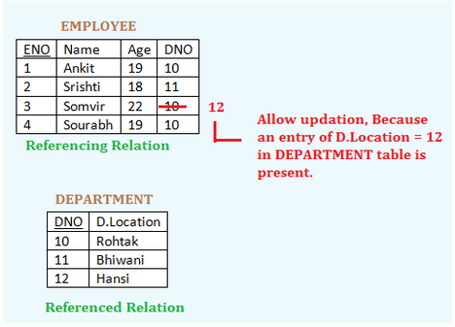
1. Updation in a referencing relation –
If there is no violation, then updation will be allowed.

Slide 29
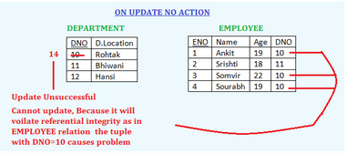
2. Updation in a referenced relation –
There are again three options available if an updation causes violation –
i. Reject the updation – (ON UPDATE NO ACTION) – It prevents updating a parent when there are children. It is the the Default Constraint. For example,

Slide 30
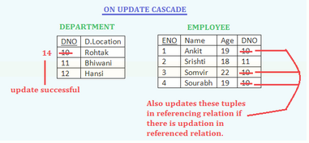
2. Updation in a referenced relation –
ii. Cascade Updation – (ON UPDATE CASCADE) – If updation causes integrity violation, then update in both the table i.e. if the tuples are updated from the referenced table, then the tuple will also be updates from the referencing relation that is being updated.

Slide 31
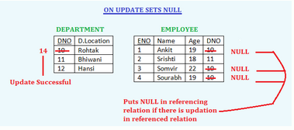
2. Updation in a referenced relation –
iii. Modify the referencing Attributes – (ON UPDATE SET NULL) – sets null value or some valid value in the foreign key field for corresponding updating referenced value. i.e. changing/updating the referencing attribute values that cause the violation either null or another valid value. If there is no restriction or constraint applied for putting the NULL value in the referencing relation – then allow to update from referenced relation otherwise prohibited.

