Slide 1
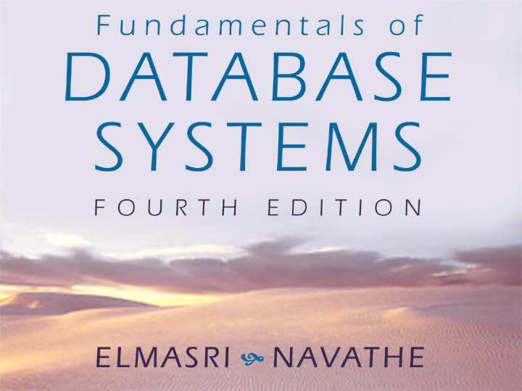

Slide 2

Chapter 6 The Relational Algebra and Calculus
Copyright © 2004 Ramez Elmasri and Shamkant Navathe

Slide 3
Chapter Outline
Example Database Application (COMPANY)
Relational Algebra
Unary Relational Operations
Relational Algebra Operations From Set Theory
Binary Relational Operations
Additional Relational Operations
Examples of Queries in Relational Algebra
Relational Calculus
Tuple Relational Calculus
Domain Relational Calculus
Overview of the QBE language (appendix D)

Slide 4
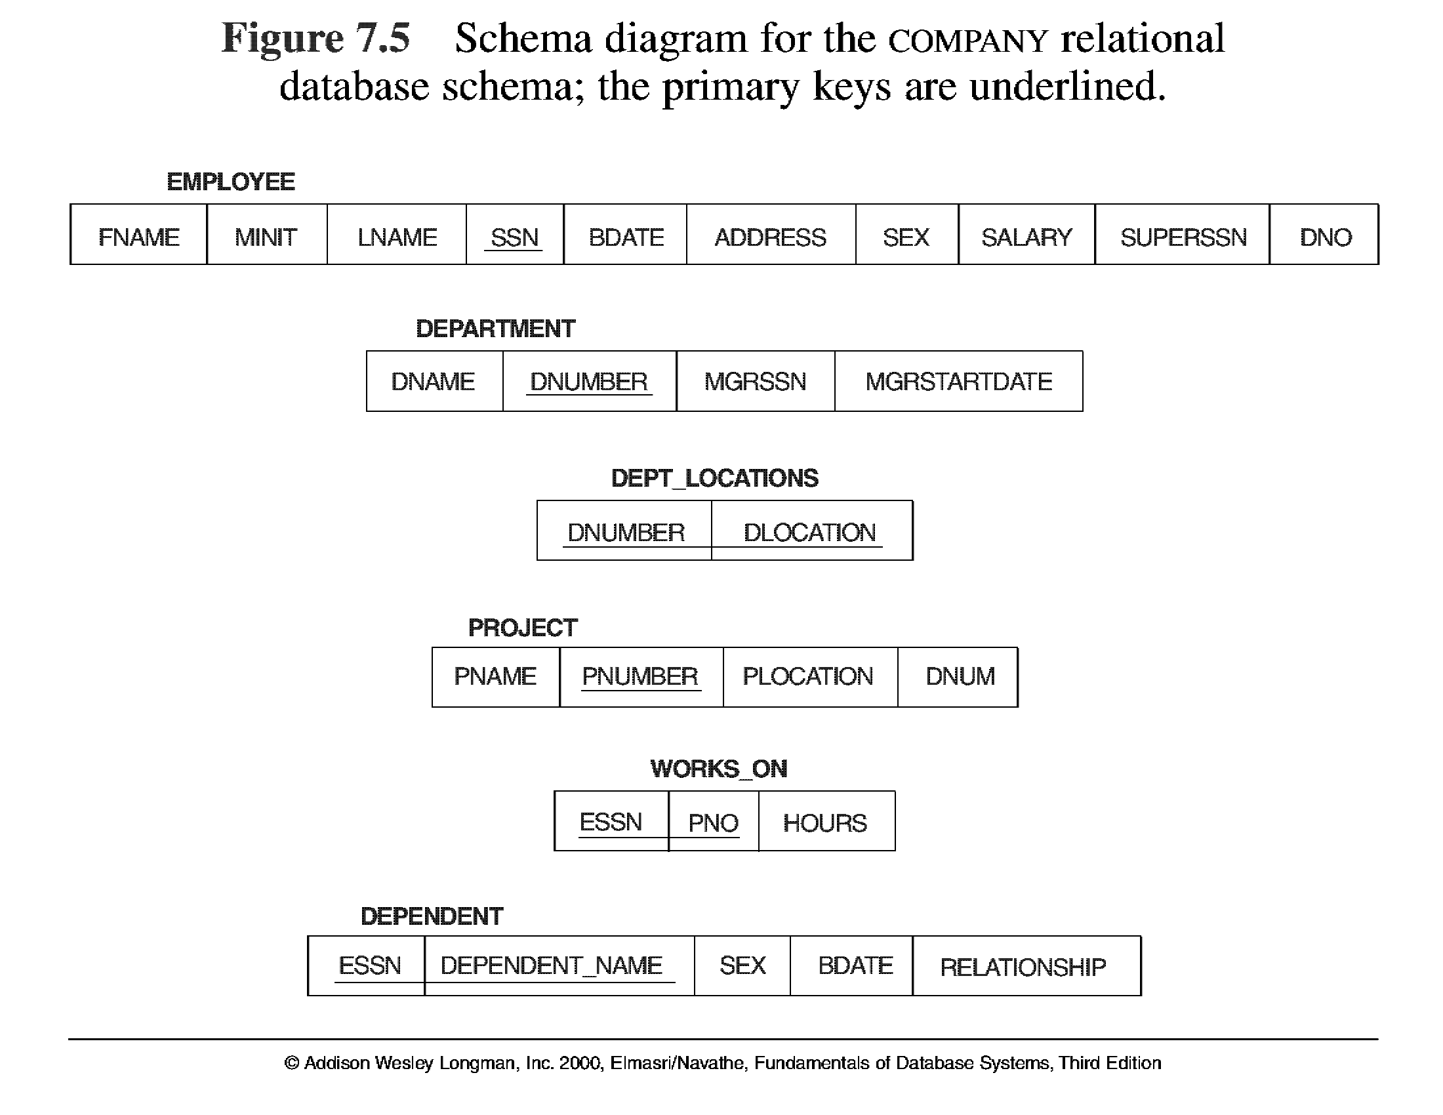
Database State for COMPANY
All examples discussed below refer to the COMPANY database shown here.

Slide 5
Relational Algebra
The basic set of operations for the relational model is known as the relational algebra. These operations enable a user to specify basic retrieval requests.
The result of a retrieval is a new relation, which may have been formed from one or more relations. The algebra operations thus produce new relations, which can be further manipulated using operations of the same algebra.
A sequence of relational algebra operations forms a relational algebra expression, whose result will also be a relation that represents the result of a database query (or retrieval request).

Slide 6
Unary Relational Operations
SELECT Operation
SELECT operation is used to select a subset of the tuples from a relation that satisfy a selection condition. It is a filter that keeps only those tuples that satisfy a qualifying condition – those satisfying the condition are selected while others are discarded.
Example: To select the EMPLOYEE tuples whose department number is four or those whose salary is greater than $30,000 the following notation is used:
σDNO = 4 (EMPLOYEE)
σSALARY > 30,000 (EMPLOYEE)
In general, the select operation is denoted by _{σ <selection condition>}(R) where the
symbol σ (sigma) is used to denote the select operator, and the selection condition is a Boolean expression specified on the attributes of relation R

Slide 7
Unary Relational Operations
SELECT Operation Properties
The SELECT operation σ _{<selection condition>}(R) produces a relation S that has the same schema as R
The SELECT operation σ is commutative; i.e.,
σ _{<condition1>}(σ _{< condition2>} ( R)) = σ _{<condition2>} (σ _{< condition1>} ( R))
A cascaded SELECT operation may be applied in any order; i.e.,
σ _{<condition1>}(σ _{< condition2>} (σ _{<condition3>} ( R))
= σ _{<condition2>} (σ _{< condition3>} (σ _{< condition1>} ( R)))
A cascaded SELECT operation may be replaced by a single selection with a conjunction of all the conditions; i.e.,
σ _{<condition1>}(σ _{< condition2>} (σ _{<condition3>} ( R))
= σ <condition1> AND < condition2> AND < condition3> ( R)))

Slide 8
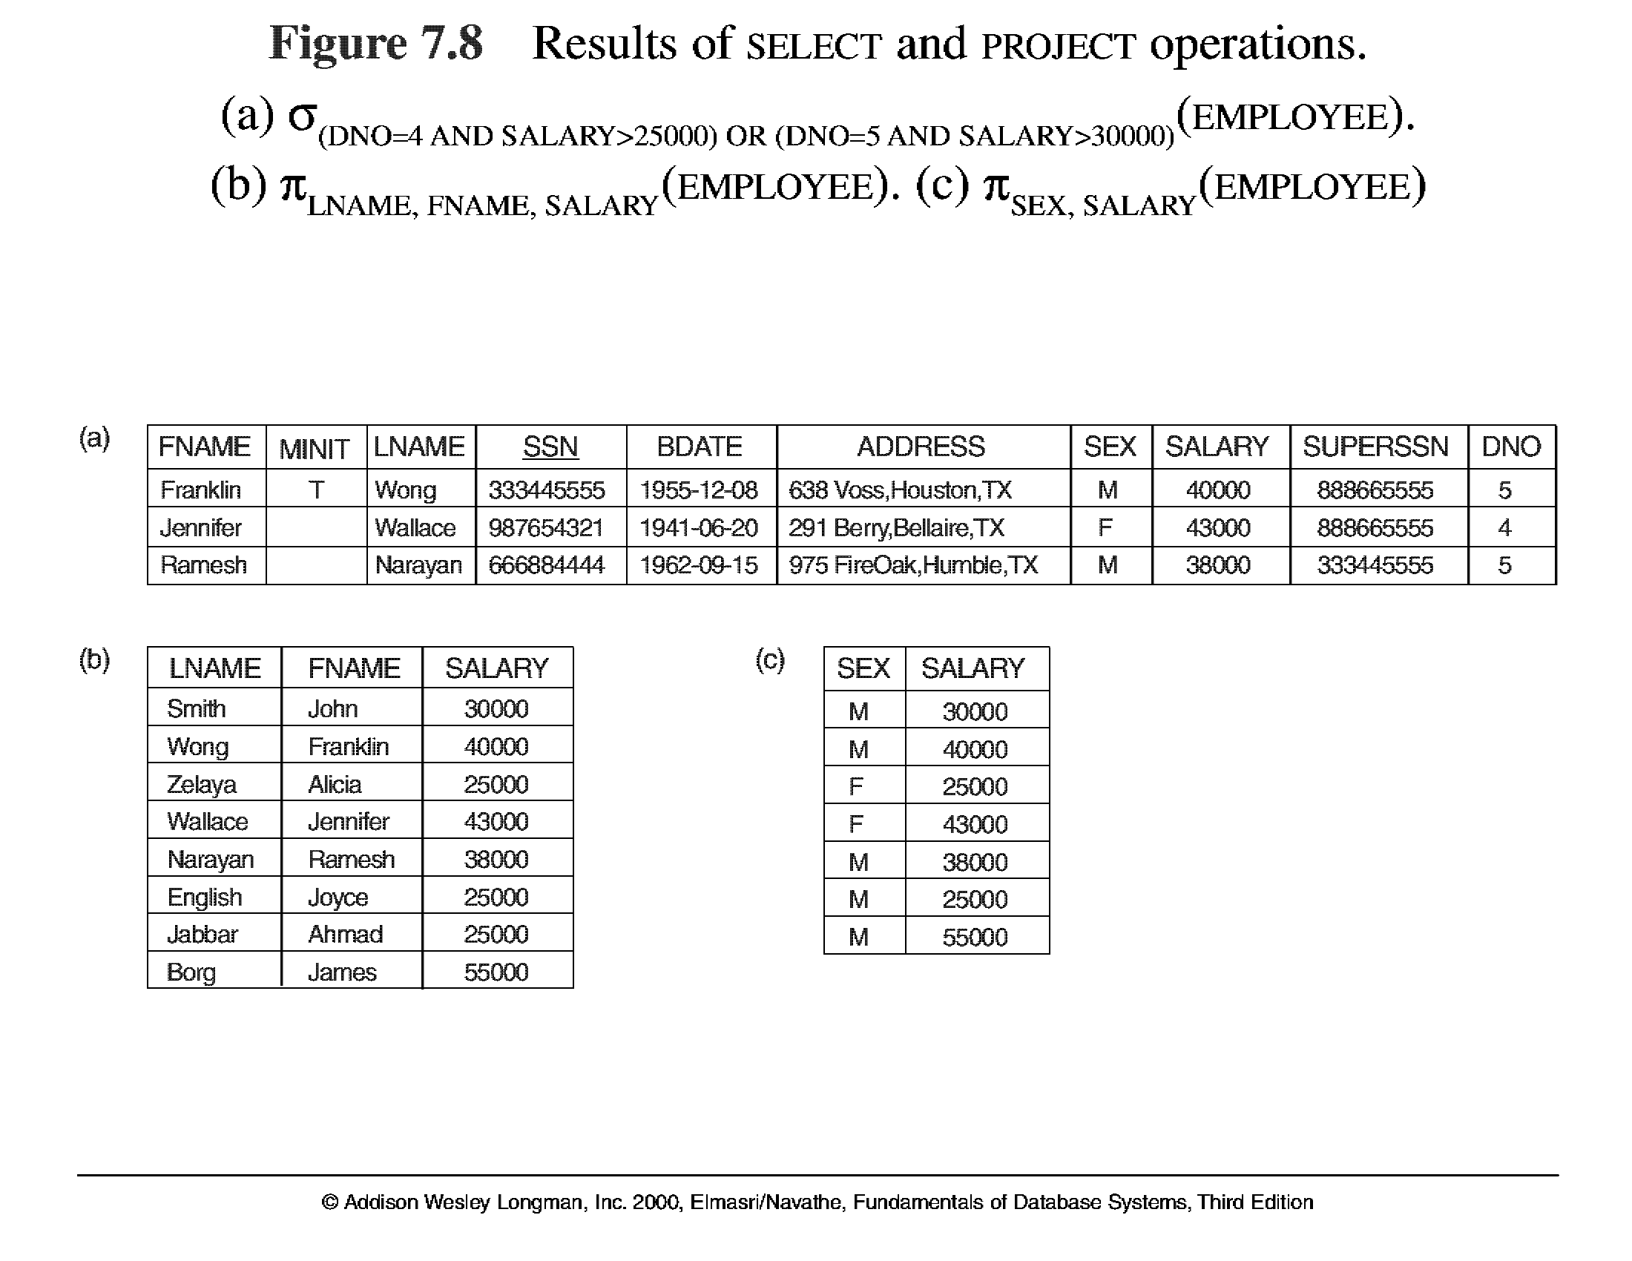
Unary Relational Operations (cont.)

Slide 9
Unary Relational Operations (cont.)
PROJECT Operation
This operation selects certain columns from the table and discards the other columns. The PROJECT creates a vertical partitioning – one with the needed columns (attributes) containing results of the operation and other containing the discarded Columns.
Example: To list each employee’s first and last name and salary, the following is used:
π_{LNAME, FNAME,SALARY}(EMPLOYEE)
The general form of the project operation is π<attribute list>(R) where π (pi) is the symbol used to represent the project operation and <attribute list> is the desired list of attributes from the attributes of relation R.
The project operation removes any duplicate tuples, so the result of the project operation is a set of tuples and hence a valid relation.

Slide 10
Unary Relational Operations (cont.)
PROJECT Operation Properties
The number of tuples in the result of projection π _{<list>} (R)is always less or equal to the number of tuples in R.
If the list of attributes includes a key of R, then the number of tuples is equal to the number of tuples in R.
π _{<list1>} (π _{<list2>} (R) ) = π _{<list1>} (R) as long as <list2> contains the attributes in <list2>

Slide 11
Unary Relational Operations (cont.)

Slide 12
Unary Relational Operations (cont.)
Rename Operation
We may want to apply several relational algebra operations one after the other. Either we can write the operations as a single relational algebra expression by nesting the operations, or we can apply one operation at a time and create intermediate result relations. In the latter case, we must give names to the relations that hold the intermediate results.
Example: To retrieve the first name, last name, and salary of all employees who work in department number 5, we must apply a select and a project operation. We can write a single relational algebra expression as follows:
π_{FNAME, LNAME, SALARY}(σ _{DNO=5}(EMPLOYEE))
OR We can explicitly show the sequence of operations, giving a name to each intermediate relation:
DEP5_EMPS ← σ _{DNO=5}(EMPLOYEE)
RESULT ← π _{FNAME, LNAME, SALARY} (DEP5_EMPS)

Slide 13
Unary Relational Operations (cont.)
Rename Operation (cont.)
The rename operator is ρ
The general Rename operation can be expressed by any of the following forms:
ρ _{S (B1, B2, …, Bn )} ( R) is a renamed relation S based on R with column names B₁, B₁, …..B_{n}.
ρ _{S} ( R) is a renamed relation S based on R (which does not specify column names).
ρ _{(B1, B2, …, Bn )} ( R) is a renamed relation with column names B₁, B₁, …..B_{n} which does not specify a new relation name.

Slide 14
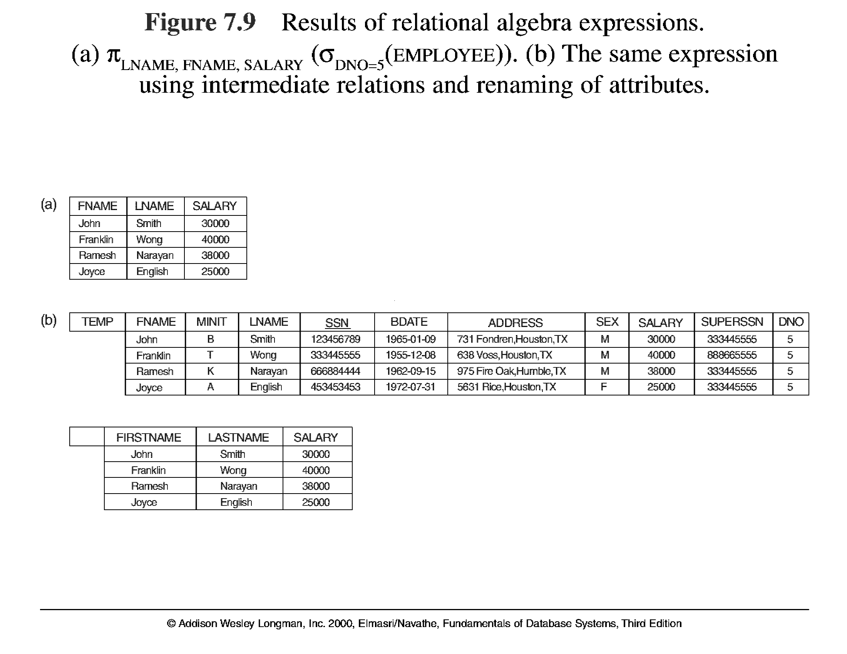
Unary Relational Operations (cont.)

Slide 15
Relational Algebra Operations From Set Theory
UNION Operation
The result of this operation, denoted by R ∪ S, is a relation that includes all tuples that are either in R or in S or in both R and S. Duplicate tuples are eliminated.
Example: To retrieve the social security numbers of all employees who either work in department 5 or directly supervise an employee who works in department 5, we can use the union operation as follows:
DEP5_EMPS ← σ_{DNO=5} (EMPLOYEE)
RESULT1 ← π _{SSN}(DEP5_EMPS)
RESULT2(SSN) ← π _{SUPERSSN}(DEP5_EMPS)
RESULT ← RESULT1 ∪ RESULT2
The union operation produces the tuples that are in either RESULT1 or RESULT2 or both. The two operands must be “type compatible”.

Slide 16
Relational Algebra Operations From Set Theory
Type Compatibility
The operand relations R₁(A₁, A₂, ..., A_{n}) and R₂(B₁, B₂, ..., B_{n}) must have the same number of attributes, and the domains of corresponding attributes must be compatible; that is, dom(A_{i})=dom(B_{i}) for i=1, 2, ..., n.
The resulting relation for R₁∪R₂,R₁ ∩ R₂, or R₁-R₂ has the same attribute names as the first operand relation R1 (by convention).

Slide 17
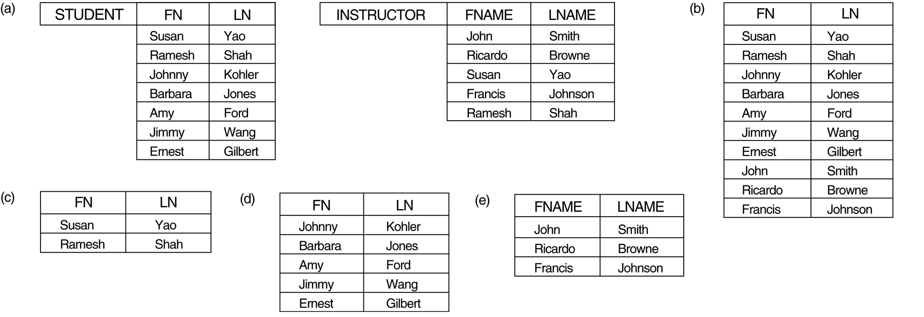
Relational Algebra Operations From Set Theory
UNION Example
STUDENT∪INSTRUCTOR

Slide 18
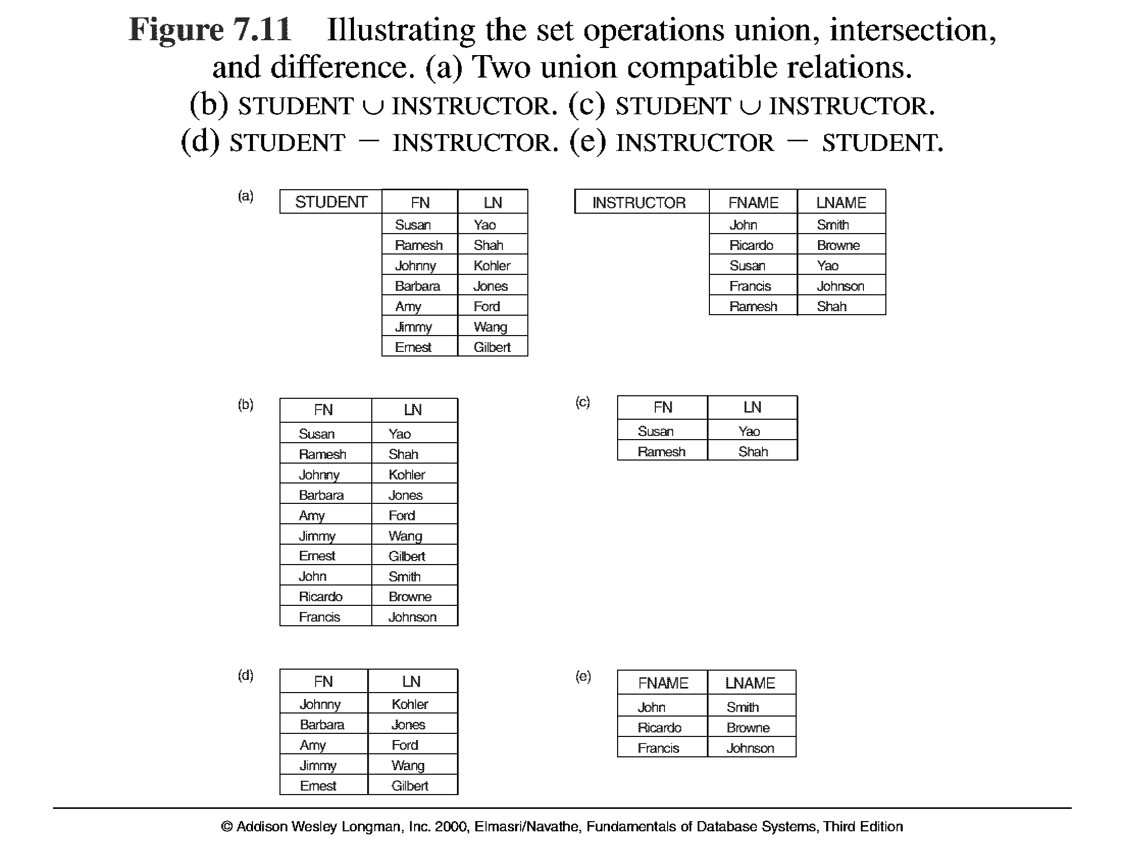
Relational Algebra Operations From Set Theory (cont.) – use Fig. 6.4

Slide 19
Relational Algebra Operations From Set Theory (cont.)
INTERSECTION OPERATION
The result of this operation, denoted by R ∩ S, is a relation that includes all tuples that are in both R and S. The two operands must be "type compatible"
Example: The result of the intersection operation (figure below) includes only those who are both students and instructors.
STUDENT ∩ INSTRUCTOR

Slide 20
Relational Algebra Operations From Set Theory (cont.)
Set Difference (or MINUS) Operation
The result of this operation, denoted by R - S, is a relation that includes all tuples that are in R but not in S. The two operands must be "type compatible”.
Example: The figure shows the names of students who are not instructors, and the names of instructors who are not students.
STUDENT-INSTRUCTOR
INSTRUCTOR-STUDENT

Slide 21
Relational Algebra Operations From Set Theory (cont.)
Notice that both union and intersection are commutative operations; that is
R ∪ S = S ∪ R, and R ∩ S = S ∩ R
Both union and intersection can be treated as n-ary operations applicable to any number of relations as both are associative operations; that is
R ∪ (S ∪ T) = (R ∪ S) ∪ T, and (R ∩ S) ∩ T = R ∩ (S ∩ T)
The minus operation is not commutative; that is, in general
R - S ≠ S – R

Slide 22
Relational Algebra Operations From Set Theory (cont.)
CARTESIAN (or cross product) Operation
This operation is used to combine tuples from two relations in a combinatorial fashion. In general, the result of R(A₁, A₂, . . ., A_{n}) x S(B₁, B₂, . . ., B_{m}) is a relation Q with degree n + m attributes Q(A₁, A₂, . . ., A_{n}, B₁, B₂, . . ., B_{m}), in that order. The resulting relation Q has one tuple for each combination of tuples—one from R and one from S.
Hence, if R has n_{R} tuples (denoted as |R| = n_{R} ), and S has n_{S} tuples, then
| R x S | will have n_{R} * n_{S} tuples.
The two operands do NOT have to be "type compatible”
Example:
FEMALE_EMPS ← σ _{SEX=’F’}(EMPLOYEE)
EMPNAMES ← π _{FNAME, LNAME, SSN} (FEMALE_EMPS)
EMP_DEPENDENTS ← EMPNAMES x DEPENDENT

Slide 23
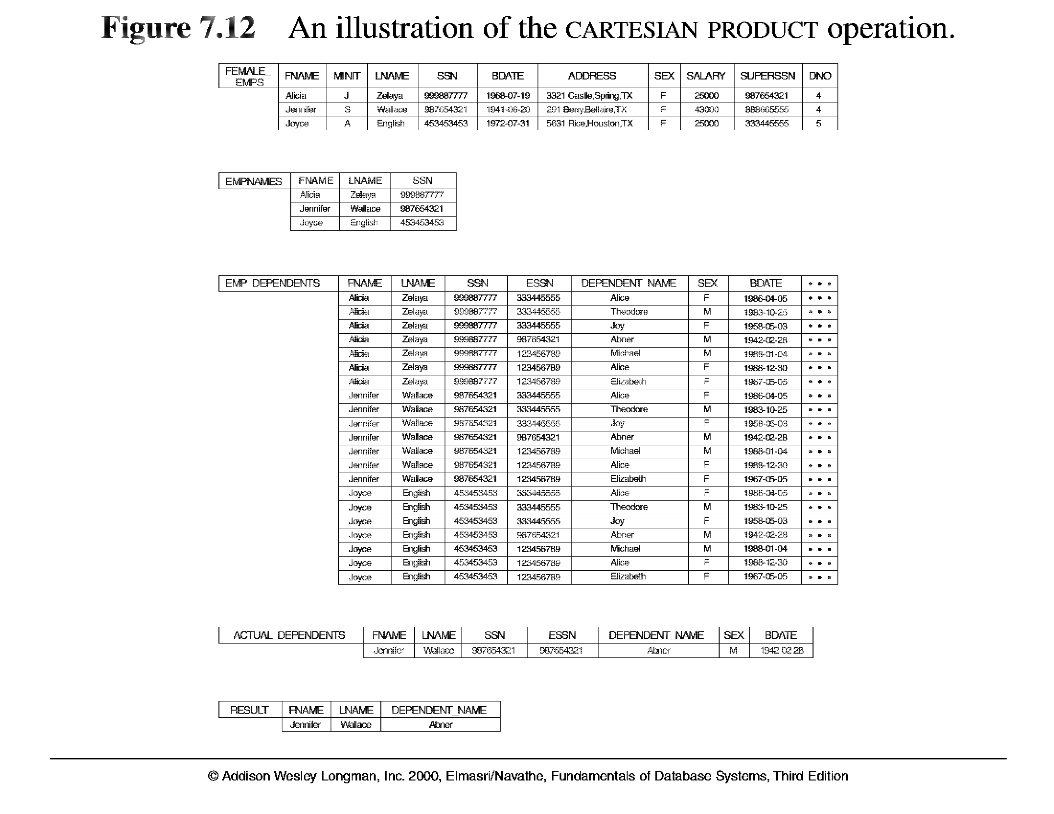
Relational Algebra Operations From Set Theory (cont.)

Slide 24
Binary Relational Operations
JOIN Operation
The sequence of cartesian product followed by select is used quite commonly to identify and select related tuples from two relations, a special operation, called JOIN. It is denoted by a
This operation is very important for any relational database with more than a single relation, because it allows us to process relationships among relations.
The general form of a join operation on two relations R(A₁, A₂, . . ., A_{n}) and S(B₁, B₂, . . ., B_{m}) is:
R _{<join condition>}S
where R and S can be any relations that result from general relational algebra expressions.

Slide 25
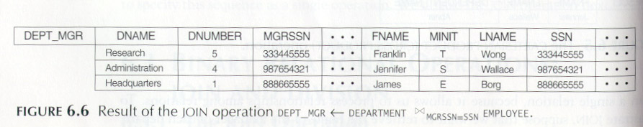
Binary Relational Operations (cont.)
Example: Suppose that we want to retrieve the name of the manager of each department. To get the manager’s name, we need to combine each DEPARTMENT tuple with the EMPLOYEE tuple whose SSN value matches the MGRSSN value in the department tuple. We do this by using the join operation.
DEPT_MGR ← DEPARTMENT _{MGRSSN=SSN} EMPLOYEE

Slide 26
Binary Relational Operations (cont.)
EQUIJOIN Operation
The most common use of join involves join conditions with equality comparisons only. Such a join, where the only comparison operator used is =, is called an EQUIJOIN. In the result of an EQUIJOIN we always have one or more pairs of attributes (whose names need not be identical) that have identical values in every tuple.
The JOIN seen in the previous example was EQUIJOIN.
NATURAL JOIN Operation
Because one of each pair of attributes with identical values is superfluous, a new operation called natural join—denoted by *—was created to get rid of the second (superfluous) attribute in an EQUIJOIN condition.
The standard definition of natural join requires that the two join attributes, or each pair of corresponding join attributes, have the same name in both relations. If this is not the case, a renaming operation is applied first.

Slide 27
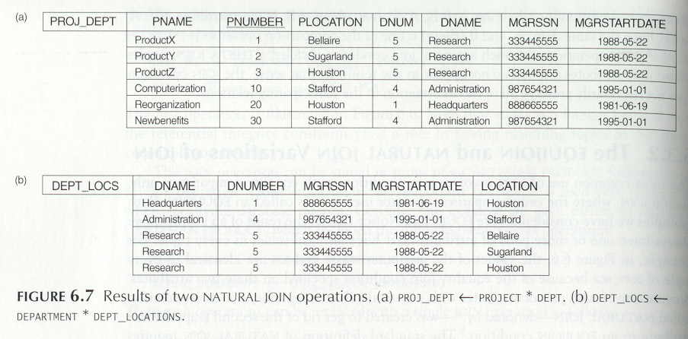
Binary Relational Operations (cont.)
Example: To apply a natural join on the DNUMBER attributes of DEPARTMENT and DEPT_LOCATIONS, it is sufficient to write:
DEPT_LOCS ← DEPARTMENT * DEPT_LOCATIONS

Slide 28
Complete Set of Relational Operations
The set of operations including select σ, project π , union ∪, set difference - , and cartesian product X is called a complete set because any other relational algebra expression can be expressed by a combination of these five operations.
For example:
R ∩ S = (R ∪ S ) – ((R − S) ∪ (S − R))
R _{<join condition>}S = σ _{<join condition>} (R X S)

Slide 29
Binary Relational Operations (cont.)
DIVISION Operation
The division operation is applied to two relations
R(Z) ÷ S(X), where X subset Z. Let Y = Z - X (and hence Z = X ∪ Y); that is, let Y be the set of attributes of R that are not attributes of S.
The result of DIVISION is a relation T(Y) that includes a tuple t if tuples t_{R} appear in R with t_{R} [Y] = t, and with
t_{R} [X] = t_{s} for every tuple t_{s} in S.
For a tuple t to appear in the result T of the DIVISION, the values in t must appear in R in combination with every tuple in S.

Slide 30
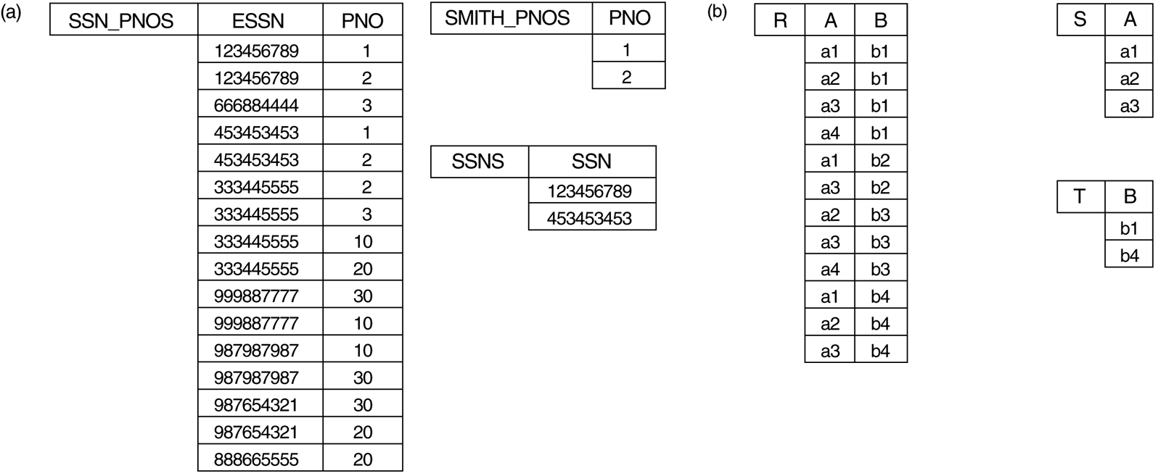
Binary Relational Operations (cont.)

Slide 31
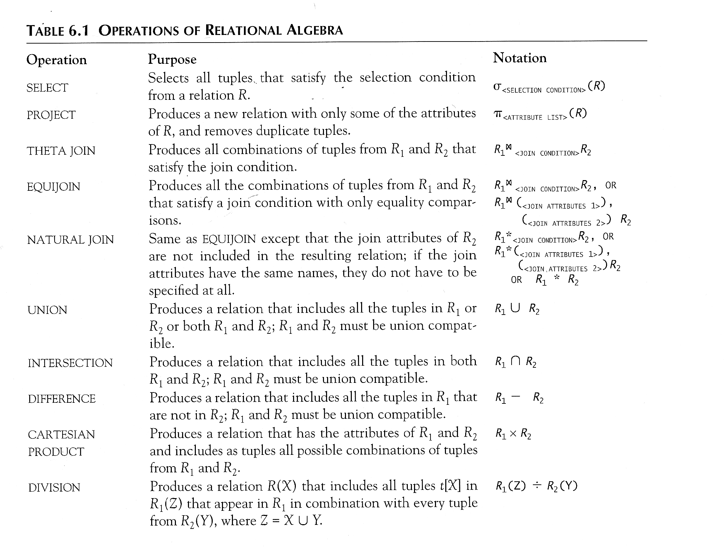
Recap of Relational Algebra Operations

Slide 32
Additional Relational Operations
Aggregate Functions and Grouping
A type of request that cannot be expressed in the basic relational algebra is to specify mathematical aggregate functions on collections of values from the database.
Examples of such functions include retrieving the average or total salary of all employees or the total number of employee tuples. These functions are used in simple statistical queries that summarize information from the database tuples.
Common functions applied to collections of numeric values include SUM, AVERAGE, MAXIMUM, and MINIMUM. The COUNT function is used for counting tuples or values.

Slide 33
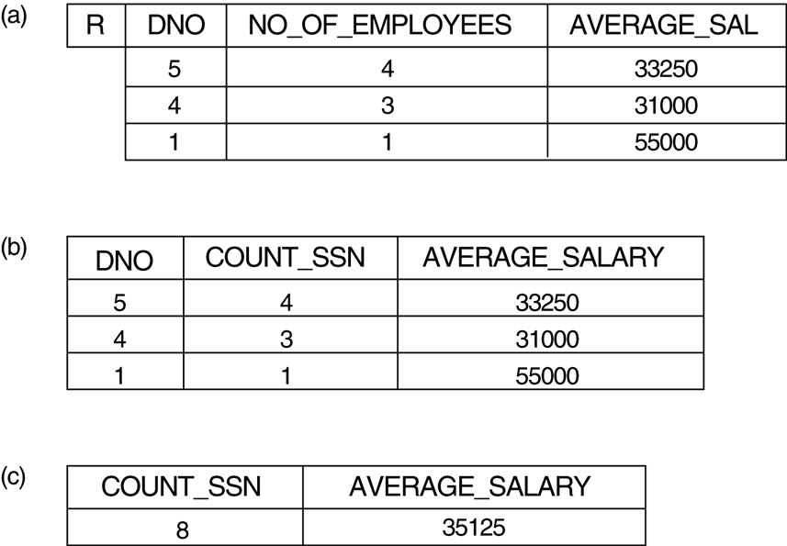
Additional Relational Operations (cont.)

Slide 34
Additional Relational Operations (cont.)
Use of the Functional operator ℱ
ℱ_{MAX Salary} (Employee) retrieves the maximum salary value from the Employee relation
ℱ_{MIN Salary} (Employee) retrieves the minimum Salary value from the Employee relation
ℱ_{SUM Salary} (Employee) retrieves the sum of the Salary from the Employee relation
_{DNO} ℱ_{COUNT SSN, AVERAGE Salary} (Employee) groups employees by DNO (department number) and computes the count of employees and average salary per department.[ Note: count just counts the number of rows, without removing duplicates]

Slide 35
Additional Relational Operations (cont.)
Recursive Closure Operations
Another type of operation that, in general, cannot be specified in the basic original relational algebra is recursive closure. This operation is applied to a recursive relationship.
An example of a recursive operation is to retrieve all SUPERVISEES of an EMPLOYEE e at all levels—that is, all EMPLOYEE e’ directly supervised by e; all employees e’’ directly supervised by each employee e’; all employees e’’’ directly supervised by each employee e’’; and so on .
Although it is possible to retrieve employees at each level and then take their union, we cannot, in general, specify a query such as “retrieve the supervisees of ‘James Borg’ at all levels” without utilizing a looping mechanism.
The SQL3 standard includes syntax for recursive closure.

Slide 36
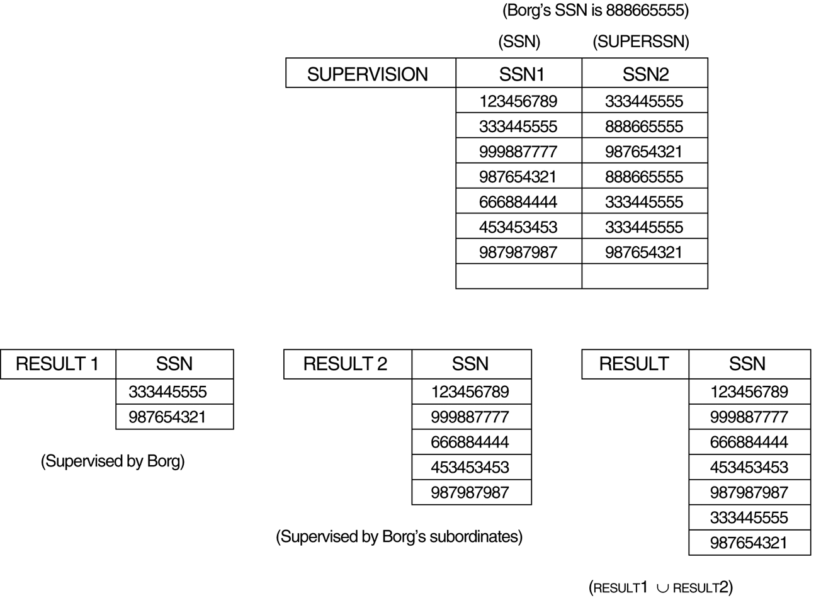
Additional Relational Operations (cont.)

Slide 37
Additional Relational Operations (cont.)
The OUTER JOIN Operation
In NATURAL JOIN tuples without a matching (or related) tuple are eliminated from the join result. Tuples with null in the join attributes are also eliminated. This amounts to loss of information.
A set of operations, called outer joins, can be used when we want to keep all the tuples in R, or all those in S, or all those in both relations in the result of the join, regardless of whether or not they have matching tuples in the other relation.
The left outer join operation keeps every tuple in the first or left relation R in R S; if no matching tuple is found in S, then the attributes of S in the join result are filled or “padded” with null values.
A similar operation, right outer join, keeps every tuple in the second or right relation S in the result of R S.
A third operation, full outer join, denoted by keeps all tuples in both the left and the right relations when no matching tuples are found, padding them with null values as needed.

Slide 38
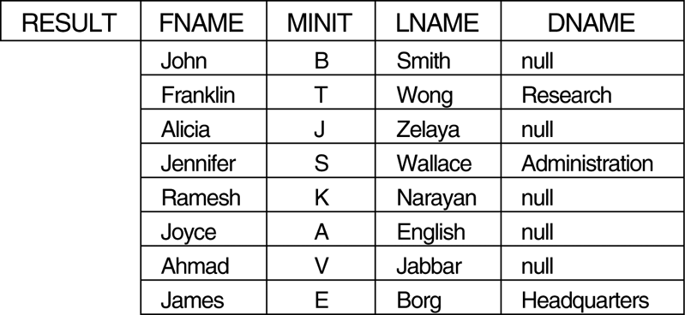
Additional Relational Operations (cont.)

Slide 39
Additional Relational Operations (cont.)
OUTER UNION Operations
The outer union operation was developed to take the union of tuples from two relations if the relations are not union compatible.
This operation will take the union of tuples in two relations R(X, Y) and S(X, Z) that are partially compatible, meaning that only some of their attributes, say X, are union compatible.
The attributes that are union compatible are represented only once in the result, and those attributes that are not union compatible from either relation are also kept in the result relation T(X, Y, Z).
Example: An outer union can be applied to two relations whose schemas are STUDENT(Name, SSN, Department, Advisor) and INSTRUCTOR(Name, SSN, Department, Rank). Tuples from the two relations are matched based on having the same combination of values of the shared attributes—Name, SSN, Department. If a student is also an instructor, both Advisor and Rank will have a value; otherwise, one of these two attributes will be null.
The result relation STUDENT_OR_INSTRUCTOR will have the following attributes:
STUDENT_OR_INSTRUCTOR (Name, SSN, Department, Advisor, Rank)

Slide 40
Examples of Queries in Relational Algebra
Q1: Retrieve the name and address of all employees who work for the ‘Research’ department.
RESEARCH_DEPT ← σ DNAME=’Research’ (DEPARTMENT)
RESEARCH_EMPS ← (RESEARCH_DEPT _{DNUMBER= DNOEMPLOYEE}EMPLOYEE)
RESULT ← π FNAME, LNAME, ADDRESS (RESEARCH_EMPS)
Q6: Retrieve the names of employees who have no dependents.
ALL_EMPS ← π SSN(EMPLOYEE)
EMPS_WITH_DEPS(SSN) ← π ESSN(DEPENDENT)
EMPS_WITHOUT_DEPS ← (ALL_EMPS - EMPS_WITH_DEPS)
RESULT ← π LNAME, FNAME (EMPS_WITHOUT_DEPS * EMPLOYEE)

Slide 41
Relational Calculus
A relational calculus expression creates a new relation, which is specified in terms of variables that range over rows of the stored database relations (in tuple calculus) or over columns of the stored relations (in domain calculus).
In a calculus expression, there is no order of operations to specify how to retrieve the query result—a calculus expression specifies only what information the result should contain. This is the main distinguishing feature between relational algebra and relational calculus.
Relational calculus is considered to be a nonprocedural language. This differs from relational algebra, where we must write a sequence of operations to specify a retrieval request; hence relational algebra can be considered as a procedural way of stating a query.

Slide 42
Tuple Relational Calculus
The tuple relational calculus is based on specifying a number of tuple variables. Each tuple variable usually ranges over a particular database relation, meaning that the variable may take as its value any individual tuple from that relation.
A simple tuple relational calculus query is of the form
{t | COND(t)}
where t is a tuple variable and COND (t) is a conditional expression involving t. The result of such a query is the set of all tuples t that satisfy COND (t).
Example: To find the first and last names of all employees whose salary is above $50,000, we can write the following tuple calculus expression:
{t.FNAME, t.LNAME | EMPLOYEE(t) AND t.SALARY>50000}
The condition EMPLOYEE(t) specifies that the range relation of tuple variable t is EMPLOYEE. The first and last name (PROJECTION π_{FNAME, LNAME}) of each EMPLOYEE tuple t that satisfies the condition t.SALARY>50000 (SELECTION
σ _{SALARY >50000}) will be retrieved.

Slide 43
The Existential and Universal Quantifiers
Two special symbols called quantifiers can appear in formulas; these are the universal quantifier (∀) and the existential quantifier (∃).
Informally, a tuple variable t is bound if it is quantified, meaning that it appears in an (∀ t) or (∃ t) clause; otherwise, it is free.
If F is a formula, then so is (∃ t)(F), where t is a tuple variable. The formula (∃ t)(F) is true if the formula F evaluates to true for some (at least one) tuple assigned to free occurrences of t in F; otherwise (∃ t)(F) is false.
If F is a formula, then so is (∀ t)(F), where t is a tuple variable. The formula (∀ t)(F) is true if the formula F evaluates to true for every tuple (in the universe) assigned to free occurrences of t in F; otherwise (∀ t)(F) is false.
It is called the universal or “for all” quantifier because every tuple in “the universe of” tuples must make F true to make the quantified formula true.

Slide 44
Example Query Using Existential Quantifier
Retrieve the name and address of all employees who work for the ‘Research’ department.
Query :
{t.FNAME, t.LNAME, t.ADDRESS | EMPLOYEE(t) and (∃ d) (DEPARTMENT(d) and d.DNAME=‘Research’ and d.DNUMBER=t.DNO) }
The only free tuple variables in a relational calculus expression should be those that appear to the left of the bar ( | ). In above query, t is the only free variable; it is then bound successively to each tuple. If a tuple satisfies the conditions specified in the query, the attributes FNAME, LNAME, and ADDRESS are retrieved for each such tuple.
The conditions EMPLOYEE (t) and DEPARTMENT(d) specify the range relations for t and d. The condition d.DNAME = ‘Research’ is a selection condition and corresponds to a SELECT operation in the relational algebra, whereas the condition d.DNUMBER = t.DNO is a JOIN condition.

Slide 45
Example Query Using Universal Quantifier
Find the names of employees who work on all the projects controlled by department number 5.
Query :
{e.LNAME, e.FNAME | EMPLOYEE(e) and ( (∀ x)(not(PROJECT(x)) or not(x.DNUM=5)
OR ( (∃ w)(WORKS_ON(w) and w.ESSN=e.SSN and x.PNUMBER=w.PNO) ) ) )}
Exclude from the universal quantification all tuples that we are not interested in by making the condition true for all such tuples. The first tuples to exclude (by making them evaluate automatically to true) are those that are not in the relation R of interest.
In query above, using the expression not(PROJECT(x)) inside the universally quantified formula evaluates to true all tuples x that are not in the PROJECT relation. Then we exclude the tuples we are not interested in from R itself. The expression not(x.DNUM=5) evaluates to true all tuples x that are in the project relation but are not controlled by department 5.
Finally, we specify a condition that must hold on all the remaining tuples in R.
( (∃ w)(WORKS_ON(w) and w.ESSN=e.SSN and x.PNUMBER=w.PNO)

Slide 46
Languages Based on Tuple Relational Calculus
The language SQL is based on tuple calculus. It uses the basic
SELECT <list of attributes>
FROM <list of relations>
WHERE <conditions>
block structure to express the queries in tuple calculus where the SELECT clause mentions the attributes being projected, the FROM clause mentions the relations needed in the query, and the WHERE clause mentions the selection as well as the join conditions.
SQL syntax is expanded further to accommodate other operations. (See Chapter 8).
Another language which is based on tuple calculus is QUEL which actually uses the range variables as in tuple calculus.
Its syntax includes:
RANGE OF <variable name> IS <relation name>
Then it uses
RETRIEVE <list of attributes from range variables>
WHERE <conditions>
This language was proposed in the relational DBMS INGRES.

Slide 47
The Domain Relational Calculus
Another variation of relational calculus called the domain relational calculus, or simply, domain calculus is equivalent to tuple calculus and to relational algebra.
The language called QBE (Query-By-Example) that is related to domain calculus was developed almost concurrently to SQL at IBM Research, Yorktown Heights, New York. Domain calculus was thought of as a way to explain what QBE does.
Domain calculus differs from tuple calculus in the type of variables used in formulas: rather than having variables range over tuples, the variables range over single values from domains of attributes. To form a relation of degree n for a query result, we must have n of these domain variables—one for each attribute.
An expression of the domain calculus is of the form
{x1, x2, . . ., xn | COND(x1, x2, . . ., xn, xn+1, xn+2, . . ., xn+m)}
where x1, x2, . . ., xn, xn+1, xn+2, . . ., xn+m are domain variables that range over domains (of attributes) and COND is a condition or formula of the domain relational calculus.

Slide 48
Example Query Using Domain Calculus
Retrieve the birthdate and address of the employee whose name is ‘John B. Smith’.
Query :
{uv | (∃ q) (∃ r) (∃ s) (∃ t) (∃ w) (∃ x) (∃ y) (∃ z)
(EMPLOYEE(qrstuvwxyz) and q=’John’ and r=’B’ and s=’Smith’)}
Ten variables for the employee relation are needed, one to range over the domain of each attribute in order. Of the ten variables q, r, s, . . ., z, only u and v are free.
Specify the requested attributes, BDATE and ADDRESS, by the free domain variables u for BDATE and v for ADDRESS.
Specify the condition for selecting a tuple following the bar ( | )—namely, that the sequence of values assigned to the variables qrstuvwxyz be a tuple of the employee relation and that the values for q (FNAME), r (MINIT), and s (LNAME) be ‘John’, ‘B’, and ‘Smith’, respectively.

Slide 49
QBE: A Query Language Based on Domain Calculus (Appendix D)
This language is based on the idea of giving an example of a query using example elements.
An example element stands for a domain variable and is specified as an example value preceded by the underscore character.
P. (called P dot) operator (for “print”) is placed in those columns which are requested for the result of the query.
A user may initially start giving actual values as examples, but later can get used to providing a minimum number of variables as example elements.
The language is very user-friendly, because it uses minimal syntax.
QBE was fully developed further with facilities for grouping, aggregation, updating etc. and is shown to be equivalent to SQL.
The language is available under QMF (Query Management Facility) of DB2 of IBM and has been used in various ways by other products like ACCESS of Microsoft, PARADOX.
For details, see Appendix D in the text.

Slide 50
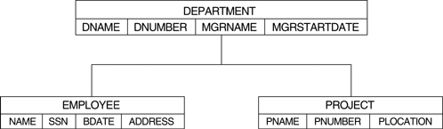
QBE Examples
QBE initially presents a relational schema as a “blank schema” in which the user fills in the query as an example:

Slide 51
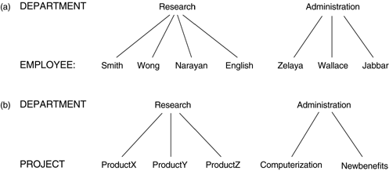
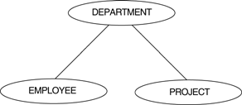
QBE Examples
The following domain calculus query can be successively minimized by the user as shown:
Query :
{uv | (∃ q) (∃ r) (∃ s) (∃ t) (∃ w) (∃ x) (∃ y) (∃ z)
(EMPLOYEE(qrstuvwxyz) and q=’John’ and r=’B’ and s=’Smith’)}

Slide 52
QBE Examples
Specifying complex cinditions in QBE:
A technique called the “condition box” is used in QBE to state more involved Boolean expressions as conditions.
The D.4(a) gives employees who work on either project 1 or 2, whereas the query in D.4(b) gives those who work on both the projects.

Slide 53
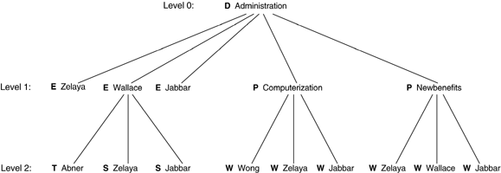
QBE Examples
Illustrating join in QBE. The join is simple accomplished by using the same example element in the columns being joined. Note that the Result is set us as an independent table.

