Slide 1
CAP Theorem
Introduction
The CAP theorem is a tool used to makes system designers aware of the trade-offs while designing networked shared-data systems. CAP has influenced the design of many distributed data systems. It made designers aware of a wide range of tradeoffs to consider while designing distributed data systems.

Slide 2
CAP Theorem
Availability and Consistency
The theorem states that networked shared-data systems can only guarantee/strongly support two of the following three properties:
Consistency - All the replicas are in sync and maintain the same state of any given object at any given point of time. Also known as sequential consistency.
Availability - A request will eventually complete successfully. A read/write request on any node of the system will never be rejected as long as the particular node is up and running.
Network Partition Tolerance - When the network connecting the nodes goes down, the system will still continue to operate even though some/all nodes can longer communicate with each other.

Slide 3
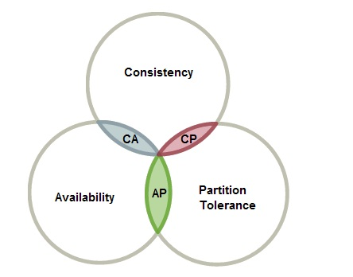
CAP Theorem
Availability and Consistency
According to CAP theorem it is impossible for a distributed system to simultaneously provide all three guarantees:

Slide 4
CAP Theorem
CAP theorem categorizes
The CAP theorem categorizes systems into three categories:
CP (Consistent and Partition Tolerant) - The CP category is confusing, i.e., a system that is consistent and partition tolerant but never available. CP is referring to a category of systems where availability is sacrificed only in the case of a network partition.
CA (Consistent and Available) - CA systems are consistent and available systems in the absence of any network partition. Often a single node's DB servers are categorized as CA systems. Single node DB servers do not need to deal with partition tolerance and are thus considered CA systems. The only hole in this theory is that single node DB systems are not a network of shared data systems and thus do not fall under the preview of CAP.
AP (Available and Partition Tolerant) - These are systems that are available and partition tolerant but cannot guarantee consistency.

Slide 5
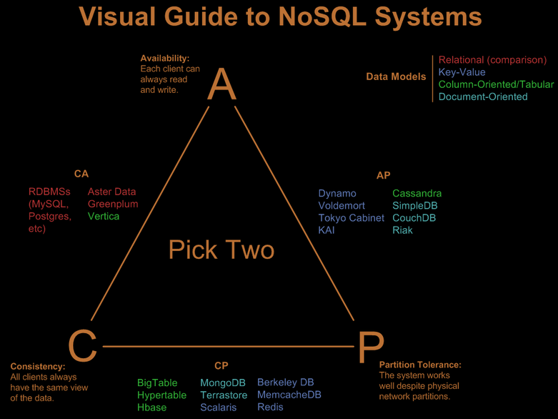
CAP Theorem
CAP theorem categorizes

