Slide 1
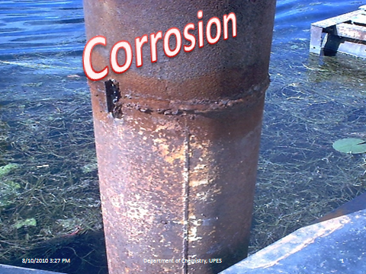
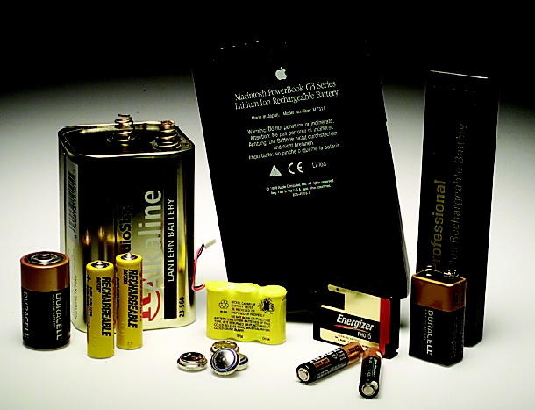
ELECTROCHEMISTRY
Presented by
Dept., of Chemistry
University of Petroleum & Energy Studies
(Premier Domain Specific University in India)
Dehradun,
Notes:
To play the movies and simulations included, view the presentation in Slide Show Mode.

Slide 2

Contents
Conductance
Kohlrausch law
Transport Number
Galvanic cells
ECS
Nernst Equation
Instrumental titrations

Slide 3
Conductance
Electrolytic conductance
Specific conductance
Learning points
Molar conductance
Equivalent conductance
Effect of dilution
Numericals

Slide 4
Conductance
Ease with which electricity flows through a solution.
Dependence:
Number of ions
Mobility of ions

Slide 5
Electrolytic conductance
Conductance of an electrolytic solution.
C = 1/R
Units: ohm⁻¹ or Siemen (S)
Effect of dilution: It increases.

Slide 6
Specific conductance
Conductance / unit volume
κ = 1/ρ = C.l/A
Units: Ω⁻¹cm⁻¹
Effect of dilution: It decreases.
Specific conductanceof N/50 KCl = 0.002765ohm-1cm-1

Slide 7
Molar conductance
Conductance of all the ions present in one mole of electrolyte in the solution.
λ_{m} = κ.V = 1000 κ / C
Units: Ω⁻¹cm²mole⁻¹
Effect on dilution: It increases.

Slide 8
Equivalent conductance
Conductance of all the ions present in one gram equivalent of electrolyte in the solution.
λ_{eq} = κ.V = 1000 κ / C
Units: Ω⁻¹cm²equivalent⁻¹
Effect on dilution: It increases.

Slide 9
Cell constant
x = l/A
x = Observed resistance / Specific resistance
x = Specific conductance / Observed conductance
Units: cm⁻¹

Slide 10
Degree of dissociation
Equivalent conductance at any dilution
Equivalent conductance at infinite dilution
λ_{c}
α =
λ∞
Strong electrolyte
α
Weak electrolyte
dilution

Slide 11
Kohlrausch law
λ∞ = λ₊ + λ_
Applications:
Calculation of absolute ionic mobility.
Determination of solubility of sparingly soluble salt.

Slide 12
Problems
Specific conductance of a decimolar solution of KCl at 18ºC is 1.12 Sm⁻¹. The resistance of a conductivity cell containing the solution at 18ºC was found to be 55 ohm. What is the cell constant?
The resistance of 0.01M solution of an electrolyte was found to be 210 ohm at 25ºC. Calculate the molar conductance of the solution at 25ºC. Cell constant is 0.88 cm⁻¹.
Answers
1. 0.616 m⁻¹ 2. 0.0419 Sm²mole⁻¹

Slide 13
Transport number
The transport number, is the fraction of total current carried by the ions of a specific type. For a solution of two kinds of ions, the transport numbers of the cations (t₊) and anions (t₋) are
t₊ = I₊/I
t₋ = I-/I
Determination:
Hittorf Method
Moving Boundary Method

Slide 14
Hittorf Method
Principle: The fall in concentration around any electrode is directly proportional to the speed of ion moving away from it.
T_{c} = Vc
Vc + Va
T_{a} = Va
Vc + Va
Where, Vc= speed of cation
Va= speed of anion

Slide 15
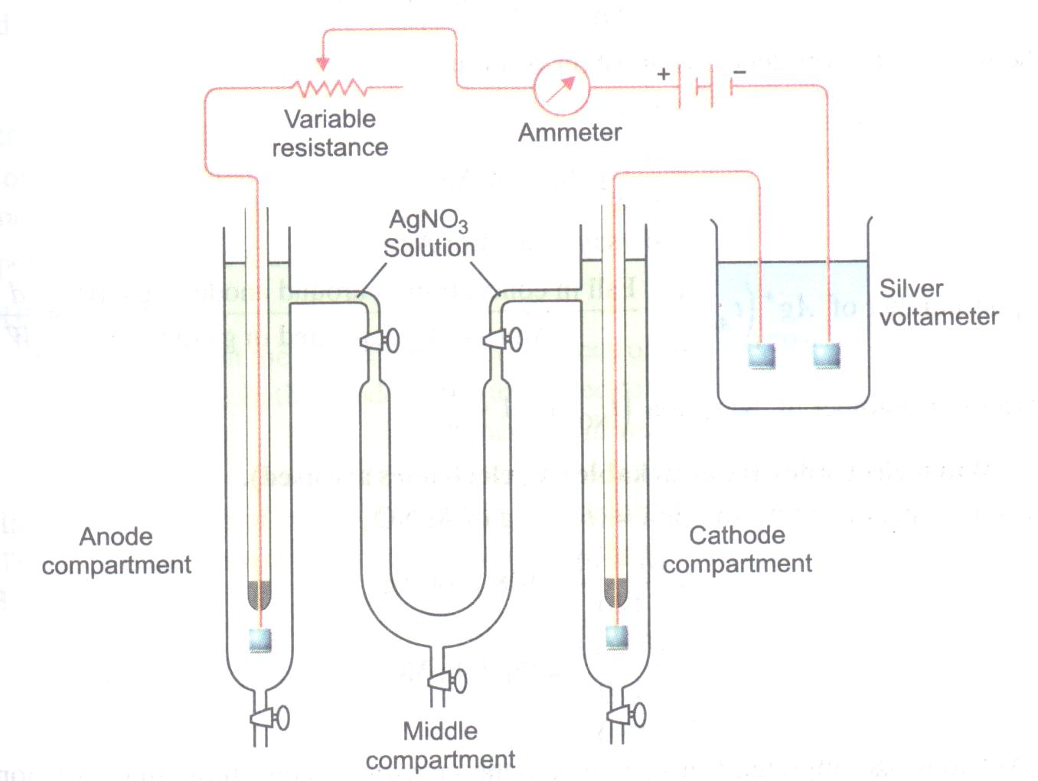

Slide 16
Moving Boundary Method
Principle: The movement of boundary of the principal electrolyte is indicated with the help of an indicator electrolyte.
T_{c} = lAc
1000 Q
Where, l = distance travelled by HCl
A= cross-section area of electrodes
C= concentration of HCl
Q= Amount of electricity passed

Slide 17
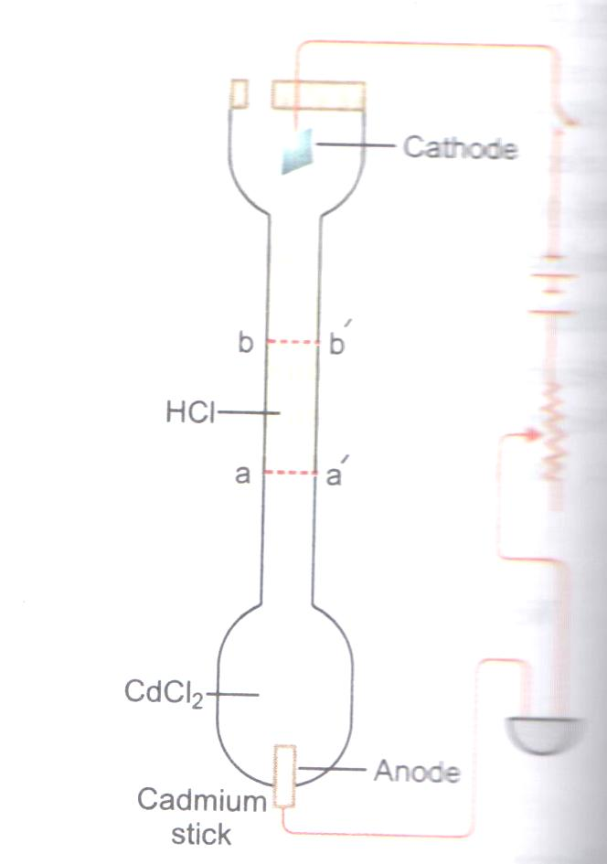
Moving Boundary Method

Slide 18
Electrochemical cells

Slide 19
Electrochemical cells
Single electrode
Galvanic cells
Learning points
Nernst’s equation
ECS & its applications
Numericals
Notes:
nnnnnnn

Slide 20
Redox Reactions-the source of energy
OXIDATION: Loss of electron(s)
R O + ne⁻
‘OR’ increase in oxidation number
REDUCTION: Gain of electron(s)
O + ne⁻ R
‘OR’ decrease in oxidation number
OXIDIZING AGENT: electron acceptor
REDUCING AGENT: electron donor
→
→

Slide 21
Source of electrons-anode
Oxidation: Loss of electrons

Slide 22
Consumer of electrons - cathode
Reduction: Addition of electrons

Slide 23
Flow of electrons from anode to cathode
Redox reaction

Slide 24
Oxidation
removal of electrons at anode
-
In To Circuit
M M^{+n} + ne⁻¹
In to Solution
+
Anode

Slide 25
Reduction
Addition of electrons at cathode
+
At Electrode
M^{+n} + ne⁻¹ M
-
From Solution
From Circuit
Cathode

Slide 26
Electrochemical cells
Device for converting chemical energy into electric current.
Important electrochemical cells:
Galvanic/voltaic cell
Daniel cell

Slide 27
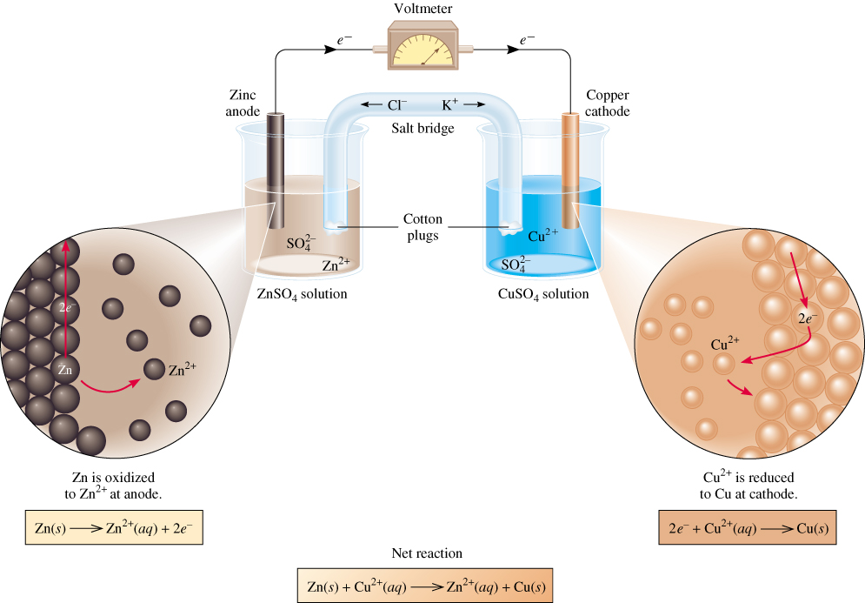
Galvanic Cells
anode
oxidation
cathode
reduction
-
+
spontaneous
redox reaction

Slide 28
Representation of cell reaction
Zn (s) | Zn²⁺ (1 M) || Cu²⁺ (1 M) | Cu (s)
anode cathode

Slide 29
Salt Bridge
Device used to connect the oxidation and reduction half-cells of a galvanic cell.
Allows the flow of ions to maintain a balance in charge between the oxidation and reduction vessels while keeping the contents of each separate.
Types: Glass tube bridges
Filter paper bridges
Filled with inert electrolyte.

Slide 30
Representation of single electrodes
Non metal electrodes
SHE or NHE : Pt|H₂(g, 1 bar)|H⁺(a = 1) ||
Chlorine electrode : Pt|Cl₂(g, 1 bar)|Cl⁻(M) ||
Metal electrodes
Copper electrode : Cu(s)|Cu²⁺(1 M)||
Zinc electrode : Zn(s)|Zn²⁺(1 M)||

Slide 31
Standard Electrode Potential
Potential of eletcrode during reaction under standard condition (when all solutes are 1 M and all gases are at 1 atm).
Standard reduction potential
Standard oxidation potential

Slide 32
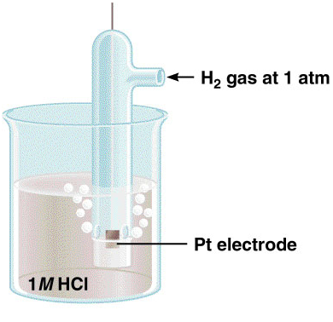
Determination of standard electrode potential
W.r.t. Standard Hydrogen Electrode.
2e⁻ + 2H⁺ (1 M) H₂ (1 atm)
E⁰ = 0 V
H₂ (1 atm) → 2e⁻ + 2H⁺ (1 M)
E⁰ = 0 V

Slide 33
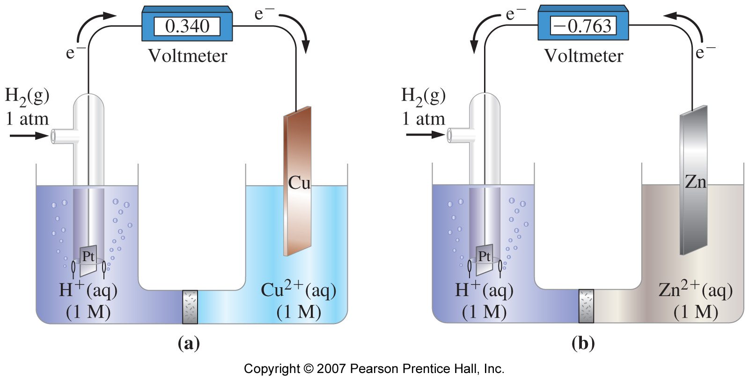
Examples
anode
cathode
cathode
anode

Slide 34
Determination of EMF
E⁰ = E⁰_{cathode} - E⁰_{anode}
E⁰_{cathode}: Reduction potential of electrode undergoing reduction
E⁰_{anode}: Reduction potential of electrode undergoing oxidation

Slide 35
Nernst Equation

Slide 36
Consider a reduction reaction,
Cu²⁺ + e → Cu
E = E + 0.05691] log[Cu²⁺ ]
n

Slide 37
TABLE OF STANDARD REDUCTION POTENTIALS
oxidizing
ability of ion
o
E
(V)
(Red. Pot)
Cu
2+
+ 2e- Cu
+0.34
+
2 H
+ 2e- H
0.00
2
Zn
2+
+ 2e- Zn
-0.76
To determine an Eox from a reduction table, just take the opposite sign of the reduction!
reducing ability
of element

Slide 38
Consider a reduction reaction,
Red1 + Ox2 Red2 + Ox1
Eg.,
Zn + Cu2+ Cu + Zn2+

Slide 39
Zn --> Zn²⁺ + 2e-
Cu²⁺ + 2e- --> Cu
Oxidation
Anode
Negative
Reduction
Cathode
Positive
<--Anions
Cations-->
•Electrons travel through external wire.
Salt bridge allows anions and cations to move between electrode compartments.

Slide 40
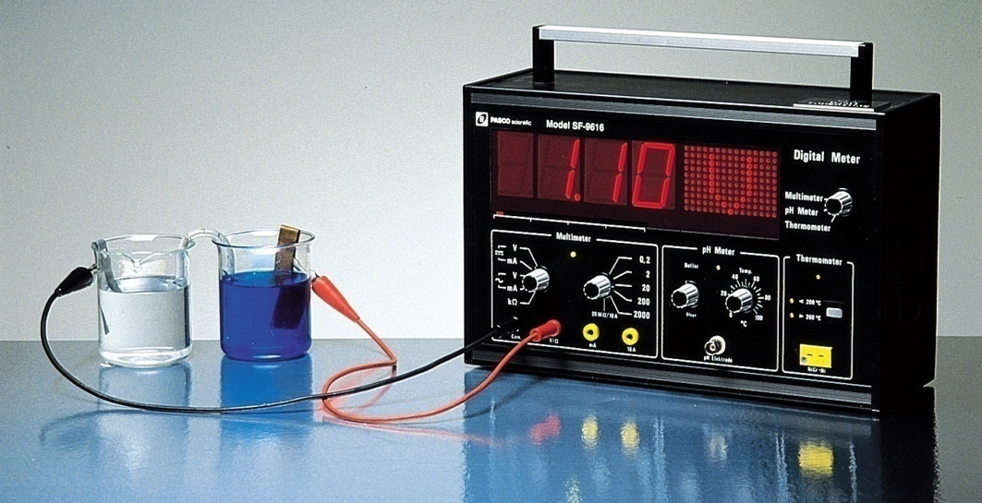
Galvanic Cells
The difference in electrical potential between the anode and cathode is called:
cell voltage
electromotive force (emf)
cell potential
Cell equation
Zn (s) + Cu²⁺ (aq) Cu (s) + Zn²⁺ (aq)
Zn (s) | Zn²⁺ (1 M) || Cu²⁺ (1 M) | Cu (s)
anode
cathode
19.2

Slide 41
Criteria for reversibility
Thermodynamic criteria
Driving force = opposite force
Rate of discharging = Rate of charging
E(cell) = o volts
While discharging:
Cu²⁺ + Zn -----→ Cu + Zn²⁺
While charging:
Cu + Zn²⁺ ----→ Cu²⁺ +Zn
Net reaction:
Cu²⁺ +Zn <-----→ Cu + Zn²⁺

Slide 42
Applications of EMF measurements
Determination of activity coefficients of electrolytes
Determination of Transport number of ions
Determination of Valency of ions in doubtful cases
Determination of solubility product
Determination of pH of an unknown solution by using
a) HE || SCE system
c) GE || SCE
b) SCE || QH₂ system

Slide 43
Determination by HE|| SCE system
Construct a cell by using HE and SCE as shown below:
Pt, H₂( 1 atm), H⁺( M = ?)|| KCl(sat),HgCl₂(s),Hg
E_{cell} = E _{RHS} - E_{LHS}
= 0.2422 - ( -0.05915pH)

Slide 44
Determination by HE||GE system
Construct a cell by using HE and GE as shown below:
Pt, 0.1M HCl|glass| H+(M=?)|| KCl(sat),HgCl₂(s),Hg
E_{cell} = E _{RHS} - E_{LHS}
= 0.2422 - ( Eg⁰-0.05915pH)

Slide 45
Determination of pH by SCE||QH₂ system
Construct a cell by using SCE and QH2 as shown below:
Hg,Hg₂Cl₂(s),KCl(sat)|| H⁺(M =?) Q,QH₂,Pt
E_{cell} = E _{RHS} - E_{LHS}
= ( 0.6996-0.0591pH) - 0.2422

Slide 47
Instrumental analysis

Slide 48
Instrumental analysis
Conductometric titrations
Learning points
SA Vs. SB
SA Vs. WB
WA Vs. SB

Slide 49
HCl + NaOH Na⁺Cl⁻ + H₂0
Consider an acid base reaction
HCl Base
N1 = ? N2 = Given
V1 = 20ml(say) V2 = from graph
N1V1 = N2V2
N1 ca be evaluated

Slide 50
Strong acid vs. strong base
HCl + NaOH Na⁺Cl⁻ + H₂0
λ
End point?
Vol. of base

Slide 51
Strong acid vs. weak base
HCl + NH₄OH NH₄⁺Cl⁻ + H₂0
λ
End point?
Vol. of base

Slide 52
Weak acid vs. strong base
CH₃COOH + NaOH CH₃COO⁻ Na⁺ + H₂0
λ
Vol. of base

Slide 53
Mixture of two acids vs. strong base
HCl + CH₃COOH + NaOH CH₃COO⁻ Na⁺ + NaCl + H₂0
NaOH
CH₃COOH
λ
HCl
Vol. of base

Slide 54
Mixture of two acids vs. strong base
HCl + CH₃COOH + NaOH CH₃COO⁻ Na⁺ + NaCl + H₂0
NaOH
CH₃COOH
λ
HCl
Vol. of base

Slide 55
Instrumental analysis
Potentiometric titrations
Learning points
Acid Vs. Base
Redox titration
Precipitation titration

Slide 56
Acid-base titration
Principle: A platinum wire and an SCE are dipped in
experimental solution(H+). A galvanic cell is formed.
Pt, H₂( 1 atm), H⁺( M = ?)|| KCl(sat),HgCl₂(s),Hg
E = E_{SCE} - E_{HE}
= 0.2422 - (-0.059logH⁺)
= 0.2422 + 0 .059pH
As H+ concn., changes during titration, E also changes.

Slide 57
Experimental procedure
100ml of 0.1M HCl (say) is taken in a beaker and the following cell is set up:
Pt, H₂( 1 atm), H⁺( M = ?)|| KCl(sat),HgCl₂(s),Hg
As the titration proceeds, the H+ ion conc. decreases and hence, the Ecell also decreases.
At the end point, due to depletion of acid and addition of base, the potential suddenly increases.
Thereafter the potential remains constant.
Volume of alkali vs. potential graph is drawn.

Slide 58
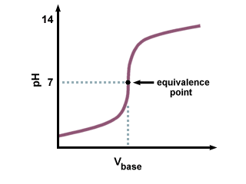
E _{cell}

Slide 59
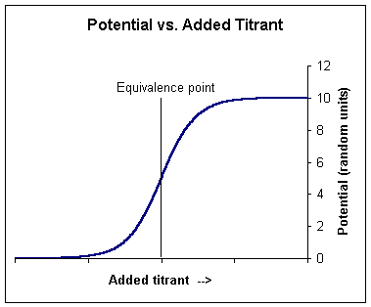

Slide 60
Result
HCl Base
N1 = ? N2 = Given
V1 = 100ml(say) V2 = from graph
N1V1 = N2V2
N1 ca be evaluated

Slide 61
Precipitation titration
Objective: Determination of AgCl by
precipitating with standard KCl
Principle: Consider the rection:
AgNO₃ + KCl → AgCl ↓ + KNO
During the titration, Ag+ is removed and K+ is added to the system.
also, λ(Ag+ ) = λ(K+)

Slide 62
Potential remains constant in the beginning
Suddenly rises at the end point
Afterwards remains constant again
Remaining calculations are similar to acid –base titration.

Slide 63


