Slide 1
Exception Handling

Slide 2
Exception Handling in C++
Errors can be broadly categorized into two types. We will discuss them one by one.
Compile Time Errors (Asynchronous type Exception)
Run Time Errors (Synchronous type Exception)
Compile Time Errors –Errors caught during compiled time is called Compile time errors. Compile time errors include library reference, syntax error or incorrect class import.

Slide 3
Run Time Errors - They are also known as exceptions. An exception caught during run time creates serious issues.
C++ is designed to handle only synchronous exceptions.

Slide 4
Error Handling Mechanism
Find the Problem (Hit the exception).
Inform that an error has occurred (Throw the exception)
Receive the error information (Catch the exception)
Take corrective actions (Handle the exception)

Slide 5
C++ exception handling is built upon three keywords: try, catch, and throw.
try − A try block identifies a block of code for which particular exceptions will be activated. It's followed by one or more catch blocks.
catch − A program catches an exception with an exception handler at the place in a program where you want to handle the problem. The catch keyword indicates the catching of an exception.
throw − A program throws an exception when a problem shows up. This is done using a throw keyword.

Slide 6
Try
{
//code
throw exception;
}
catch(type arg)
{
//code to handle exception
}

Slide 7
When a try block throws as exception, the program control leaves the try block and enters the catch statement of the catch block.
Note that exception are objects used to transmit information about a problem.
If the type of object thrown matches the arg type in the catch statement, then catch block is executed for handling the exception.
If they do not match, the program is aborted with the help of abort() function which is invoked by default.

Slide 8
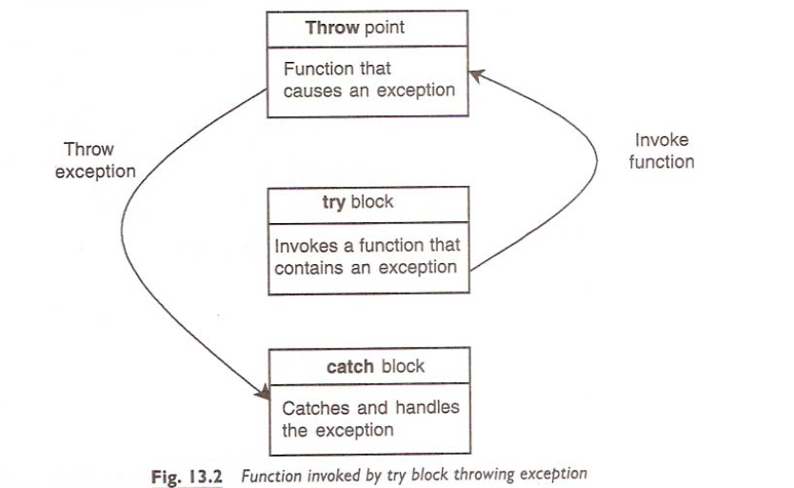

Slide 9
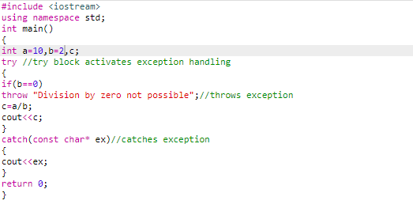

Slide 10
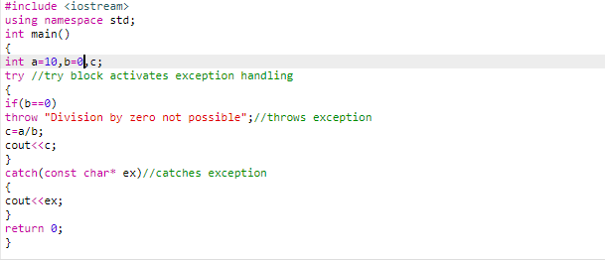

Slide 11
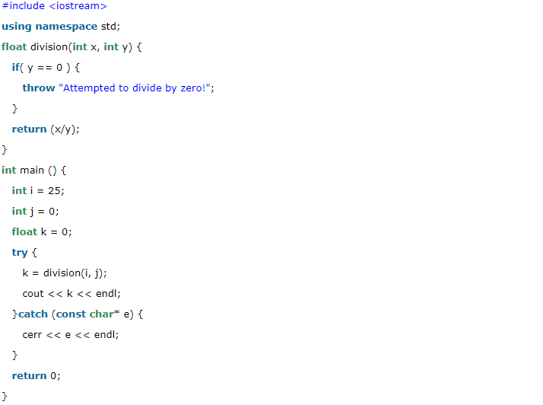

Slide 12
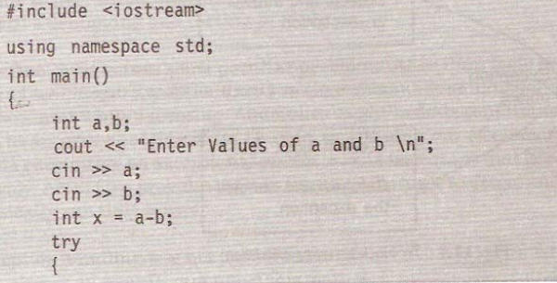

Slide 13
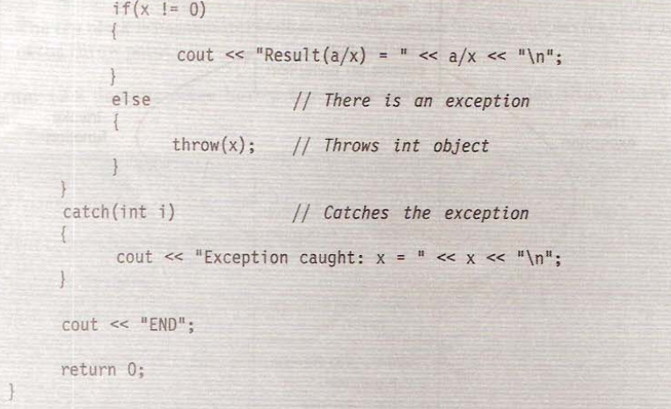

Slide 14
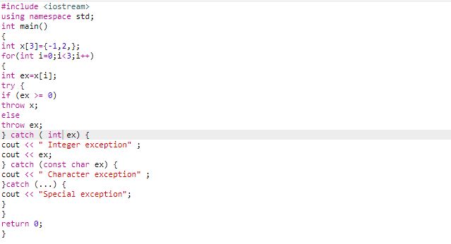

Slide 15
C++ Standard Exceptions
C++ provides a list of standard exceptions defined in <exception> which we can use in our programs.
These are arranged in a parent-child class hierarchy

Slide 16
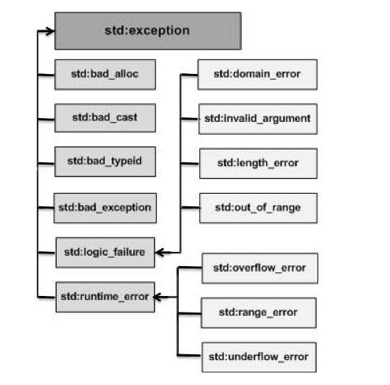

Slide 17
std::exception
An exception and parent class of all the standard C++ exceptions.
std::bad_alloc
if new operator cannot allocate dynamic memory of the requested size, then it should throw an exception of type std::bad_alloc .
This can be thrown by new.
std::bad_cast
This can be thrown by dynamic_cast.
Dynamic casts can be used to safely cast a superclass pointer (or reference) into a pointer (or reference) to a subclass in a class hierarchy.

Slide 18
std::bad_typeid
This can be thrown by typeid.
An exception of this type is thrown when a typeid operator is applied to a dereferenced null pointer value.
std::bad_exception
This is useful device to handle unexpected exceptions in a C++ program.
std::logic_error
An exception that theoretically can be detected by reading the code.

Slide 19
std::domain_error
This is an exception thrown when a mathematically invalid domain is used.
For example, the square root function is only defined for non-negative numbers. Thus, a negative number for such a function would qualify as a domain error.
std::invalid_argument
This is thrown due to invalid arguments.

Slide 20
std::length_error
This is thrown when a too big std::string is created.
NOTE:Max Size of string is std::string::max_size()
std::out_of_range
vector, deque, string throw exceptions of this type to signal arguments out of range.
std::runtime_error
An exception that theoretically cannot be detected by reading the code.

Slide 21
std::overflow_error
This is thrown if a mathematical overflow occurs.
std::range_error
This is occurred when you try to store a value which is out of range.

Slide 22
Define New Exceptions
You can define your own exceptions by inheriting and overriding exception class functionality.

