Slide 1
Database Management System
Module 2

Slide 2
ER Model - Basic Concepts
The ER model defines the conceptual view of a database.
It works around real-world entities and the associations among them.
At view level, the ER model is considered a good option for designing databases.

Slide 3
Entity
An entity can be a real-world object, that can be easily identified.
For example, in a school database, students, teachers, classes, and courses offered can be considered as entities.
All these entities have some attributes or properties that give them their identity.

Slide 4
Entity Set
An entity set is a collection of similar types of entities.
An entity set may contain entities with attribute sharing similar values.
For example, a Students set may contain all the students of a school; likewise a Teachers set may contain all the teachers of a school from all faculties.
Entity sets need not be disjoint.

Slide 5
Attributes
Entities are represented by means of their properties, called attributes. All attributes have values.
For example, a student entity may have name, class, and age as attributes.
There exists a domain or range of values that can be assigned to attributes.
For example, a student's name cannot be a numeric value. It has to be alphabetic.
A student's age cannot be negative, etc.

Slide 6
Types of Attributes
Simple attribute − Simple attributes are atomic values, which cannot be divided further. For example, a student's phone number is an atomic value of 10 digits.
Composite attribute − Composite attributes are made of more than one simple attribute. For example, a student's complete name may have first_name, middle name and last_name.
Derived attribute − Derived attributes are the attributes that do not exist in the physical database, but their values are derived from other attributes present in the database. For example, average_salary in a department should not be saved directly in the database, instead it can be derived. For another example, age can be derived from data_of_birth.
Single-value attribute − Single-value attributes contain single value. For example − Social_Security_Number.
Multi-value attribute − Multi-value attributes may contain more than one values. For example, a person can have more than one phone number, email_address, etc.

Slide 7
Entity-Set and Keys
Key is an attribute or collection of attributes that uniquely identifies an entity among entity set.
For example, the roll_number of a student makes him/her identifiable among students.
Super Key − A set of attributes (one or more) that collectively identifies an entity in an entity set.
Candidate Key − A minimal super key is called a candidate key. An entity set may have more than one candidate key.
Primary Key − A primary key is one of the candidate keys chosen by the database designer to uniquely identify the entity set. A primary is unique and cannot be null.

Slide 8
Some More Keys…
Partial Key: A partial key means just part of a key - some proper subset of the key attributes.
Composite Key (Compound key): Composite key is a combination of more than one attributes that can be used to uniquely identity each record. A composite key may be a candidate or primary key.
Foreign Key: Foreign key is used to generate the relationship between the tables. Foreign Key is a field in database table that is Primary key in another table. A foreign key can accept null and duplicate value.

Slide 9
Some More Keys…
Artificial Key (Surrogate Key): An artificial key is one that has no meaning to the business or organization.
Artificial keys are permitted when
1) no attribute has all the primary key properties,
or
2) The primary key is large and complex.
Natural Key: A natural key is a key composed of columns that actually have a logical relationship to other columns within a table.
Alternate Key (Secondary Key ): Alternate keys are candidate keys that are not selected as primary key. Alternate key can also work as a primary key.

Slide 10
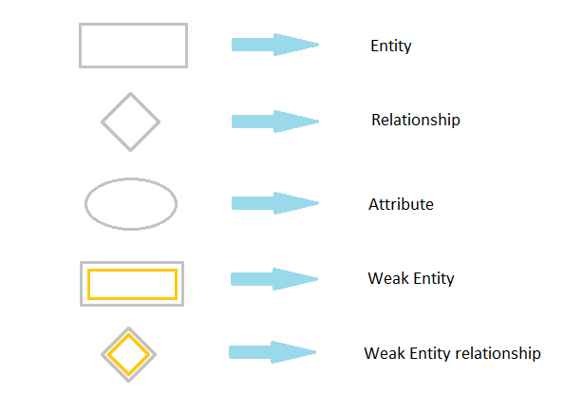
Symbols and Notations

Slide 11
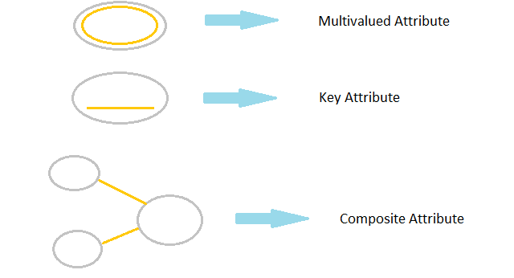
Symbols and Notations

