Slide 1
FUELS
PART-II
Comparison of solid, liquid & gaseous fuels
Knocking
Octane number
Cetane number
Synthetic petrol

Slide 2
Comparison between solid, liquid and gaseous fuels
Properties | Solid fuels | Liquid fuels | Gaseous fuels
Price | Cheap and easily available | Costly | Costly except natural gas
Transport and storage | easy | Transported easily though pipelines but must be stored in closed containers carefully | Transported through pipelines and are stored in leak proof tanks

Slide 3
Combustion | slow | quick | Very fast
Fire hazards | Less risk | Greater risk | Even greater than liquid fuels
Smoke and ash | Always produced and reduces calorific value | Ash is not produced but smoke is produced | Neither ash nor smoke is produced
Calorific value | least | higher | Highest

Slide 4
KNOCKING
The metallic sound produced due to the irregular burning of the fuel.
Causes loss in power of engine.
Reason: Mistimed ignition due to increase in temperature of the cylinder resulting from the heat of compression.
Knocking α 1 α 1
Octane number Fuel efficiency
Knocking among different categories of compounds:
Straight chain paraffins > branched chain paraffins > olefins > naphthenes > aromatics.

Slide 5
OCTANE NUMBER
O.N. signifies the ignition quality of gasoline in automobile engines.
For grading gasoline(Petrol)
Isooctane = 100
n-heptane = 0
The % of isooctane present in the mixture of isooctane and n-heptane which has the same knocking property as the fuel itself.
More the octane number, better the fuel efficiency.

Slide 6
Reasons for opting the blend of iso-octane & n-heptane:
The different hydrocarbon in gasoline:
Straight chain paraffin
Iso-paraffins
Naphthenes
Aromatics
For the same Carbon No; straight chain paraffin have lowest octane No.
Branched chain paraffin (isomers), Naphthenes have higher octane No.
Olefins also have high O.N. but they cause gum deposits in the fuel tank and are not desirable.
Aromatic have high O.N. but their content is being restricted due to their carcinogenic nature.

Slide 7
Octane numbers of few hydrocarbons:
Carbon | Hydrocarbon | Octane No.
C₆ – Straight chain | n- Hexane | 28.8
C₆ – Isomer | Methyl Pentane | 73.4
C₆ – Isomer | Dimethyl Butane | 91.8
C₆ – Napthenes | Cyclohexane | 83
C₆ – Aromatic | Benzene | 98
C₇ – Paraffin | n - Heptane | 0
C₇ – Isomer | Dimethyl Pentane | 88
C₈ – Isomer | Iso – Octane | 100
C₇ – Aromatics | Toluene | 107

Slide 8
Methods to increase octane number:
By adding the antiknocking agent: e.g. TEL (about 1.0-1.5ml /lt. petrol) along with some ethylene dibromide.
By isomerisation
By alkylation
By aromatisation

Slide 9
CETANE NUMBER
Reverse of Octane No.
Normal paraffin's have highest cetane no. followed by naphthenes, isoporaffins, olefins and aromatics.
For grading diesel oil.
Hexadecane (cetane) = 100
α- methyl naphthalene = 0
The % of cetane present in the mixture of cetane and α-methyl naphthalene which has the same ignition property as the fuel itself.
More the cetane number, better the fuel efficiency.

Slide 10
Conversion of coal into liquid fuels (Synthetic Petrol)
Two methods:
1)Bergius process
2)Fischer Tropsch method

Slide 11
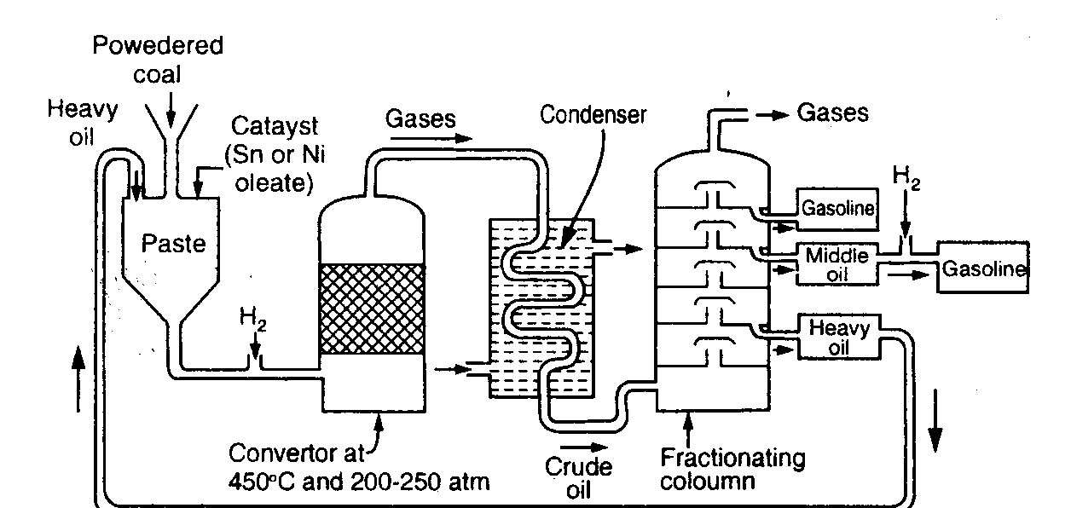
Bergius method

Slide 12
Low ash coal
Add heavy oil & catalyst
(tin+nickel oleate)
Make paste
Heat with H₂ at 450ºC, 200-250atm
for about 1.5 hrs
Saturated hydrocarbons
Fractionated
Low boiling liquid hydrocarbons + Gases
Gases cooled in condenser

Slide 13
Liquid resembling crude oil
Fractionation
Gasoline + middle oil + heavy oil
Middle oil
Vapor phase hydrogenation
Gasoline
(Total gasoline : about 60% of wt. of coal dust)

Slide 14
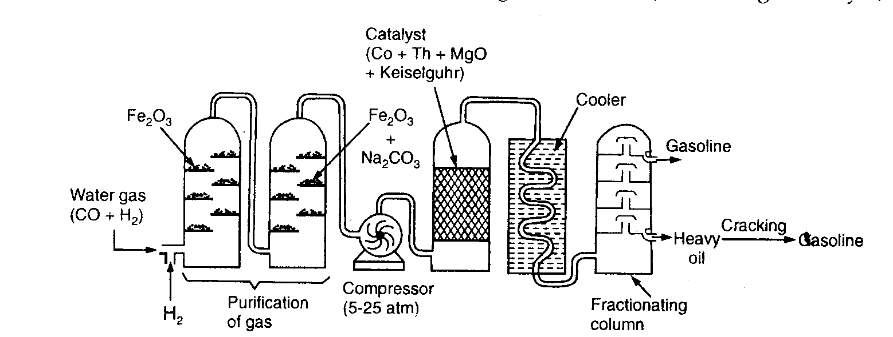
Fisher-Tropsch method

Slide 15
Water gas (CO+H₂) + some more hydrogen
Passed through a tower containing Fe₂O₃
(Removal of H₂S)
Passed through a tower containing Fe₂O₃.Na₂CO₃
(Removal of organic sulfur compounds)
Purified gas
Compressed at 5-25 atm
Passed to converter containing catalyst mixture
(100 parts cobalt, 5 parts thoria, 8 parts magnesia & 200 parts
kieselgurh earth) maintained at 200-300°C

Slide 16
Mixture of saturated and unsaturated hydrocarbons
nCO+2nH₂ C_{n}H_{2n}+nH₂O
nCO+(2n+1)H₂ C_{n}H_{2n+2}+nH₂O
(Exothermic reaction)
Product gases are cooled
Liquid resembling crude oil
Fractionation
Gasoline + heavy oil

Slide 17
Refining of gasoline
Removal of sulfur (Desulfuring/sweetening):
2 RSH + Na₂PbO Pb(SR) ₂ + 2NaOH
Pb(SR) ₂ + S PbS + RSSR
Removed by Extracted with a
filtration suitable solvent
Removal of olefins & coloring matter: By adsorption on ‘fuller’s earth’.
Addition of inhibitors.
Blending.

