Slide 1
Normalization

Slide 2
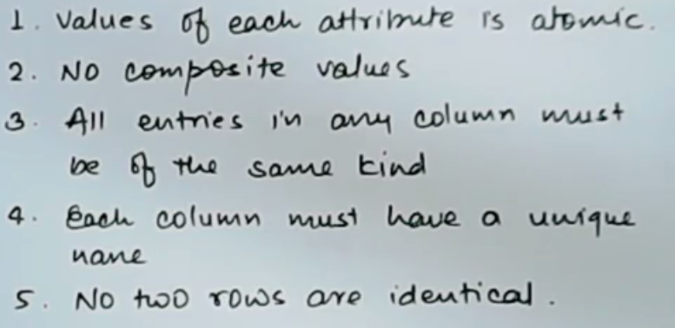
1NF

Slide 3
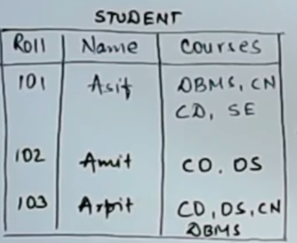
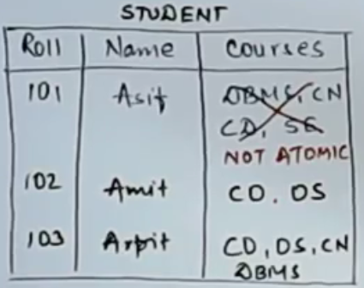
I NF

Slide 4
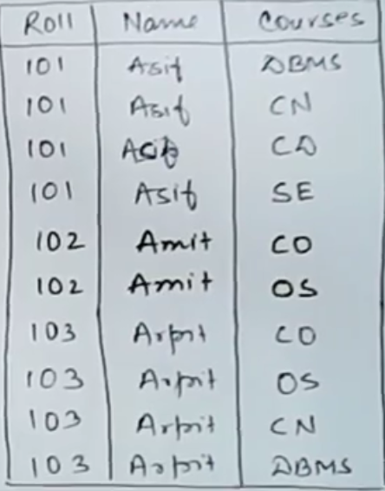

Slide 5
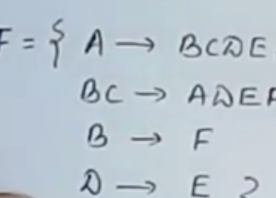


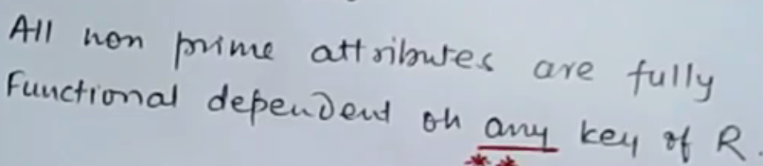
Example-1

Slide 6



Example:1
Find out all the possible candidate key:
Because of this FD, it is not in 2NF

Slide 7
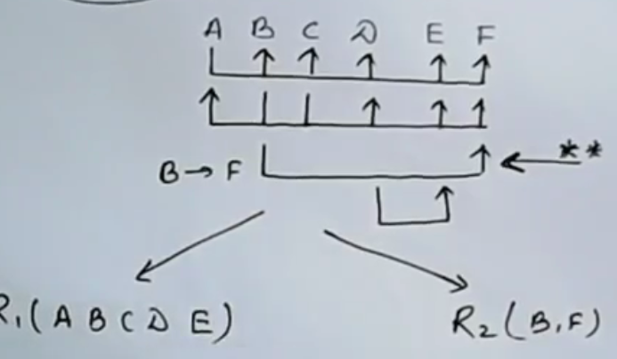
Convert to 2NF

Slide 8
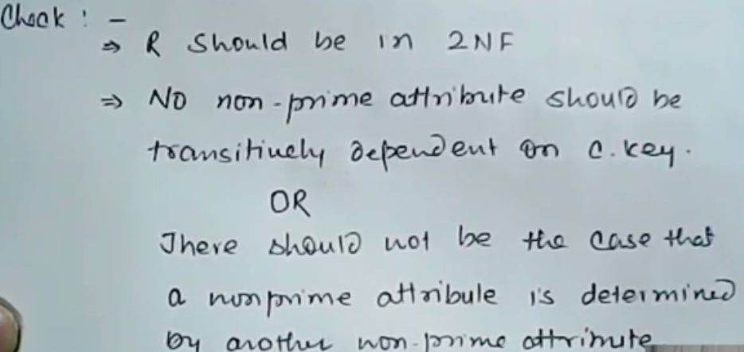
3NF

Slide 9
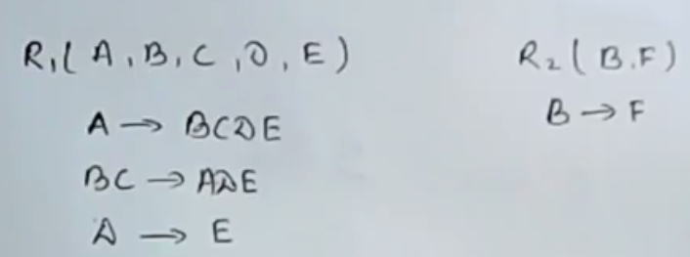
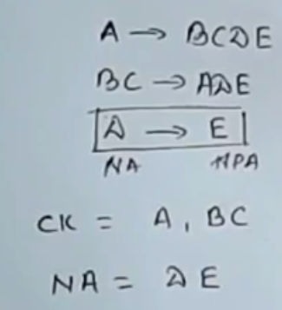
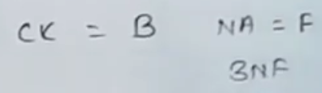
Example:1
Relation is in 3NF
NOT IN 3NF

Slide 10
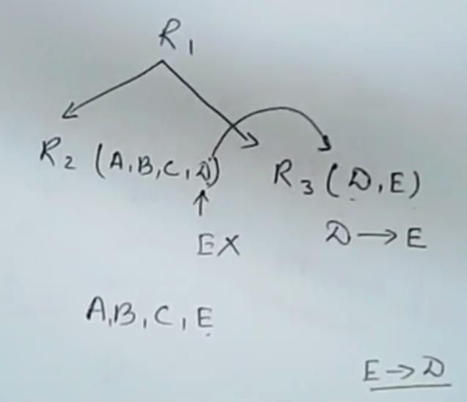
Convert to 3 NF
We decompose table such that we have a common attribute in R2 and R3. We cannot keep E in R2 because we will not be able to determine D from E

Slide 11
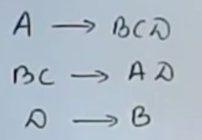
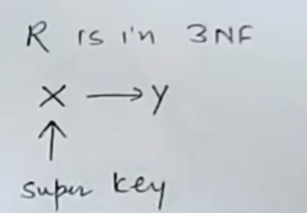
BCNF (Boyce cod normal form)
Rules:
BCNF?
The above relation is already in 3NF but check whether it is in BCNF or not?

Slide 12

Question:1
Here, D is not a super key, therefore relation is not in BCNF

Slide 13
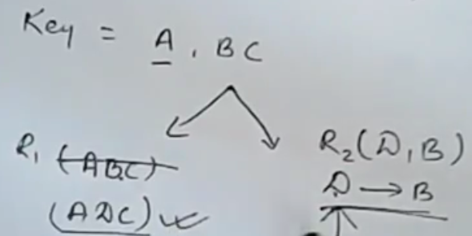
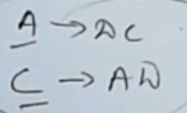
Convert to BCNF
Here A and C are candidate key therefore it is in BCNF

Slide 14
4 NF

Slide 15


Slide 16
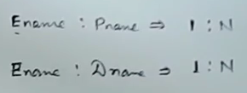
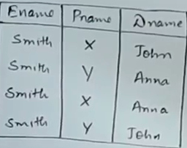

Example:1

Slide 17
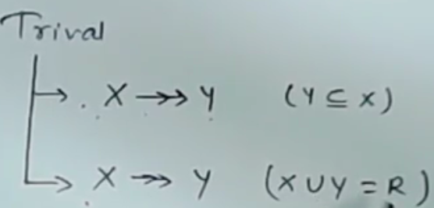
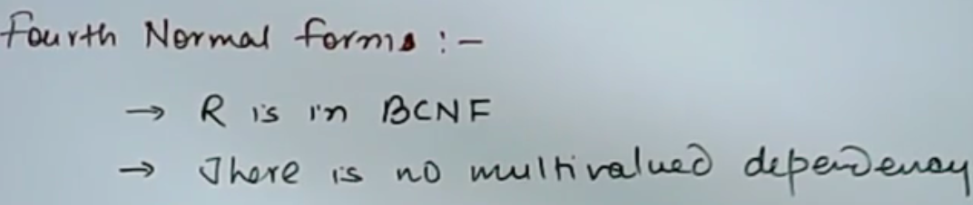
Example:1

Slide 18
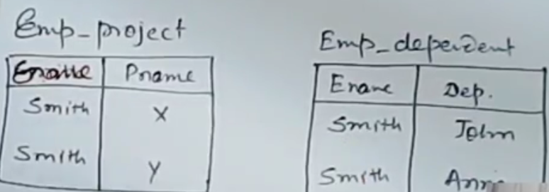
Convert to 4NF

Slide 19
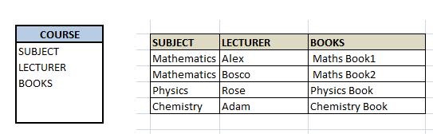
Example:2
If we observe the data in the table above it satisfies 3NF. But LECTURER and BOOKS are two independent entities here. There is no relationship between Lecturer and Books. In the above example, either Alex or Bosco can teach Mathematics. For Mathematics subject , student can refer either 'Maths Book1' or 'Maths Book2'. i.e.;

Slide 20
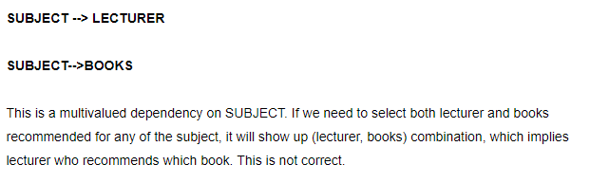

Example:2

Slide 21
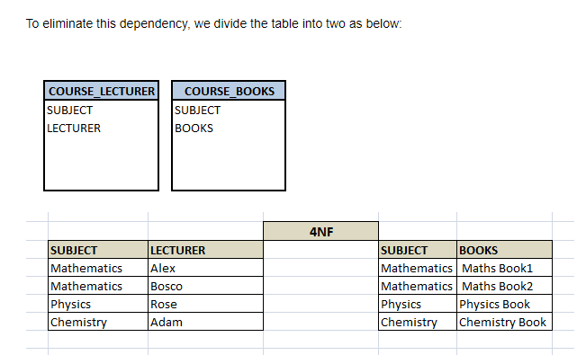

Slide 22
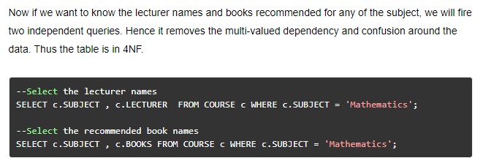
Example:2

Slide 23
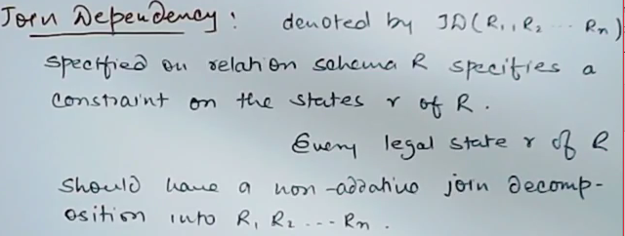
5 NF

Slide 24
5 NF
A database is said to be in 5NF, if and only if,
It's in 4NF
If we can decompose table further to eliminate redundancy and anomaly, and when we re-join the decomposed tables by means of candidate keys, we should not be losing the original data or any new record set should not arise. In simple words, joining two or more decomposed table should not lose records nor create new records.
Consider an example of different Subjects taught by different lecturers and the lecturers taking classes for different semesters.
Note: Please consider that Semester 1 has Mathematics, Physics and Chemistry and Semester 2 has only Mathematics in its academic year!!

Slide 25
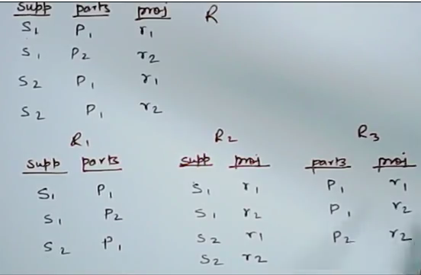
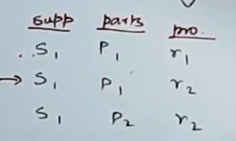
Example:1
Additive row

Slide 26


5 NF
R must be in 4NF
If Join dependency does not exists

Slide 27
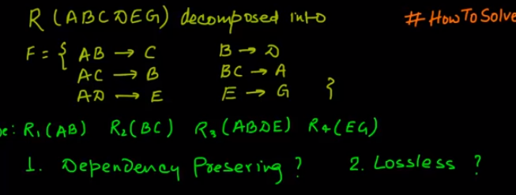
Dependency preserving??
Dependency is not preserved here. Therefore,
decomposition is not dependency preserving

Slide 28
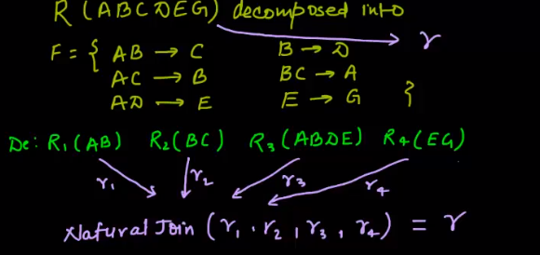
Lossless Join??

Slide 29
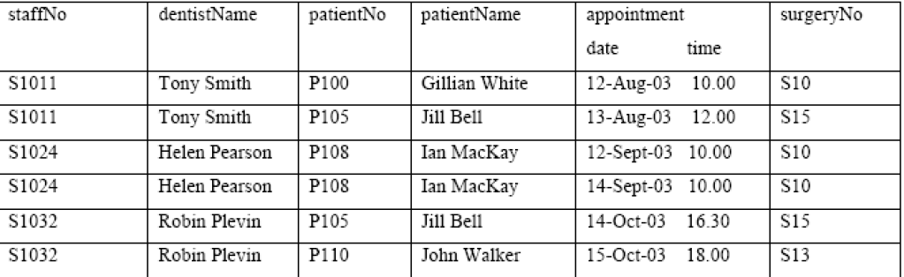
Example-2

Slide 30
Insertion anomalies:
To insert a new patient particular that makes an appointment with the designated Doctor, we need to enter the correct detail for the staff. For example, to insert the details of new patient in patientNo, patientName and an appointment, we must enter the correct details of the doctor (staffNo, dentistName) so that the patient details are consistent with values for the designated Doctor for example, S1011.
To enter new patient data that doesn’t have Doctor to be assigned we can’t insert NULL values for the primary key.

Slide 31
Deletion anomalies:
If we want to delete a patient named Ian MacKay for example, two records need to be deleted as in row 3 and 4. This anomaly also obvious when we want to delete the dentistName, multiple records needs to be deleted to maintain the data integrity.
When we delete a Dentist record, for example Tony Smith, the details about his patients also lost from the database.

Slide 32
Modification anomalies:
With redundant data, when we want to change the value of one columns of a particular Dentist, for example the dentistName, we must update all the Dentist records that assigned to the particular patient otherwise the database will become inconsistent. We also need to modify the appointment schedules because different Dentist has different schedules

Slide 33
(b) Describe and illustrate the process of normalizing the table shown in Figure 1 to 3NF. State any assumptions you make about the data shown in this table.
Assumptions made include that a patient is registered at only one surgery and he/she may have more than one appointment on a given day. All the schedules have been fixed for the whole days and week.

Slide 34
In the 1NF we remove all the repeating groups (appointment), assigning new column (apptDate and apptTime) and assigned primary keys (candidate keys). Then we figure out the functional dependencies (FDs). By using dependency diagram we represent the table as shown below. (NF –stand for Normal Form)
Note: How to find the FDs is subjective!!! However, the rule is, it must reflect the real word situation.

Slide 35
