Slide 1
APPLICATION & MIDDLEWARE OVERVIEW
© 2013 IBM Corporation

Slide 2
UNIT OBJECTIVE
In this unit you should be able to understand
What MQ is all about
Application servers
Email
Data ware housing concepts

Slide 3
INTEGRATING APPLICATIONS
Applications run on different hardware, technologies were developed during a period of time
Discrete applications need to communicate to serve business requirement
Applications can communicate using middleware

Slide 4
MIDDLEWARE
Lies in between two applications as a mediator
Facilitates interoperability of applications
Simplifies communication of complex applications
Reduces time and resources

Slide 5
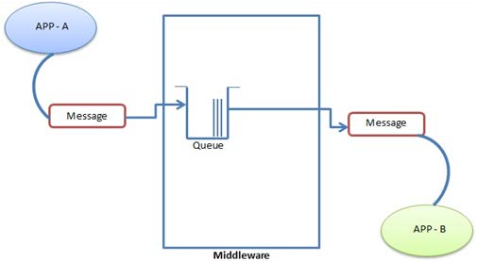
MESSAGE ORIENTED MIDDLEWARE
Middleware that enables communication between applications using messages
Message is the data that the application wants to communicate with other application
Advantages
Asynchronous interaction of applications
Loosely coupled
Reliability
Scalability
availability

Slide 6
IBM WEBSPHERE MQ
Message Oriented Middleware from IBM
Introduced in 1993 as MQSeries
Can make communication possible for applications running on powerful machines like servers with applications running on systems less powerful like mobile devices and tablets
Market leader

Slide 7
WEBSPHERE MQ OBJECTS
Queue Managers
piece of software which is responsible for accepting and delivering messages.
Queues
Queue managers uses queues to store all messages that are waiting to be processed or routed.
Channels
A channel provides a communication path between Queue Managers on the same, or different, platforms

Slide 8
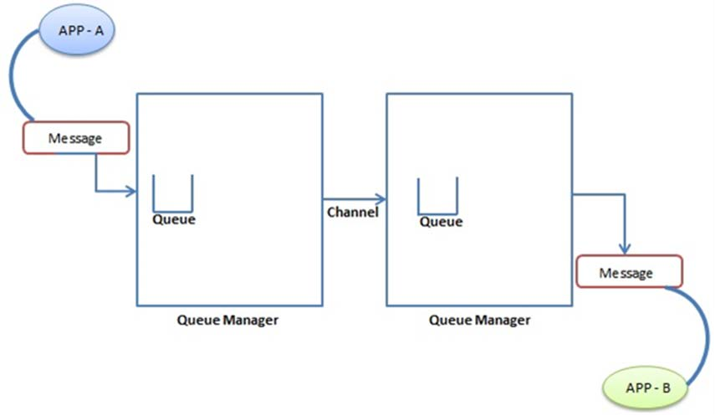
MESSAGING

Slide 9
WEB TIER DEPLOYMENT
Multi tier architecture consists of
Client tier
Web tier
Business tier
Data tier
Advantages
Performance
Scalability
Availability
Security
Maintenance

Slide 10
WEB TIER DEPLOYMENT
Client tier
Browsers and other applications that the user uses to connect the enterprise application from a remote location through network.
Web Tier
HTTP Server – Serves static HTTP content and routes incoming HTTP requests to the application server.

Slide 11
WEB TIER DEPLOYMENT
Business Tier
Application Server hosts the enterprise application, which consists of dynamic web pages and application business logic
Data Tier
Database Server Hosts the database to store business data for the application.

Slide 12
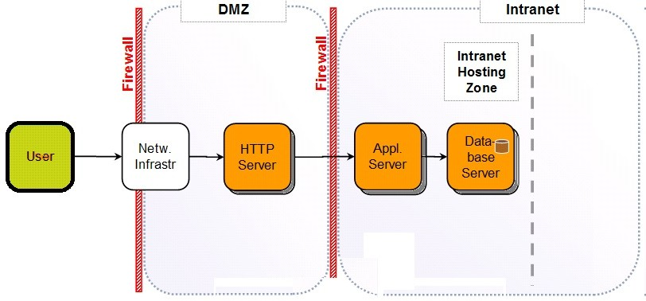
WEB TIER DEPLOYMENT
Network Aspects
HTTP Server which the user is connecting should be in Demilitarized zone.
Application server and Database servers are placed in more secure internal network.
All the requests are routed through the HTTP server.

Slide 13
APPLICATION SERVERS
Application server provides the environment for an enterprise application to run no matter what the application do
Application servers host the business logic for the client applications using various protocols including HTTP
Web server provides static pages whereas the application server enhances the capability of webserver by providing dynamic, customized pages by executing the business logic.

Slide 14
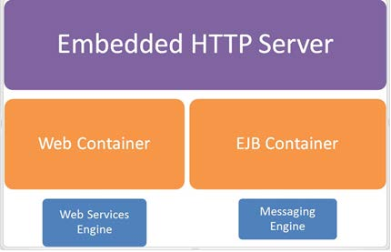
APPLICATION SERVERS

Slide 15
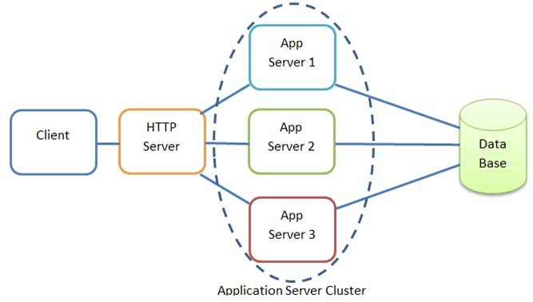
CLUSTER DEPLOYMENT
Set of servers that is grouped together, managed together to share work load
Clustering enables the enterprise applications to scale beyond the limits of one server.
Clusters enable the applications hosted to be highly available as there are other servers to run the application in case of failure at one server.

