Slide 1
DATA STORAGE Flat file System Tabular File System Relational Databases

Slide 2
What does Data Storage mean?
Data storage is a general term for archiving data in electromagnetic or other forms for use by a computer or device. Different types of data storage play different roles in a computing environment. In addition to forms of hard data storage, there are now new options for remote data storage, such as cloud computing, that can revolutionize the ways that users access data.

Slide 3
Data storage is the collective methods and technologies that capture and retain digital information on electromagnetic, optical or silicon-based storage media. Storage is a key component of digital devices, as consumers and businesses have come to rely on it to preserve information ranging from personal photos to business-critical information.
Storage is frequently used to describe the devices and data connected to the computer through input/output (I/O) operations, including hard disks, flash devices, tape systems and other media types.

Slide 4
Why data storage is important ?
Underscoring the importance of storage is a steady climb in the generation of new data, which is attributable to big data and the profusion of internet of things ( IoT ) devices. Modern storage systems require enhanced capabilities to allow enterprises to apply machine learning-enabled artificial intelligence (AI) to capture this data, analyze it and wring maximum value from it.
Larger application scripts and real-time database analytics have contributed to the advent of highly dense and scalable storage systems, including high-performance computing storage, converged infrastructure , composable storage systems, hyper-converged storage infrastructure, scale-out and scale-up network-attached storage (NAS) and object storage platforms.

Slide 5
By 2025, it is expected that 163 zettabytes (ZB) of new data will be generated, according to a report by IT analyst firm IDC. That estimate represents a potential tenfold increase from the 16 ZB produced through 2016.
How data storage works ?
The term storage may refer both to a user's data generally and, more specifically, to the integrated hardware and software systems used to capture, manage and prioritize the data. This includes information in applications, databases, data warehouses, archiving, backup appliances and cloud storage .

Slide 6
Digital information is written to target storage media through the use of software commands. The smallest unit of measure in a computer memory is a bit, described with a binary value of 0 or 1, according to the level of electrical voltage contained in a single capacitor. Eight bits make up one byte.
Other capacity measurements to know are:
kilobit (Kb)
megabit (Mb)
gigabit (Gb)
terabit (Tb)
petabit (Pb)
exabit (Eb)

Slide 7
Larger measures include:
kilobyte (KB) equal to 1,024 bytes
megabyte (MB) equal to 1,024 KB
gigabyte (GB) equal to 1,024 MB
terabyte (TB) equal to 1,024 GB
petabyte (PB) equal to 1,024 TB
Exabyte (EB) equal to 1,024 PB

Slide 8
Data storage capacity requirements define how much storage is needed to run an application, a set of applications or data sets. Capacity requirements take into account the types of data.
For instance, simple documents may only require kilobytes of capacity, while graphic-intensive files, such as digital photographs, may take up megabytes, and a video file can require gigabytes of storage.
Computer applications commonly list the minimum and recommended capacity requirements needed to run them.

Slide 9
Flat File
A flat file database is a database that stores data in a plain text file. Each line of the text file holds one record, with fields separated by delimiters, such as commas or tabs. A flat file database cannot contain multiple tables like a relational database can.
Most database programs such as Microsoft Access and FileMaker Pro can import flat file databases and use them in a larger relational database.
Flat file is also a type of computer file system that stores all data in a single directory. There are no folders or paths used organize the data. A flat file system becomes increasingly inefficient as more data is added.
The original Macintosh computer used this kind of file system, creatively called the Macintosh File System (MFS).

Slide 10
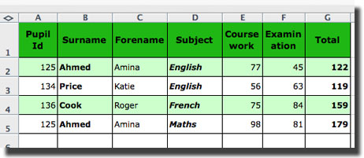
Data stored on an ICT system is stored and organised in files. When the data is organised in rows and columns with data values being repeated, it is called a flat file.

Slide 11
A type of database based on a flat file. These typically have a minimal structure and are often based on delimited files that represent tables. However, they are typically extremely limited as opposed to a database that structures its data. For example, a flat file database may not support relationships between tables.
This file has a very simple row and column structure. There are no relationships between data. The main weakness of this type of file is that data has to be repeated. Look at the entry for “Amina Ahmed”. Her name is recorded twice because she studies both English and Maths.
In a relational database system, this would not happen. The surname and forename of each person would be stored only once and a related table would be created to hold the rest of the data. The two tables would then be linked. When data is repeated unnecessarily it is said to be redundant.

Slide 12
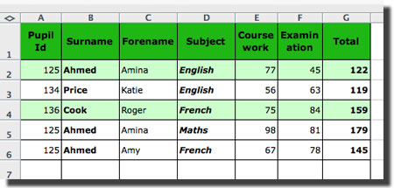
In the example above, each subject that the pupil studies has to be entered as a separate record.
If another entry is made for Amina Ahmed the file would now look like this:

Slide 13
Disadvantages of flat file databases :
The computer has more data to read through, so accessing and searching through them can be slow.
Data has to be repeated and leads to inputting errors and inconsistencies
File sizes can be large due to repeated data

Slide 14
Types of Flat Files
Plain Text
A text file that contains the symbols of a natural language such as English or Russian. Restricted to the characters in its character set. For example, ASCII has 128 characters for English and UTF-8 supports most major languages and a wide variety of special symbols with 1,112,064 characters.
Binary File
A file that includes any sequence of binary data as opposed to being restricted to the characters in a character set.
Binary is data that is encoded as a series of 0s and 1s. Digital computers, the dominant form of computing hardware, can only process binary data.

Slide 15
Delimited File
Delimited files represent table structures with special characters such as commas that indicate the end of fields. Technically speaking, delimited files aren't flat files as they have a structure. However, they are so simple that it is common to consider them a flat file.
Comma-separated values (CSV)
The use of commas to separate fields. The end of each row is indicated with a newline character. Often given the file extension ".csv". In some cases, semicolons are used at the end of a row as opposed to a newline character. It is common to place data that includes commas in double quotes and to use an escape sequence when data includes a double quote.

Slide 16
Tab-separated values (TSV)
The use of tab characters to separate fields and newline to indicate a new row. Common in regions where commas are used as decimals in numbers making commas an extremely bad choice as a delimiter. Tab characters are rarely used in data.

Slide 17
Tabular Database
What does Tabular Database mean?
A tabular database, as the name implies is a database that is structured in a tabular form.
It arranges data elements in vertical columns and horizontal rows.
Each cell is formed by the intersection of a column and row.
Each row and column is uniquely numbered to make it orderly and efficient.
This type of database has a virtually infinite range for mass data storage.

Slide 18
Structuring data in tabular form may be the oldest method used. It also simple. Elementary students are taught to organize data into tabular formats while high school students are taught to master various spreadsheet programs that are commonly laid out in table form.
Tabular databases include the following key properties: They share the same set of properties per record. This means that every row has the same set of column titles.
Each column is usually assigned with metadata as its header title.
If one of the rows lacks data for a specific column, a missing value that is related to that column’s metadata will be stored in that cell.

Slide 19
They access records through identifiers.
Each table in a tabular database contains a particular set of related information that is connected with the database subject through key fields, which describe each record (row) so that in the event of a query, the system can quickly locate the record.
Tabular Data.
For most people working with small amounts of data, the data table is the fundamental unit of organization. The data table, arguably the oldest datastructure, is both a way of organizing data for processing by machines and of presenting data visually for consumption by humans.

Slide 20
Tabular vs. Relational
the basic properties that make a dataset intrinsically tabular:
1) Every record shares the same set of variables.
2) Typical queries will map a record identifier onto one or more variables.
3) Lack of ‘normalization’ does not unreasonably increase data volumes.

Slide 21
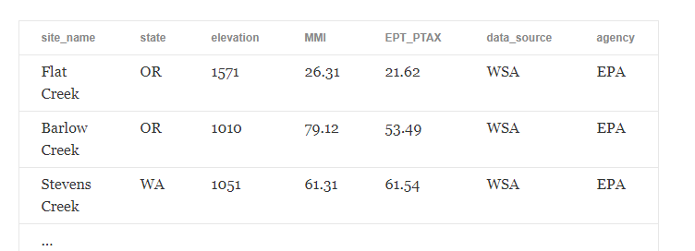
Tabular database

Slide 22
Relational Database
A relational database is a set of formally described tables from which data can be accessed or reassembled in many different ways without having to reorganize the database tables.
The standard user and application programming interface (API) of a relational database is the Structured Query Language (SQL).
SQL statements are used both for interactive queries for information from a relational database and for gathering data for reports.

Slide 23
The relational database was invented in 1970 by E. F. Codd, then a young programmer at IBM. In his paper, "A Relational Model of Data for Large Shared Data Banks," Codd proposed shifting from storing data in hierarchical or navigational structures to organizing data in tables containing rows and columns.
Each table, which is sometimes called a relation, in a relational database contains one or more data categories in columns, also called attributes.
Each row, also called a record or tuple, contains a unique instance of data, or key, for the categories defined by the columns.
Each table has a unique primary key, which identifies the information in a table. The relationship between tables can then be set via the use of foreign keys -- a field in a table that links to the primary key of another table.

Slide 24
For example, a typical business order entry database would include a table that described a customer with columns for name, address, phone number and so forth.
Another table would describe an order: product, customer, date, sales price and so forth.
A user of a relational database can then obtain a view of the database to fit their needs. For example, a branch office manager might like a view or report on all customers that bought products after a certain date.
A financial services manager in the same company could, from the same tables, obtain a report on accounts that need to be paid.

Slide 25
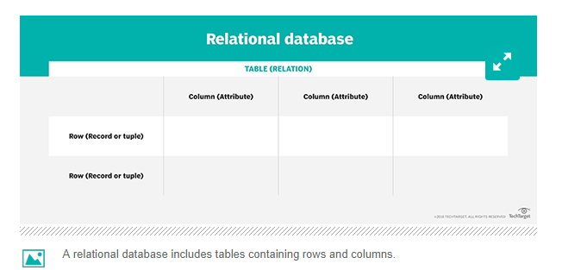

Slide 26
When creating a relational database, you can define the domain of possible values in a data column and further constraints that may apply to that data value.
For example, a domain of possible customers could allow up to 10 possible customer names but be constrained in one table to allowing only three of these customer names to be specifiable.

Slide 27
Standard relational databases enable users to manage predefined data relationships across multiple databases. Popular relational databases include Microsoft SQL Server, OracleDatabase, MySQL and IBM DB2.
Cloud-based relational databases, or database as a service (DBaaS), are also widely used because they enable companies to outsource database maintenance, patching and infrastructure support requirements.
Cloud relational databases include Amazon Relational Database Service (RDS), Google Cloud SQL, IBM DB2 on Cloud, Microsoft Azure SQL Database and Oracle Database Cloud Service.

Slide 28
Other relational database advantages include:
Accurate: Data is stored just once, which eliminates data deduplication.
Flexible: Complex queries are easy for users to carry out.
Collaborative: Multiple users can access the same database.
Trusted: Relational database models are mature and well-understood.
Secure: Data in tables within relational database management systems (RDBMSes) can be limited to allow access by only particular users.

Slide 29
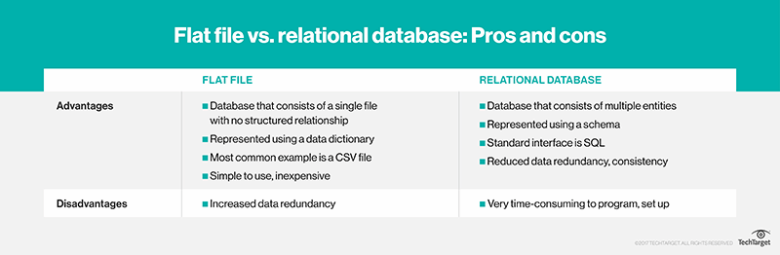

Slide 30
THANK YOU

