Slide 1
Data , information and units of data storage

Slide 2
Objectives
To Understand about Data
To Understand about information
To Understand about the memories and storage devices

Slide 3
What is Data?
Raw facts and figures
Numbers, characters, symbols, images etc., which can be processed by a computer
Data must be interpreted, by a human or machine, to derive meaning
Data is meaningless because it’s just raw facts

Slide 4
Types of Data
ALPHANUMERIC DATA (COMBINATION OF NUMBERS AND LETTERS)
TEXT DATA (SENTENCES & PARAGRAPHS USED IN WRITTEN COMMUNICATION)
IMAGE DATA (GRAPHICS, SHAPES, FIGURES ETC)
AUDIO (HUMAN VOICE & OTHER SOUNDS)

Slide 5
Example-:
Yes, Yes, No, Yes, No, Yes, No, Yes
42, 63, 96, 74, 56, 86
111192, 111234
All this data is meaningless until they are given a CONTEXT and PROCESSED into a useable form and when it is processed it becomes information

Slide 6
Information
Data that has been processed within a context to give it meaning.
"Information is data that has been processed”
"Information is interpreted data"
Information is meaningful
So when we combine all the meaningless data then it becomes a useful inforamtion

Slide 7
Example-:
Raw Data
55,77,82,90,65
Test scores achieve by students
Context
Processing
Information
Average test score calculated and show’s a student’s scores in an assessment

Slide 8
Difference Between Data and Information
Data
Raw Facts of figures
No Contextual meaning
Just numbers and text
Information
Data with exact meaning
Processed data and organized context

Slide 9
Key Terms-:
Bits
Bytes
Binary numbers
All of the prefixes related to storage
KB
MB
GB
TB

Slide 10
Bit
bit comes from the word “binary digit”
It is the basic unit of information for computers
1 or 0 are the only values

Slide 11
What is a Byte?
Eight bits grouped together as a unit
Provides enough different combinations of 0’s and 1’s to represent 256 individual characters
Numbers
Uppercase and lowercase letters
Punctuation marks

Slide 12
1 Byte = 8 bits
Each keyboard character is stored as a Byte
Example -: A = 01000001

Slide 13
Units-bigger then bytes
Byte a grouping of eight bits for instance --> 0110 0001
Kb (kilobyte) about 1000 bytes
Mb (megabyte) about one thousand Kb or one million bytes
Gb (gigabyte) about one thousand Mb or one billion bytes
Tb (terabyte) is about one thousand Gb or one trillion bytes

Slide 14
Terms for Storage Capacities
1 bit = 0 or 1
8 bits = 1 byte
1 thousand bytes = kilobyte (KB)
1 million bytes = megabyte (MB)
1 billion bytes = gigabyte (GB)
1 trillion = terabyte (TB)

Slide 15
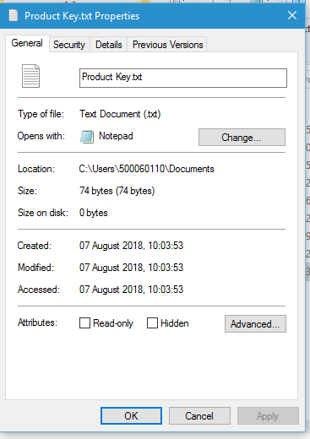
Examples in real life-:
A file with size =74 Bytes

Slide 16
74 Bytes =74 * 8 Bits
=592 Bits

Slide 17
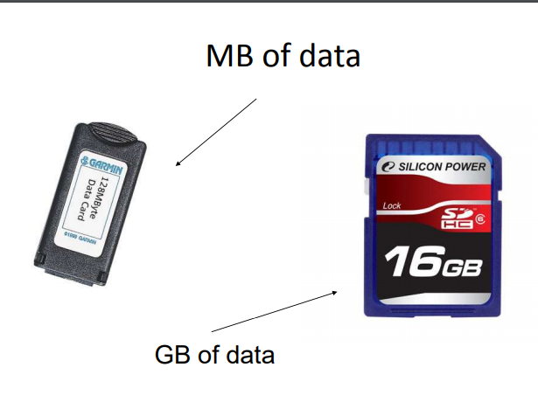

Slide 18
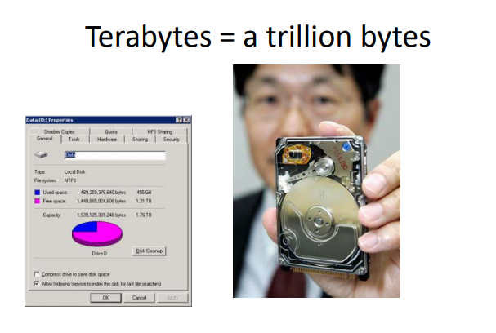

Slide 19
How is memory measured?
By number of bytes available for storage
1 KB = 1024 bytes

Slide 20
