Slide 1
Module 3( Online lectures are highlighted using red color)
Module-3 Array, Structure and Union
Introduction to data structures, Arrays - concepts, declaration, definition, One-Dimensional arrays, Storage representation, character array (introduction to strings)
Two-dimensional and Multi-dimensional arrays
Variable length arrays, Arrays and functions (Array as functions argument)
Dynamic memory managements functions, string handling using library functions
Derived types - Structures- declaration & definition, Nested structures
Arrays of structures, Structures and functions, pointers to structures
Self-referential structures, Access structure members using pointers
Unions, typedef (creating structures and union), ADT, Reflection & Discussion

Slide 2
Pointer usage
The C language was developed along with the UNIX operating system in the AT & T Bell Labs.The C language language was actually developed for programming the UNIX OS.Thus a special tool was needed which was close to the hardware and could access memory easily and efficiently.Hence,pointers were introduced in C.
It supports direct interactions with hardware. That's a must for any systems programming language as without pointers you are unable to write a device driver. For example, if you want to read data from a device in your program, you need to instruct the device to write n bytes in address a. Because of that, you need a data type that can store addresses and an operator that returns the address of a variable.
Imagine you have an array of data with 100 positions. If you have a pointer to this array (the pointer points to the first element by means of its address in memory) you can easily access its data by simply arithmetic (you can add an offset to the pointer to access a given position in the array).
A common use of pointers is to reference a dynamically allocated data structure. The malloc() function returns a pointer (address) to the beginning of the allocated data. You can store this address in a pointer of a specific type (which you can define your own, for complex types for example) and use the data with correct alignment
Notes:
https://www.codesdope.com/c-array/

Slide 3
Arrays
In C language, arrays are referred to as structured data types. An array is defined as finite ordered collection of homogenous data, stored in contiguous memory locations.
finite means data range must be defined.
ordered means data must be stored in continuous memory addresses.
homogenous means data must be of similar data type.
Example where arrays are used,
to store list of Employee or Student names,
to store marks of a students,
or to store list of numbers or characters etc.
Since arrays provide an easy way to represent data, it is classified amongst the data structures in C. Other data structures in c are structure, lists, queues, trees etc.

Slide 4
Declaring an Array (One dimensional)
Note: Declaration ?
int a; creating memory for the variable a which will take 4 bytes (64bit compiler)
(It is not for user, it is for compiler)
a
100
Initialization?
a=10; a
printf(“%d”, a)
Here, a represents value
Output: 10 100
Garbage value
10

Slide 5
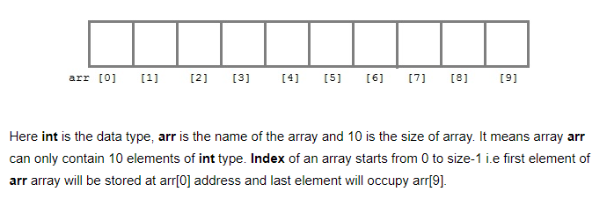
Declaring an Array
Declaring one dimensional Array
Arrays must be declared before they are used. General form of array declaration is,
data-type variable-name[size];
for example : int arr[10];

Slide 6
Initialization of an Array
After an array is declared it must be initialized. Otherwise, it will contain garbage value(any random value). An array can be initialized at either compile time or at runtime.
Compile time Array initialization (1 D array)
1. Array declaration by initializing elements
int arr[] = {10, 20, 30, 40} ;
Note: Compiler creates an array of size 4.
// above is same as int arr[4] = {10, 20, 30, 40};
Compile time Array initialization (2 D array)
When we initialize a 1 D array during declaration, we need not to specify the size of it. However that’s not the case with 2D array, we must always specify the second dimension even if we are specifying elements during the declaration. Example

Slide 7
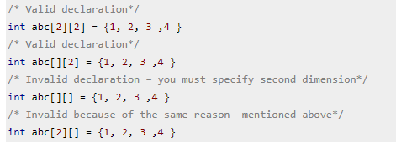
Initialization of an Array
Notes:
Reason: For passing multidimensional arrays is, first array dimension does not have to be specified. The second (and any subsequent) dimensions must be given
Reason: If we remember what we learned about simple arrays and functions, however, two questions arise. First, in our earlier function definitions, we were able to leave out the (single) array dimension, with the understanding that since the array was really defined in the caller, we didn't have to say (or know) how big it is. The situation is the same for multidimensional arrays, although it may not seem so at first. The hypothetical function func above accepts a parameter a, where a is an array of 5 things, where each of the 5 things is itself an array. By the same argument that applies in the single-dimension case, the function does not have to know how big the array a is, overall. However, it certainly does need to know what a is an array of. It is not enough to know that a is an array of ``other arrays''; the function must know that a is an array of arrays of 7 ints. The upshot is that although it does not need to know how many ``rows'' the array has, it does need to know the number of columns. That is, if we want to leave out any dimensions, we can only leave out the first one:

Slide 8
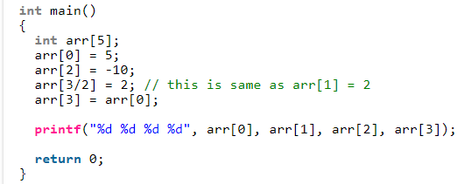
Initialization of an Array
2. Initializing values one after another.
Note: arr[] (It gives compile time error if we do not specify size of array)
Notes:
Output: 5 2 -10 5

Slide 9
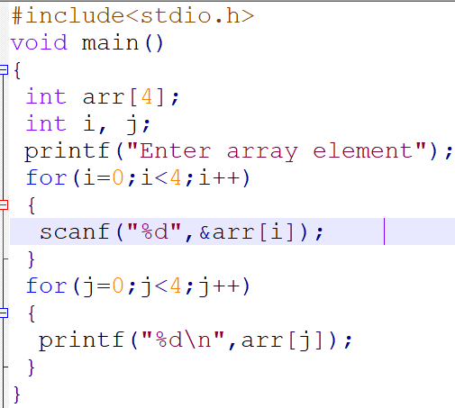
Initialization of Array
3. Runtime Array initialization (1D array): store user input data into 1 D array An array can also be initialized at runtime using scanf() function. This approach is usually used for initializing large array, or to initialize array with user specified values. Example,

Slide 10
Initialization of Array
Runtime Array initialization (2 D array): store user input data into 2 D array We can calculate number of elements in 2 dimensional array using this formula:
The array arr[n1][n2] can have n1*n2 elements. The array that we have in the example below is having the dimensions 5 and 4. These dimensions are known as subscripts. So this array has first subscript value as 5 and second subscript value as 4. So the array
abc[5][4] can have 5*4 = 20 elements.
To store the elements entered by user we are using two for loops, one of them is a nested loop. The outer for loop(for row) runs from 0 to the (first subscript -1) and the inner for loops(for column) runs from 0 to the (second subscript -1). This way the the order in which user enters the elements would be abc[0][0], abc[0][1], abc[0][2]…so on.

Slide 11
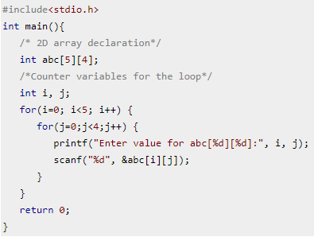
Example

Slide 12
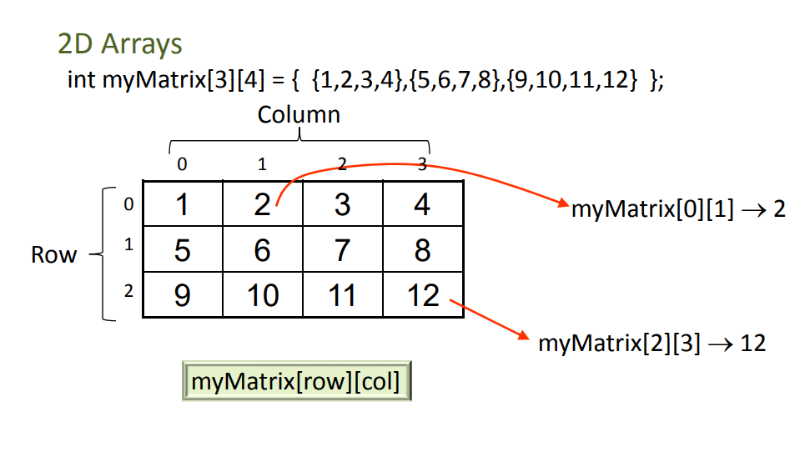
How arrays are stored in memory: Conceptual Representation

Slide 13
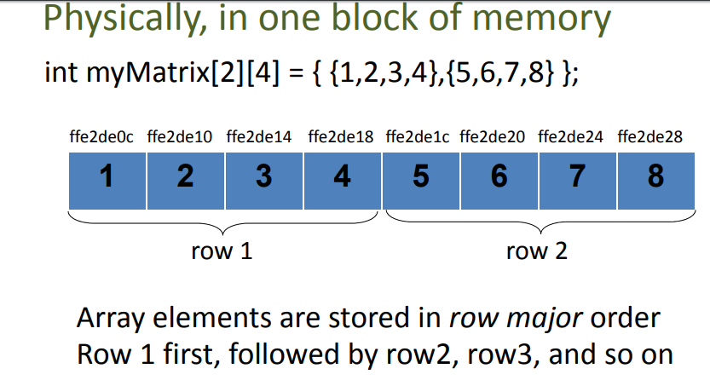
Actual Representation

Slide 14
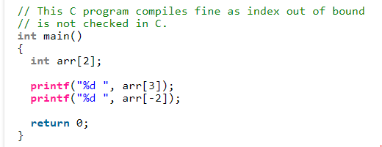
Points to remember:
1. No Index Out of bounds Checking: There is no index out of bound checking in C, for example the following program compiles fine but may produce unexpected output when run.
2. In C, it is not compiler error to initialize an array with more elements than specified size. For example the below program compiles fine.
Notes:
Output: 2 3 4

Slide 15
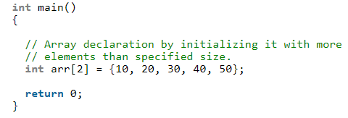
Points to remember:
We will not get compile time error but get a warning

Slide 16
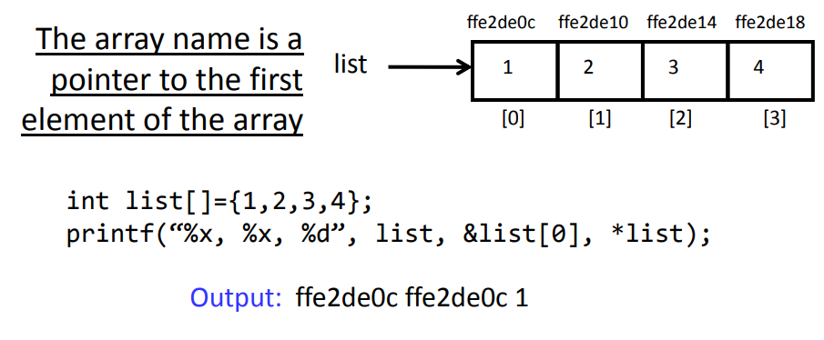
Arrays and Pointer in C (important)

Slide 17
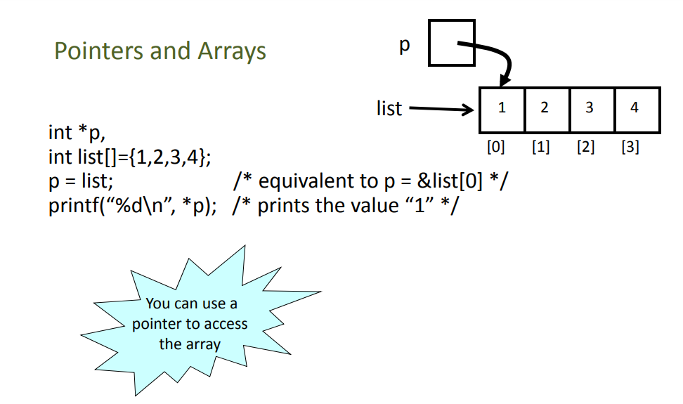
Arrays and Pointer in C (important)

Slide 18
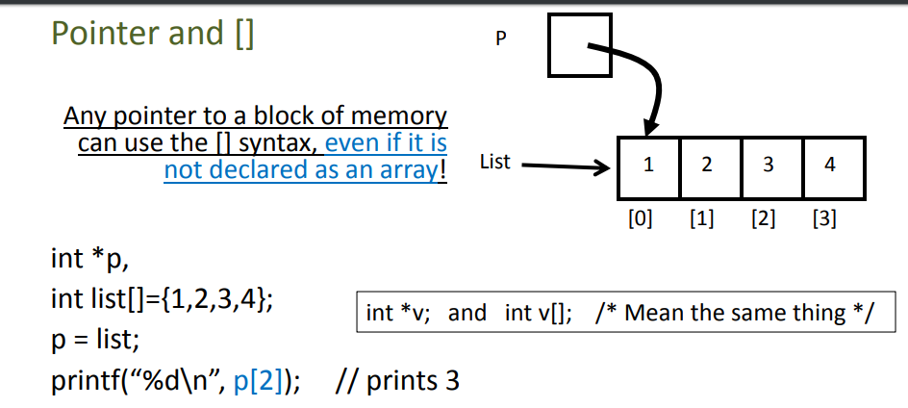
Pointer and []

Slide 19
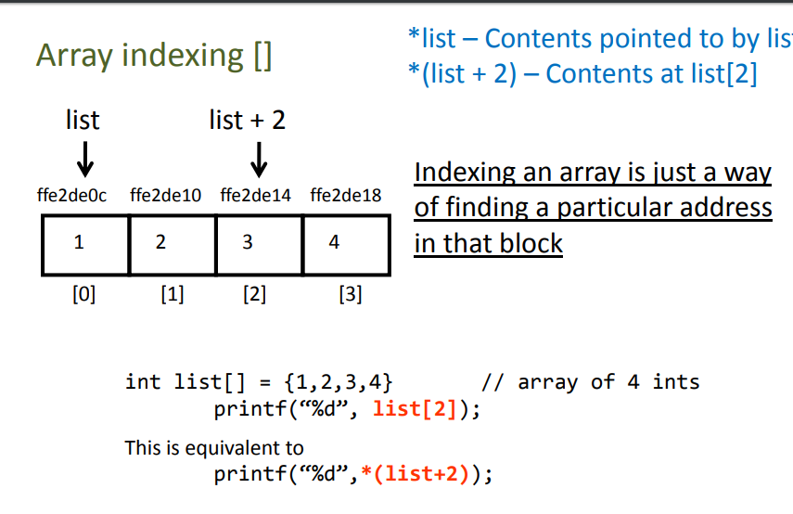
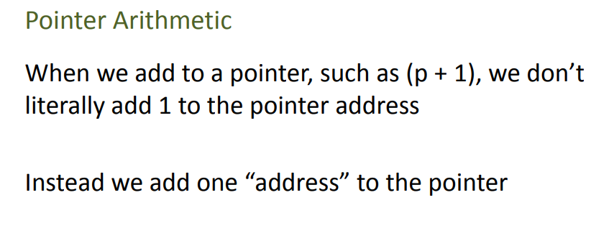

Slide 20
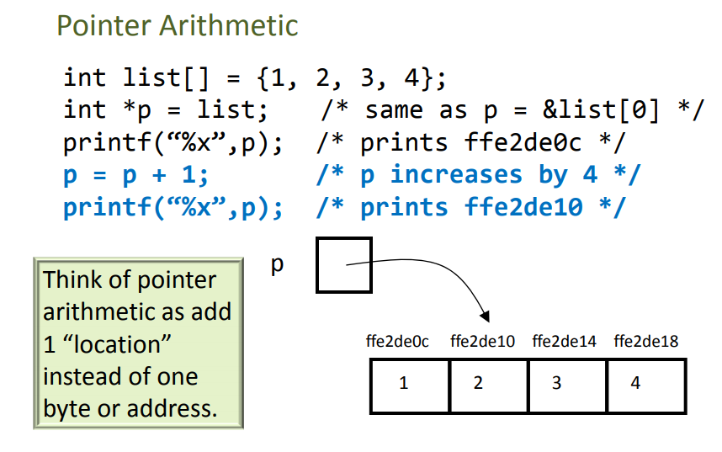

Slide 21
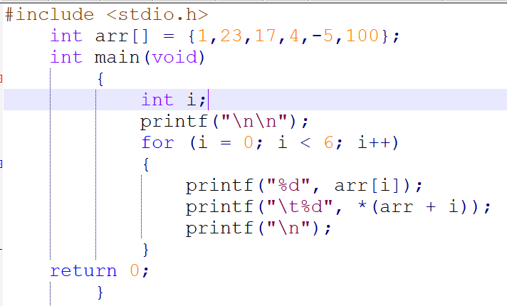
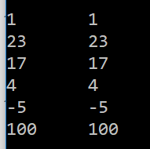
Example-1
Output

Slide 22
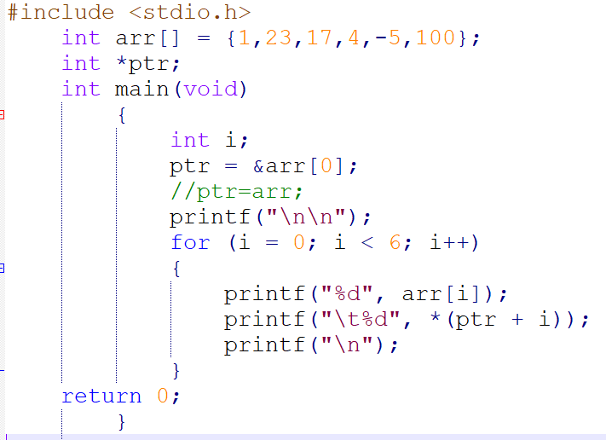
Example-2
Output

Slide 23
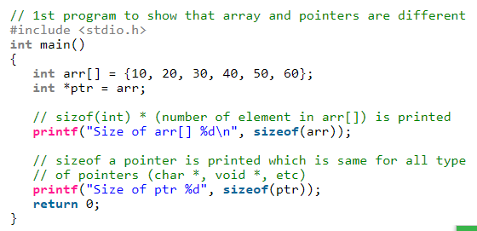
Difference between pointer and array in C?
Behavior of sizeof operator
sizeof(array) returns the amount of memory used by all elements in array sizeof(pointer) only returns the amount of memory used by the pointer variable itself
Output:
Size of arr[] 24
Size of ptr 4
Notes:
Most of the time, pointer and array accesses can be treated as acting the same, the major exceptions being:

Slide 24
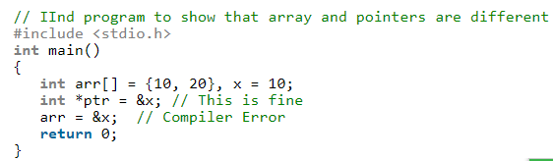
Difference between pointer and array in C?
2. Assigning any address to an array variable is not allowed.
Note that array name is pneumonic whereas pointer is a variable.
Notes:
Array name is not a variable but mnemonic (other way of representing memory) whereas pointer is a variable: Pointer variable can be assigned a value whereas array variable cannot be.
int a[10];
int *p;
p=a; /*legal*/
a=p; /*illegal*/

Slide 25
Similarity between pointer and array in C?
1) Array name gives address of first element of array.
Array name in C language behaves like a constant pointer and represents the base address of the array.
It points to the first element of the array which is located at 0th index. As array name serves like a constant pointer, it cannot be changed during the course of program execution.
Example: int arr[] = {1,23,17,4,-5,100};
Here we have an array containing 6 integers. Here,
arr = &arr[0];
and
*(arr+0)=a[0];

Slide 26
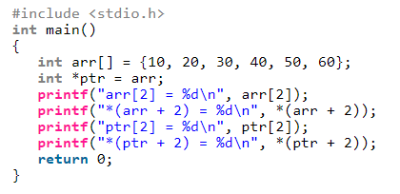
Similarity between pointer and array in C?
2) Array members are accessed using pointer arithmetic. Compiler uses pointer arithmetic to access array element. For example, an expression like “arr[i]” is treated as *(arr + i) by the compiler. That is why the expressions like *(arr + i) work for array arr, and exparr[2] = 30

Slide 27
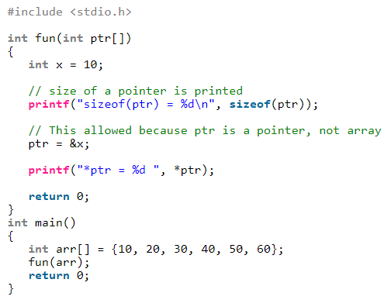
Similarity between pointer and array in C?
3. Array parameters are always passed as pointers, even when we use square brackets.
Output:
sizeof(ptr) = 4
*ptr = 10

Slide 28
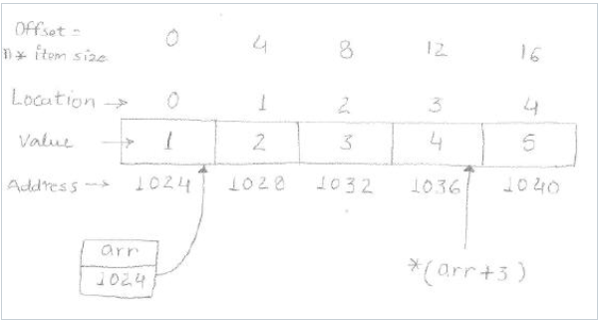
Computing address in one Dimensional Arrays
Below is the pictorial representation of arr, where the array arr points to first element at location 0. This element has address 1024 that is the base address of the array and represented by the array name.

Slide 29
Computing address in one Dimensional Arrays
Elements stored in an array are accessed by following the syntax "arrayName[index]" e.g., arr[3] yields 4 in above example.
This strategy computes the address of the desired element by combining the base address of the array with the index of desired element.
Every array element takes a fixed number of bytes, which is known at compile time and this is decided by the type of array. In above example array is of type integer thus consumes 4 bytes (size of integer) per element.
nth element address = base address of array + (n * size of element in bytes)
Ex: arr[3]= 1024+(3*4)=1036 (Here base address is 1024 and n is 3)

Slide 30
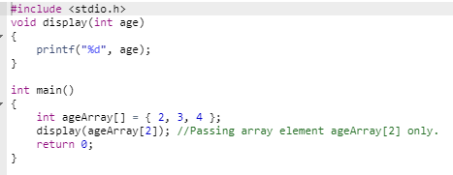
Array and Function (Important)
Passing Array to Function Single element of an array can be passed in similar manner as passing variable to a function.

Slide 31
Array and Function
Passing an entire one-dimensional array to a function
While passing arrays as arguments to the function, only the name of the array is passed (,i.e, starting address of memory area is passed as argument).
When we pass an array to a function, the reference of the array "decays" into a pointer to its first element.
Declaring Function with array in parameter list
We can either have an array in parameter.
int sum (int arr[])
Or, we can have a pointer in the parameter list, to hold base address of array.
int sum (int* ptr)
int sum (int arr[]) means exactly the same as int sum (int* ptr)

Slide 32
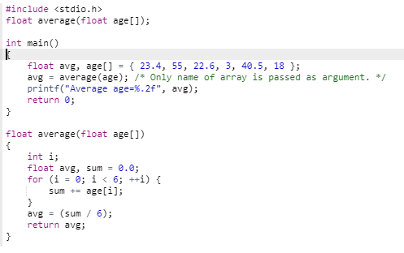
Example 1
Example: C program to pass an array containing age of person to a function. This function should find average age and display the average age in main function.

Slide 33
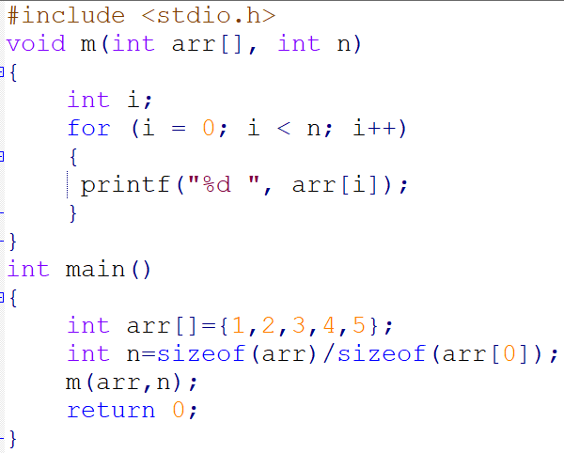
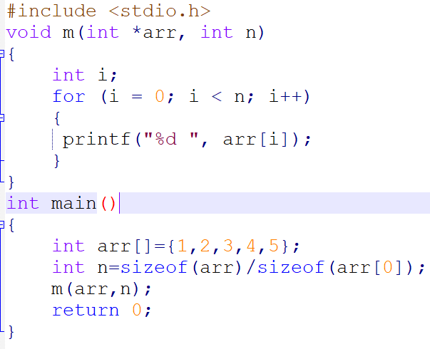
Example 2
PART A PART B
Notes:
Note: If we are taking the size of the array from the user. In that case, the size of the array is not fixed. Here, we need to pass the size of array as the second argument to the function.

Slide 34
Example 2
One important thing for passing multidimensional arrays is, first array dimension does not have to be specified. The second (and any subsequent) dimensions must be given.
For passing multidimensional arrays is, first array dimension does not have to be specified. The second (and any subsequent) dimensions must be given
Reason: If we remember what we learned about simple arrays and functions, however, two questions arise. First, in our earlier function definitions, we were able to leave out the (single) array dimension, with the understanding that since the array was really defined in the caller, we didn't have to say (or know) how big it is. The situation is the same for multidimensional arrays, although it may not seem so at first. The hypothetical function func above accepts a parameter a, where a is an array of 5 things, where each of the 5 things is itself an array. By the same argument that applies in the single-dimension case, the function does not have to know how big the array a is, overall. However, it certainly does need to know what a is an array of. It is not enough to know that a is an array of ``other arrays''; the function must know that a is an array of arrays of 7 ints. The upshot is that although it does not need to know how many ``rows'' the array has, it does need to know the number of columns. That is, if we want to leave out any dimensions, we can only leave out the first one:
1

Slide 35
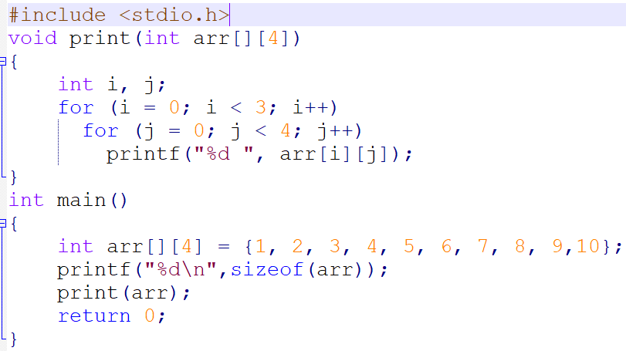
Passing 2d array to function

Slide 36
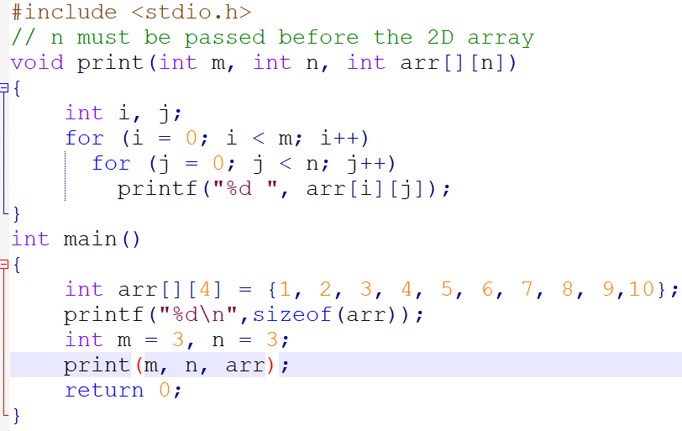
If compiler is C99 compatible From C99, C language supports variable sized arrays to be passed simply by specifying the variable dimensions

Slide 37
String
In C programming, array of characters is called a string. A string is terminated by a null character \0. For example:
"c string tutorial”
Declaration of strings
1. Strings as character arrays
When strings are declared as character arrays, they are stored like other types of arrays in C.
For example, if str[] is an auto variable then string is stored in stack segment, if it’s a global or static variable then stored in data segment, etc.

Slide 38
Declaration of strings

Slide 39
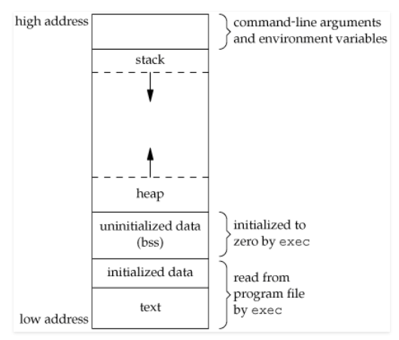
Memory layout of C Programs
contains the global variables and static variables that are initialized by the programmer.
Notes:
global string defined by char s[] = “hello world” in C outside the main (i.e. global) would be stored in initialized read-write area. And a global C statement like const char* string = “hello world” makes the string literal “hello world” to be stored in initialized read-only area and the character pointer variable string in initialized read-write area.

Slide 40
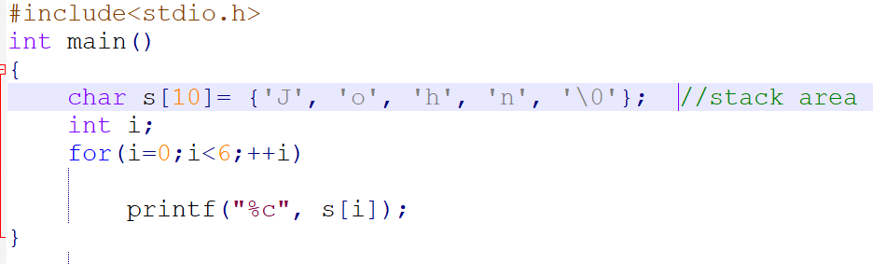
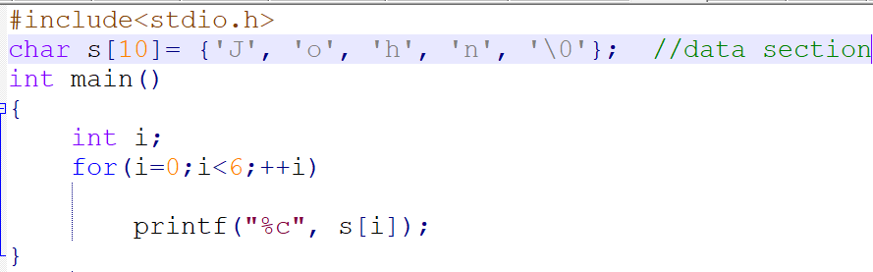
Examples:

Slide 41
Declaration of strings
2. Strings using character pointers Using character pointer strings can be stored in two ways:
a) Read only string in a shared data segment. When string value is directly assigned to a pointer, in most of the compilers, it’s stored in a read only block (generally in data segment) that is shared among functions.
char *str = "GfG";
In the above line “GfG” is stored in a shared read only location, but pointer str is stored in a read-write memory
We can change str to point something else but cannot change value at present str.
So this kind of string should only be used when we don’t want to modify string at a later stage in program.

Slide 42
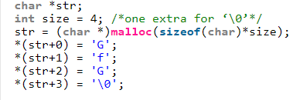
Declaration of strings
b) Dynamically allocated in heap segment( Read –write string ) Strings are stored like other dynamically allocated things in C and can be shared among functions.

Slide 43
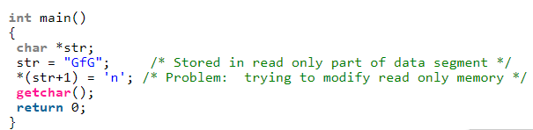
Examples:
Example 1 (Try to modify string) The below program may crash (gives segmentation fault error) because the line *(str+1) = ‘n’ tries to write a read only memory.
Example2. This program works perfectly fine as str[] is stored in writable stack segment.

Slide 44
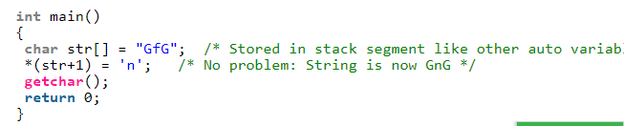
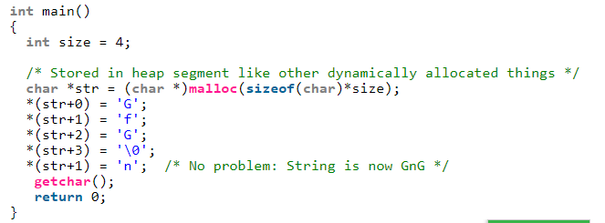
Examples:
Example3. This program also works perfectly fine as data at str is stored in writable heap segment.

Slide 45
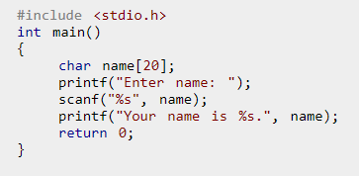
Reading Strings from user
Using scanf() function: We can use scanf() function to read a string like any other data type Howerver, the scanf() function only takes the first entered word. The function terminates when it encounters a white space.
Example:
Output:
Enter name: Dennis Ritchie
Your name is Dennis.
Notes:
Output:
Enter name: Dennis Ritchie
Your name is Dennis.

Slide 46
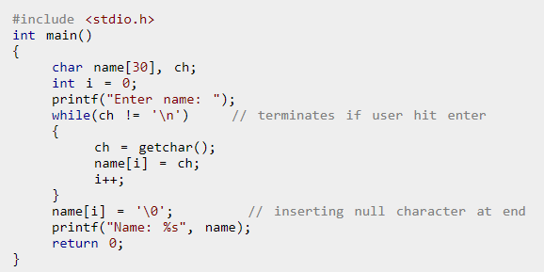
Reading Strings from user
Reading a line of text
2. Using getchar() to read a line of text

Slide 47
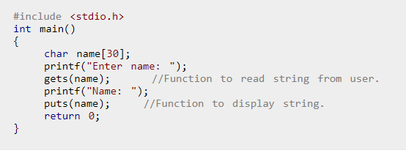
Reading Strings from user
This process is repeated until the user enters return (enter key). Finally, the null character is inserted at the end to make it a string.
This process to take string is tedious.
3. Using standard library function to read a line of text
a. C program to read line of text using gets() and puts()
There are predefined functions gets() and puts() in C language to read and display strings respectively.
Notes:
Note: Though, gets() and puts() function handle strings, both these functions are defined in "stdio.h" header file.

Slide 48
Reading String from input with space character
1. fgets (name, 100, stdin);100 is the max length of the buffer. You should adjust it as per your need.
2. scanf ("%[^\n]%*c", name);The [] is the scanset character. [^\n] tells that while the input is not a newline ('\n') take input. Then with the %*c it reads the newline character from the input buffer (which is not read), and the * indicates that this read in input is discarded (assignment suppression), as you do not need it, and this newline in the buffer does not create any problem for next inputs that you might take.
Note you can also use gets but ....
Never use gets(). Because it is impossible to tell without knowing the data in advance how many characters gets() will read, and because gets() will continue to store characters past the end of the buffer, it is extremely dangerous to use. It has been used to break computer security. Use fgets() instead.

Slide 49
Online lecture(Refer blackboard voice over PPT for these topics)
Dynamic memory managements functions, string handling using library functions
String handling using library functions
Refer these programs

Slide 50
Dynamic Memory Allocaion
Dynamic Memory Allocation in C Programming Language - C language provides features to manual management of memory, by using this feature we can manage memory at run time, whenever we require memory allocation or reallocation at run time by using Dynamic Memory Allocation functions we can create amount of required memory.
There are following functions:
malloc - It is used to allocate specified number of bytes (memory blocks).
calloc - It is used to allocate specified number of bytes (memory blocks) and initialize all memory with 0.
reaclloc - It is used to reallocate the dynamically allocated memory to increase or decrease amount of the memory.
free - It is used to release dynamically allocated memory.

Slide 51
void *realloc(void *ptr, size_t size);
realloc deallocates the old object pointed to by ptr and returns a pointer to a new object that has the size specified by size. The contents of the new object is identical to that of the old object prior to deallocation, up to the lesser of the new and old sizes. Any bytes in the new object beyond the size of the old object have indeterminate values.
realloc() should only be used for dynamically allocated memory. If the memory is not dynamically allocated, then behavior is undefined.

Slide 52
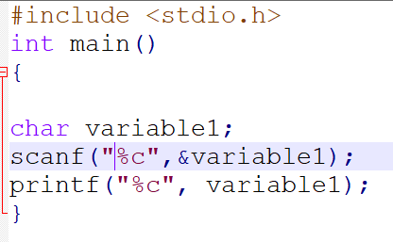
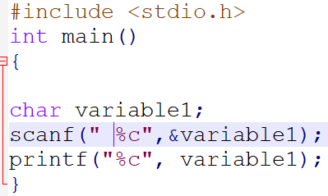
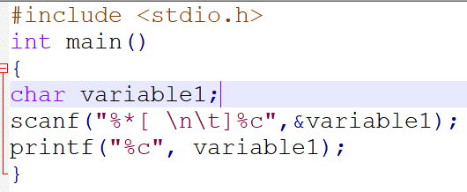
Try out these examples:

Slide 53
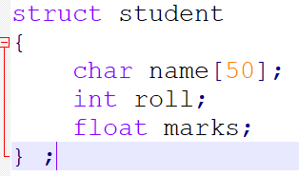
Structures in C
A Structure is a user defined data type that can store related information together. (Unlike arrays which permit a programmer to group only elements of same data types)
How to create a structure?
‘struct’ keyword is used to create a structure. Example
This tells the compiler how big our struct is and how the different data items (“members”) are laid out in memory. But it does not allocate any memory

Slide 54
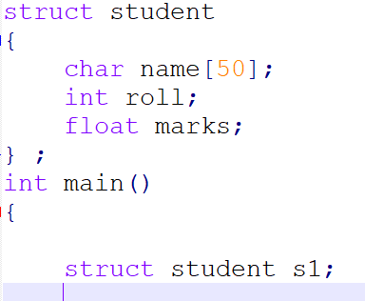
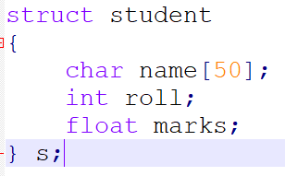
Structures declaration in C
How to declare structure variables? A structure variable can either be declared with structure declaration or as a separate declaration like basic types.
A variable declaration with structure declaration.
A variable declaration like basic
data types
Defines a structure variable named s and s1

Slide 55
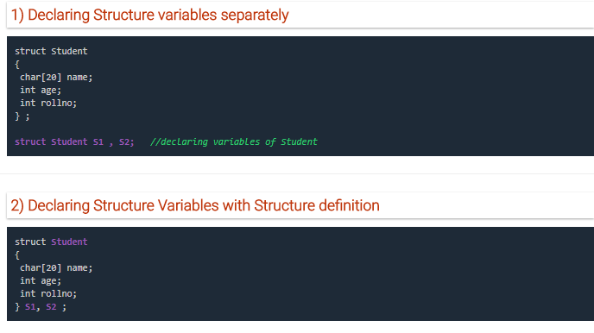
Example:

Slide 56
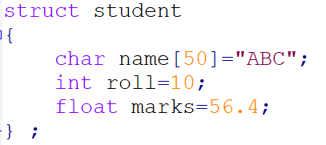
initializing structure members
How to initialize structure members?
Structure members cannot be initialized with declaration. For example the following C program fails in compilation.
The reason for above error is simple, when a datatype is declared, no memory is allocated for it. Memory is allocated only when variables are created.
Notes:
Note: In C++, the struct keyword is optional before in declaration of variable. In C, it is mandatory.

Slide 57
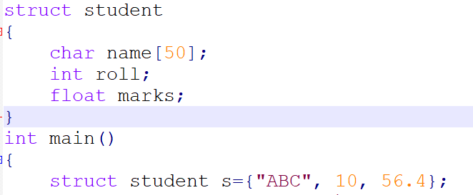
Initializing structure members
Structure members can be initialized using curly braces ‘{}’. For example, following is a valid initialization.
Notes:
C struct memory layout:
https://fresh2refresh.com/c-programming/c-structure-padding/

Slide 58
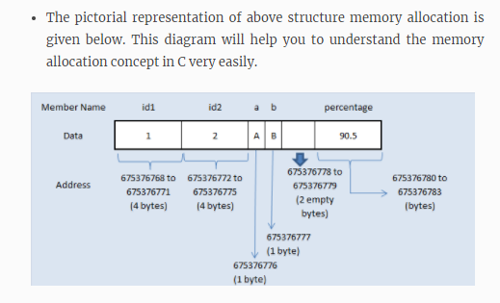
HOW STRUCTURE MEMBERS ARE STORED IN MEMORY? (Not part of syllabus)
Always, contiguous(adjacent) memory locations are used to store structure members in memory. Consider below example to understand how memory is allocated for structures.
There are 5 members declared for structure in above program. In 32 bit compiler, 4 bytes of memory is occupied by int datatype. 1 byte of memory is occupied by char datatype and 4 bytes of memory is occupied by float datatype.
Refer the program here
Notes:
Click here for additional details: https://fresh2refresh.com/c-programming/c-struct-memory-allocation/

Slide 59
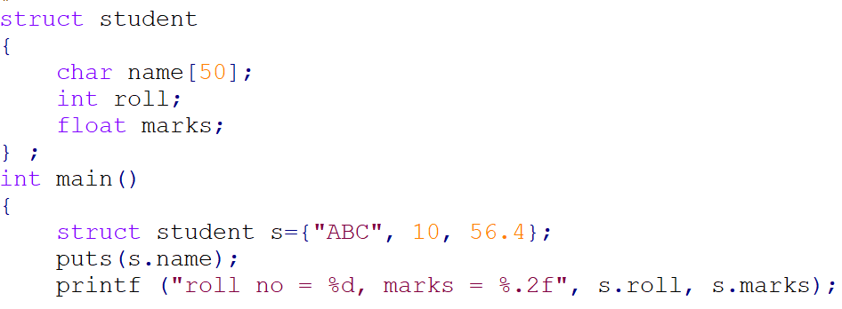
How to access structure elements?
How to access structure elements?
Structure members are accessed using dot (.) operator.

Slide 60
C – Array of Structures
C Structure is collection of different datatypes ( variables ) which are grouped together. Whereas, array of structures is nothing but collection of structures. This is also called as structure array in C.
This program is used to store and access “id, name and percentage” for 3 students. Structure array is used in this program to store and display records for many students. You can store “n” number of students record by declaring structure variable as ‘struct student record[n]“, where n can be 1000 or 5000 etc.
Refer the program here
Notes:
Reading string from input with space character?
Use:
fgets (name, 100, stdin);100 is the max length of the buffer. You should adjust it as per your need.
Use:
scanf ("%[^\n]%*c", name);The [] is the scanset character. [^\n] tells that while the input is not a newline ('\n') take input. Then with the %*c it reads the newline character from the input buffer (which is not read), and the * indicates that this read in input is discarded (assignment suppression), as you do not need it, and this newline in the buffer does not create any problem for next inputs that you might take.
Note you can also use gets but ....
Never use gets(). Because it is impossible to tell without knowing the data in advance how many characters gets() will read, and because gets() will continue to store characters past the end of the buffer, it is extremely dangerous to use. It has been used to break computer security. Use fgets() instead.

Slide 61
Structures and functions
PASSING STRUCTURE TO FUNCTION IN C:
It can be done in below 3 ways.
Passing structure to a function by value
Passing structure to a function by address(reference)
No need to pass a structure – Declare structure variable as global
1. Passing structure to a function by value
In this program, the whole structure is passed to another function by value. It means the whole structure is passed to another function with all members and their values. So, this structure can be accessed from called function. This concept is very useful while writing very big programs in C.
Refer the program here

Slide 62
Structures and functions
2. PASSING STRUCTURE TO FUNCTION IN C BY ADDRESS:
In this program, the whole structure is passed to another function by address. It means only the address of the structure is passed to another function. The whole structure is not passed to another function with all members and their values. So, this structure can be accessed from called function by its address.
3. Declaring STRUCTURE VARIABLE AS GLOBAL IN C:
Structure variables also can be declared as global variables as we declare other variables in C. So, When a structure variable is declared as global, then it is visible to all the functions in a program. In this scenario, we don’t need to pass the structure to any function separately.
Refer the program here
Refer the program here

Slide 63
Pointers to structures
C structure can be accessed in 2 ways in a C program. They are,
Using normal structure variable
Using pointer variable
Dot(.) operator is used to access the data using normal structure variable and arrow (->) is used to access the data using pointer variable.
Refer programs here

Slide 64


Self-referential Structures(imp)
A self-referential C structure
is one which includes a pointer to
an “instance” of itself.
Notes:
https://stackoverflow.com/questions/588623/self-referential-struct-definition

Slide 65

Self-referential Structures(imp)

Slide 66
Online lecture(Refer blackboard voice over PPT for these topics)
Unions, typedef (creating structures and union), ADT, Reflection & Discussion

Slide 67


typedef
typedef :
typedef is used to give data type a new name.
This gives us a way to make code more readable by giving application-specific names to types.
so typedef defines a new type much like the built-in types int, double etc.
Notes:
Typical practice: Put typedef’s into a header file, and use type names in main program. If the definition of Color/Flight changes, you might not need to change the code in your main program file.

Slide 68


typedef
In C, typedef is considered as a storage class like other storage classes (auto, register, static and extern),nevertheless the purpose of typedef is to assign alternative names to existing types.
Output:
5 Compiler Error: multiple storage classes in
declaration specifiers

