Slide 1
Intro to Event LOG mining with R
Dave Langer
Data Science dojo meetup
January 4th, 2017

Slide 2
Intro
Sr. Director – BI & Analytics, Microsoft Manufacturing & Supply Chain IT.
20 years in IT, last 8 years at Microsoft.
Current team of responsible for BI, DW, Big Data, and Analytics platforms.
Recently recognized by KDNuggets.com as #1 Data Scientist on YouTube.

Slide 3
What’s in it for you
Goals
Brief introduction to event log mining.
Some hands-on experience mining event logs using OSS tools.
Get you excited about applying event log mining in your own work – tomorrow!
Non-Goals:
Teach you R programming.
Address specialized scenarios (e.g., Azure-scale event log mining).
Make you an expert on Process Mining algorithms.

Slide 4
Why Mine event logs?
As a Business/Data Analyst:
My workflows/processes aren’t meeting KPIs, how is work actually being done?
How do workflows/processes vary with season, geography, product line, etc.?
As a Program/Product Manager:
How is my site/product/service/system actually being used?
How is usage changing over time?
As a Data Scientist:
Can mining event logs provide context/structure that provides additional insights?
Can I use these insights (e.g., temporal orderings) to engineer features for better models?

Slide 5
Our world view
For the next 90 or so minutes, everything is an event – and I mean everything!
Entering a purchase order in an ERP system.
Customer adding a product to their shopping cart on a website.
An IoT device taking a temperature reading.
Credit card authorization.
A user refreshing a Power BI dashboard.
A patient receiving a diagnosis.
Every event can (and should) be logged!
Architect/design for event logs.
Configure for event logging.
Demand event log options (e.g., SQL Server DB Audit Specifications)!

Slide 6
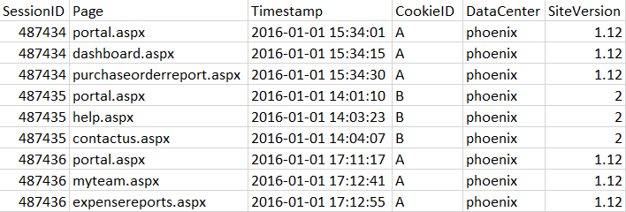
Contrived example
Event Log
Activity
Timestamp
Resource?
Case
Case
Events
Case
Traces for this event log:
Portal, dashboard, purchaseorderreport
Portal, help, contactus
Portal, myteam, expensereports

Slide 7
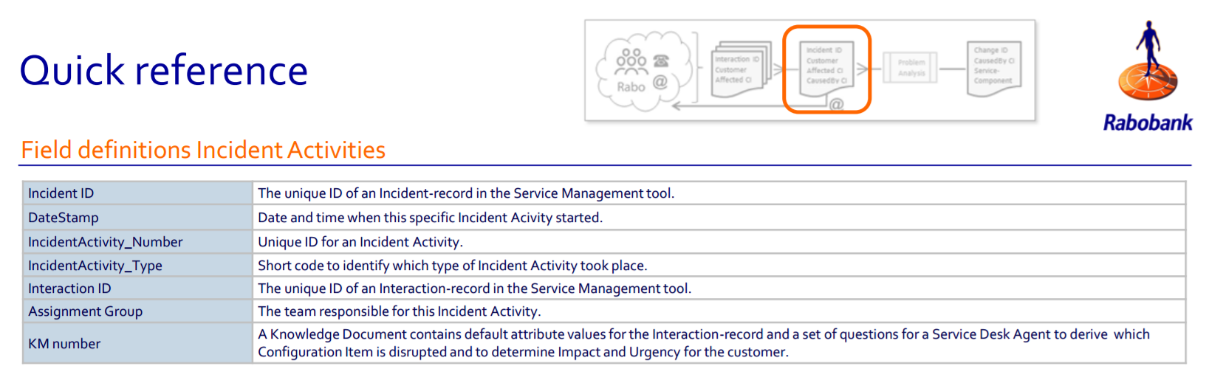
Case study
2014 Business Processing Intelligence Challenge (BPIC)
Scenario – Enterprise IT Operations for a Bank.
Data – Event log of Incident Management activities:
Activities related to returning an IT service back to normal operation.

Slide 8
DEMO

Slide 9
Where to learn more
Great free, online introductory course on Process Mining from FutureLearn:
https://www.futurelearn.com/courses/process-mining
In-depth course – Process Mining: Data Science in Action from Coursera:
https://www.coursera.org/learn/process-mining
The definitive book – Process Mining: Data Science in Action
https://www.amazon.com/Process-Mining-Data-Science-Action/dp/3662498502
Latest Process Mining research:
http://www.processmining.org
The edeaR package on CRAN:
https://cran.r-project.org/web/packages/edeaR/index.html

Slide 10
Thank you!

Slide 11
Appendix

Slide 12
Get the Data, tools, and code
The GitHub repo – R code and PowerPoint:
https://github.com/EasyD/IntroToEventLogMiningMeetup
The case study data – 2014 BPIC incident activity records:
http://www.win.tue.nl/bpi/lib/exe/fetch.php?media=2014:detail_incident_activity.zip
DOI - 10.4121/uuid:86977bac-f874-49cf-8337-80f26bf5d2ef
ProM – Process Mining workbench:
http://www.promtools.org/doku.php
Azure Data Science VM:
https://azure.microsoft.com/en-us/marketplace/partners/microsoft-ads/standard-data-science-vm/

Slide 13
Terminology
Timestamp: The date and time at which something worthy of note happened.
Activity: A well-defined step in some workflow/process.
Resource: Staff and/or other assets used/consumed in execution of an activity.
Lifecycle: Metadata tying an activity to an end-to-end model including state such as schedule, start, assign, and complete.
Event: At a minimum, the combination of an activity and a timestamp. Optionally, events may have associated resources, lifecycle, and other data.
Case: A related set of events denoted, and connected, by a unique identifier where the events can be ordered.
Event Log: A list of cases and associated events.
Trace: A distinct pattern of case activities within an event log where each activity is present at most once per trace. Event log typically contain many traces.

