Slide 1
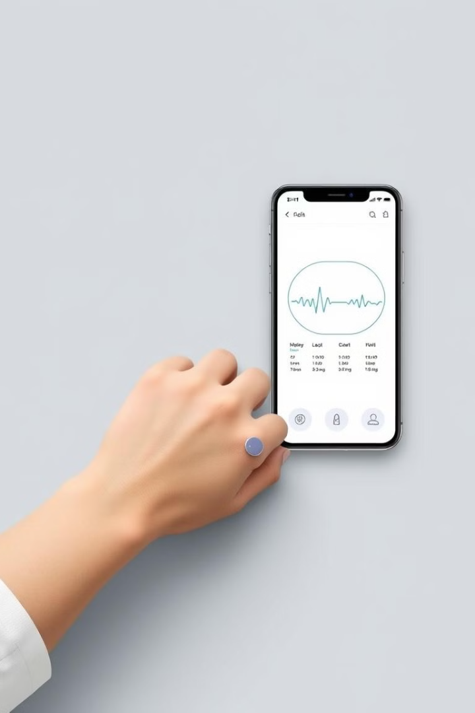
Remote Patient Monitoring: Transforming Healthcare Delivery
Explore how remote patient monitoring is changing healthcare. This technology offers proactive, personalized, and efficient care.
by Aditya K
IIHMR-B
AI & DS class

Slide 2
A Brief History of Remote Patient Monitoring
Remote patient monitoring has evolved significantly over the decades. It began with NASA's astronaut monitoring in the 1960s.
Early Stages
Modern Advancements
1960s: NASA's vital sign monitoring
2000s: Wireless tech & data analytics
1970s-90s: Telemedicine development
2010s-Present: IoT, cloud, and AI
Today, IoT, cloud computing, and AI drive personalized, preventative care.
Page 01

Slide 3
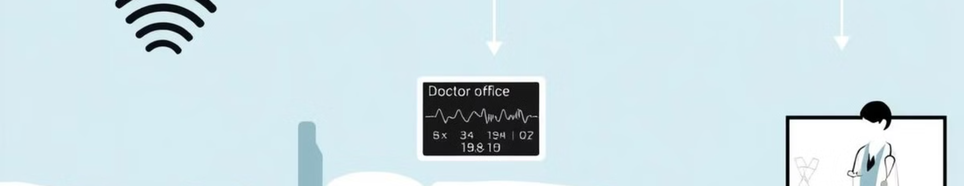



What is Remote Patient Monitoring (RPM)?
RPM uses technology to monitor health data outside clinics. Wearable sensors and mobile apps collect patient data.
Patient-Facing Devices
Communication Infrastructure
Data Analytics Platform
Wearables, blood pressure cuffs, glucose meters.
Cloud storage, processing, and analysis.
Secure data via Bluetooth, Wi-Fi, or cellular.
Page 02

Slide 4
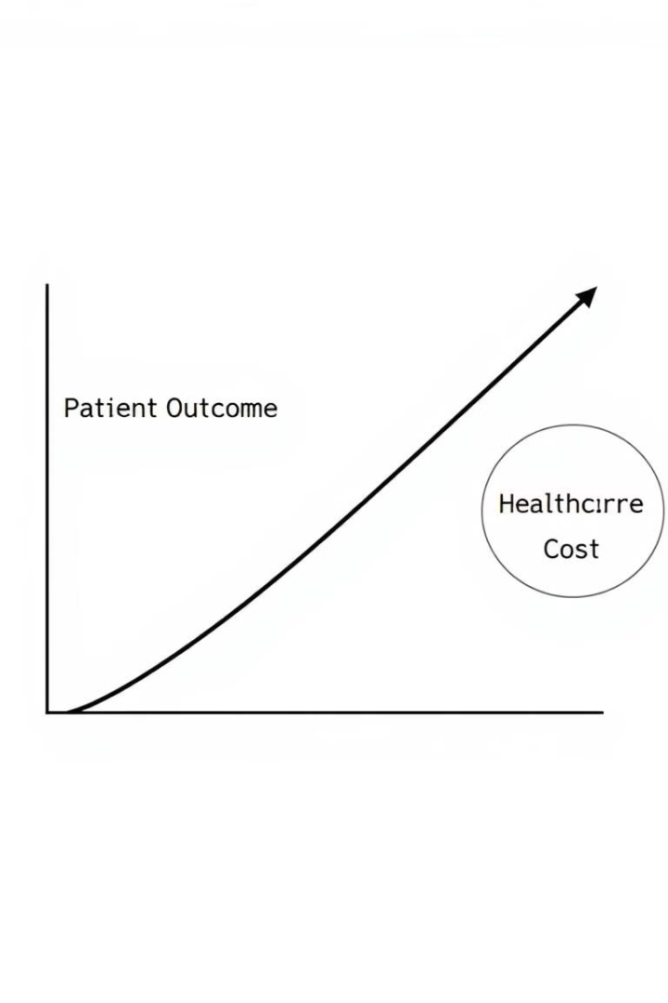



Benefits of Remote Patient Monitoring
RPM improves patient outcomes with continuous monitoring. It also reduces healthcare costs through proactive interventions.
Improved Outcomes
Reduced Costs
Enhanced Engagement
Prevents ER visits & hospitalizations.
Early detection of health issues.
Active participation in care.
Patients become active participants, improving adherence to treatment plans. It offers increased access, especially for rural populations.
Page 03

Slide 5
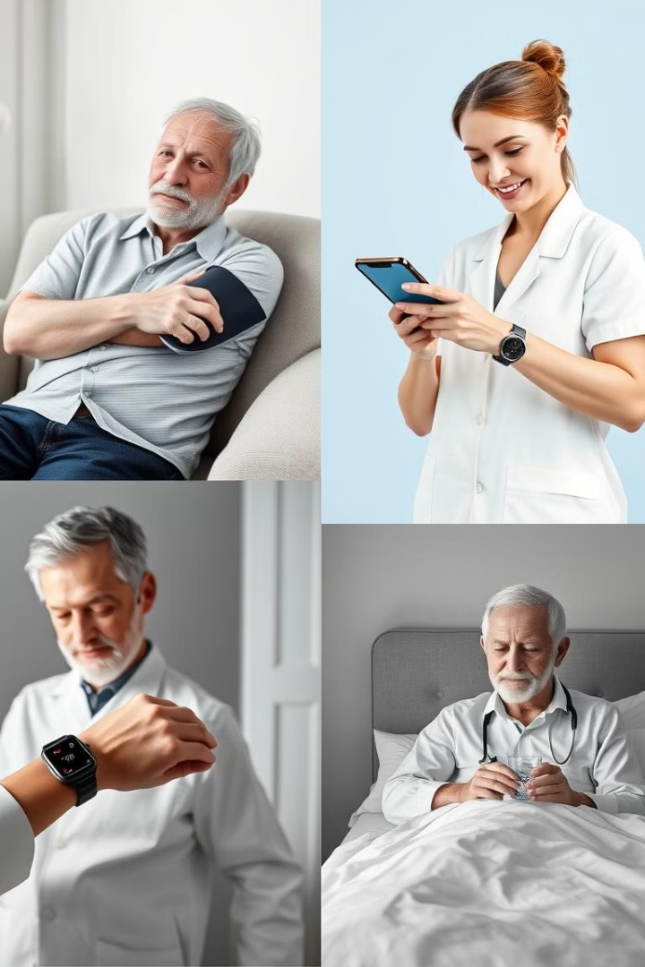
Key Applications of RPM
RPM is effective in managing chronic diseases like diabetes and hypertension. It supports post-acute and elderly care, ensuring safety.
Chronic Disease Management
Post-Acute Care
Surgery recovery monitoring
Diabetes: Glucose monitoring
Wound healing assessment
Hypertension: BP monitoring
Heart Failure: Symptom tracking
Elderly Care
Vital signs monitoring
Fall detection systems
Page 04

Slide 6




Challenges Implementing RPM
Data security and privacy are critical concerns. Integrating RPM data with EHR systems poses interoperability challenges.
Data Security
HIPAA compliance, cyber threat protection.
Interoperability
EHR integration, data standards.
Patient Adoption
Training, digital literacy.
Patient adoption requires addressing digital literacy barriers. Sustainable reimbursement models are essential for RPM services.
Page 05

Slide 7
Case Study: RPM for Heart Failure Management
A study implemented RPM for heart failure patients using wearable sensors. Clinicians reviewed data daily, adjusting medications.
Intervention
1
Wearable sensors, remote monitoring.
Monitoring
2
Daily data review.
Results
3
Reduced readmissions & costs.
The RPM program reduced hospital readmissions by 20% and costs by 15%. Patient satisfaction improved significantly.
Page 06

Slide 8
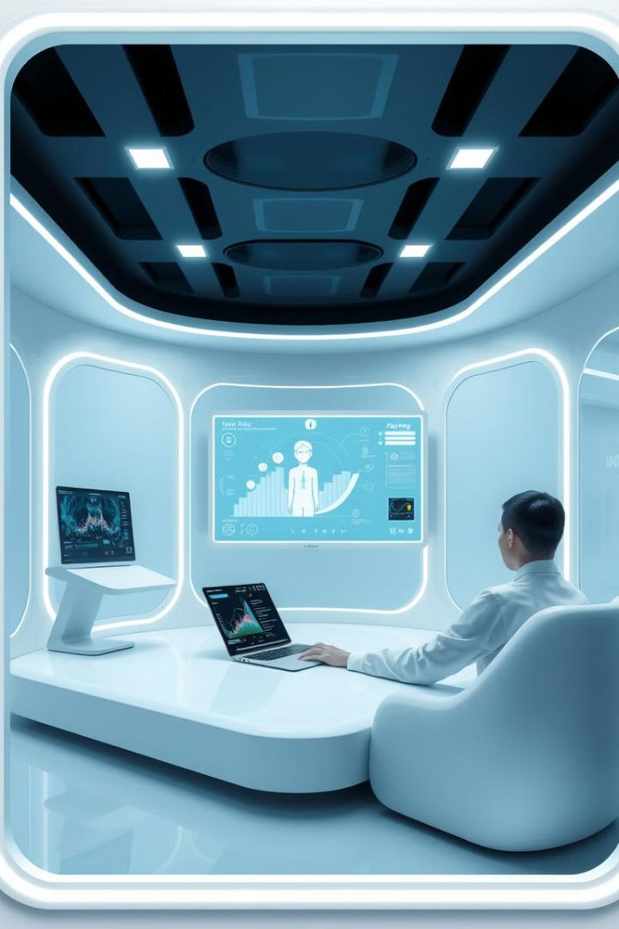
Conclusion: The Future of Remote Patient Monitoring
RPM transforms healthcare, enabling proactive, personalized care. AI integration will enhance data analysis. RPM's role will grow.
1
AI Integration
Improve data analysis.
2
Expansion
New clinical areas.
3
User-Friendly Devices
Accessible RPM devices.
Expect expansion into new areas and more accessible devices. Thank you. Questions?
Page 07

