Slide 1
Anime Information Management System
Team info –
ADITYA RAJ 1DT19CS009
HARSHIT SINGH 1DT19CS055

Slide 2
Technology used
Front End - React (JavaScript)
Back End - Node
DB - MySQL
IDE Platform - VS Code

Slide 3
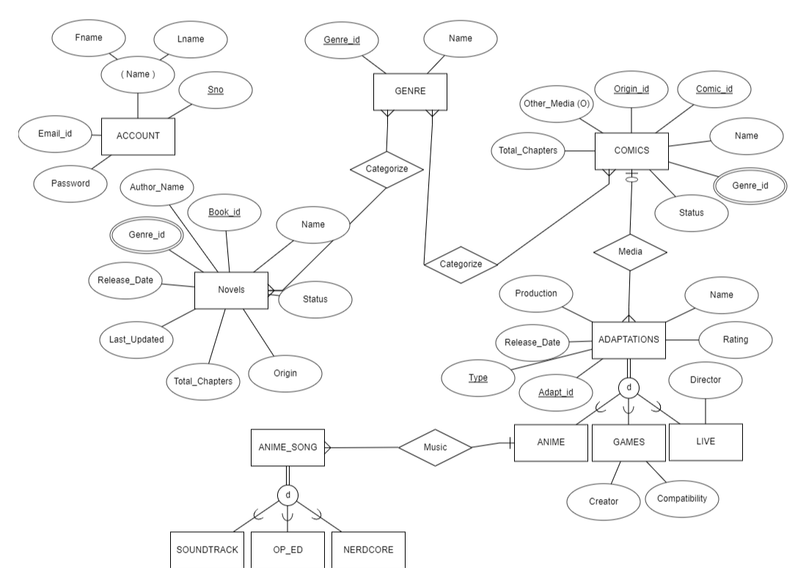
ER Diagram
m
m
n
1
n
TP
n
n
TP
1

Slide 4
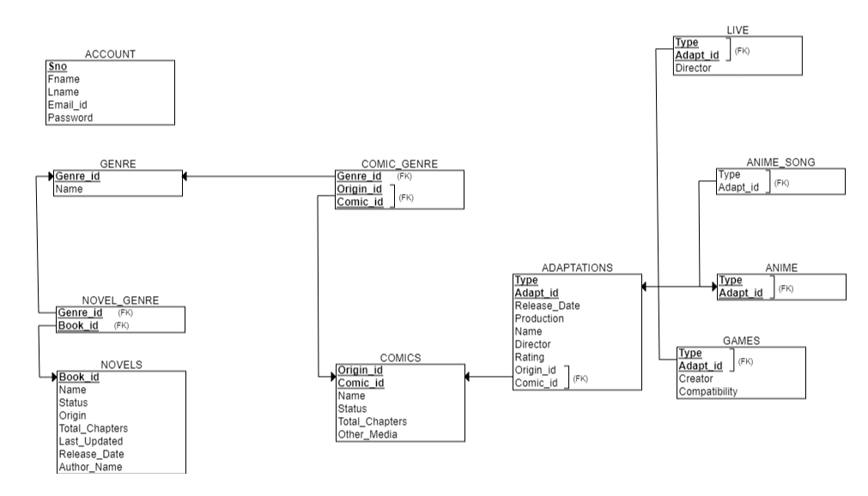
Schema Diagram

Slide 5
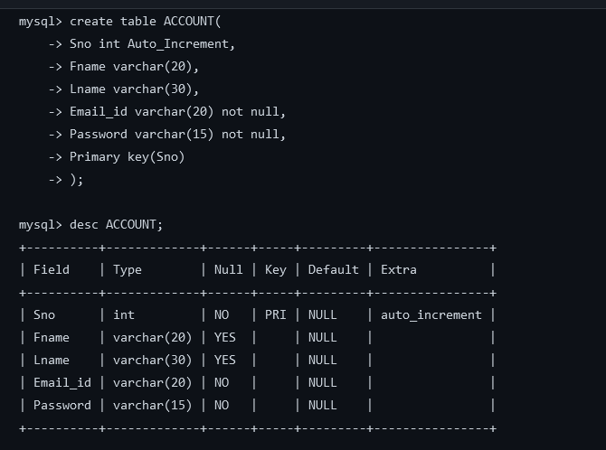
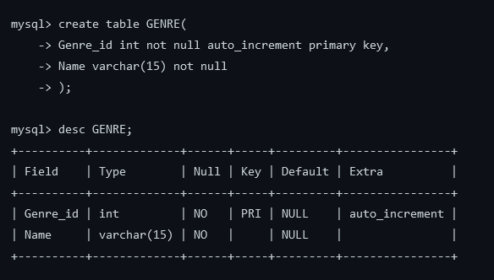
DDL COMMANDS FOR TABLE CREATION

Slide 6
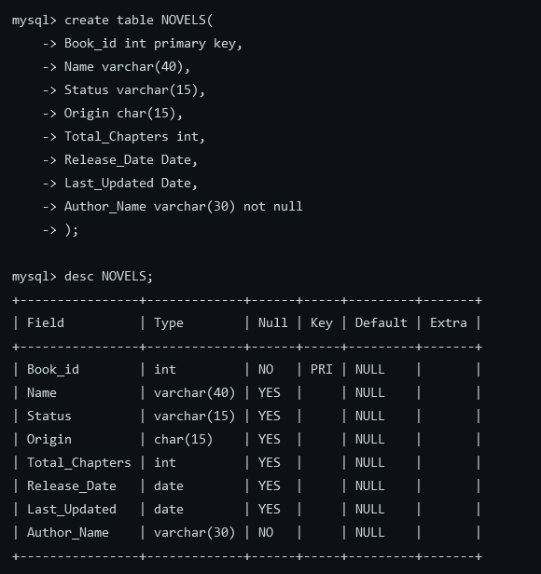
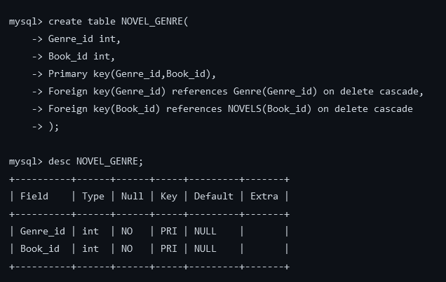
DDL COMMANDS FOR TABLE CREATION

Slide 7
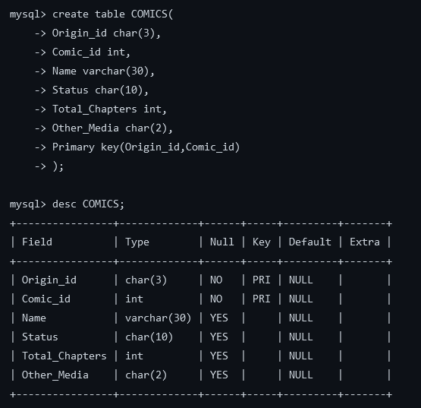
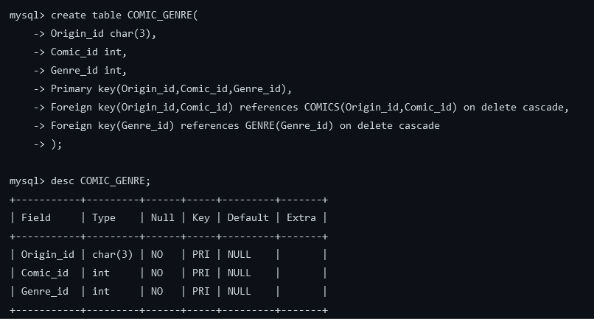
DDL COMMANDS FOR TABLE CREATION

Slide 8
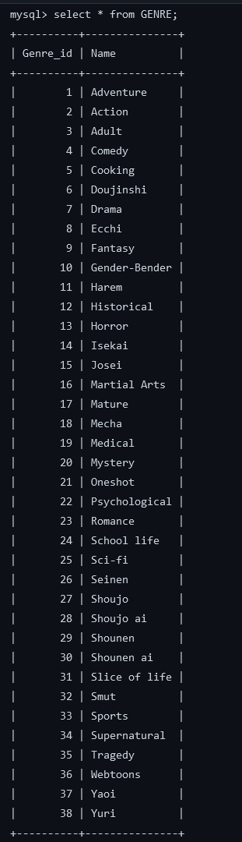
--Insertion in GENRE Table
mysql> insert into GENRE (Name) values ('Adventure'),
('Action'), ('Adult'), ('Comedy'), ('Cooking'),
('Doujinshi'), ('Drama'), ('Ecchi'), ('Fantasy'),
('Gender-Bender') ,('Harem'), ('Historical'),
('Horror'), ('Isekai'),('Josei'), ('Martial Arts'),
('Mature'), ('Mecha'),('Medical'), ('Mystery'),
('Oneshot'), ('Psychological'),('Romance'),
('School life'), ('Sci-fi'), ('Seinen'),('Shoujo'),
('Shoujo ai'), ('Shounen'), ('Shounen ai'),
('Slice of life'), ('Smut'), ('Sports'), ('Supernatural'),
('Tragedy'), ('Webtoons'), ('Yaoi'), ('Yuri');

Slide 9
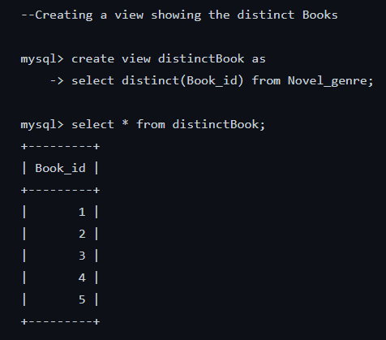
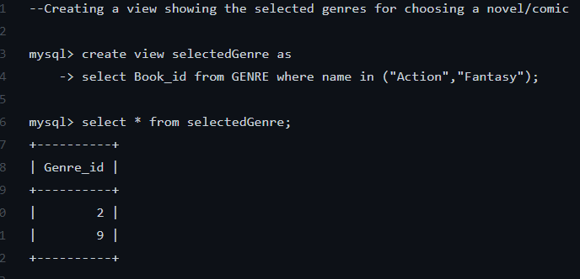
DML COMMAND TO ACCESS CONTENTS HAVIN A SPECIFIC SET OF GENRES::
Attribute Y
Attribute X

Slide 10
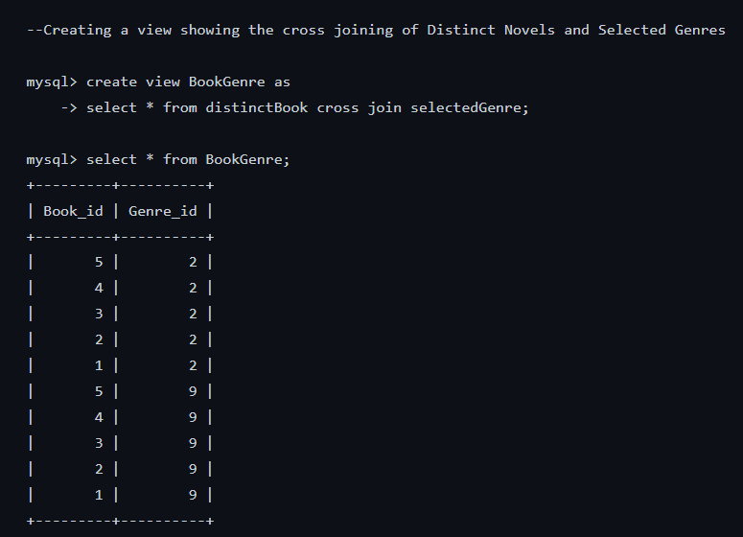
BookGenre= X cross join Y
= R(z)
Where Z= X+Y

Slide 11
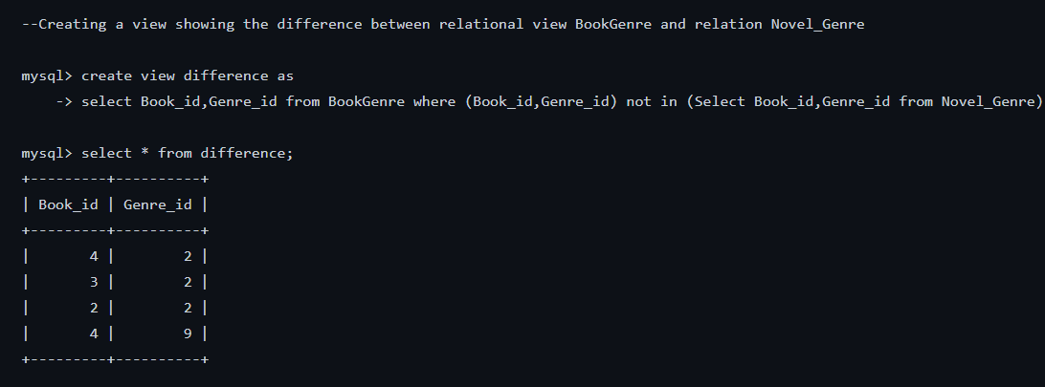
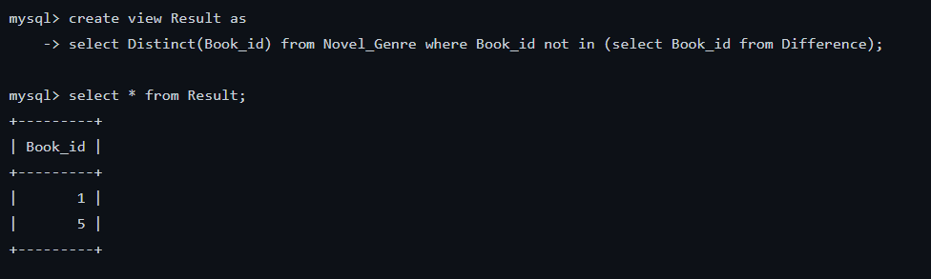
BookGenre-Novel_Genre

Slide 12
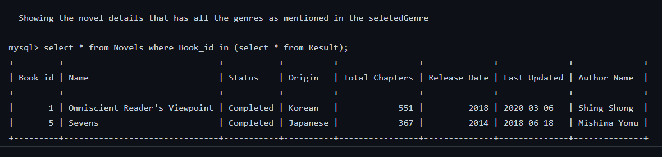

Slide 13
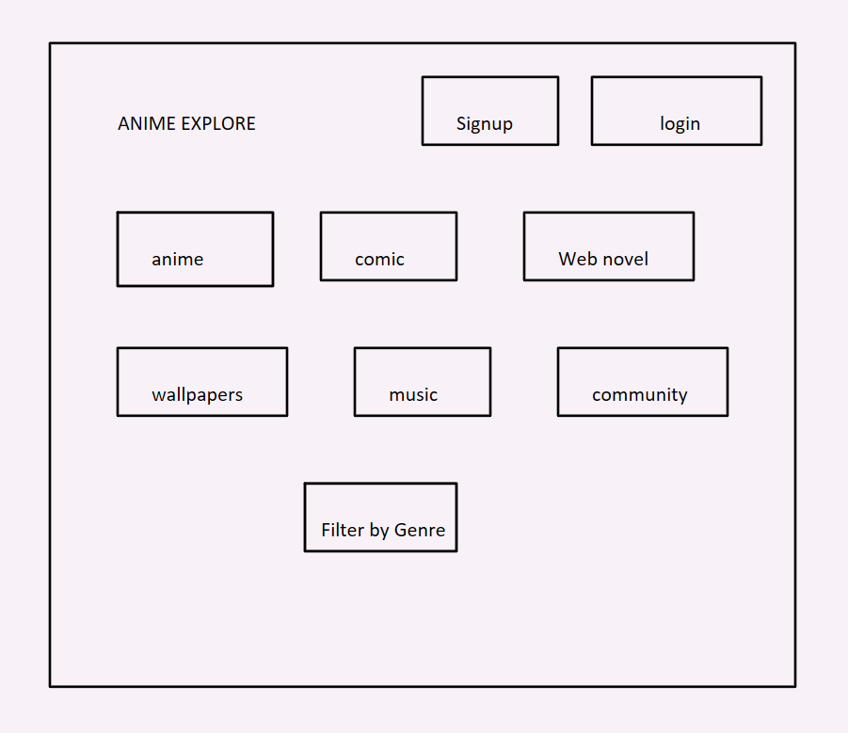
To Be Shown on the
HOME PAGE::--
Account Page
Anime
Manga
Light novels
Games
Nerdcore Music
Wallpapers
Forums
Prediction Channels
Sources to all above

